Slide 1
NOAA Hydrographic Services Review Panel Brandy Christian, President & CEO| August 27, 2019
Notes:
.

Slide 2
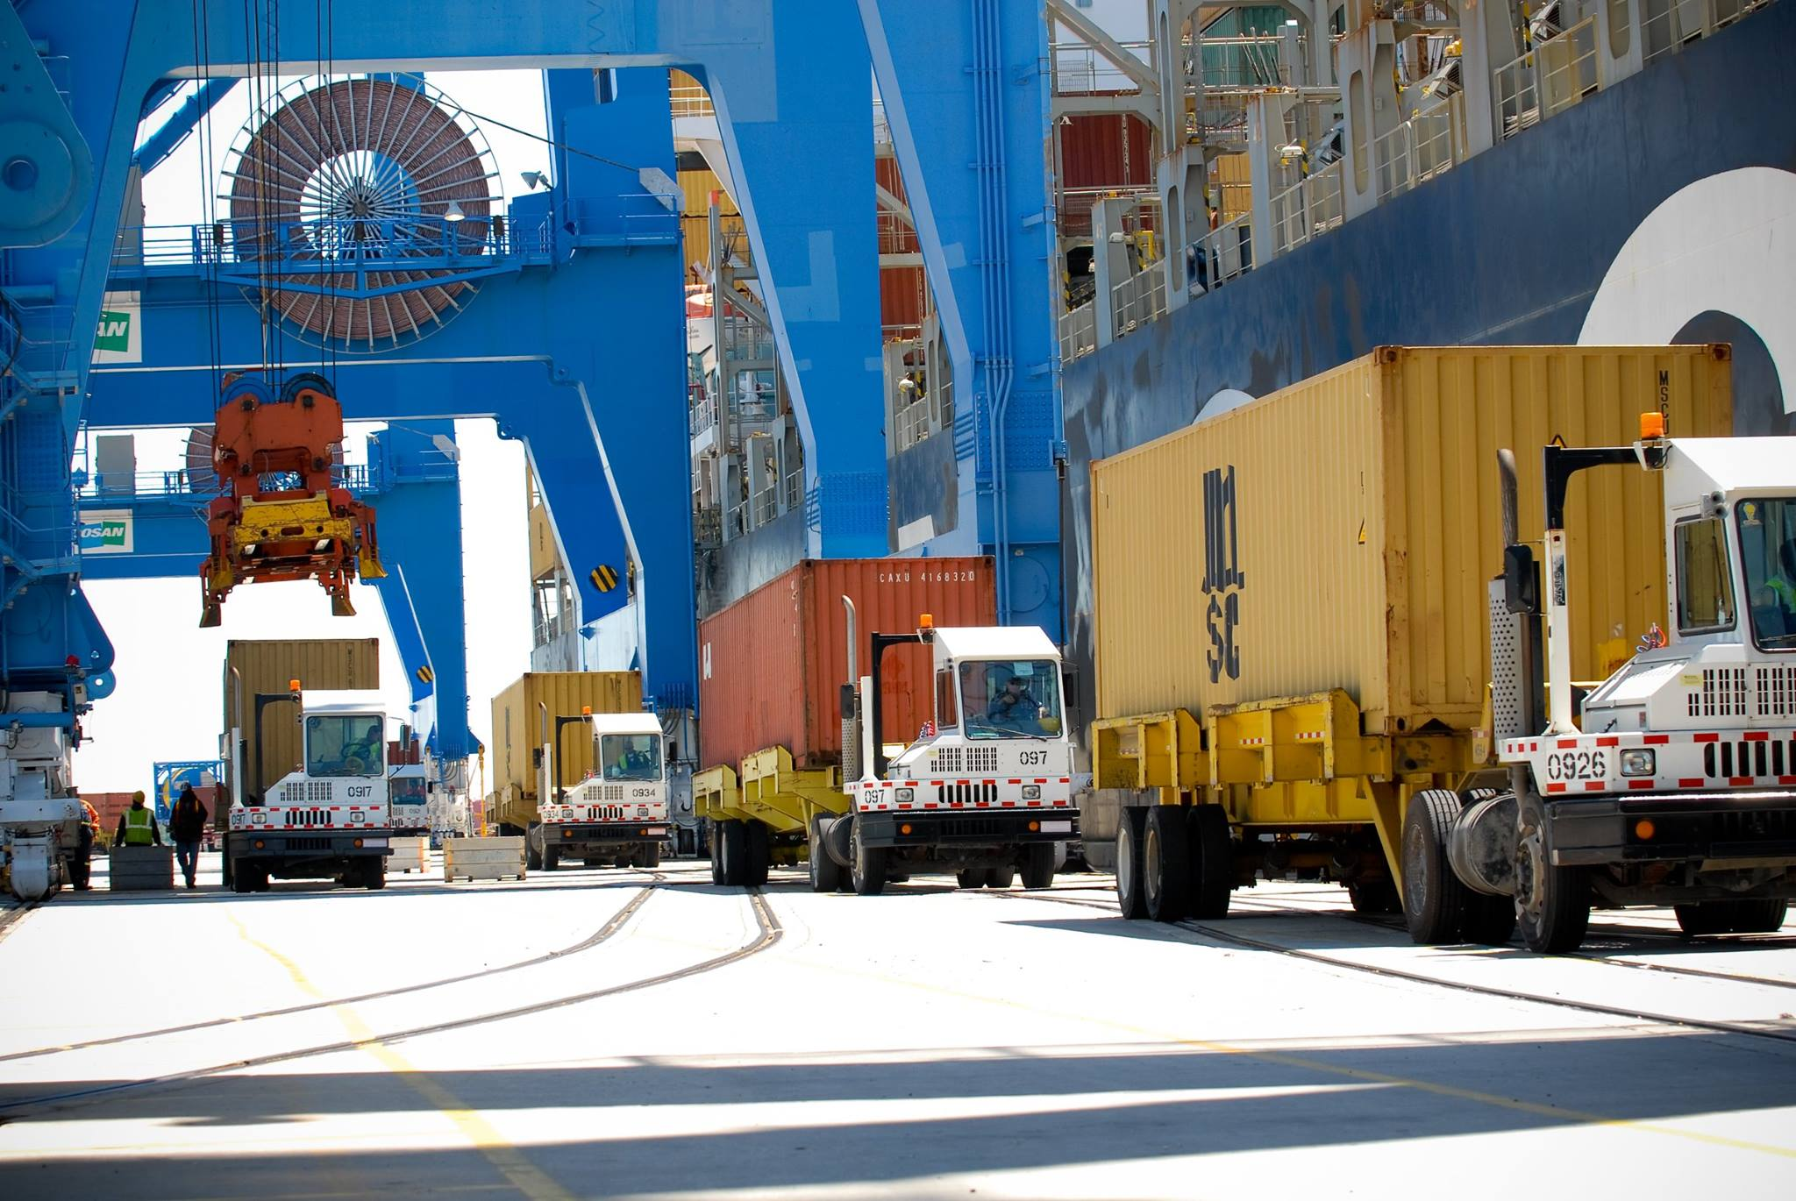
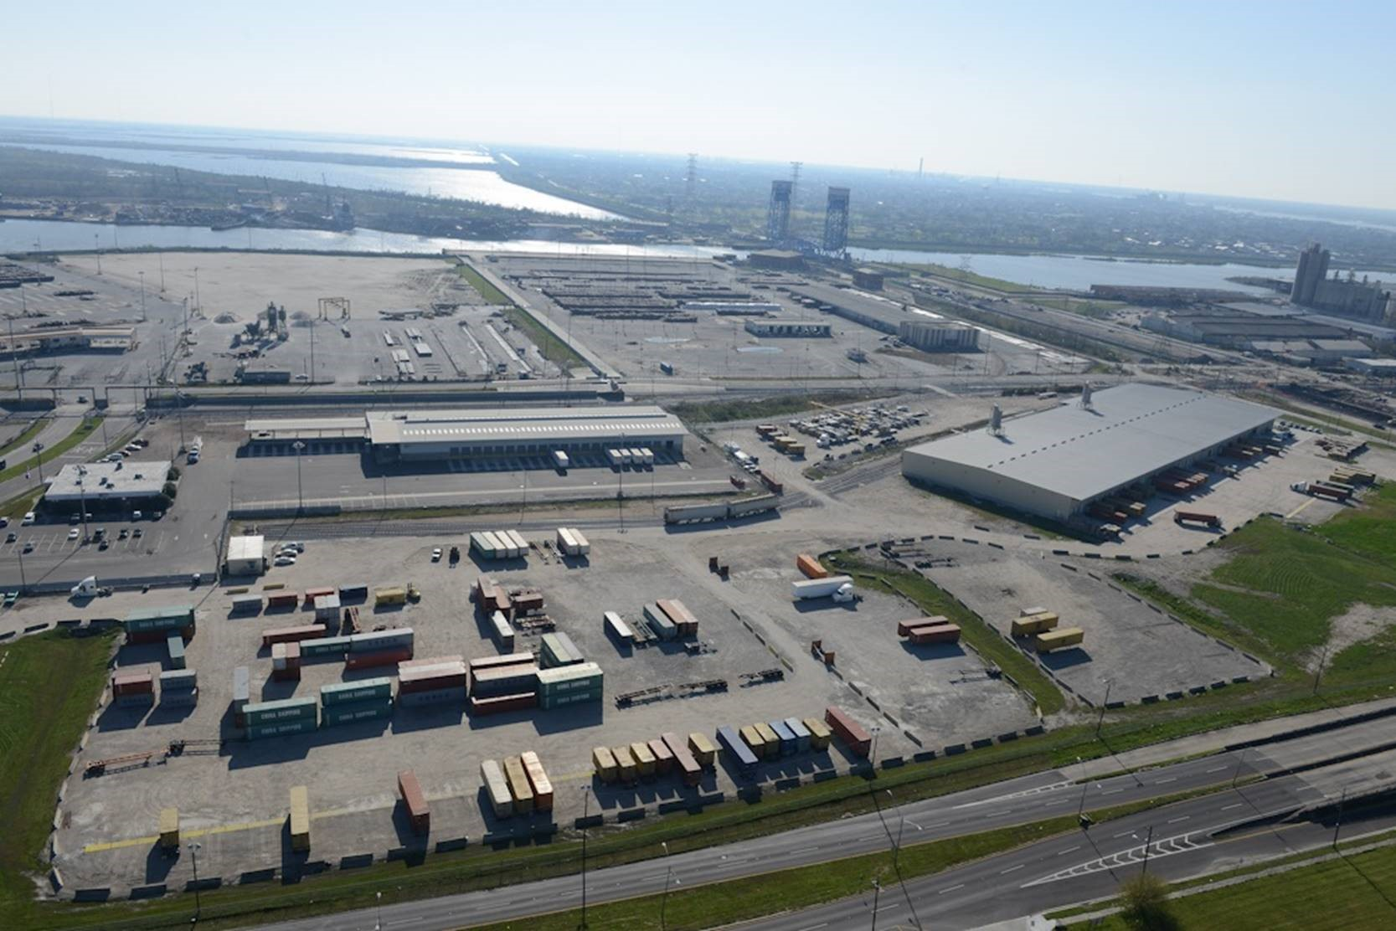
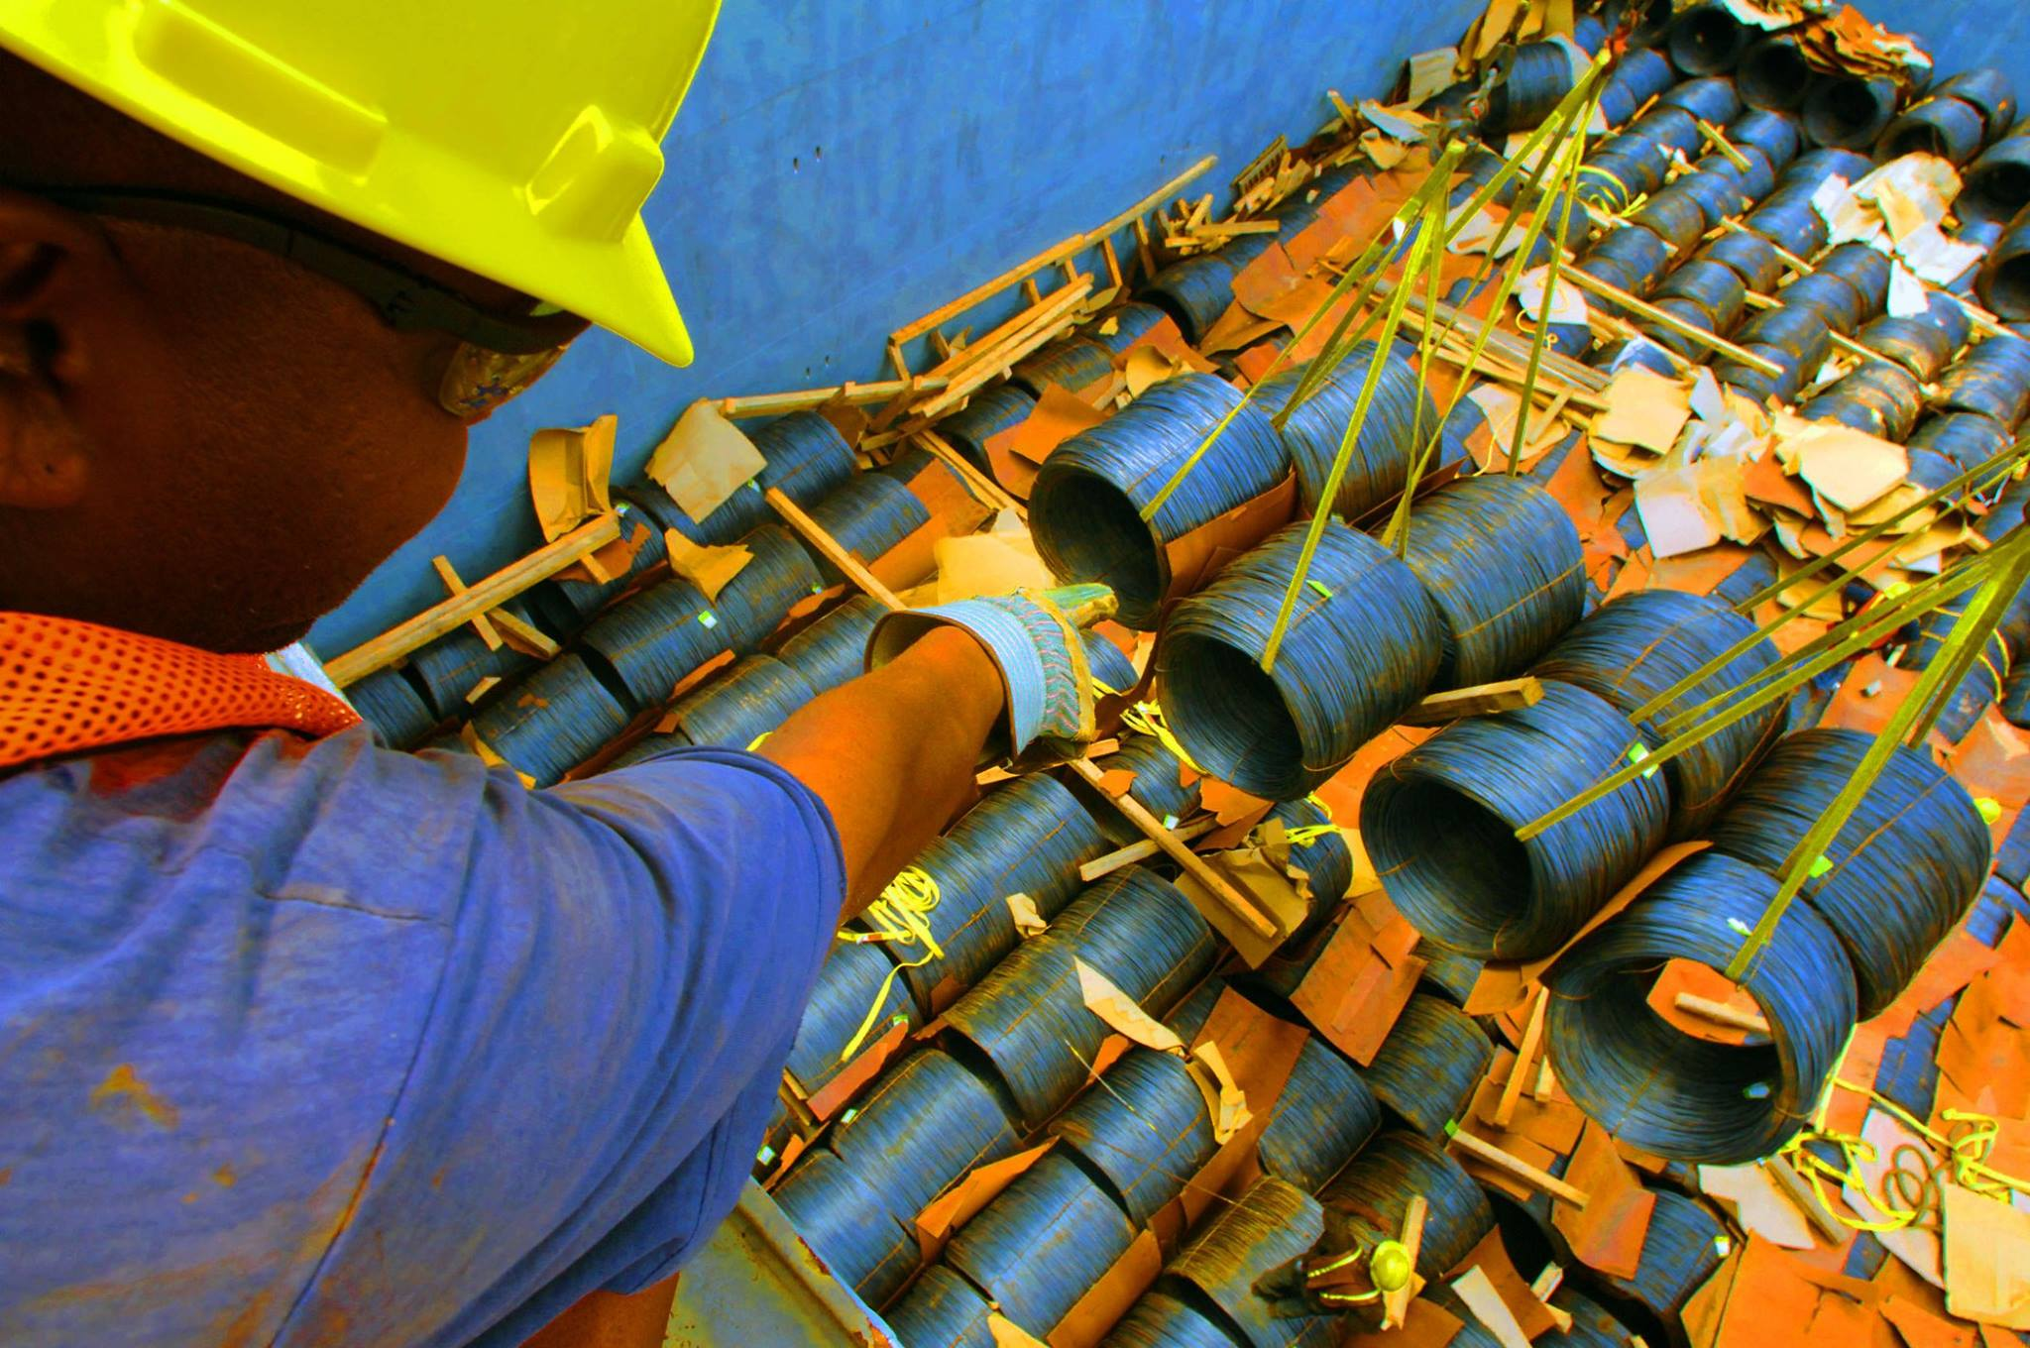
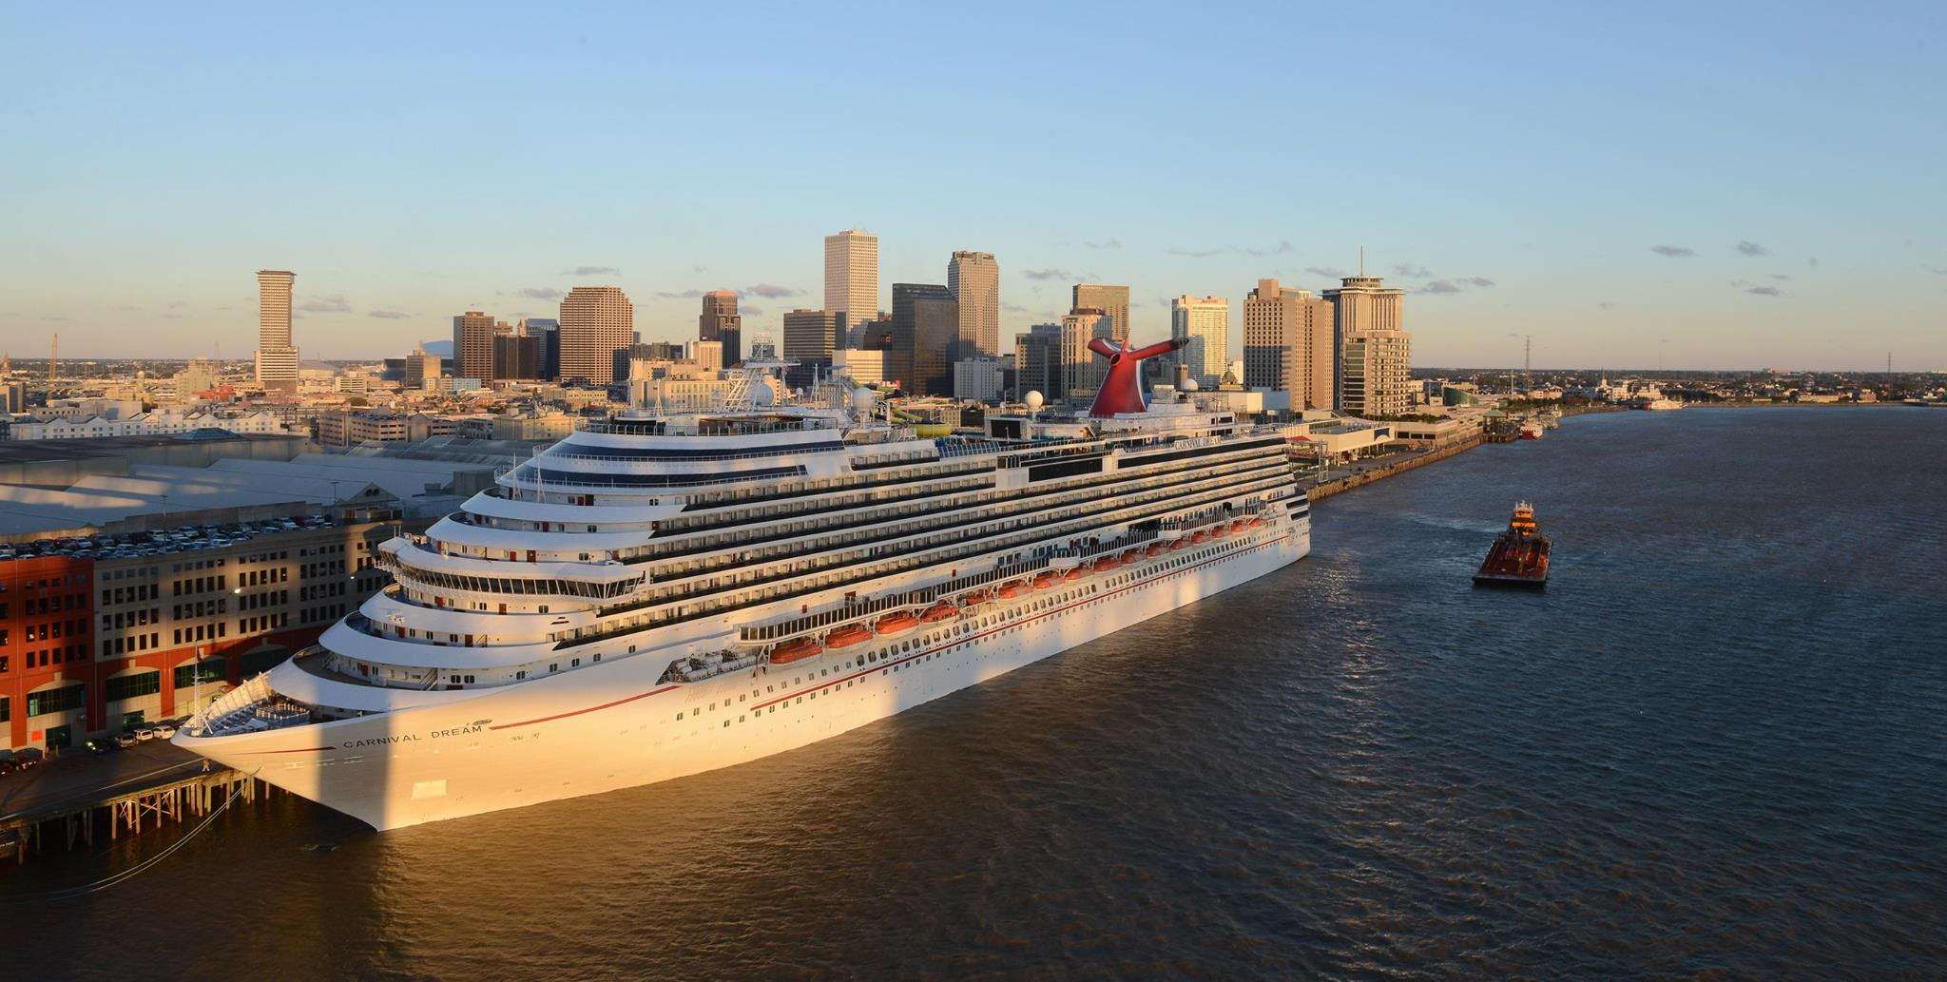

Slide 3
Growing the Blue Economy

Slide 4
Thank you for your partnership
Connect with us…
Facebook
/NewOrleansPort
LinkedIn
@PortNola
YouTube
PortofNola
Twitter
@PortNola
Instagram
portnola
portnola.com

