Slide 1
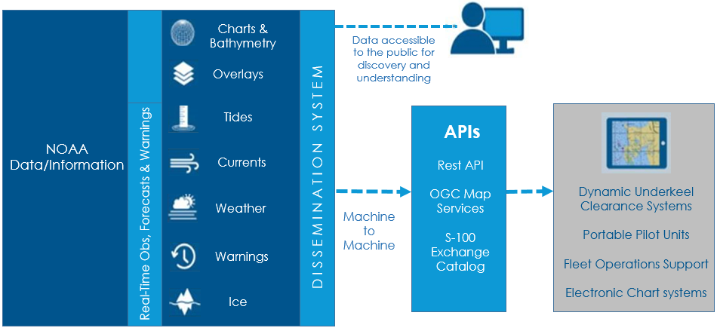
to Machine
Machine to
Machine
Building a NOAA Precision Navigation Dissemination System
John G.W. Kelley, Jason Greenlaw, and Erin Nagel
August 2019

Slide 2
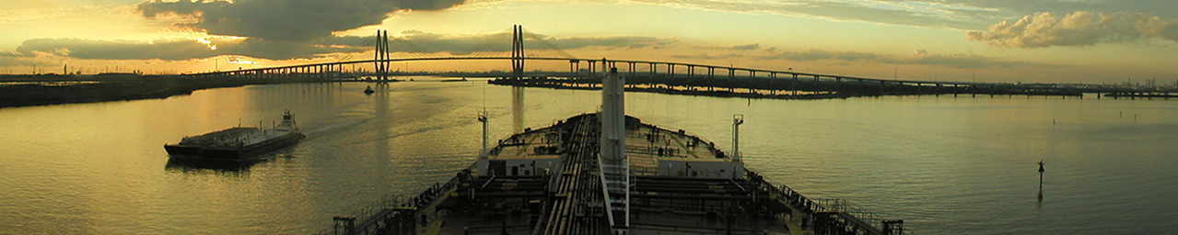
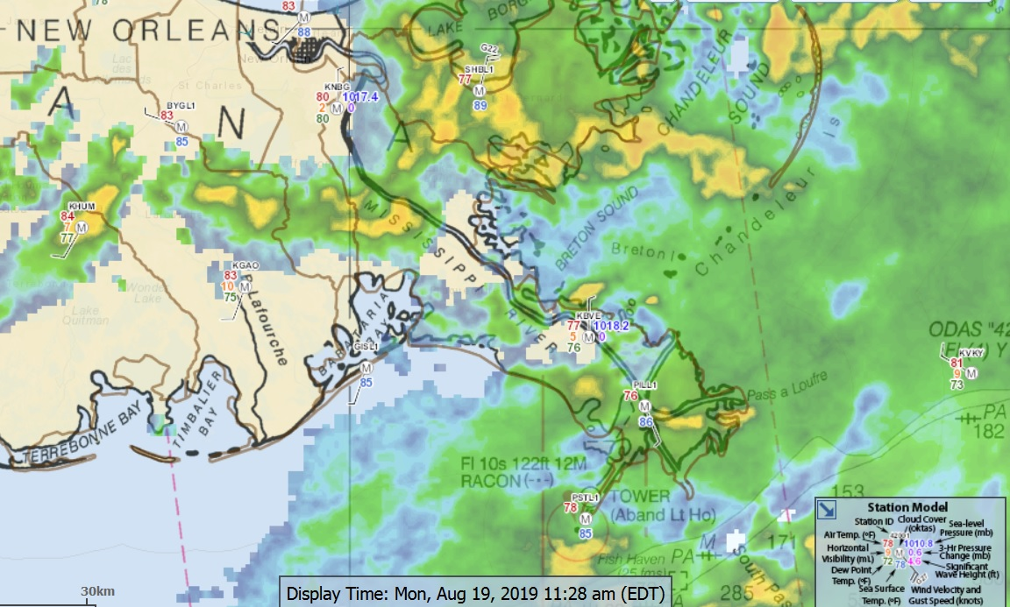
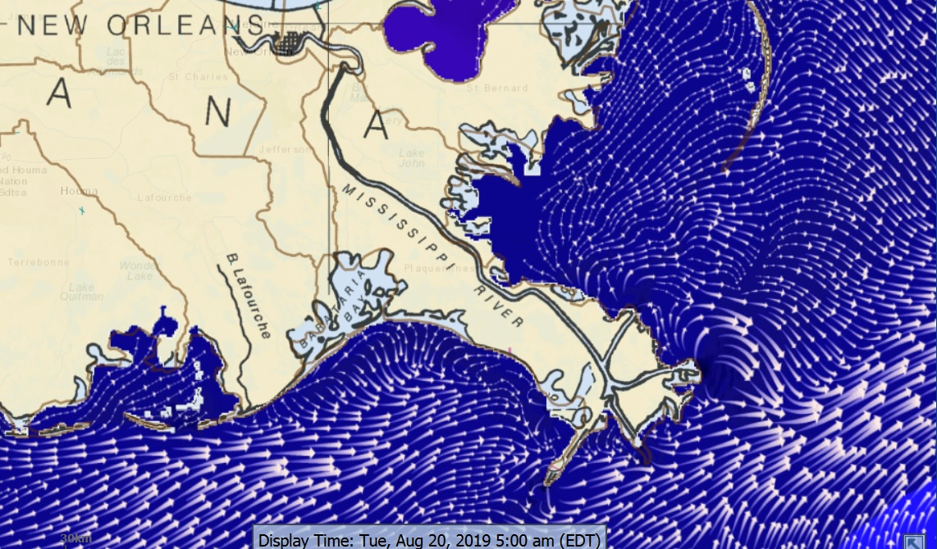
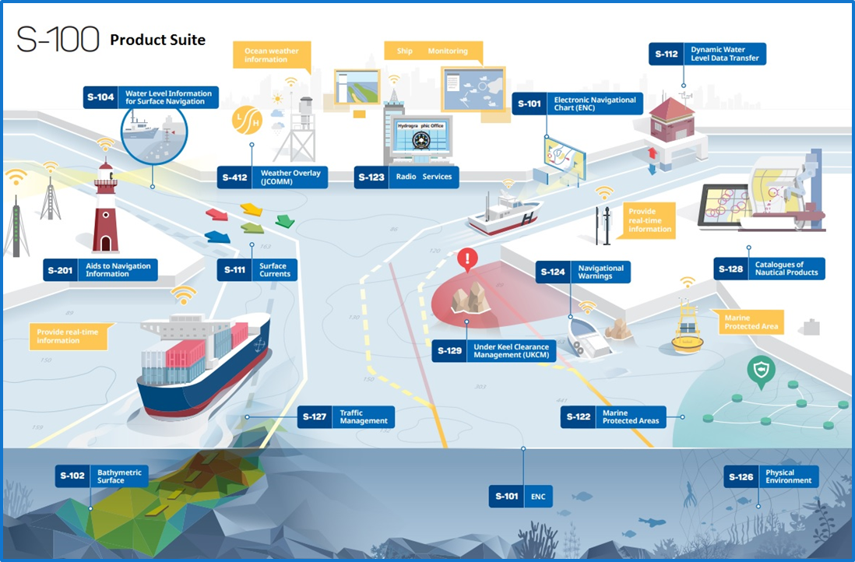
NOAA Precision Navigation Program
Precision marine navigation - ability of a vessel to safely and efficiently navigate and operate in close proximity to the seafloor, bridges, narrow channels, or other marine hazards.
NOAA’s Precision Navigation Program’s Goal
Seamlessly integrate NOAA’s high-resolution bathymetry, high accuracy positioning and shoreline data with real-time observations, predictions, and forecast data (i.e. water levels, currents, salinity, water temperature, waves, & weather forecasts ) that can be easily accessed and integrated into maritime portable pilot units or other decision support tools.
To achieve this goal….
Development, testing, and implementation of the International Hydrographic Organization’s (IHO) S-100 framework - allow for the consistent integration of NOAA datasets
Designing & testing a prototype dissemination system to provide a single location for users to access NOAA’s datasets through an initial suite of S-100 products & OGC-compliant web mapping services
Notes:
Precision marine navigation is the ability of a vessel to safely and efficiently navigate and operate in close proximity to the seafloor, bridges, narrow channels, or other marine hazards.
Importance of NOAA Data to Precision Navigation
For large vessels entering a seaport, where space is limited and time is critical, mariners analyze
NOAA’s near-real-time observations (e.g. water levels, waves, winds, air gap), tide predictions,
marine weather forecasts along with the nautical charts to anticipate oceanographic &
weather conditions and their impacts.
Accessing NOAA Data
NOAA datasets are encoded in different data formats (NetCDF, GRIB2, plain text, GeoTIFF, etc.) and are spread across various NOS, NWS, & NESDIS websites and data servers.
This presents a challenge for marine users as well as navigation system manufactures who wish to ingest and process NOAA data for distribution to their customers.
This challenge will grow as the number of data sources & sheer amount of navigational information increases.
NOAA’s PN Program is a coordinated effort across several NOAA offices, including the Office of Coast Survey (OCS), the Center for Operational Oceanographic Products & Services (CO-OPS), the National Geodetic Survey (NGS), the U.S. Integrated Ocean Observing System (IOOS), and the National Weather Service (NWS).

Slide 3
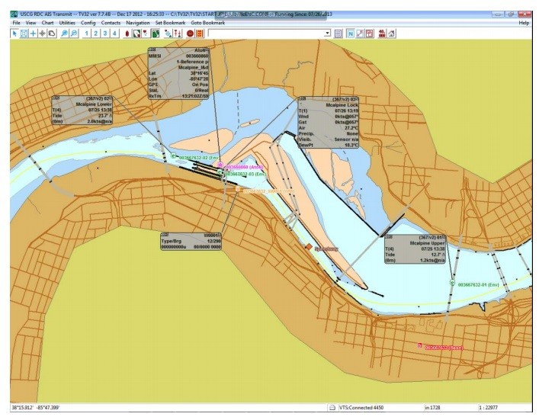
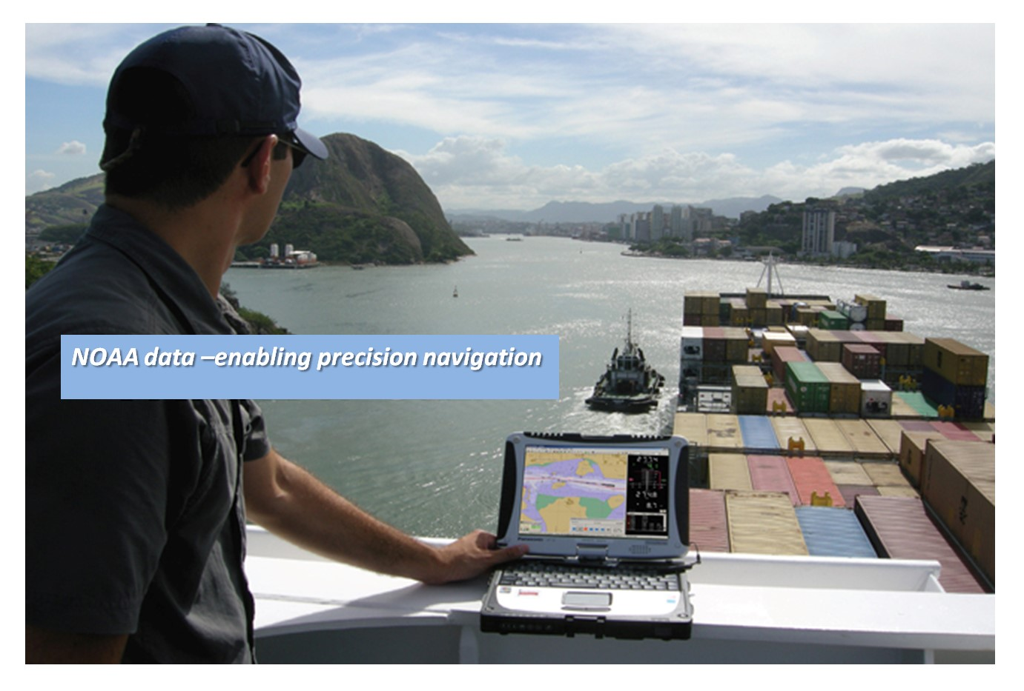
Desired Outcome
The Dissemination System will make it easier for ECS and PPU manufacturers and under-keel-clearance software companies to ingest/process/display NOAA’s marine navigation data and information to enable precision navigation at major U.S. seaports

Slide 4
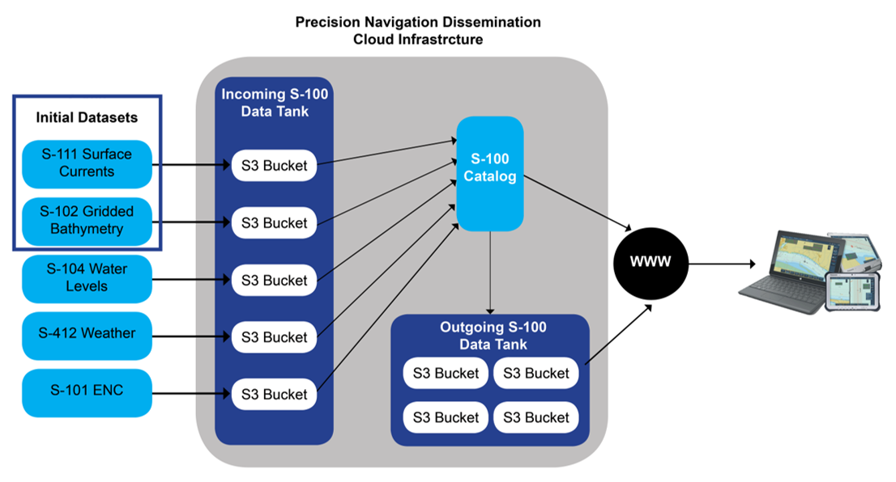
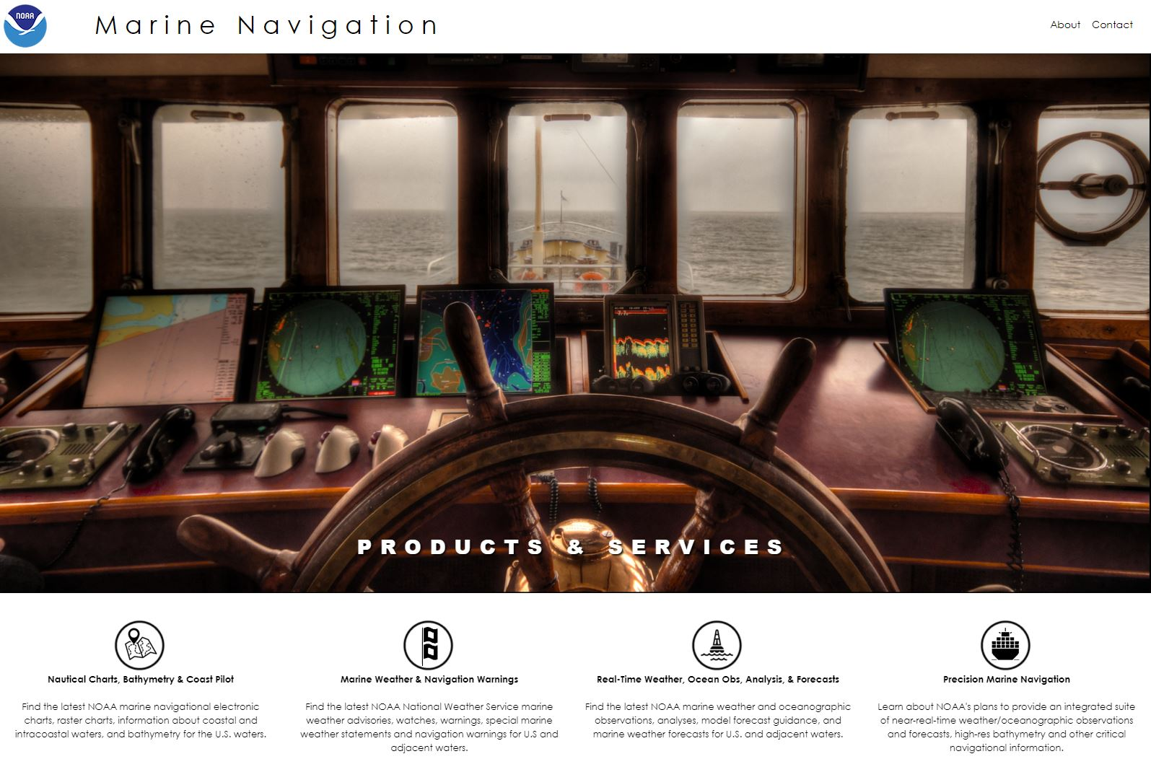
Deliverables
NOAA Precision Navigation Dissemination System
- provide one location for commercial and recreational mariners to obtain NOAA’s S-100 Product Suite
marinenavigation.noaa.gov
- provide one site for commercial & recreational mariners to discover, find, and learn about the extensive amount of NOAA marine navigation information available to them.
Notes:
SS3 = Simple Storage Service
An Amazon S3 bucket is a public cloud storage resource available in Amazon Web Services' (AWS) Simple Storage Service (S3), an object storage offering. Amazon S3 buckets, which are similar to file folders, store objects, which consist of data and its descriptive metadata.
It has simple web services interface that helps developers to store and retrieve data from anywhere around the globe.

Slide 5
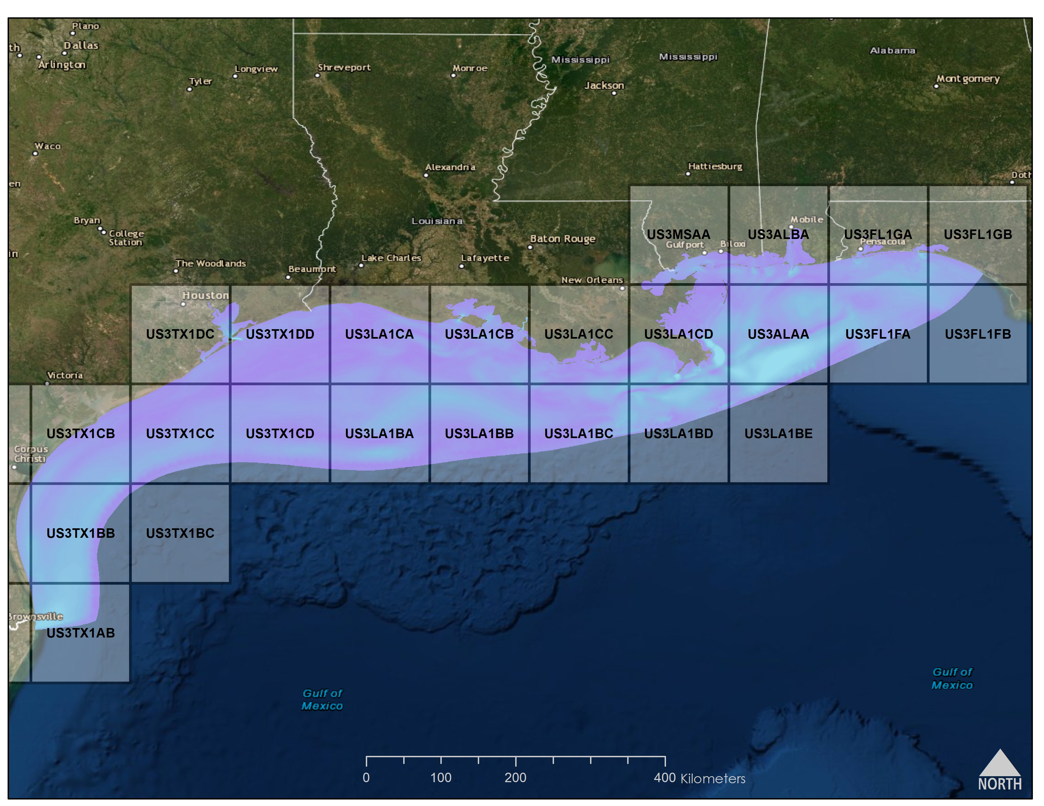
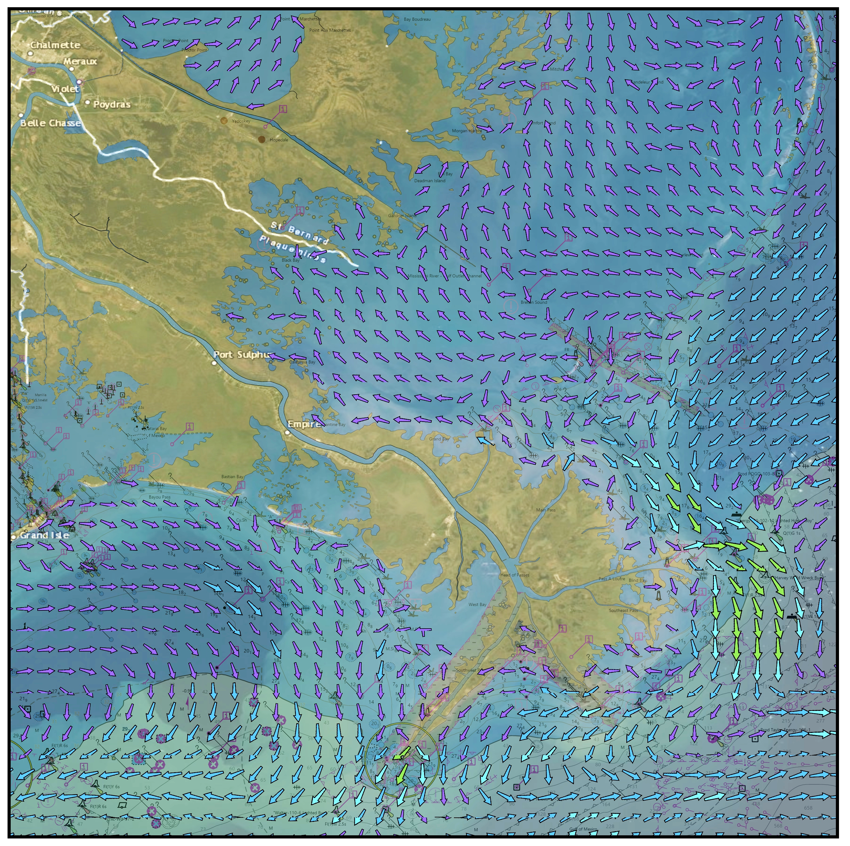

NOAA Precision Navigation Products
For example:
S-111 Water Currents Forecast Guidance from NOAA/National Ocean Service’s Northern Gulf of Mexico Operational Oceanographic Forecast Modeling System
S111US_NGOFS_20180813T15Z_TYP2_US3LA1CD.h5
Future Dissemination – Band 3 Extents
27 NGOFS S-111 Files 4x/Day
Visualization of Surface Currents Forecast Guidance in part of the Northern Gulf of Mexico OFS Domain

Slide 6
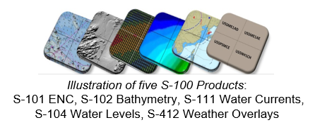
NOAA Precision Navigation Overview
Contact Information
John G. W. Kelley, PN Dissemination Manager/nowCOAST Project Manager
NOAA/National Ocean Service/Coast Survey Development Lab
John.Kelley@noaa.gov
Jason Greenlaw, Lead Developer for PN Dissemination System & nowCOAST
NOAA/National Ocean Service/Coast Survey Development Lab
Jason.Greenlaw@noaa.gov
Capt. Liz Kretovic
NOAA Precision Navigation Program Manager
Deputy Hydrographer
NOAA/National Ocean Service/Office of Coast Survey
Elizabeth.Kretovic@noaa.gov

Slide 7
Extra Slides

Slide 8
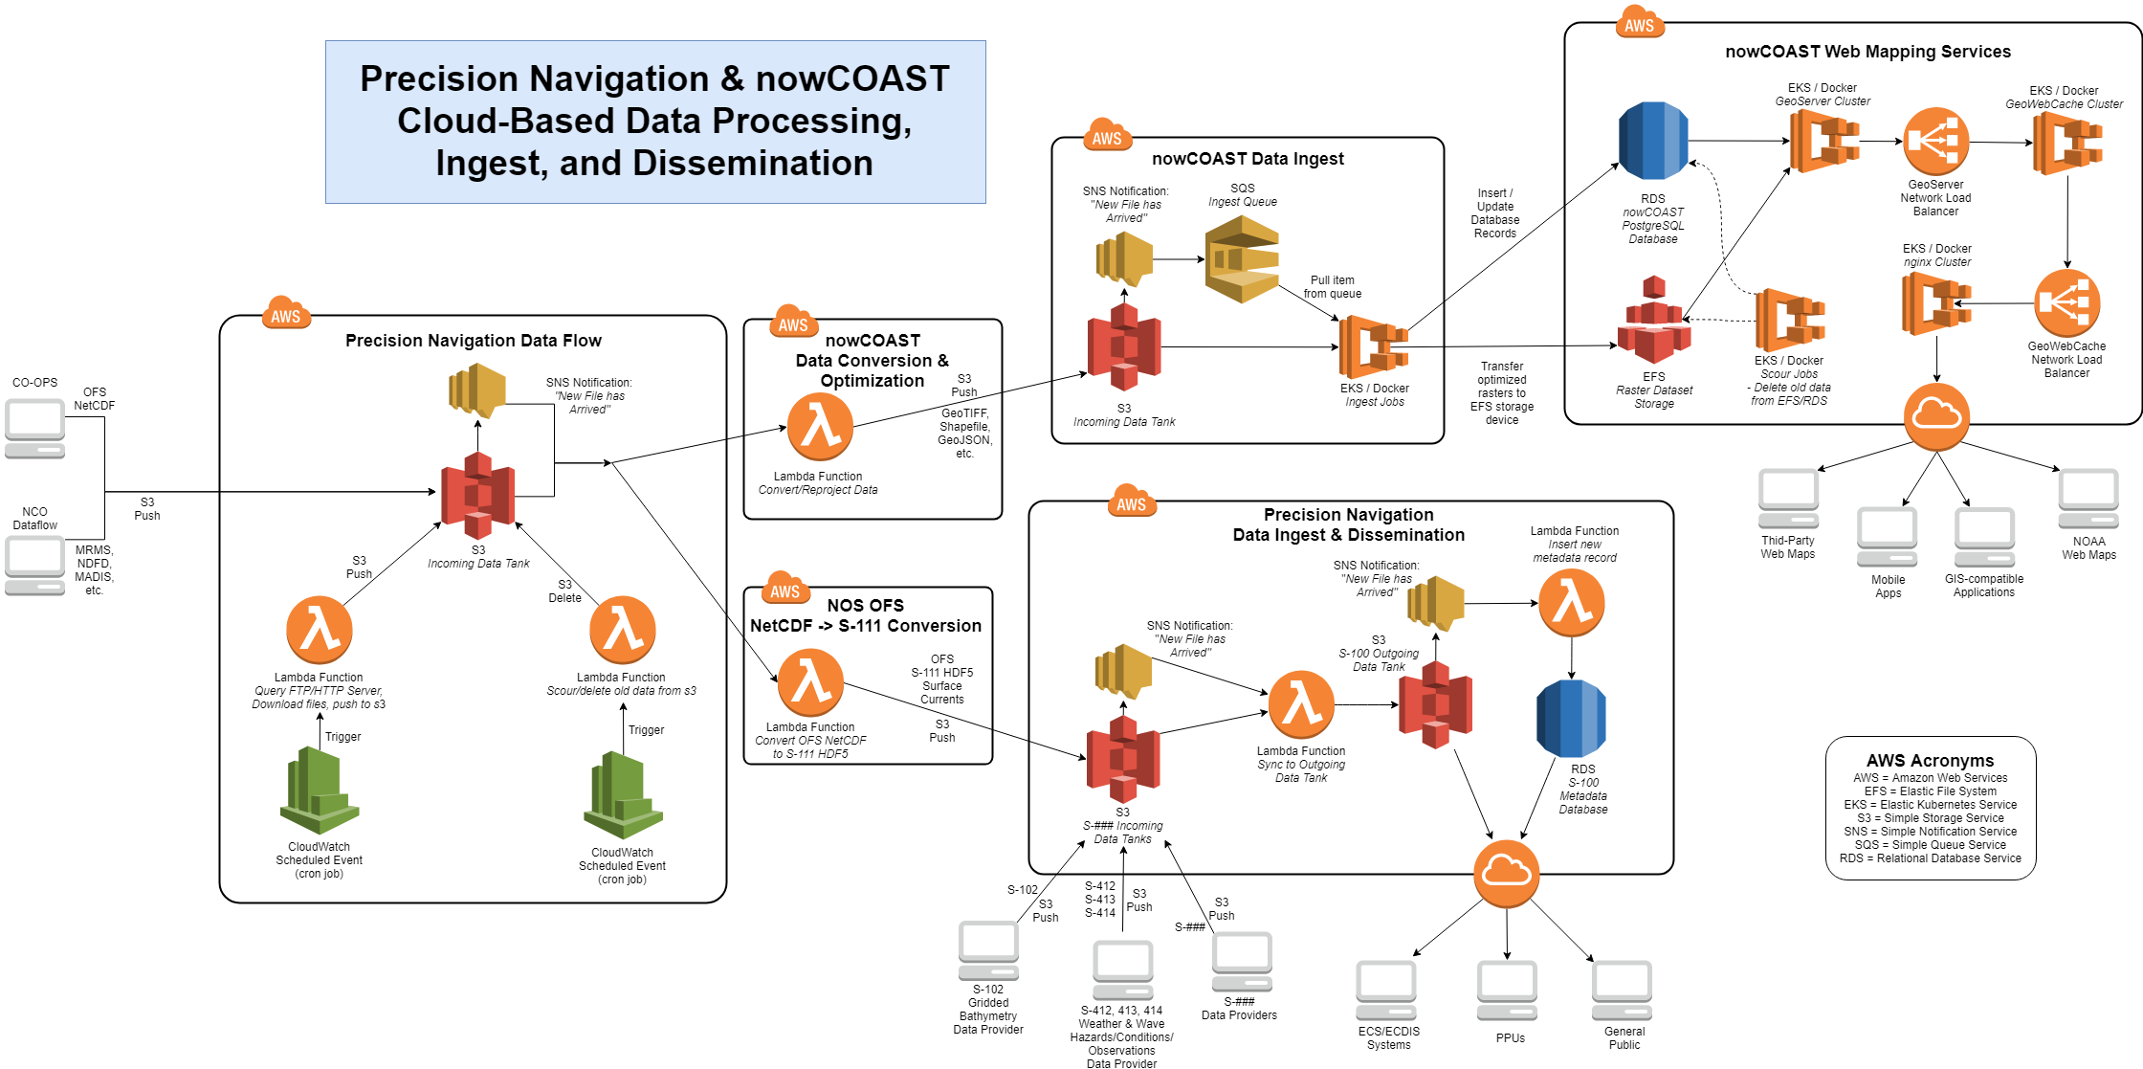
Tentative Plans
Why Commercial Cloud?
cloud-based Platform-as-a-Service & infrastructure-as-a-Service offerings allow for reduced overhead associated with maintaining operational hardware, virtual machine, operating system, and networking infrastructure (especially impacted by difficulty in hiring IT personnel in the federal gov)
greater potential to implement new versions on a regular basis
scalable - can rapidly respond to meet sudden surges in web traffic
Notes:
SS3 = Simple Storage Service
An Amazon S3 bucket is a public cloud storage resource available in Amazon Web Services' (AWS) Simple Storage Service (S3), an object storage offering. Amazon S3 buckets, which are similar to file folders, store objects, which consist of data and its descriptive metadata.
It has simple web services interface that helps developers to store and retrieve data from anywhere around the globe.
Infrastructure-as-a-Service (IaaS) vs.
Platform-as-a-Service (Paas)
IaaS clients can still access their servers and storage directly, but it is all outsourced through a “virtual data center” in the cloud. IaaS clients are responsible for managing aspects such as applications, runtime, OSes, middleware, and data.
IaaS
In an IaaS model, a cloud provider hosts the infrastructure components traditionally present in an on-premises data center, including servers, storage and networking hardware, as well as the virtualization or hypervisor layer.
The IaaS provider also supplies a range of services to accompany those infrastructure components. These can include detailed billing, monitoring, log access, security, load balancing and clustering, as well as storage resiliency, such as backup, replication and recovery. These services are increasingly policy-driven, enabling IaaS users to implement greater levels of automation and orchestration for important infrastructure tasks. For example, a user can implement policies to drive load balancing to maintain application availability and performance.
IaaS customers access resources and services through a wide area network (WAN), such as the internet, and can use the cloud provider's services to install the remaining elements of an application stack. For example, the user can log in to the IaaS platform to create virtual machines (VMs); install operating systems in each VM; deploy middleware, such as databases; create storage buckets for workloads and backups; and install the enterprise workload into that VM. Customers can then use the provider's services to track costs, monitor performance, balance network traffic, troubleshoot application issues, manage disaster recovery and more.
PaaS
In an IaaS model, a cloud provider hosts the infrastructure components traditionally present in an on-premises data center, including servers, storage and networking hardware, as well as the virtualization or hypervisor layer.
The IaaS provider also supplies a range of services to accompany those infrastructure components. These can include detailed billing, monitoring, log access, security, load balancing and clustering, as well as storage resiliency, such as backup, replication and recovery. These services are increasingly policy-driven, enabling IaaS users to implement greater levels of automation and orchestration for important infrastructure tasks. For example, a user can implement policies to drive load balancing to maintain application availability and performance.
IaaS customers access resources and services through a wide area network (WAN), such as the internet, and can use the cloud provider's services to install the remaining elements of an application stack. For example, the user can log in to the IaaS platform to create virtual machines (VMs); install operating systems in each VM; deploy middleware, such as databases; create storage buckets for workloads and backups; and install the enterprise workload into that VM. Customers can then use the provider's services to track costs, monitor performance, balance network traffic, troubleshoot application issues, manage disaster recovery and more.

Slide 9
FY20 Milestones
Initial S-100 Product Suite by end of FY20 Q2 (Mar. 2020) available on Prototype PN Dissemination System:
S-111 Water Currents for several of the NOS operational oceanographic forecast modeling systems (OFS) and NWS/NCEP Global Real-Time Ocean Forecast System (GRTOFS)
S-102 Gridded Bathymetry (‘skin of the Earth’, no features)
  New England Region
Marine Navigation Web Site (Ver. 0.5)
Prototype S-100 Exchange Catalog which includes metadata for S-111 datasets

Slide 10
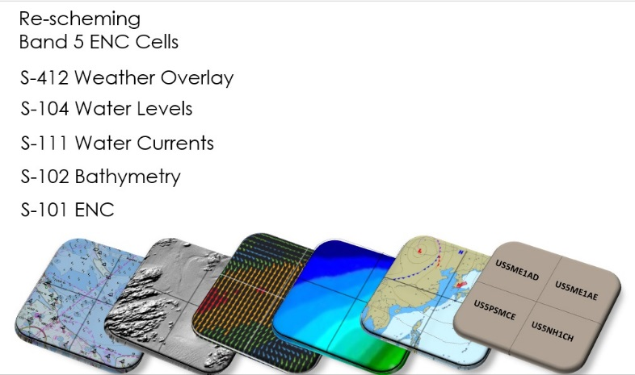
FY21 Milestones
Disseminate additional S-100 Production Suite formats
  S-412 Weather and Wave Hazards Overlay
(From NWS/NCEP Ocean Prediction Center)
Illustration of five S-100 Products:
S-101 ENC, S-102 Bathymetry, S-111 Water Currents, S-104 Water Levels, S-412 Weather Overlays
High-Definition Chart for Priority Ports
Prototype nowCOAST in the Cloud site*
* Dependent on building out the PN/NC Dissemination Team

Slide 11
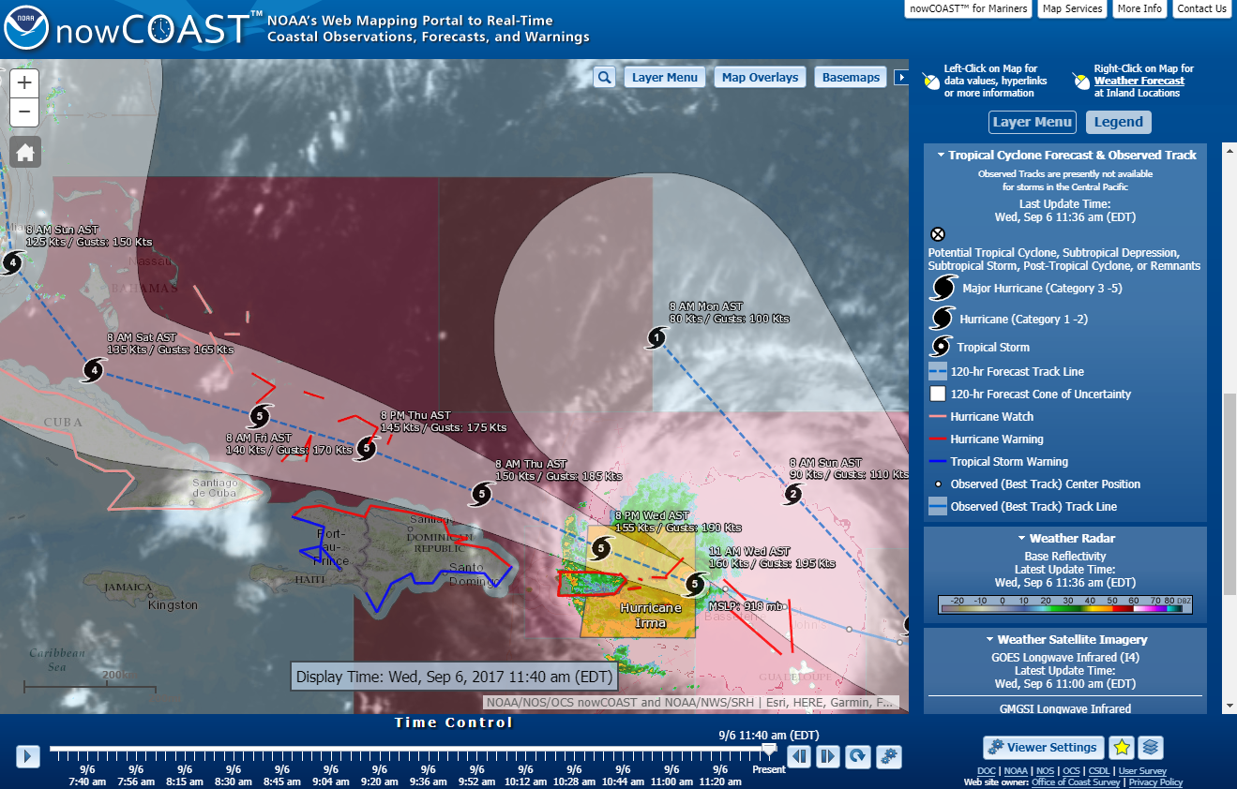
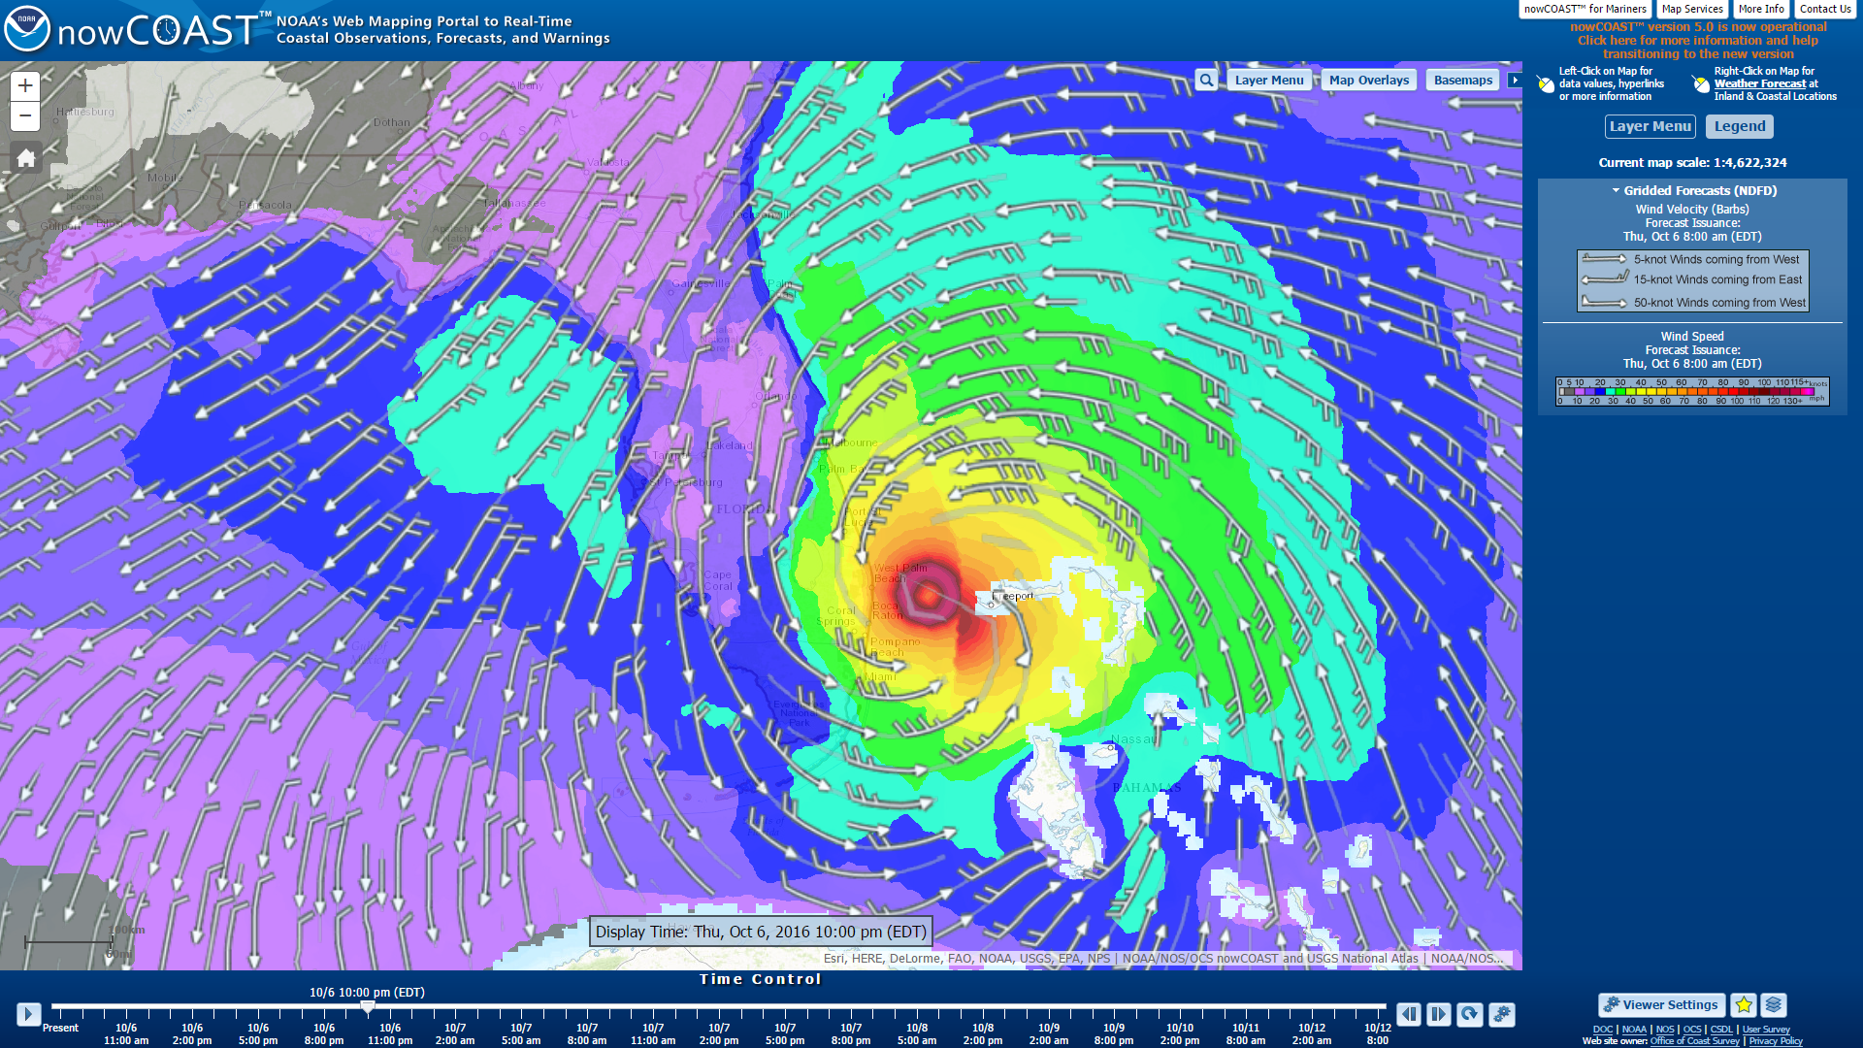
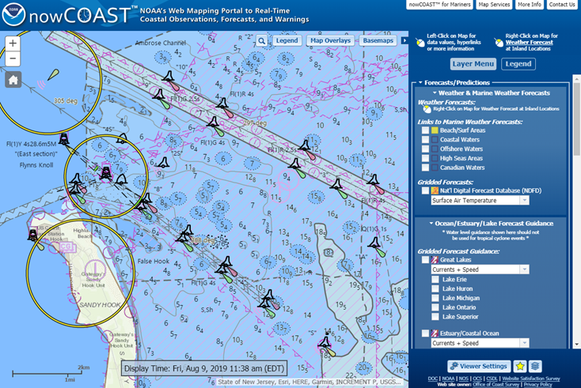
NOAA/NOS nowCOAST Web Mapping Portal
NOAA’s Flagship GIS Web Mapping Portal for observations, analyses, forecasts, model guidance, and watches/warnings/advisories
https://nowcoast.noaa.gov
Purpose:
Provide users with situational awareness/coastal intelligence of recent past, present, and future environmental conditions for coastal U.S.
Users Include:
Commercial/recreational mariners & fishermen, Emergency Managers, Coastal Managers, Search & Rescue & HAZMAT response, Risk Managers

Slide 12
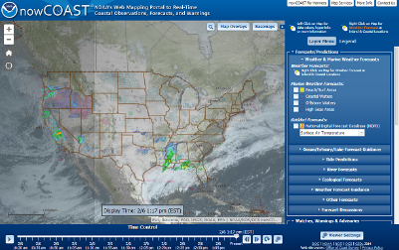
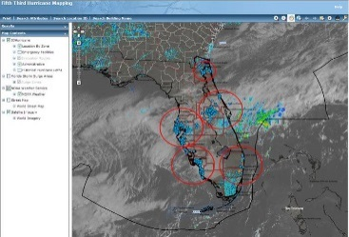
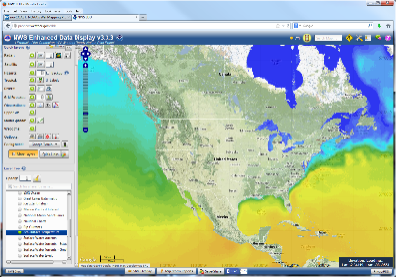
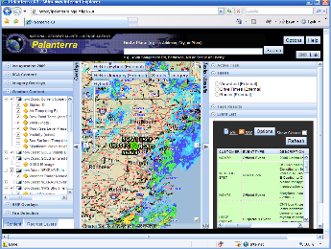
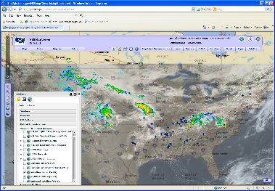
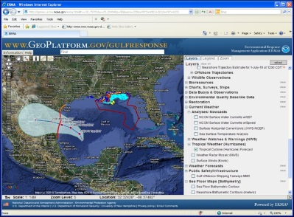
NOAA/NOS nowCOAST Web Mapping Portal
NOAA’s nowCOAST Web Mapping Services
Standards-compliant web service access
to raw data & visualizations
https://nowcoast.noaa.gov
nowCOAST Web Mapping Services
nowCOAST
Map Viewer
Fifth Third Bank
NOAA/NWS/EDD
DOD/NGA Palanterra
DHS/FEMA
NOAA/NOS/ERMA
Any desktop/mobile client application supporting open geospatial web protocols

Slide 13
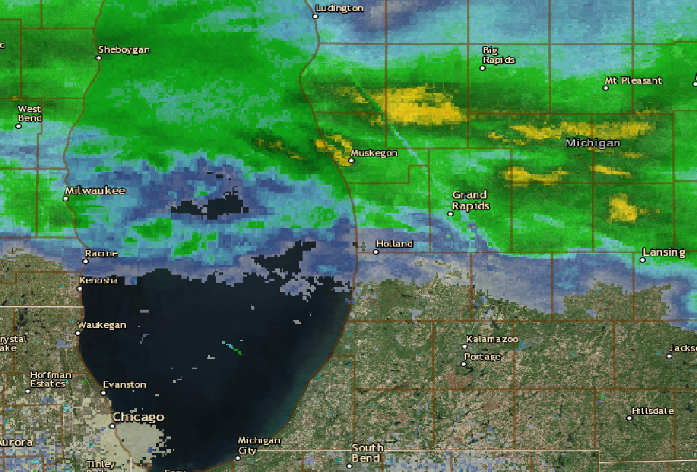
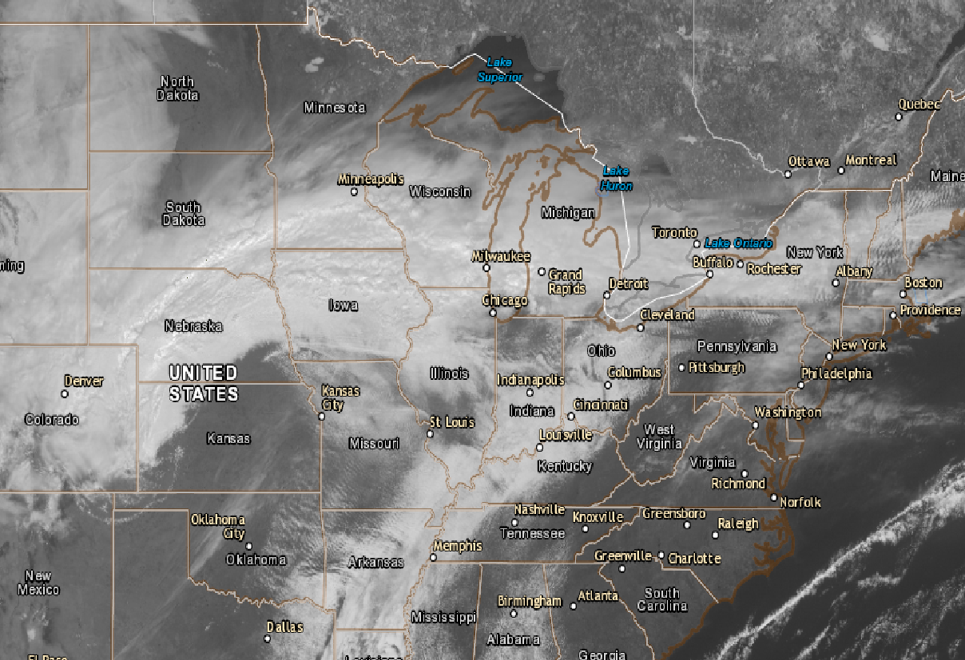

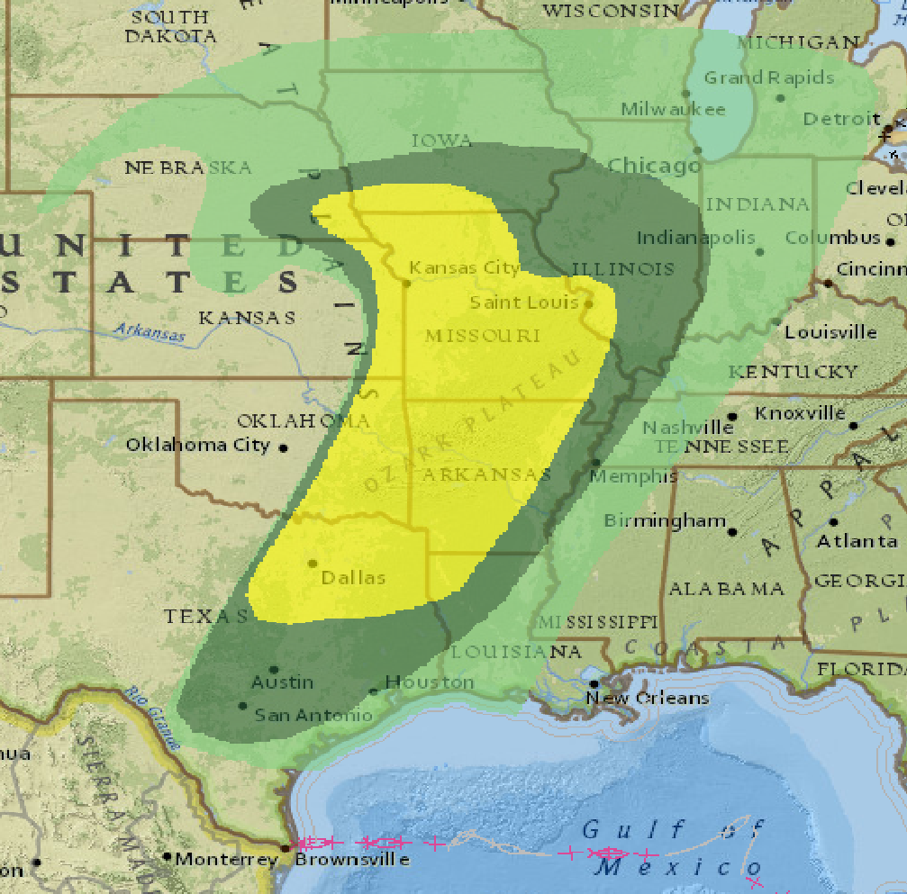
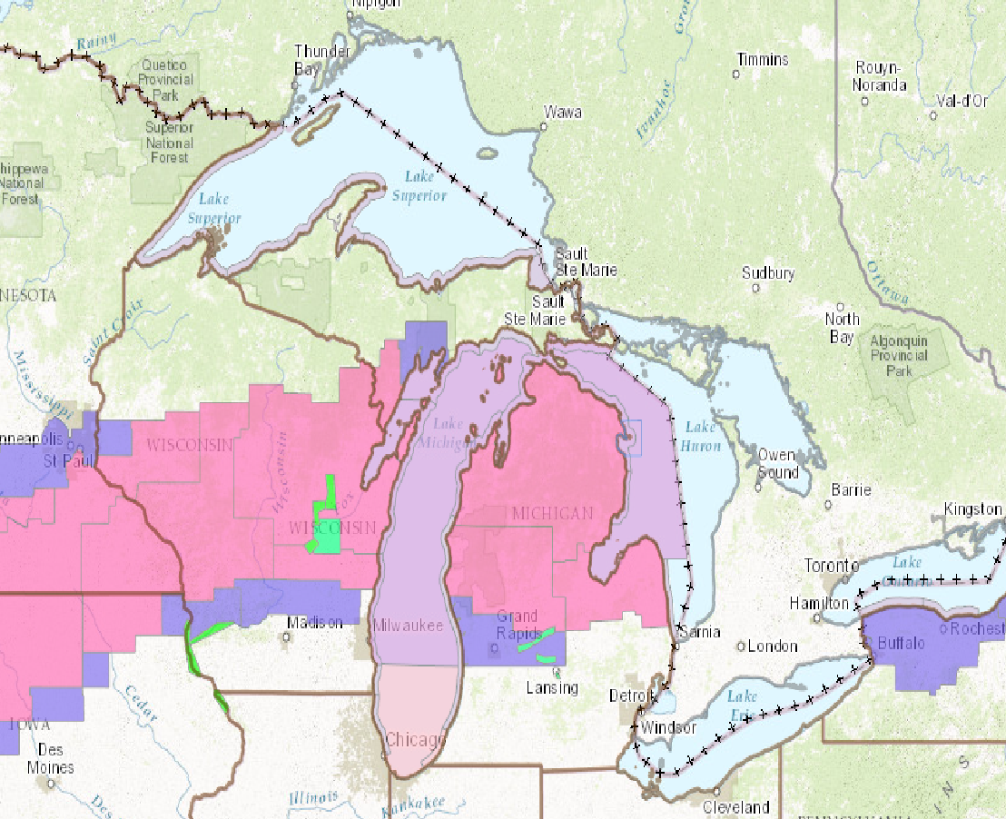
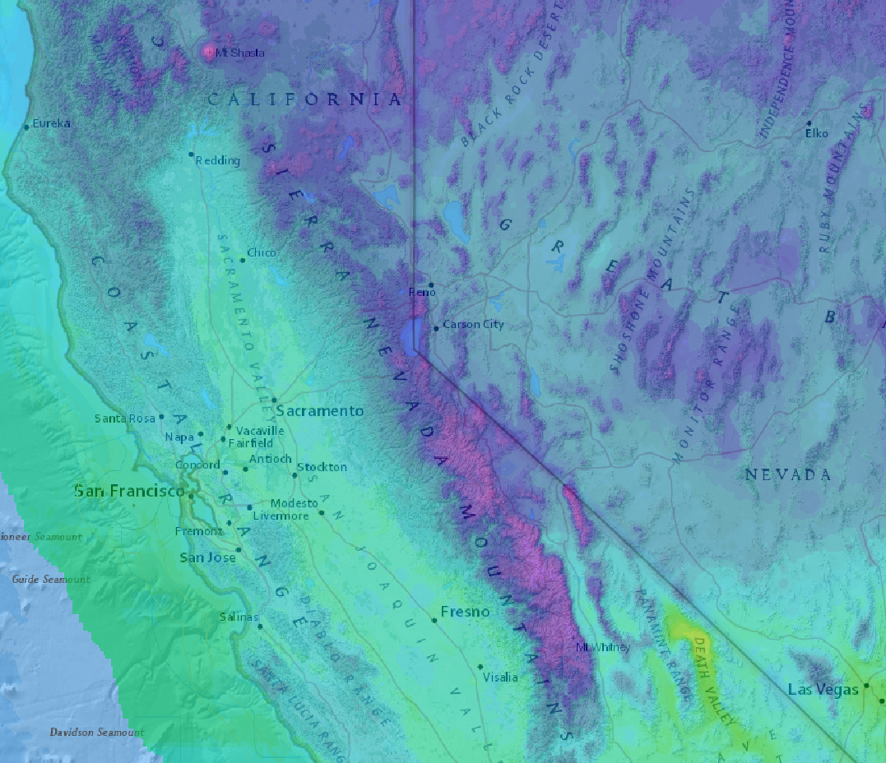
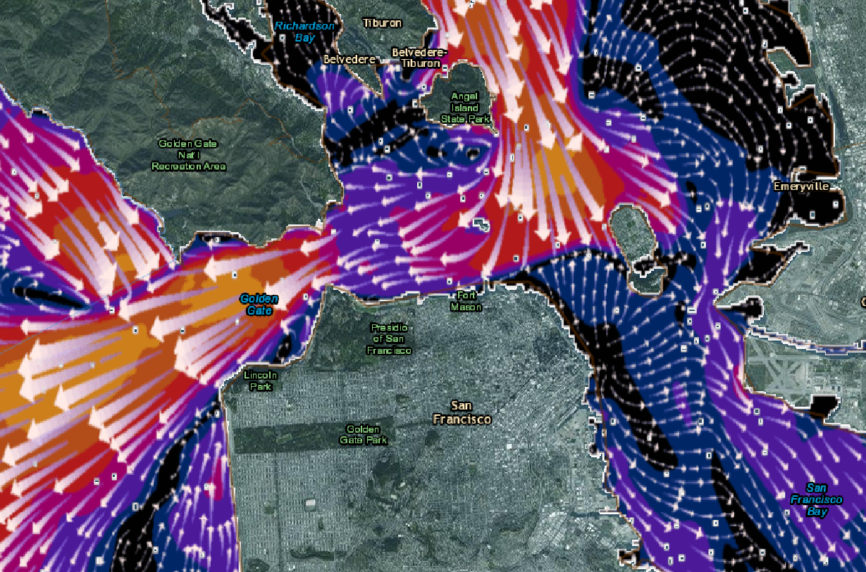
NOAA/NOS nowCOAST Web Mapping Portal
NOAA’s nowCOAST Web Mapping Services
Standards-compliant web service access
to raw data & visualizations
https://nowcoast.noaa.gov
Presently-provided layers include:
NOS Operational Forecast System (OFS) surface currents, temperature, salinity
NWS Real-Time Ocean Forecast System (RTOFS)
NOAA Weather & Ocean Observations
NWS NDFD Gridded Forecasts
NWS Watches, Warnings Advisories
NHC Tropical Cyclone Track & Intensity Forecasts
NCEP Real-Time Global Sea Surface Temp. Analysis
NWS Real-Time Mesoscale Analysis (RTMA)
NESDIS GOES Satellite Cloud Imagery
Many more…
Presently-supported web protocols:
Open Geospatial Consortium (OGC)
Web Map Service (WMS)
GeoServices REST Map Services
(ESRI ArcGIS Server REST)
Potential future supported protocols from Cloud-Based nowCOAST
OGC Web Map Tile Service (WMTS)
OGC Web Feature Service (WFS)
OGC Web Coverage Service (WCS)
Mapbox Vector Tiles (MVT)
Others as requested by users…
  Weather Radar Cloud Imagery Rainfall Analyses Outlooks Watches/Warnings Temp Forecast Model Guidance

Slide 14
FY22/23 Milestones*
Precision Navigation Dissemination System becomes 24 x 7 operational site *+
*Dependent on building out the PN/NC Dissemination Team
+ Meets NOAA IT Security Requirements

Slide 15
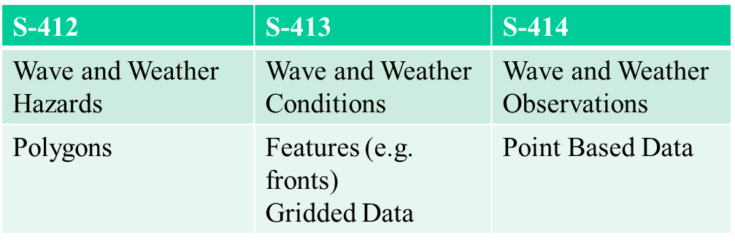
FY24 Milestones
Disseminate additional S-100 Production Suite formats in coordination with NWS/NCEP Ocean Prediction Center
S-413 Weather & Wave Conditions
S-414 Weather & Wave Observations

