Slide 1
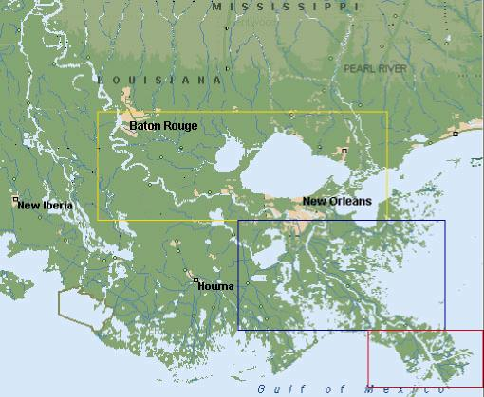
There are four state pilot associations
in Louisiana
NOBRA
Lake Charles
Crescent
Barpilots

Slide 2
PORTS
NOBRA Pilots service three major ports in the Mississippi River.
Port of New Orleans – number 7 port in the U.S. with 90,768,449 tons per year
Port of South Louisiana – number 1 port in the U.S. with 217,756,734 tons in per year.
Port of Baton Rouge – number 9 port in the U.S. with 65,631,084 tons per year
Combined tonnage of 374,156,267.

Slide 3
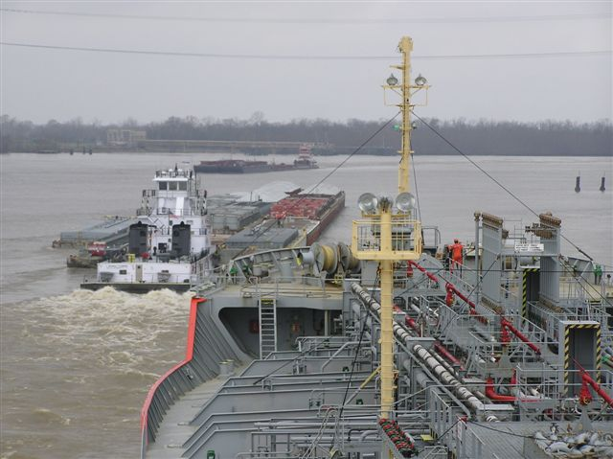

Slide 4
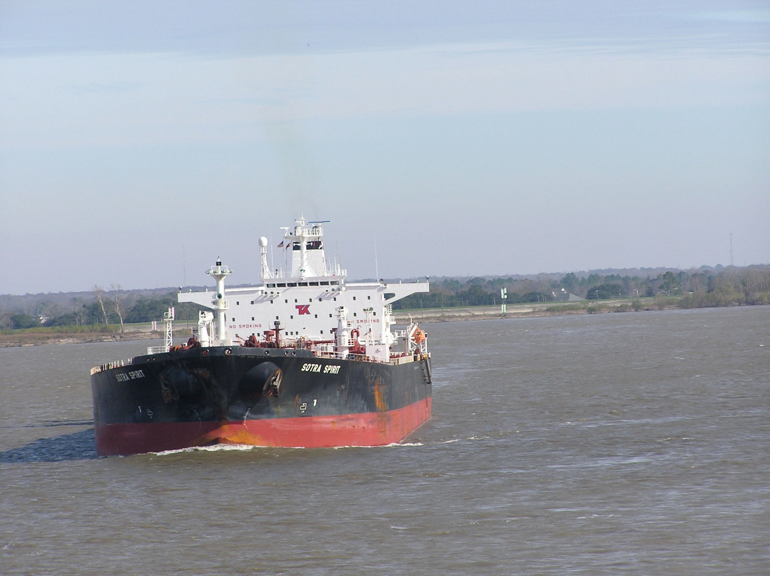
Deep Water Crossings

Slide 5
Bridges on the NOBRA Route
There are Six Bridges Crossing the River Between New Orleans and
Baton Rouge
Crescent City Connection
Huey P. Long
Luling Bridge
Gramercy Bridge
Sunshine Bridge
I-10 Bridge

Slide 6
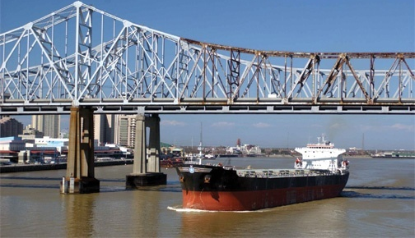
Safe and Efficient Pilotage is
Critical to That Success
Overhead Clearances!

Slide 7
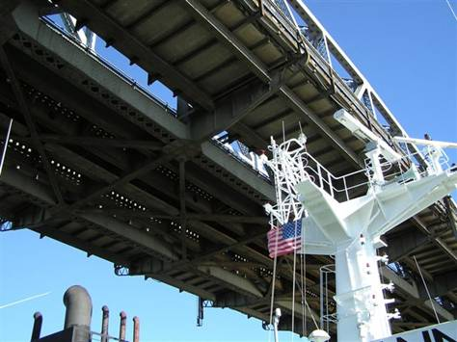

Slide 8
