Slide 1
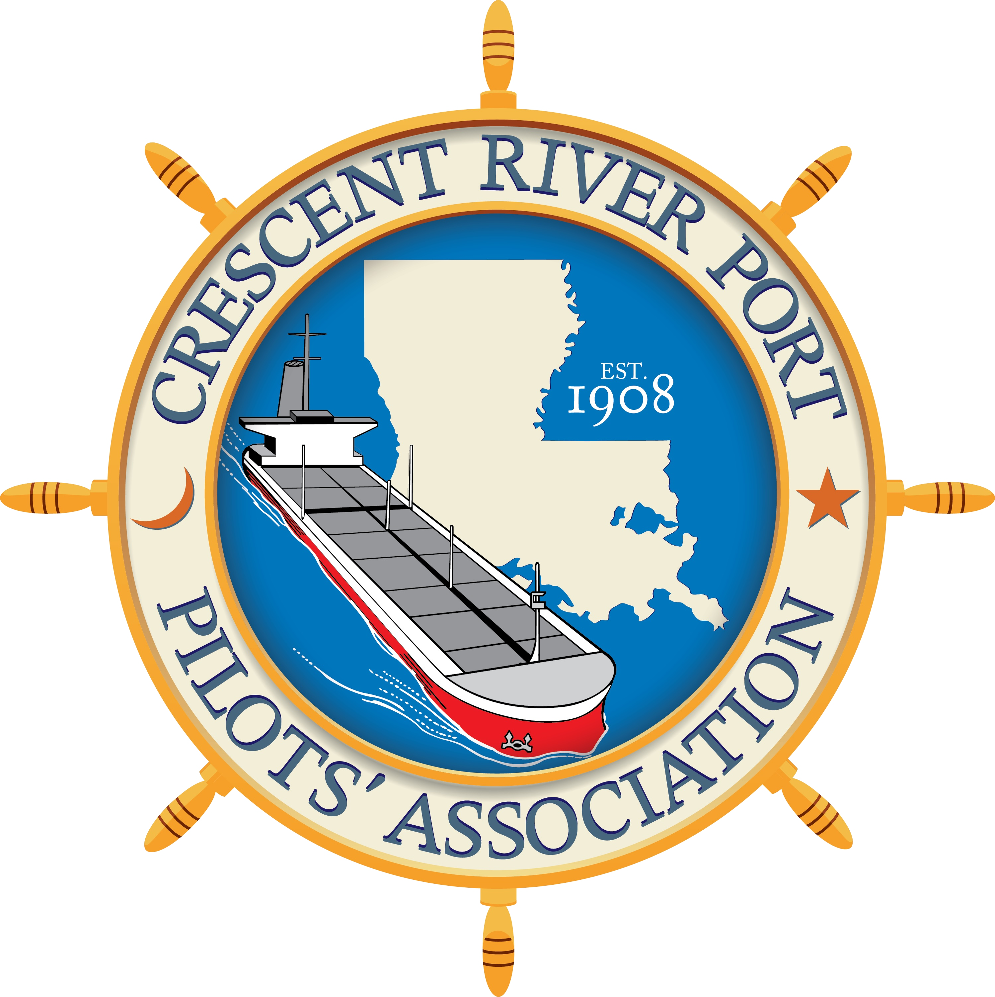
Hydrographic Services Review Panel FAC
Capt. E. Michael Bopp
Crescent River Port Pilots’ Association
Hydrographic Services Review Panel
Stakeholder Perspectives
August 27-29, 2019, New Orleans, LA

Slide 2
About Crescent River Port Pilots’ Association
Who? What? When? Where? How?
Since 1908, the Crescent Pilots have been protecting the interests of Louisiana and its citizens.
The CRPPA pilots’ knowledge, skills, experience and commitment assure a 99.98% safety record and over 380,000 jobs and $37 billion in national output, which is the lifeline that feeds the region. This enormous economic and safety record under CRPPA’s jurisdiction was accomplished in 2018 by an average of 112.5 CRPPA pilots attending to 21,614 vessel calls along the key 105 miles of the Mississippi River.
Notes:
Who - 121 Pilots.
State pilots are the only maritime professionals whose exclusive duty it is to protect the interests of Louisiana and its citizens. Pilots must manage and mitigate risk to enhance commerce and prosperity. Pilots must balance the commercial interests with safety and the interests of the citizens and property in the State.
How does this company/organization fit in with others in the industry

Slide 3
Usage of NOAA Navigation Services, products & services
“Two things seemed pretty apparent to me: One was that in order to be a Mississippi River pilot, a man had to learn more than any one man ought to be allowed to know…and the other was that he must learn it all over again a different way every 24 hours.”
– Mark Twain
Local knowledge tools of the trade
Hydrographic Surveys
Notes:
How does your company/group use NOAA Navigation Services, products and data in your day to day operations
What products do you use most often?
This slide should take roughly two minutes
Example:
Our operations are dictated by tides as we need sufficient under keel clearances to safely complete our deliveries. Accurate tidal data is critical to successfully completing our mission.

Slide 4
Real impacts of NOAA Navigation Services data, products & services
Sept – vs. March
Notes:
What could NOAA Navigation Services, data and products or related data do to help your company/group and what kind of impacts would that have on your operation? (Or stated a different way - what are some of your companies biggest limiting factors in doing business or maintaining safety?)
What products or services do you wish you had?
What products or services should be expanded?
This slide should take roughly two minutes
Example
We don’t have accurate tidal data for Port Nonexistent, causing our vessels to waste valuable time as they determine if it is safe to transit or not after arrival to the area. A new tide station here would save roughly $100k per year and allow for additional transits to this region in support of the community.

Slide 5
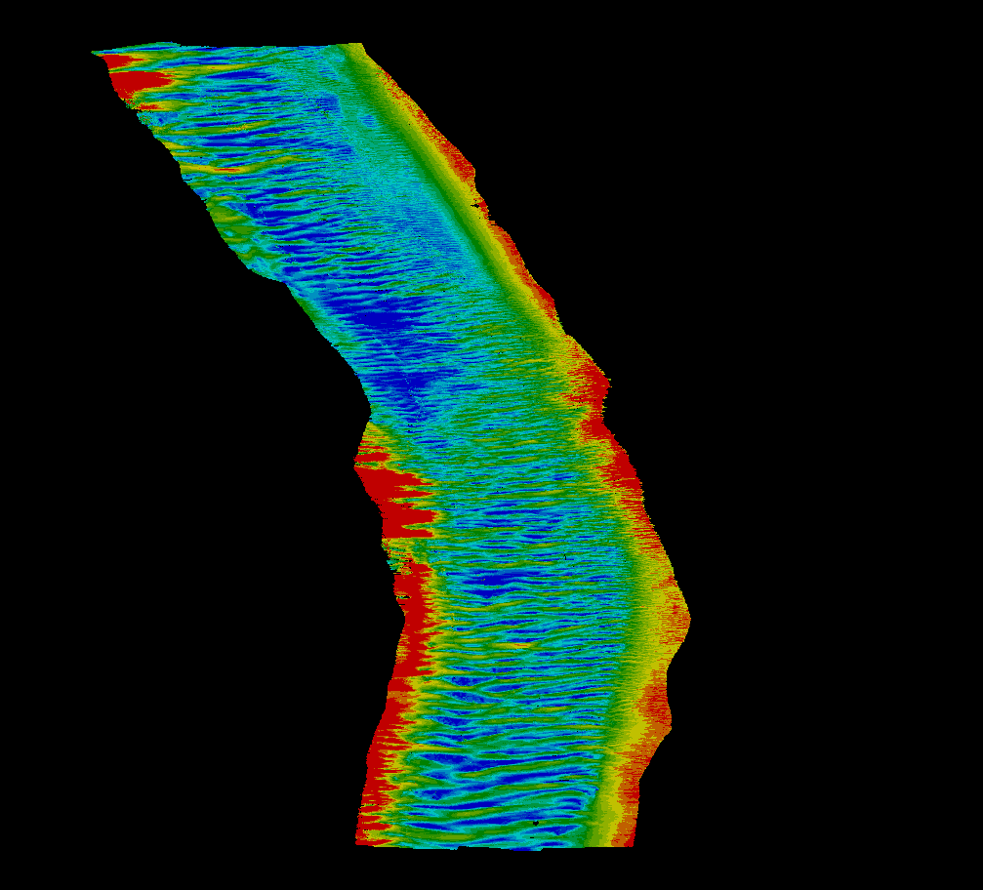
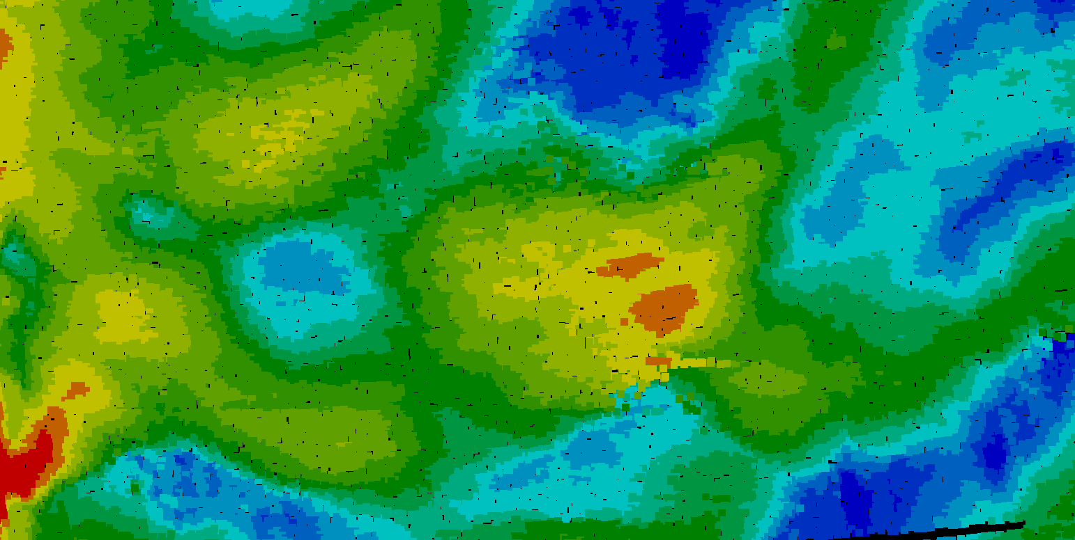
Real impacts of NOAA Navigation Services data, products & services
43.2 ft
Notes:
What could NOAA Navigation Services, data and products or related data do to help your company/group and what kind of impacts would that have on your operation? (Or stated a different way - what are some of your companies biggest limiting factors in doing business or maintaining safety?)
What products or services do you wish you had?
What products or services should be expanded?
This slide should take roughly two minutes
Example
We don’t have accurate tidal data for Port Nonexistent, causing our vessels to waste valuable time as they determine if it is safe to transit or not after arrival to the area. A new tide station here would save roughly $100k per year and allow for additional transits to this region in support of the community.

Slide 6
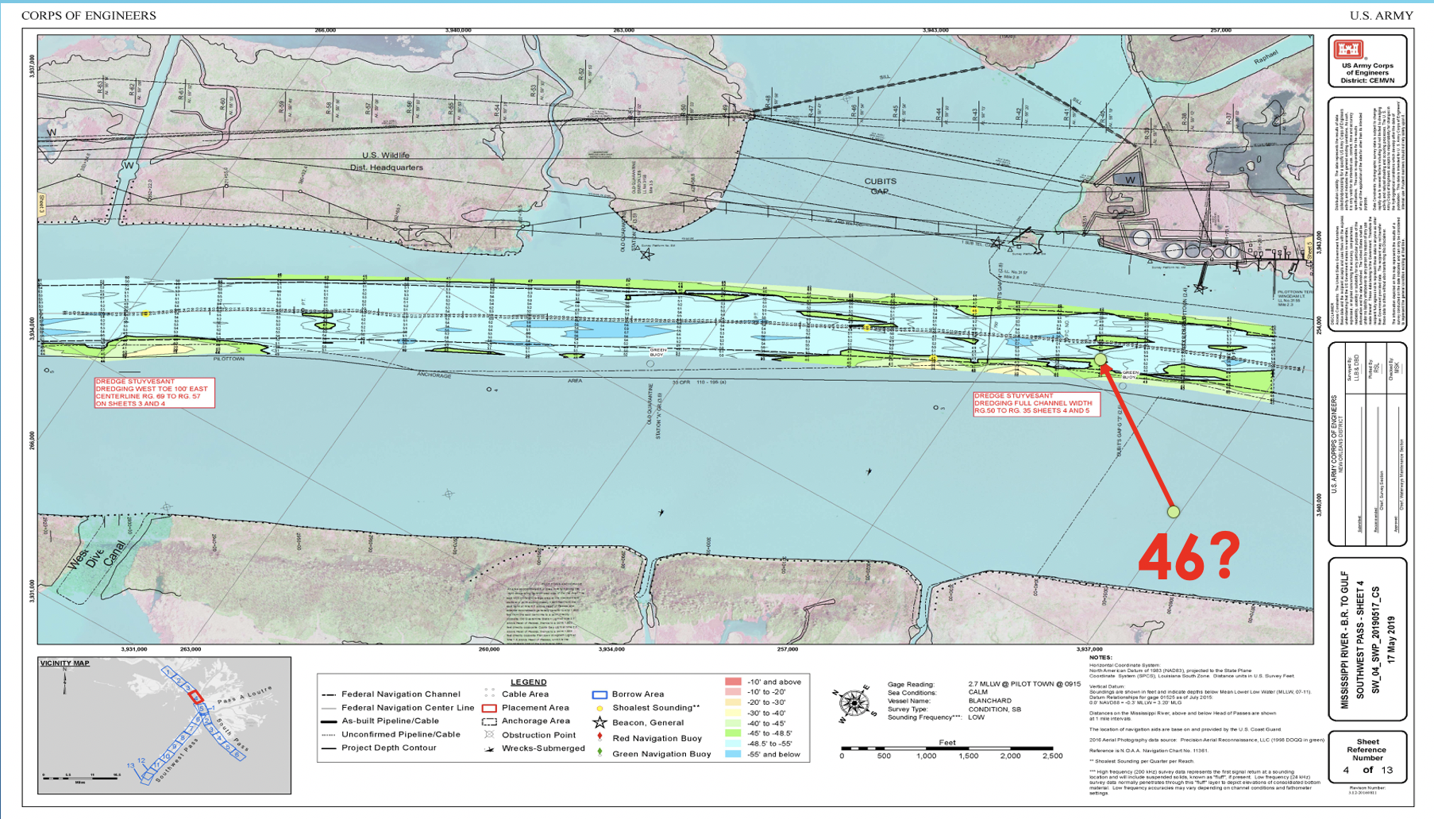
Real impacts of NOAA Navigation Services data, products & services
Notes:
Do you have a personal anecdote regarding the impacts (positive or negative) of data, products and services provided by NOAA Navigation Services?
We’re looking for a good “sea story” that conveys the real world impacts of this kind of data for your operations. This is also to help those from outside your area of expertise understand the uniqueness of your mission.
This slide should take roughly three minutes

Slide 7
Contact Information:
Capt. E. Michael Bopp
Crescent River Port Pilots’ Association
embopp69@gmail.com / 504-812-2069

