Slide 1
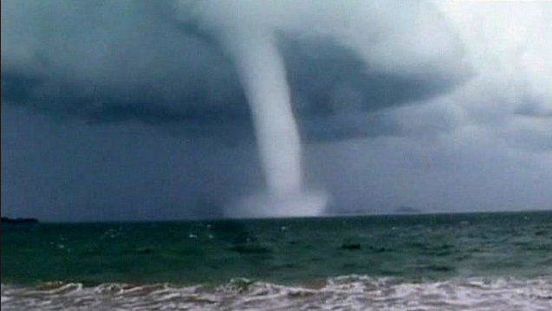
National Weather Service
Marine Update
National Weather Service
Darren Wright
National Marine Program Leader

Slide 2
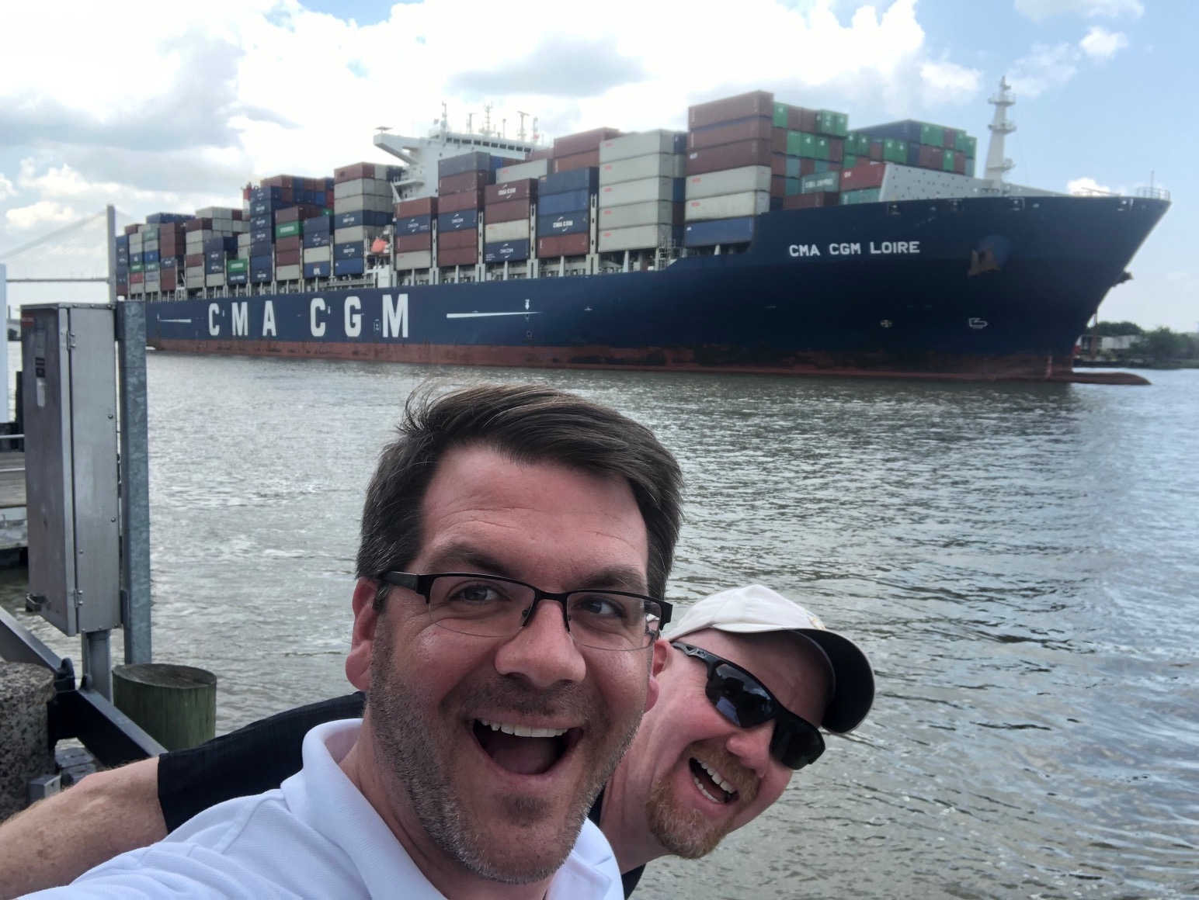
New PORTS® Manager
Chris
DiVeglio
Notes:
The NWS has 11 Service Programs
I am responsible for the marine and coastal program

Slide 3
NWS National Service Programs
Notes:
The NWS has 11 Service Programs
I am responsible for the marine and coastal program

Slide 4
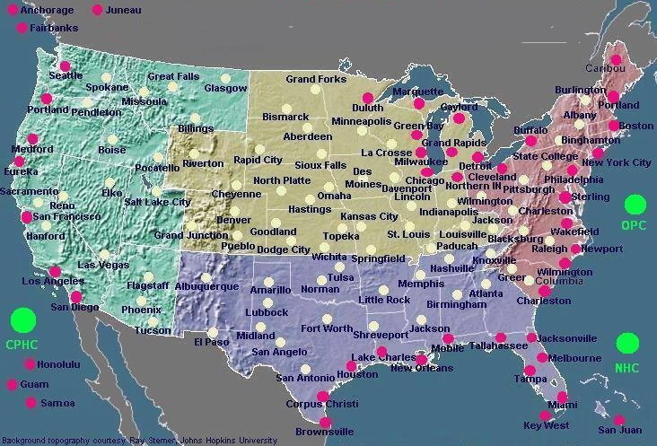
NWS Weather Forecast Offices
Provides Marine & Land Forecasts
Provides Land Forecasts
Notes:
122 Total WFOs, 53 are Marine

Slide 5
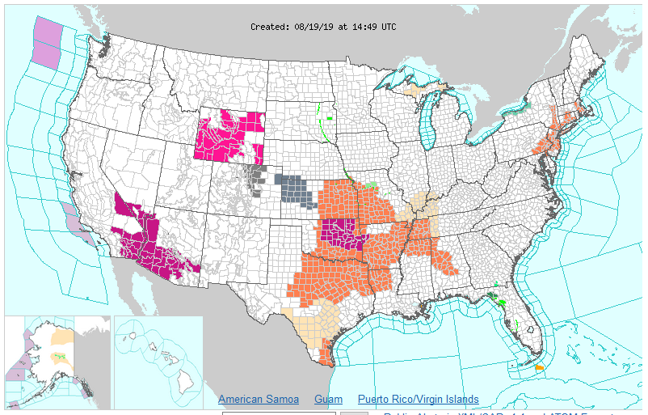
Coastal and Offshore areas

Slide 6
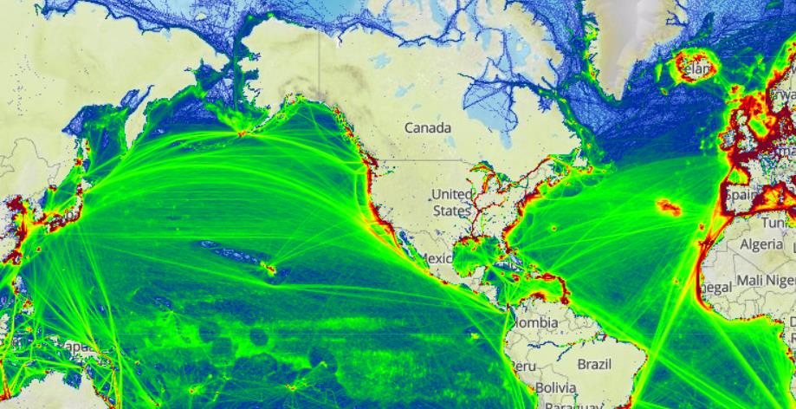
2016 Global Ship Tracks (NWS High Seas Marine Zones)
Shipping lanes in green:
OPC
OPC
NHC TAFB
WFO Honolulu
NHC TAFB
Source of 2013 total ship tracks and background: marinetraffic.com
Notes:
Ocean Prediction Center (OPC)
Tropical Analysis & Forecast Branch (TAFB)
Honolulu Weather Horecast Office (WFO)

Slide 7
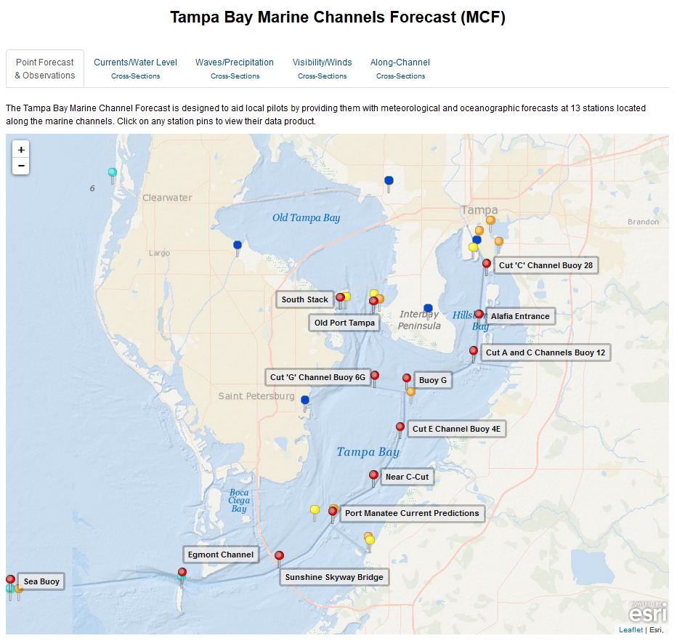
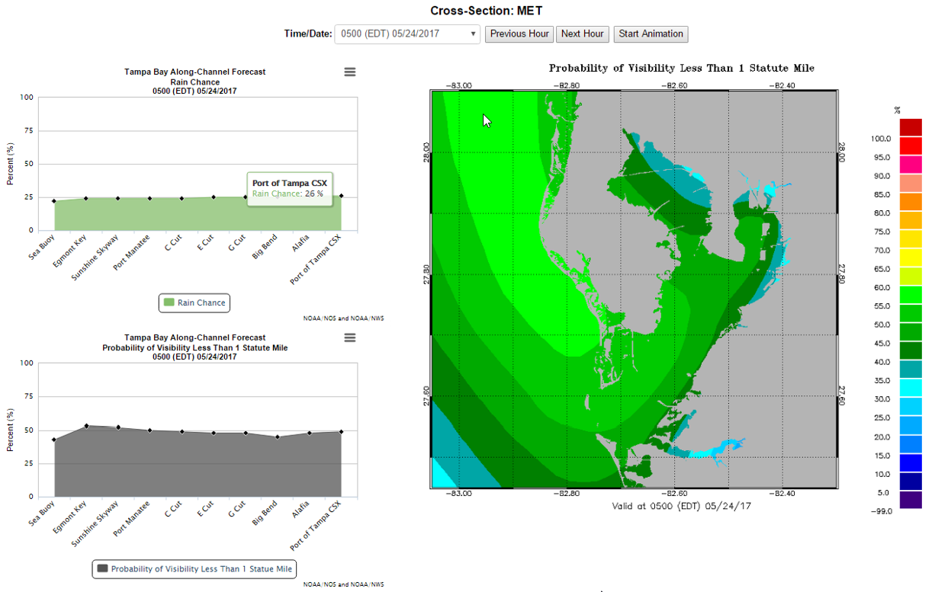
Probability of Visibility
Tampa Bay Marine Channel Forecast
Notes:
Likelihood of visibility being 1NM or less
I’m working with our National Blended Modelling team to incorporate Probability of Visibility

Slide 8
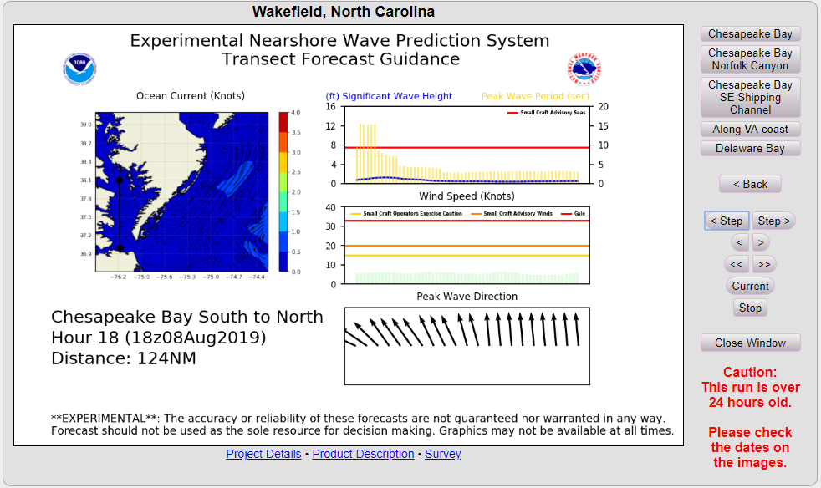
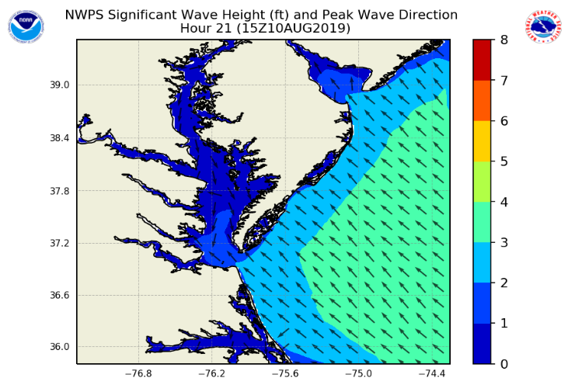
Wave and Wind Forecast Along Transect
Nearshore Wave Prediction System (NWPS)
Small Craft Advisory Line
https://polar.ncep.noaa.gov/nwps/viewer.shtml

Slide 9
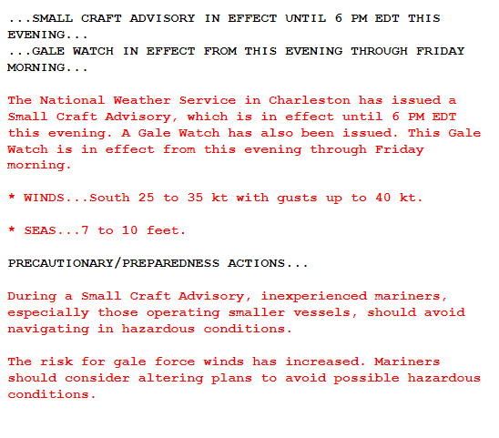
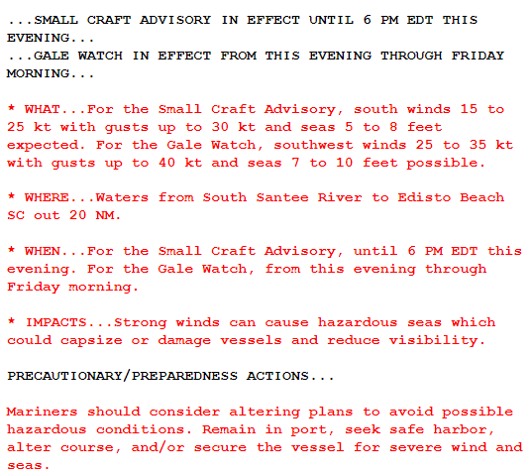
Reformatted Example - MWW
(changes shown in red)
Current Product
Reformatted Product
Notes:
On or about December 3rd

Slide 10
Text Product Consolidation - Small Craft Advisory
Existing Products
Future Product
Dec. 2019
Small Craft Advisory
Small Craft Advisory for Hazardous Seas
Small Craft Advisory for Rough Bar
Small Craft Advisory for Winds
Consolidated to
Small Craft Advisory
Notes:
On or about December 3rd

Slide 11
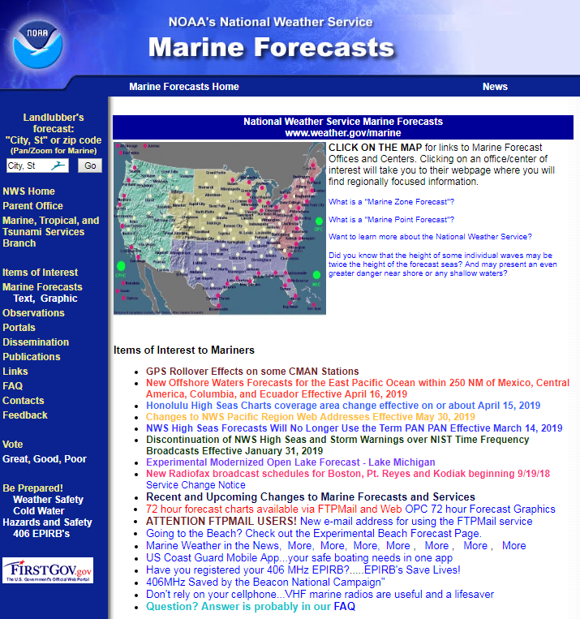
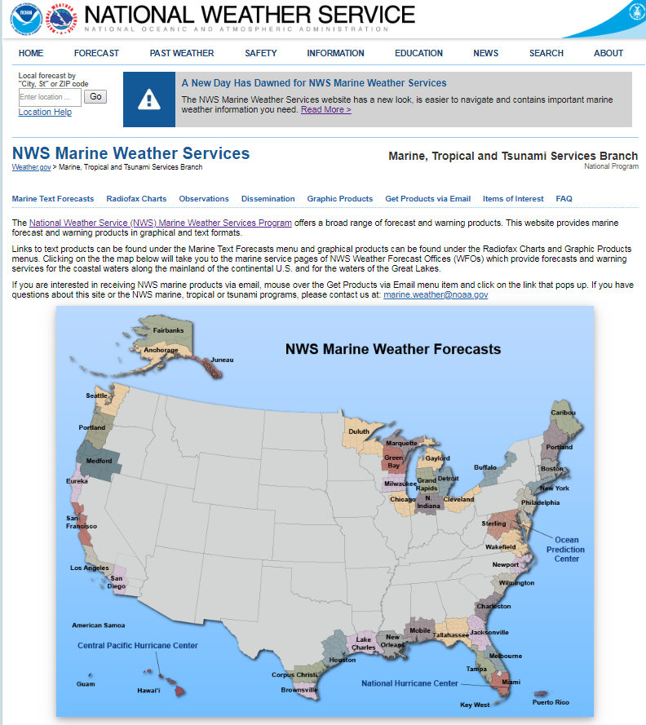
New Marine Website
http://weather.gov/marine
Current Website New Website
Notes:
On or about September 17th.

Slide 12
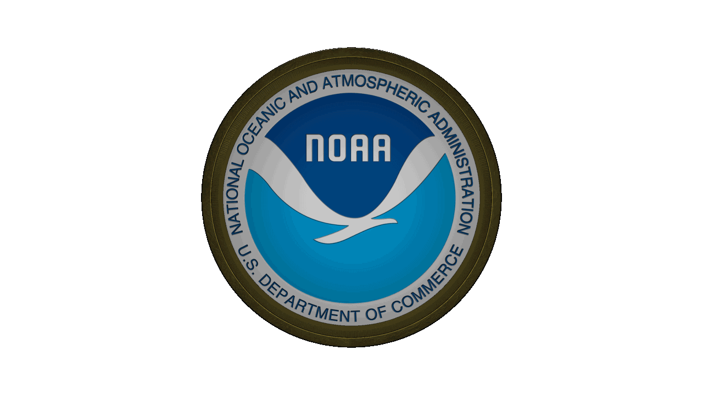
Thank you! Questions?
Darren Wright
Marine Program Leader
darren.wright@noaa.gov
301-427-9283

