Slide 1
Hydrographic Services Review Panel FAC
Craig Winn
Office of Coast Survey: MCD
Hydrographic Services Review Panel
HD Charting
August 27-29, 2019, New Orleans, LA

Slide 2
About Marine Chart Division HD Chart
HD ENC Specifications
Built to the IHO S-57 standard
Validated against IHO S-58
IHO Scale Band 6: 1 to 5,000
Gridded to adhere to MCD re-scheme
Official NOAA Chart Product

Slide 3
Marine Chart Division HD Chart
Initial Test Areas
Based upon the availability of suitable source data, this 1st phase of HD Chart production has been limited to two primary test areas.
Mississippi River, Louisiana
Ports of Long Beach/Los Angeles, California

Slide 4
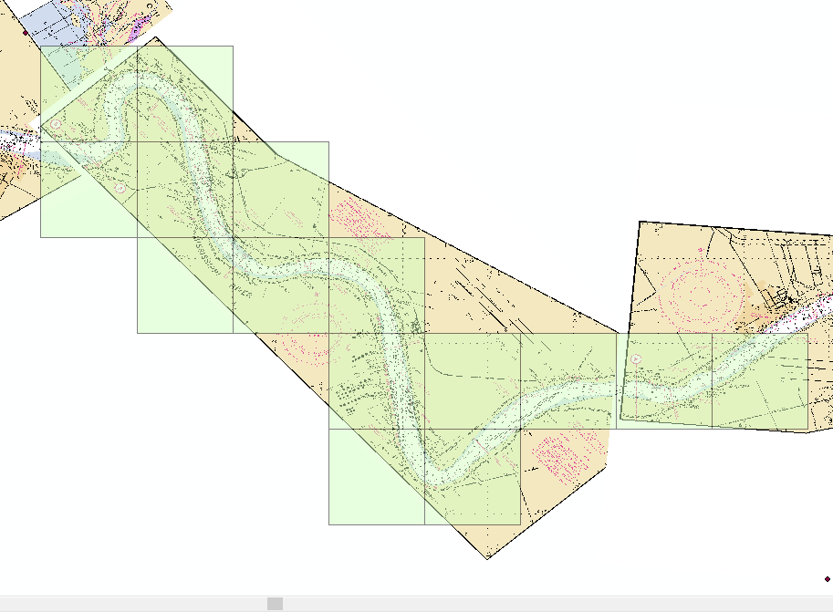
Marine Chart Division HD Chart
Scheme for HD Charts Test Area
Mississippi R.

Slide 5
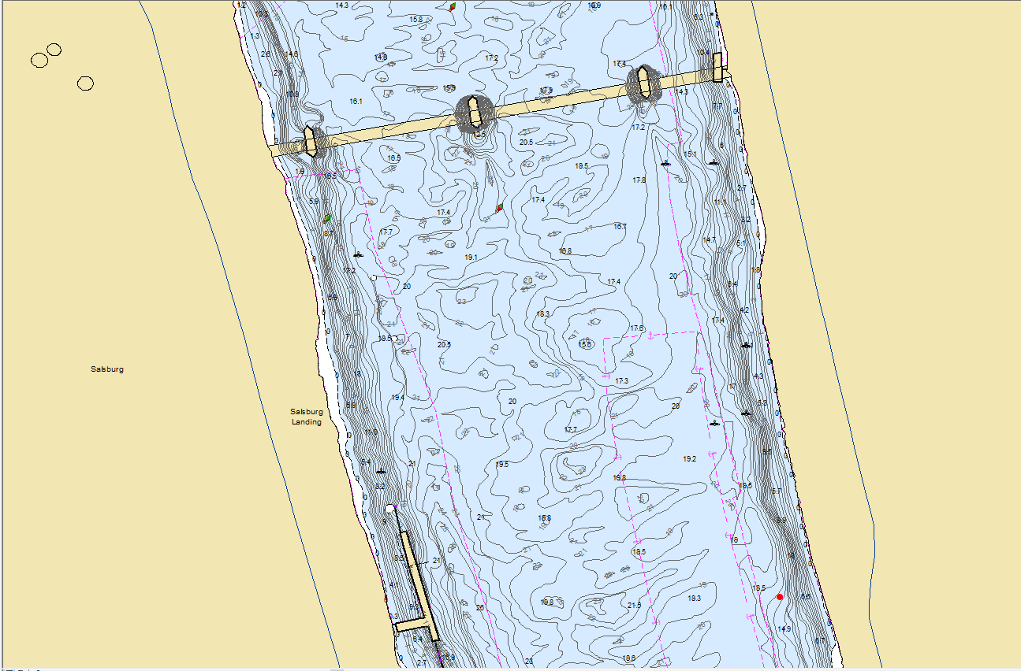
Marine Chart Division HD Chart
Existing ENC coverage
US6MRHHM Scale = 1:5,000

Slide 6
Contact Information:
Craig Winn
Marine Chart Division (MCD)
craig.winn@noaa.gov

