Slide 1
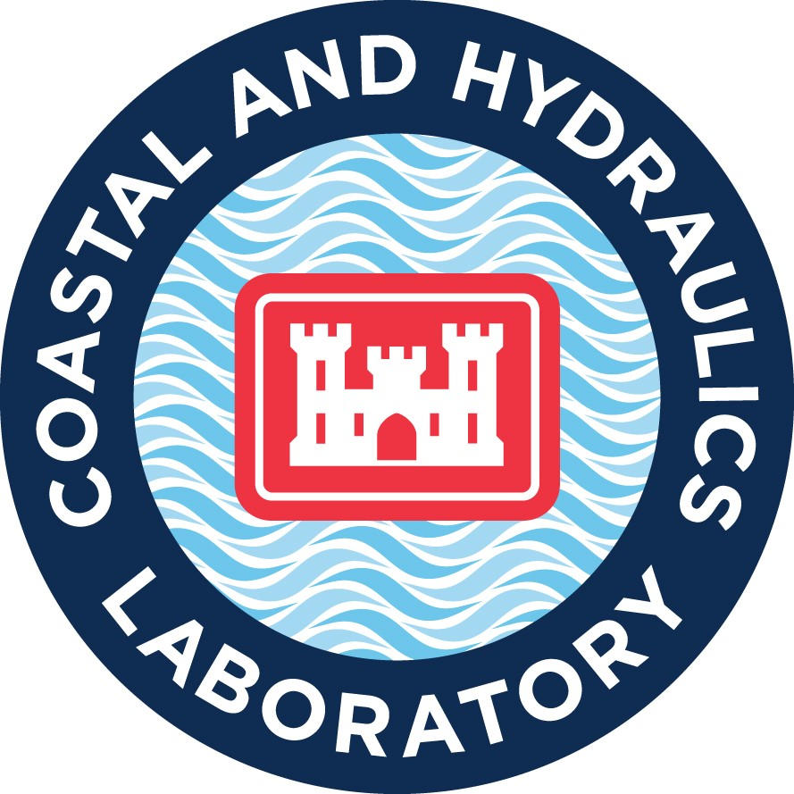
Hydrographic Services Review Panel FAC
Jackie S. Pettway, PE, PhD
Coastal and Hydraulics Laboratory
US Army Engineer Research and Development Center
Innovative Application of Hydrographic and Navigation Service Data
Hydrographic Services Review Panel
August 27-29, 2019, New Orleans, LA

Slide 2
Usage of NOAA Navigation Services, products & services
CHL uses NOAA data for physics-based model validation/determination of bias and model development, for surrogate model development/validation, for stochastic simulation, stochastic simulation validation, preparation of storm suites, Lidar for constructing model grids, Lidar for defining structure/channel topography/bathymetry/condition for planning, design, O&M, emergency management studies.
  Hydrographic surveys for Nautical Charts and model development
  Water levels from Tides and Currents web site
  River Forecast Center water level forecasts
  Waves and climate data from National Climate Data Center
  NCEP/NCAR Reanalysis winds and climate from Climate Prediction Center
  HURDAT best track data from NHC
  Lidar, meteorological data from National Climate Data Center
  Real time and historical cyclone data from National Environmental Satellite Data and Information Service (e.g. IBTRACS)
  Storm information from NHC
  S-57 Nautical Charts used for ECDIS in Ship Simulation Studies
  Observed weather
  Quantitative Precipitation Forecasts
  NOAA Fisheries and Marine Mammal information
Notes:
This slide and the next 2 should take roughly two minutes
NOAA relies upon the Corps' hydrographic surveys for publication of its Nautical Charts.
The underkeel clearance work by Brandan also uses AIS data from Marine Cadastre, which is a NOAA initiative (along with BOEM, and the data is still gathered by USCG).
NOAA's National Ocean Service (NOS) has used CPT to evaluate the benefits of its PORTS installations around the country.
Future Efforts - collaboration with AIS to be used for NOAA boat operations and marine habitat monitoring (monitoring vessel activity).

Slide 3
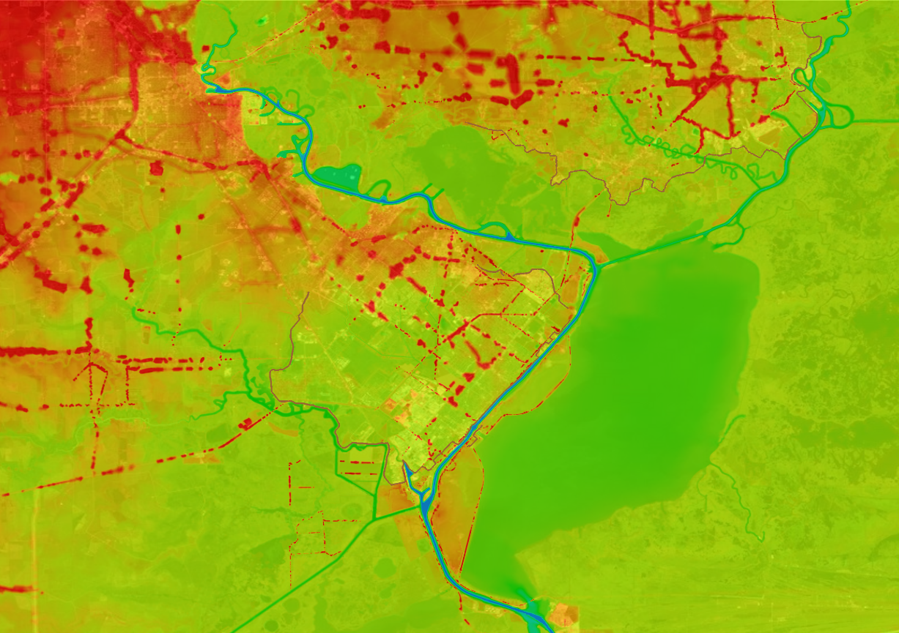
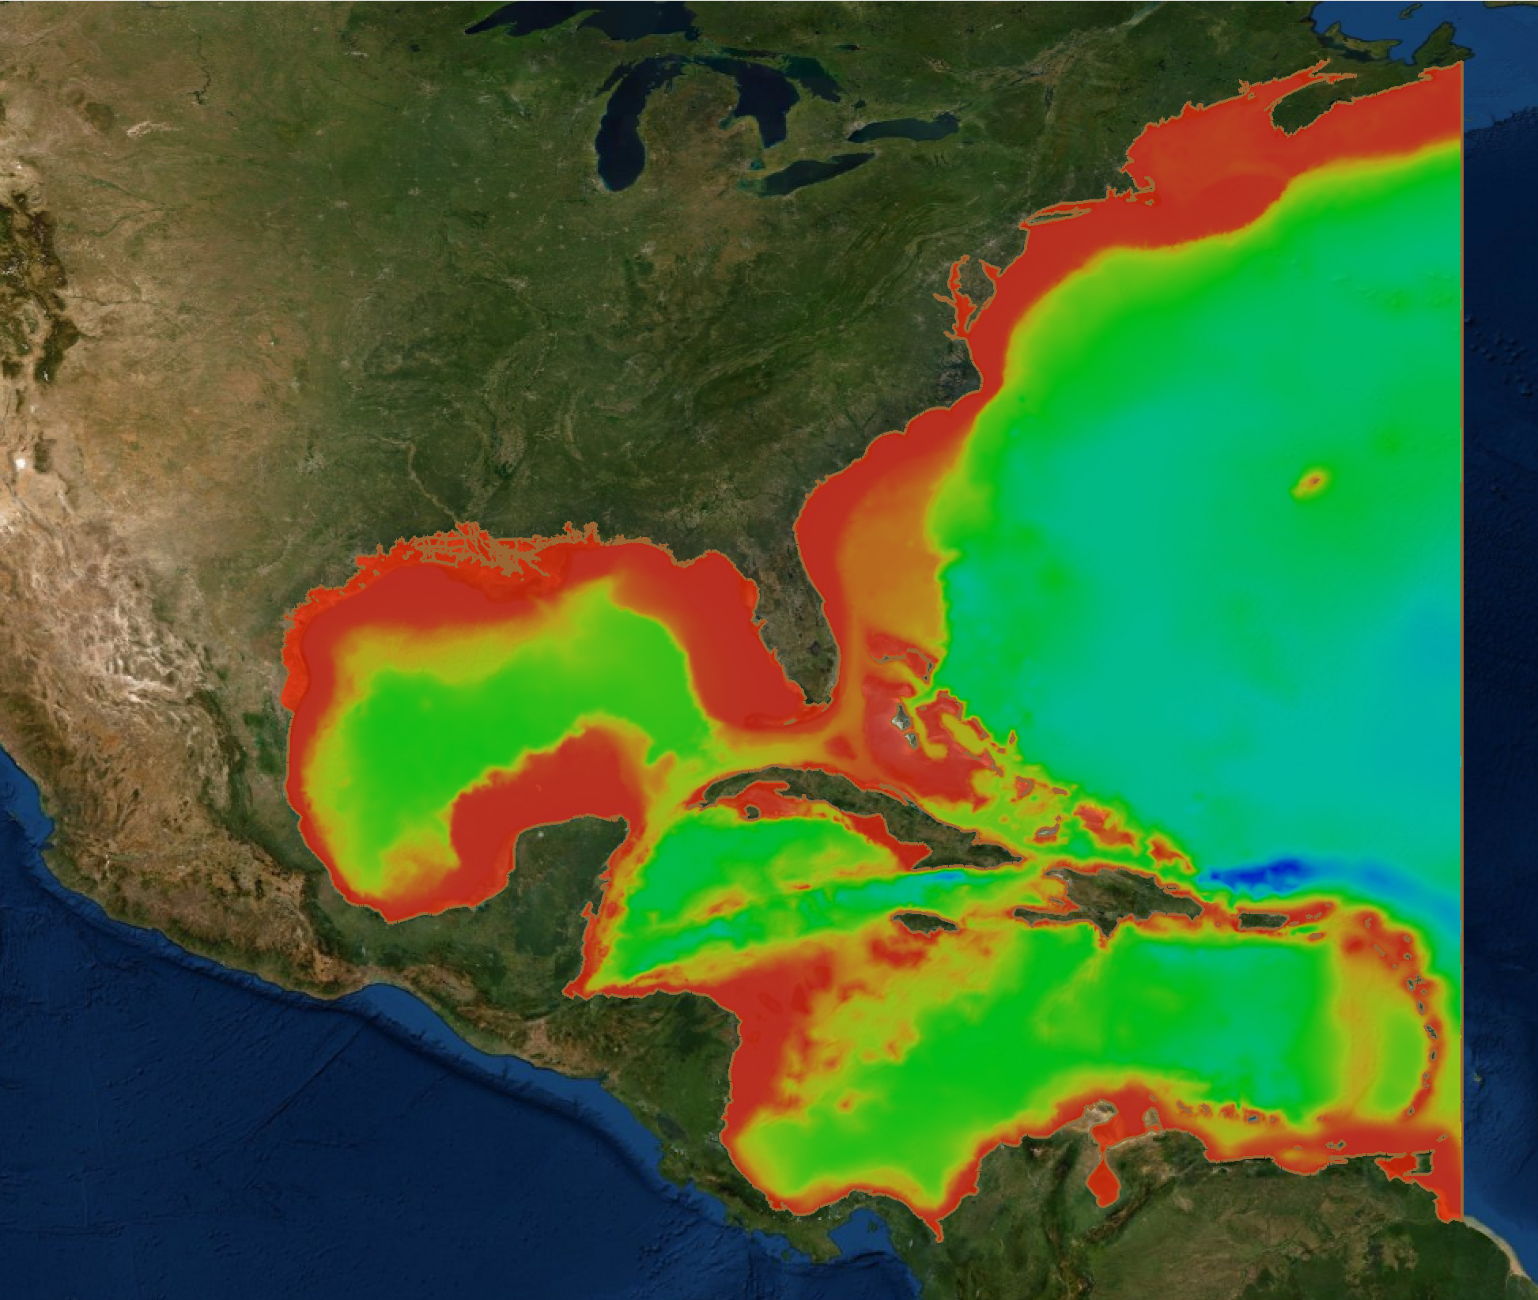
ADCIRC Model Domain from Sabine to Galveston PED Project 2018-2019
Color contours are of the model’s topo/bathy
Port Arthur, TX
Data from NOAA’s Tides and Currents was used to calibrate the ADCIRC model to tidal gauges operated by NOAA. In addition, NOAA’s VDATUM tool was used to convert vertical datum locations between NAVD88 and MSL (Mean Sea Level). Data from NOAA’s long term gauges was used to find the seasonal variability of water levels due to thermal expansion and other baroclinic effects not included in the model.
S2G PED is one of the largest cost projects in the USACE right now, with an anticipated cost of over $4 billion.
Notes:
The remainder of the slides should take 3 minutes and address the questions below from the template provided.
Do you have a personal anecdote regarding the impacts (positive or negative) of data, products and services provided by NOAA Navigation Services?
We’re looking for a good “sea story” that conveys the real world impacts of this kind of data for your operations. This is also to help those from outside your area of expertise understand the uniqueness of your mission.

Slide 4
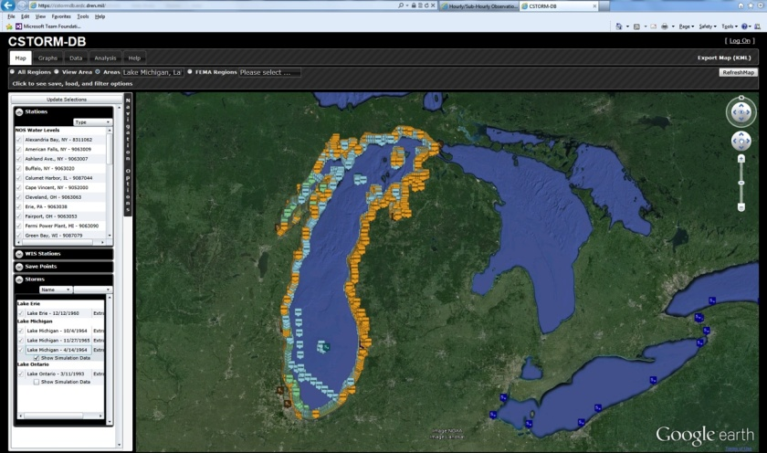
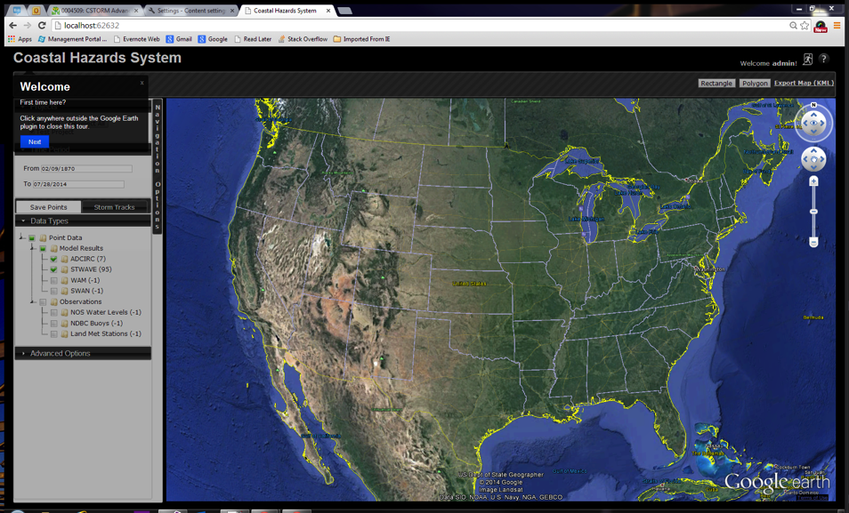
Coastal Hazard System
This data is used for risk analysis and operational tools such as the Coastal Hazards System, a web service providing measured and high-fidelity modeled coastal storm data and resulting wave, wind, water level, meteorological data, and ice responses.
Notes:
Hydrographic surveys and NOAA tidal gauges are used to develop and validate numerical models to determine hydrodynamics that are then used for a variety of engineering challenges such as sediment transport, coastal hazard analysis, navigation impacts for design changes using a ship simulator, etc.

Slide 5
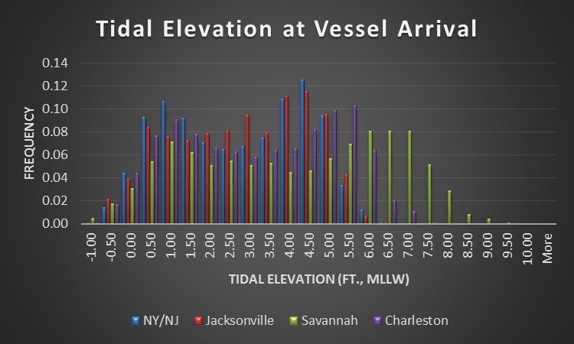
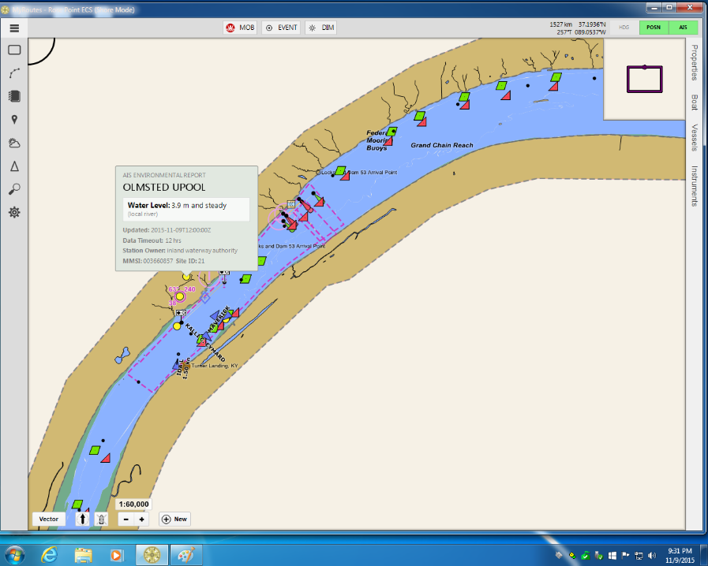
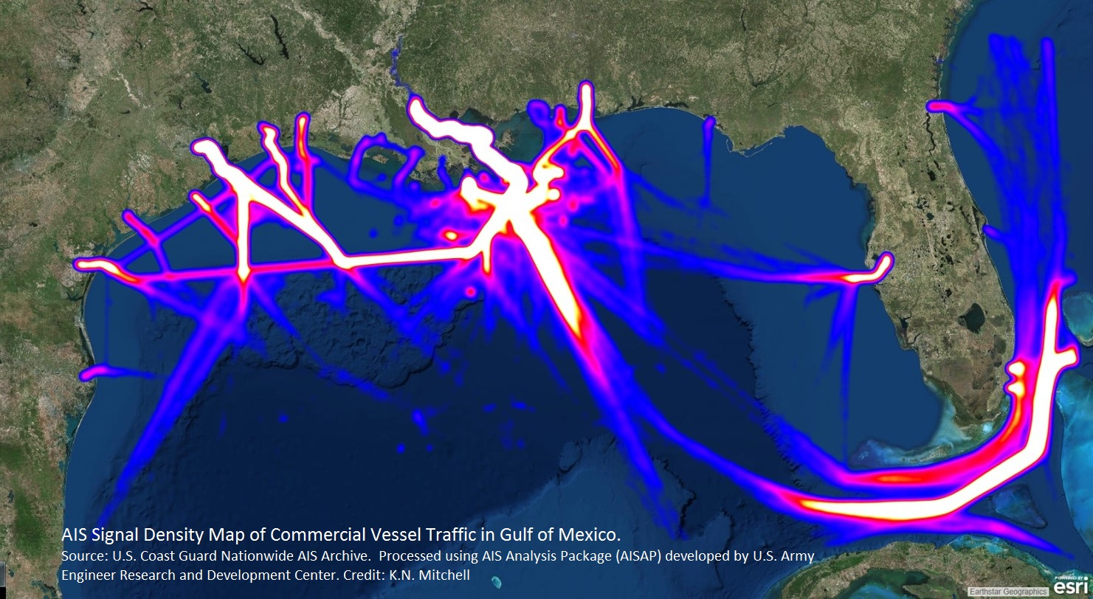
Navigation Services data to inform dredging and minimize maritime incidents
Using tidal stage information and historical vessel
position information allows researchers to identify how
tidal stage influences vessel movements.
LOMA: Water Level observations transmitted via AIS: Data source NOAA NWS
NOAA's National Ocean Service (NOS) has used CPT to evaluate the benefits of its PORTS installations around the country.
Notes:
Wolfe, Eric and Mitchell, Kenneth N. (2018) "Allisions, Collisions and Groundings: Estimating the Impact of the Physical
Oceanographic Real Time System (PORTS(R)) on Accident Reduction," Journal of Ocean and Coastal Economics: Vol. 5: Iss. 1, Article
4.
DOI: https://doi.org/10.15351/2373-8456.1091
“Over the estimated ten-year economic life of PORTS® instruments, present PORTS® installations could
produce a present value saving of $180 million. If expanded to an additional 23 ports where economic
justification might be made, up to $10 million could be saved. Over ten years this would equate to over $84
million.”

Slide 6
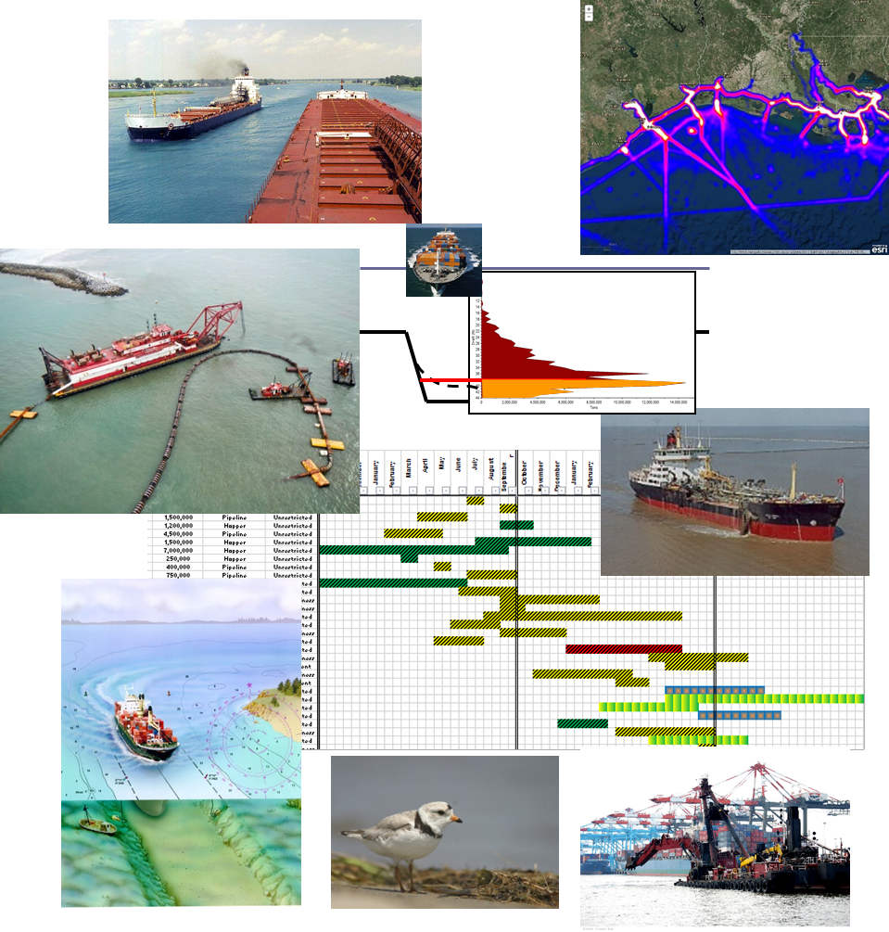
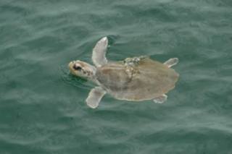
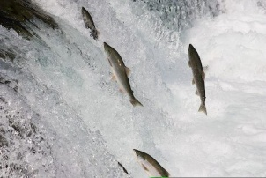
Dredging Portfolio Optimization
The selection of Navigation projects for year-to-year maintenance dredging as well as the scheduling of that work can be optimized to lower costs and increase overall dredging program efficiency.
Optimization models developed by the ERDC Dredging Innovations Group (DIG) combine established operations research (OR) methods with enterprise data sets to reveal more cost-effective dredging strategies.
Information on environmental windows assists with efficient scheduling

Slide 7
Utilizing Bathymetric Data to Monitor Bedform Changes
Linear profiles of the bedforms are extracted from the bathymetry and analyzed for roughness and dune population statistics. These statistics are compared with the flow conditions under which the bedforms were observed.
Notes:
The collection of bathymetric data in the Mississippi River in an area of persistent and
dynamic bedforms over a range of flow conditions, statistically examine
bedform geometry, and parameterize results for inclusion in numerical
models. Bathymetric data were collected several times to measure rates of
bedform transport. Linear profiles of the bedforms were extracted from the
bathymetry and analyzed for roughness and dune population statistics.
These statistics are compared with the flow conditions under which the
bedforms were observed. Bedforms increase in size with discharge and
decrease in steepness (height:length ratio). At extremely high discharges,
bedforms begin to decrease in size. In comparing results with methods for
calculating form drag coefficients, it was observed that the dunes at higher
river stages, despite their greater size, may present less resistance to flow
due to their reduced steepness and reduced relative heights (dune
height:flow depth).
Mississippi River Geomorphology &
Potamology Program
MRG&P Report No. 22
October 2018
Mississippi River Bedform Roughness and Streamflow Conditions near icksburg, Mississippi Data Collection Summary and Analysis
Michael T. Ramirez, S. Jarrell Smith, James W. Lewis,
and Thad C. Pratt
Coastal and Hydraulics Laboratory
U.S. Army Engineer Research and Development Center
3909 Halls Ferry Road
Vicksburg, MS 39180-6199

Slide 8
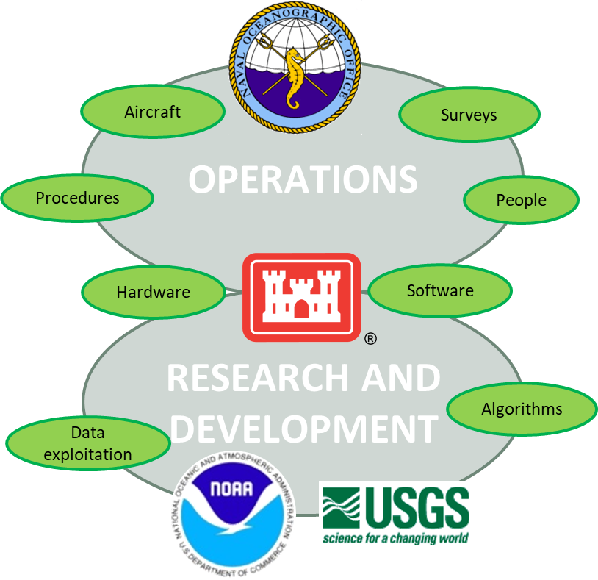
JOINT AIRBORNE LIDAR BATHYMETRY TECHNICAL CENTER OF EXTERTISE
JALBTCX is the US Government SME for topo-bathy lidar
Annual workshop convenes Federal, Industry, and Academic partners from around the world to share and advance the technology
Airborne Laser Hydrography II recently published encapsulates the past 30 years of community knowledge
USACE & NOAA collaborations @ JALBTCX
  Coordinate data collections, processing, and final product formats
  NOAA uses USACE National Coastal Mapping Program data to
    Update nautical chart bathymetry and shorelines
    Develop digital elevation models for tsunami and other coastal hazard modeling
  Post-Maria USACE data informed survey boat operations
  NOAA lidar data collected for charting were used post- storm change analyses
    South Carolina (Matthew), Florida Keys (Irma), Puerto Rico south shore (Maria), Port St. Joe Florida (Michael)
  NOAA serves USACE data to the public at the Digital Coast
  Develop requirements for bathymetric lidar testbed
  Coordinate tests of new lidar sensors and other coastal mapping technologies

Slide 9
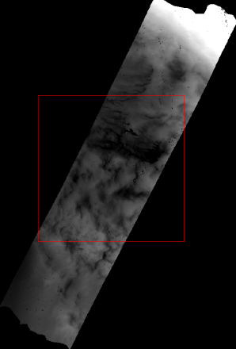
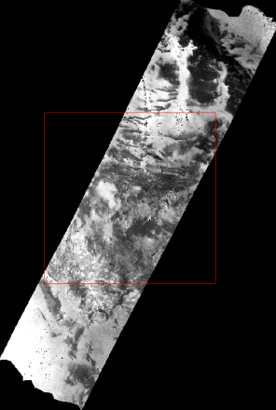
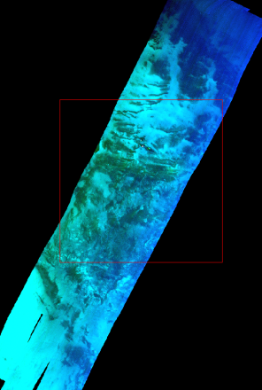
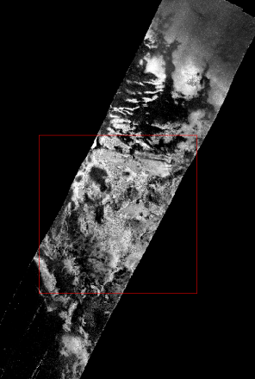
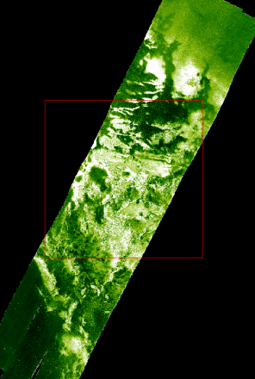
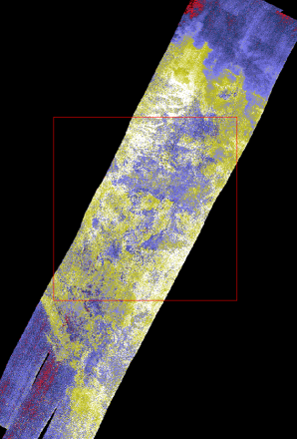
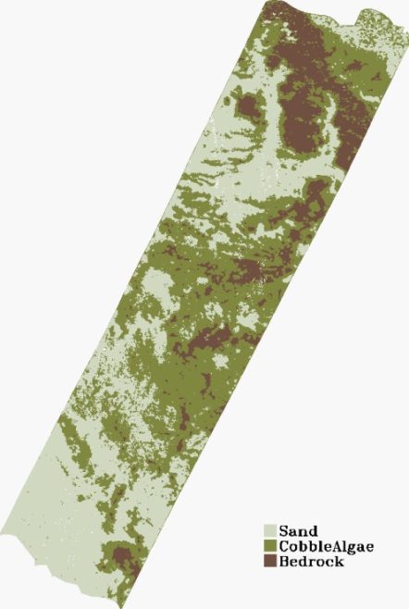
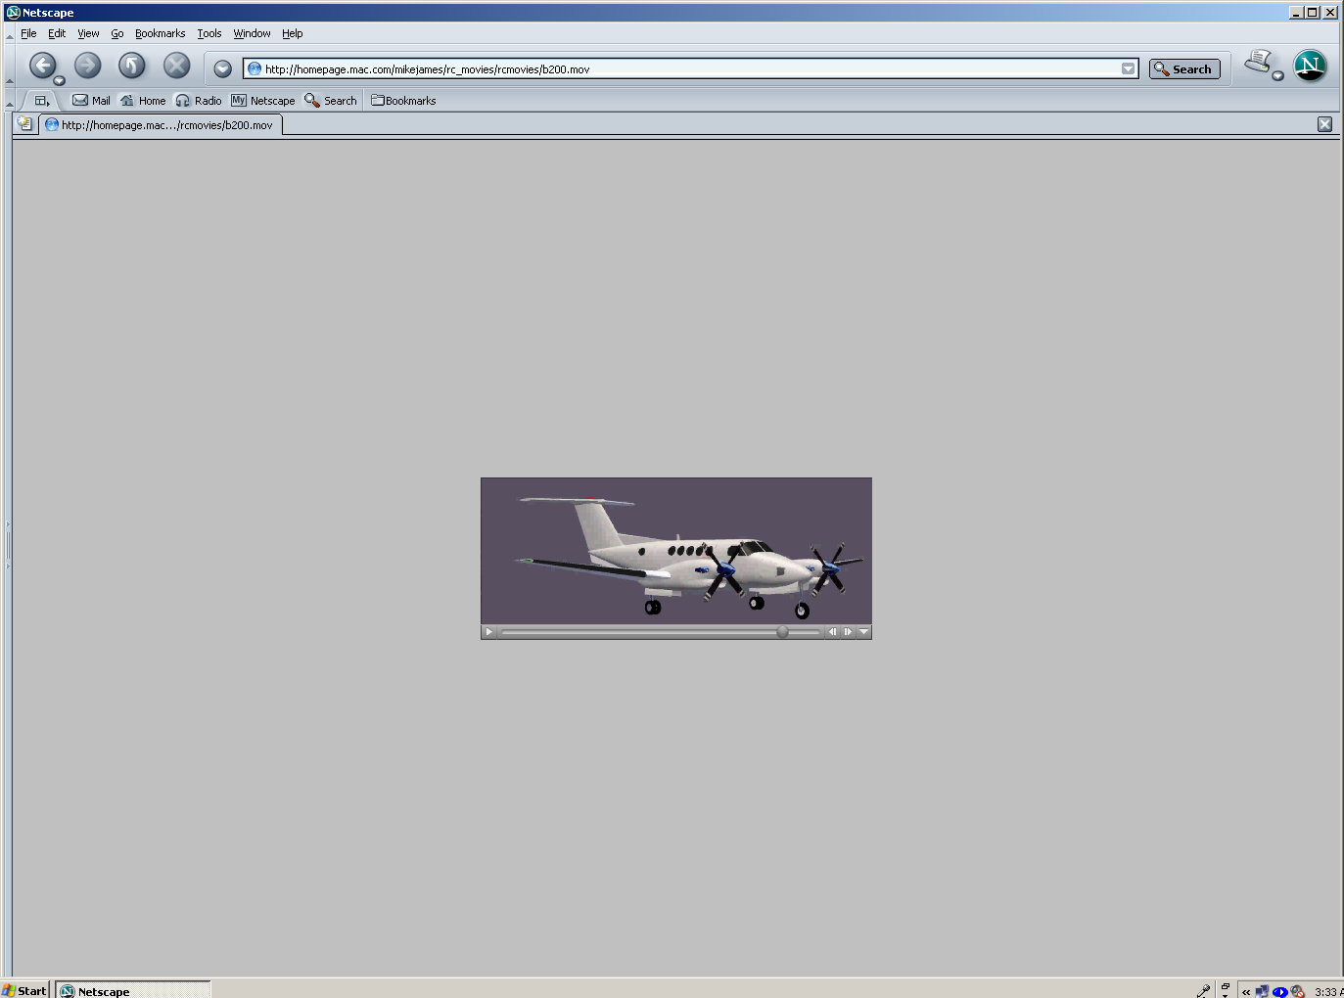


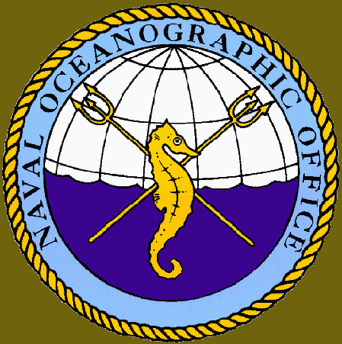





Coastal Zone Mapping and Imaging Lidar
depth
seafloor reflectance
RGB
attenuation
chlorophyll
CDOM
SHOALS
spectrometer
bottom classification
Notes:
Hydraulic and environmental properties of coastal areas can be determined and monitored utilizing additional data and imaging.

Slide 10
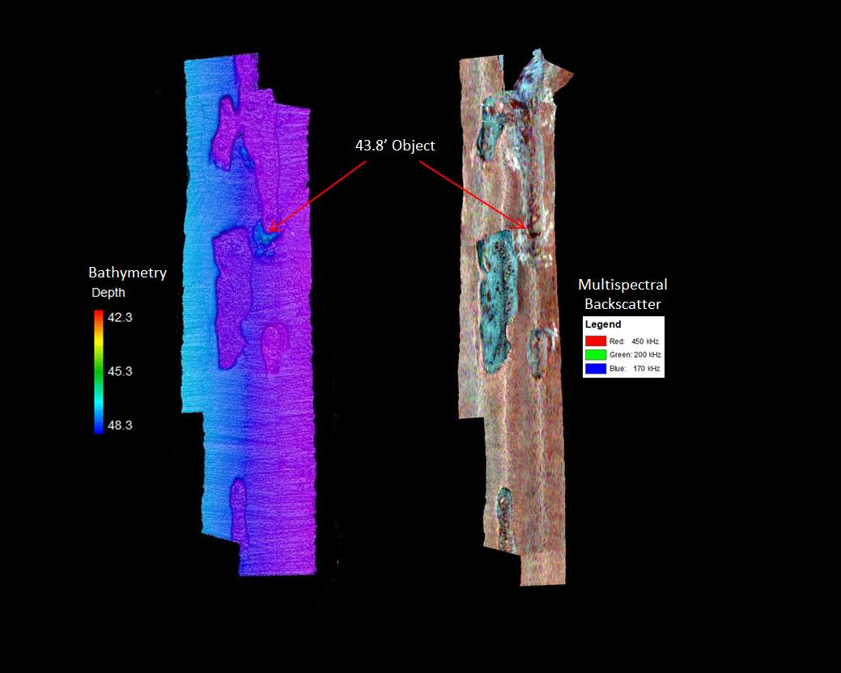
Multispectral Backscatter and Multifrequency Bathymetry
Notes:
NOAA/CCOM-data available via NGDC
Habitat mapping
Geophysical studies
Fisheries studies (NMFS)
Positioning of sediment samples for nautical charts (NOAA Ship Hassler)
Geophysical studies
Dredging/navigation
Object detection
Hard/soft bottom detection
Sediment composition
Sand searches

Slide 11
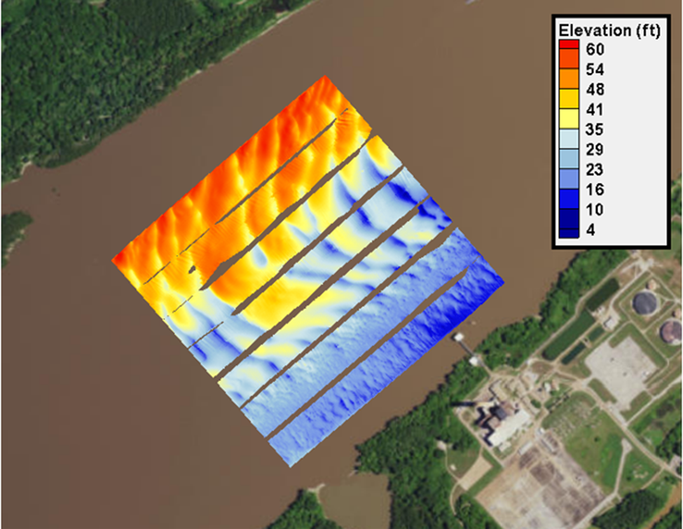
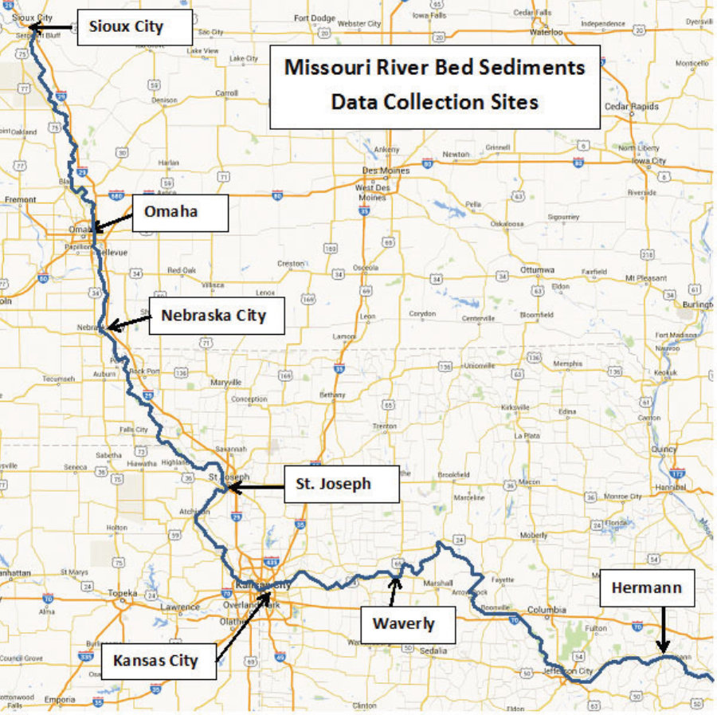
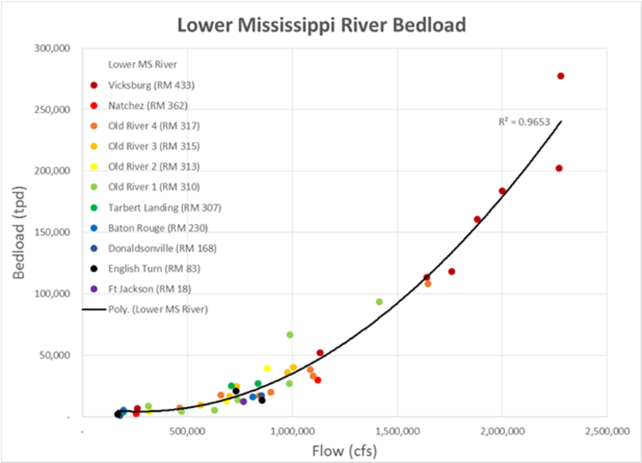
Bed-load Measurements
Example Applications:
Mississippi River
Ohio River
Missouri River
Snake River
Atchafalaya River
Red River
Swaths of bathymetric data used to compute bed load.
Notes:
A method for computing bed-load transport in large sand bed rivers.
The method uses time sequenced bathymetric swaths obtained across a river section.

Slide 12
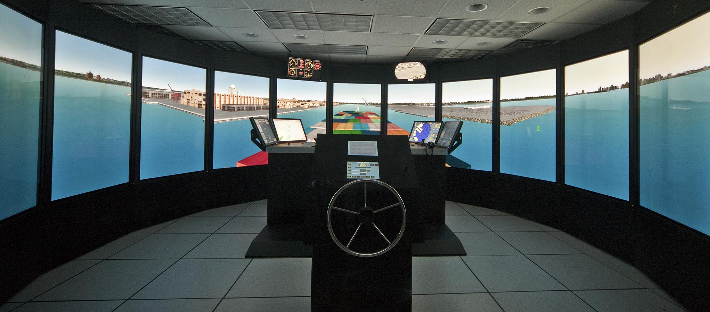
Navigation and Regional Sediment Analysis
NOAA S-57 charts are used in the ECDIS of the CHL Ship Simulator. The simulator is used to analyze and improve navigation channel design and port expansions.
The NOAA tidal gauge information as well as lidar data is used to investigate sediment processes along shorelines and during dredging operations.
Notes:
RSM, Ship Simulation In addition to the tidal gauges for model validation, NOAA S-57 charts are used in the ECDIS of the Ship Simulator.

Slide 13
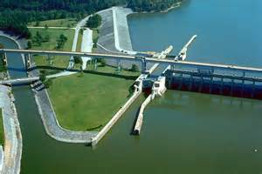
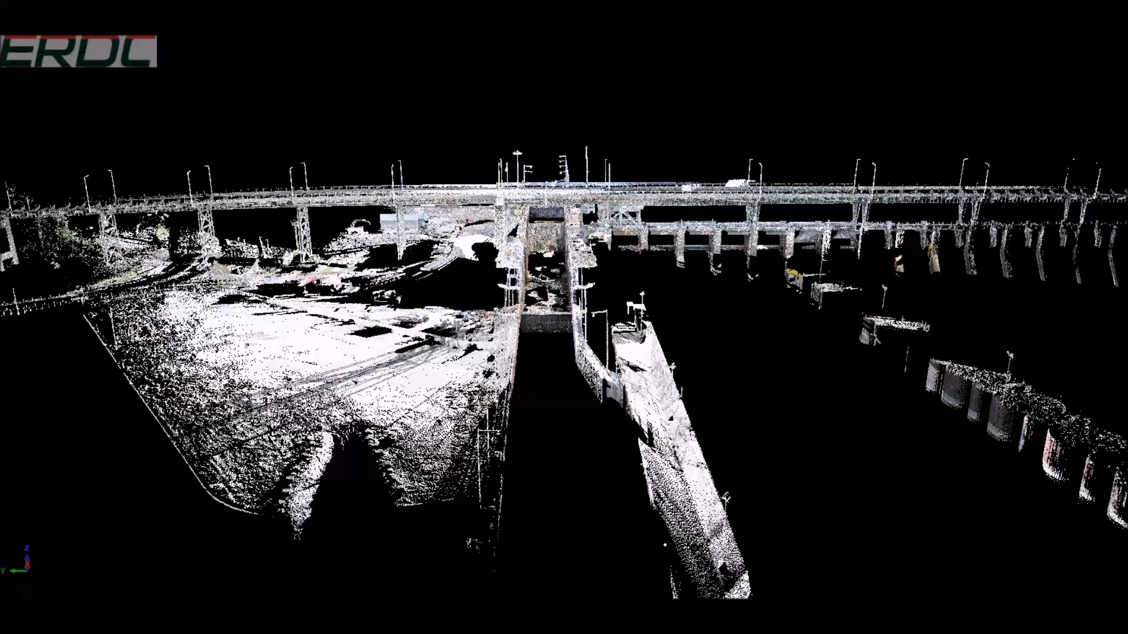
Chickamauga Lock and Dam
Use Light Detection and Ranging (LiDAR) to quantify concrete growth
This capabilities is now being used to assess conditions of locks and dams specifically during dewatering exercises.
Notes:
In August of 2010, ERDC was tasked with researching the possibility of using to Light Detection and Ranging (LiDAR) to quantify concrete growth in the Chickamauga Lock and Dam located on the Tennessee River. As of 2010, the lock had experienced around 4 inches of vertical growth and 12 inches of horizontal growth since it was constructed in 1934. A follow up survey was conducted in 2016 to measure the change in the structure.
The conclusion of this effort is that LIDAR is viable tool to measure concrete growth at the Chickamauga Lock and Dam and similar structures. In the case of the Chickamauga Lock and Dam, the results were as expected.
Around 1cm on the land side and about 2 cm on the river side were measured using LIDAR. Measurements were also made to determine any changes in the width from wall to wall, both longitudinally and horizontally. Results were all as expected for the amount of time this structure has had to grow. However, if collected in the correct method, a large amount of data can be analyzed to detect change in a structure over a period of time.

Slide 14
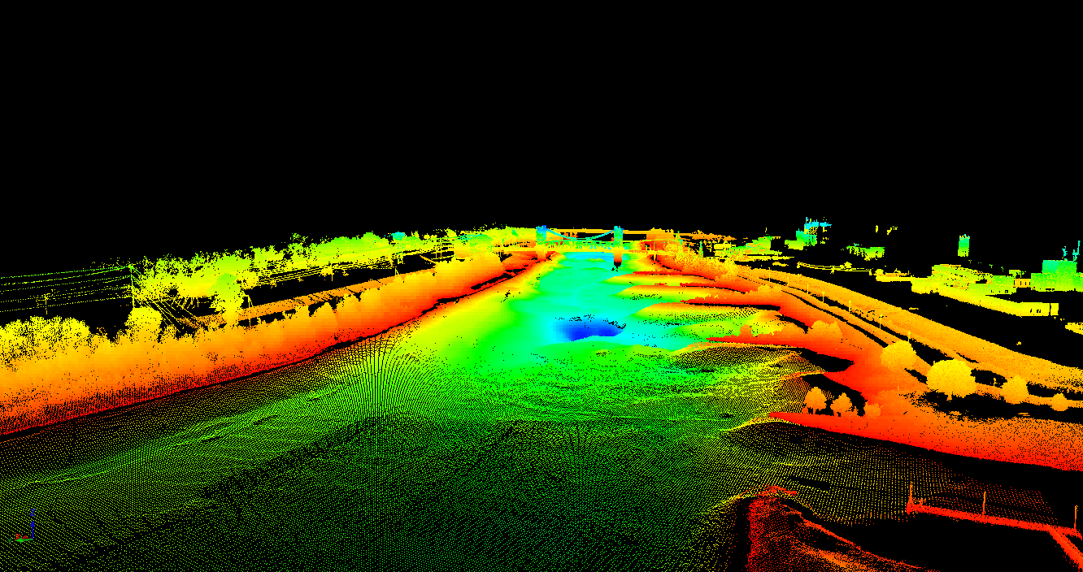
Example of an Integrated LIDAR and Multi-Beam River Survey
Notes:
Integrated LIDAR and Multi-Beam surveys can be used to determine water depths, bed elevations, and material roughness to inform numerical models. Additionally, multi-beam could give an indication of roughness and presence of fluid mud for purposes of navigation.

Slide 15
Requests for NOAA Navigation Services data, products, and services
Data used by CHL for our flood studies, navigation studies, operation & maintenance efforts, and emergency management.
Data needs and areas of future collaboration
  Detailed measurements of overland hydraulics for validation of models.
  Improve understanding of ocean/atmosphere/ice phenomena
  Watershed-scale modeling efforts require more data
  Coastal resilience modeling require remote sensing, waves, water levels, meteorological data
  Quantifying uncertainty in data measurements
  Remote sensing algorithm development
  Data Integration Framework
  Integrating data into computational fluid dynamic modeling
  Precipitation forecast that went beyond 16 days allowing longer-range forecasts
  Open-source data framework that would allow users to plug their own models and data into their modeling and data
Notes:
This slide and the next should take roughly two minutes

Slide 16
Contact Information:
Dr. Jackie S. Pettway, PE
Coastal and Hydraulics Laboratory
Jackie.S.Pettway@usace.army.mil/601-634-2288

