Slide 1
Hydrographic Services Review Panel
INGRAM MARINE GROUP PRESENTATION TO
The Challenges and Benefits the Inland River Towing Industry Faces with Changing Technology and Dynamic River conditions
Matt Lagarde
AVP Safety, Training and Compliance

Slide 2
The Nature of Our Business
We operate in close proximity to shore, shoals, structures and each other.
The channel conditions change often with rising river levels and shifting sand bars.
Barges slide, they don’t continue along a predetermined path.

Slide 3
The Nature of Our Business
We must operate as close as possible to buoy lines on southbound trips in order to avoid sliding into the bank on the bottom of the turn.
We must operate on the edges of the channel on upbound trips to maximize speed and maneuverability in the slack water.
Eddys create problems and advantages during navigation.
Pilots must learn to “read the river” taking note of local knowledge, river current “tells” and local landmarks.

Slide 4
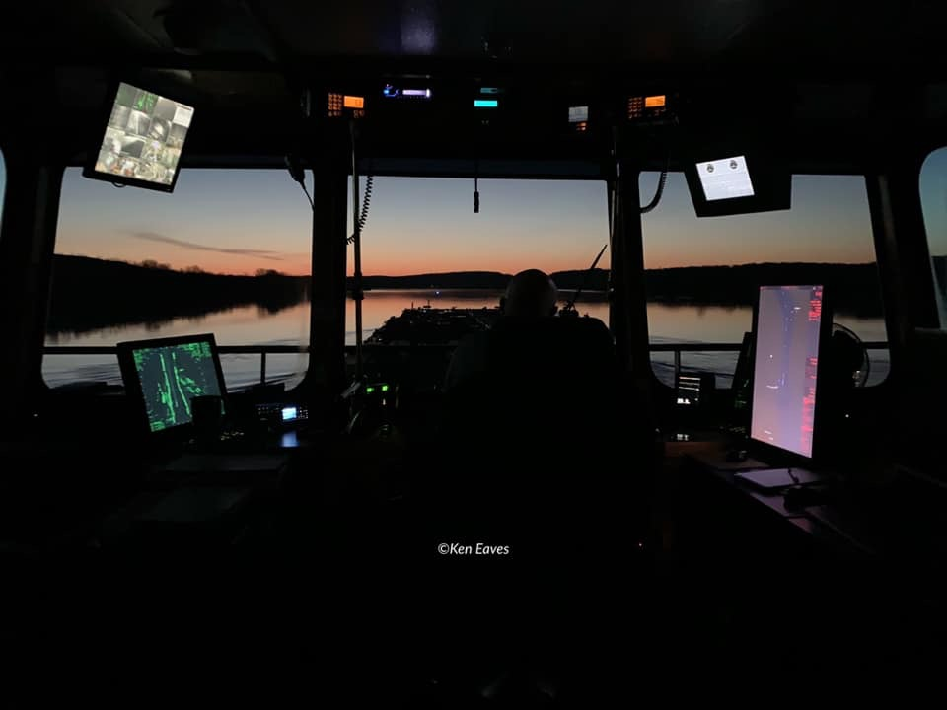
The Tools We Use
GPS/Swing Meter
AIS
Electronic Navigation Systems
Traditional Paper Charts
USCG Local Notice to Mariners
River Gauges and Forecasts
Weather Forecasts
Lock Information
Hurricane Center Information

Slide 5
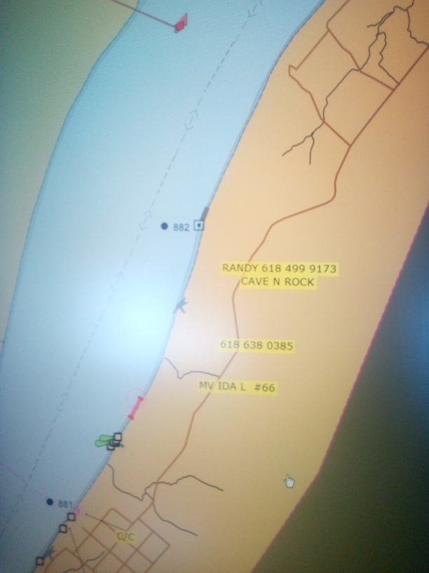
Electronic Chart Benefits
Currency
Accuracy of Position
Detail
Overlay of AIS information
2 Min Predictions
Closest Point of Approach

Slide 6
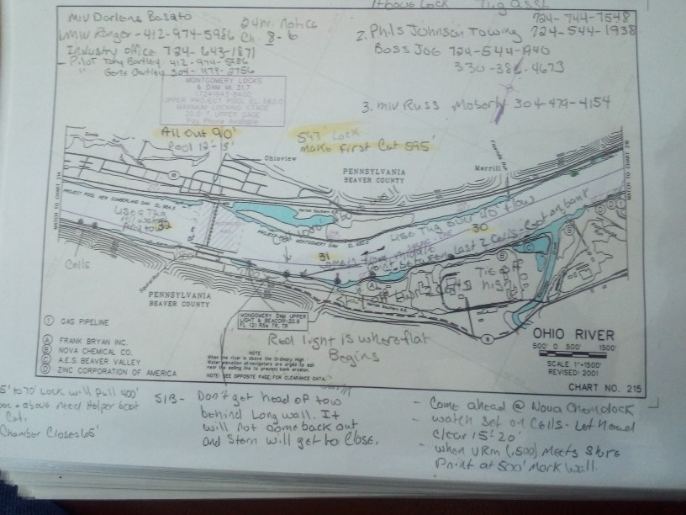
Electronic Chart Challenges
Lost ability for detailed notes
Content dictated by agency

Slide 7
The Future “Asks”
Integration of weather, river forecast info and lock info into single data source.
Real time bridge clearance data
Real time lock queue and dam output data
3D Bottom Contouring

Slide 8
Wish List
Ability of the system to show river current features including
  Outdrafts
  Cross currents
  Eddys
Display system of this data similar to Video Game Golf where the system displays arrows across the putting green showing how the ball might be expected to roll.
Having detailed information about current characteristics prior to arriving at a particular point such as a bridge or lock is invaluable.

Slide 9
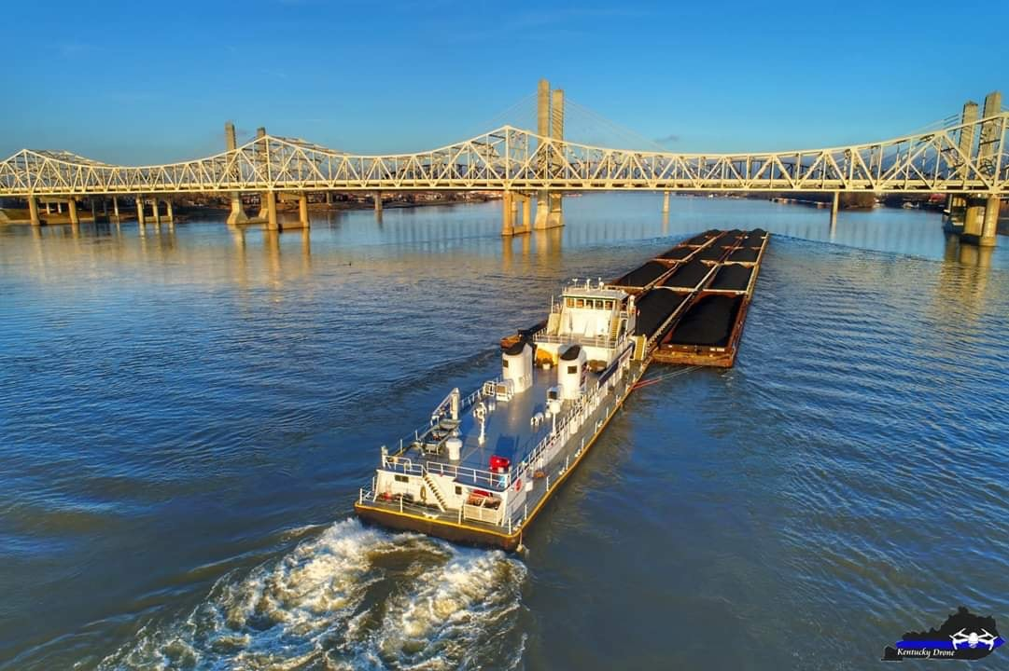
Questions?

