Slide 1
Hydrographic Services Review Panel FAC
Paul G. Aucoin
Port of South Louisiana
Hydrographic Services Review Panel
PLACEHOLDER: Stakeholder Perspectives
August 27-29, 2019, New Orleans, LA

Slide 2
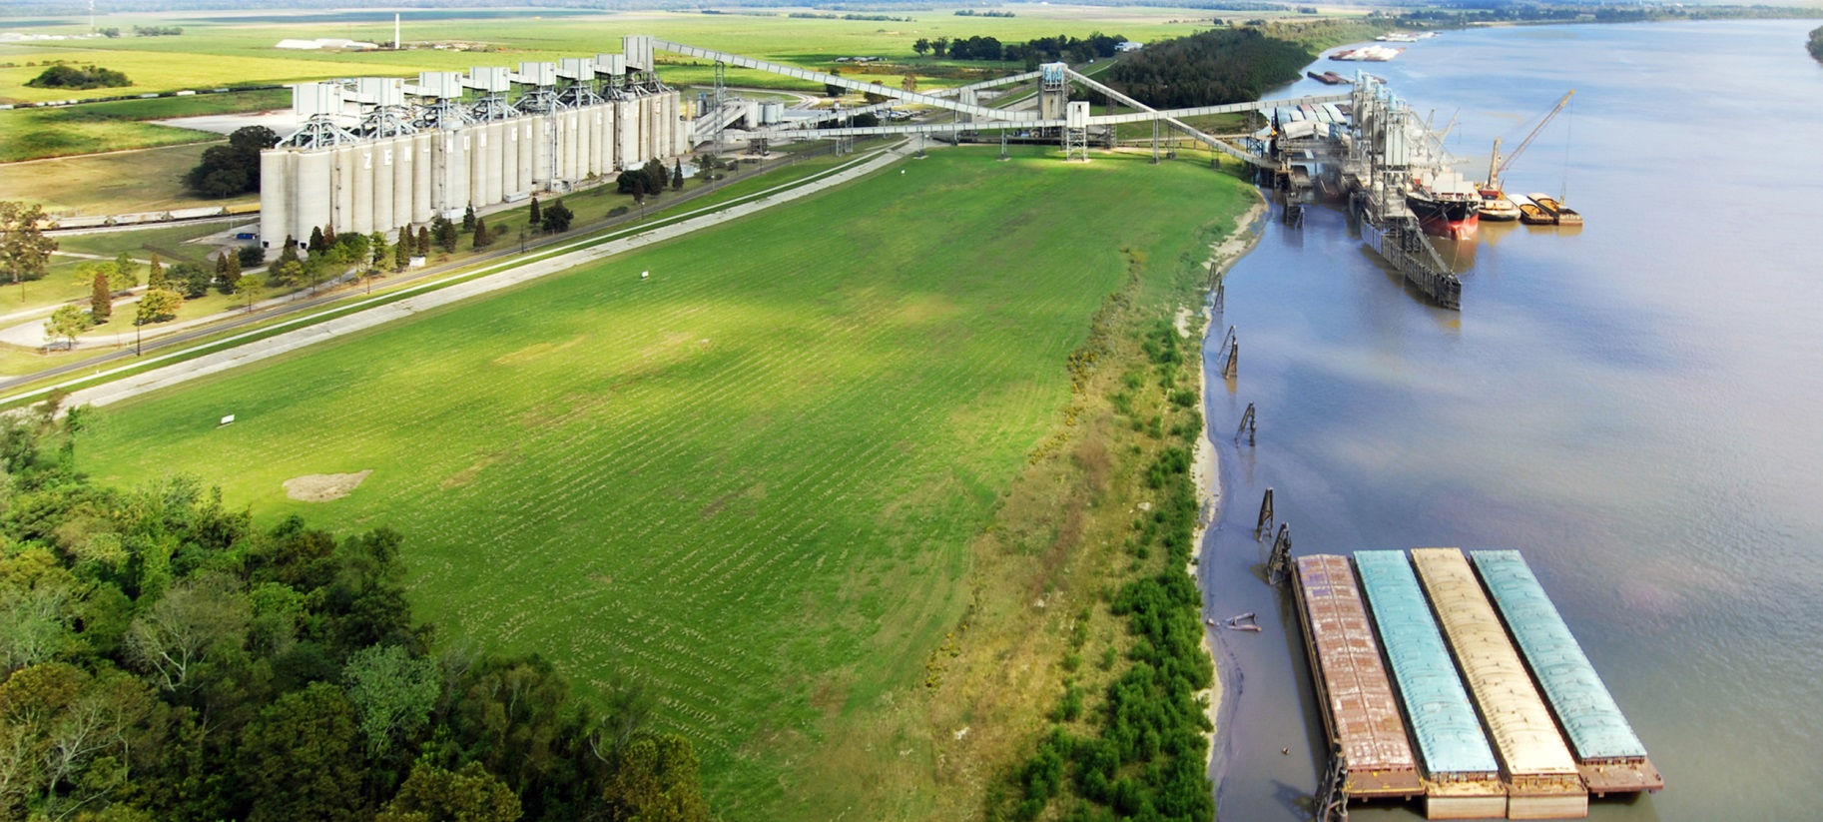
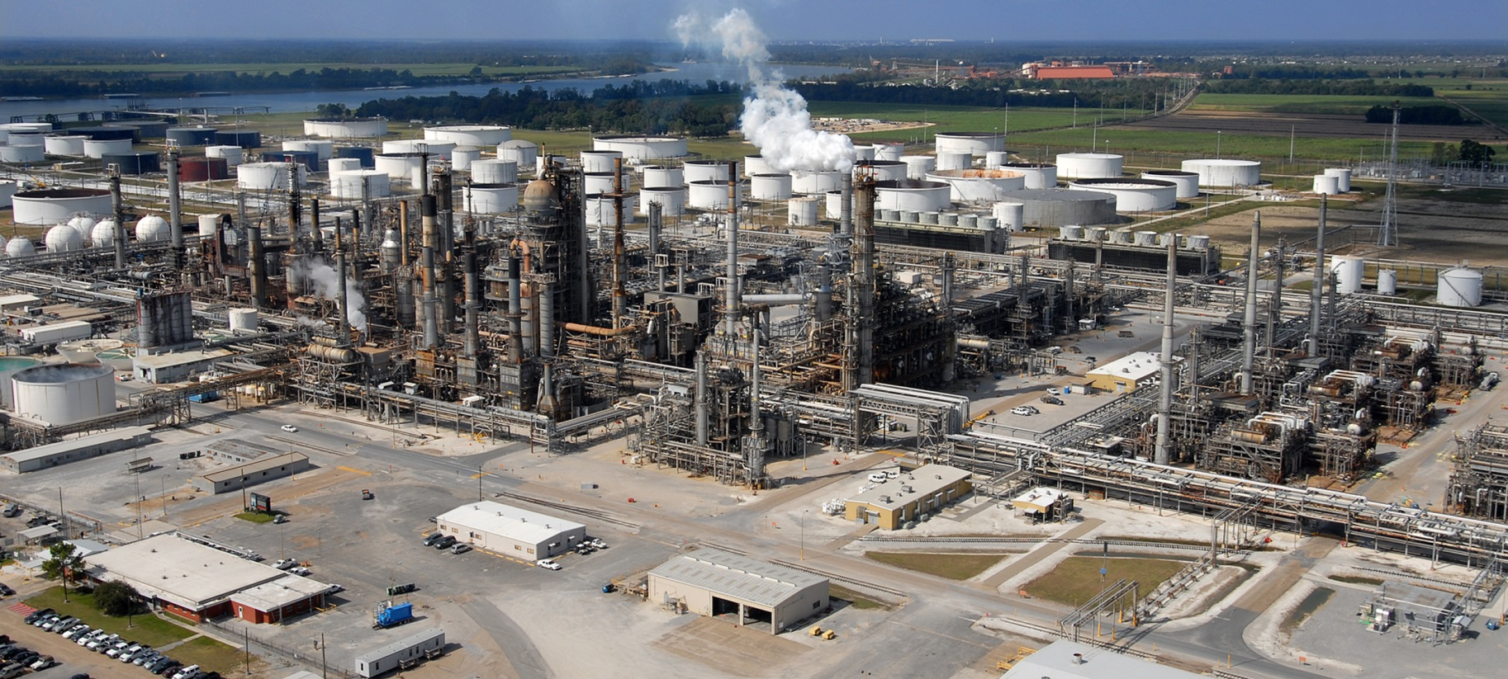
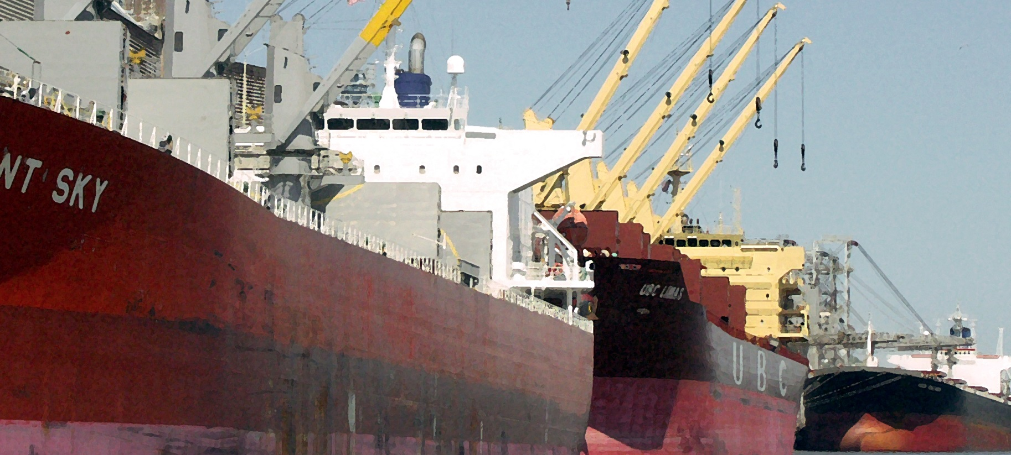
About Port of South Louisiana
Largest Tonnage Port in the Western Hemisphere
#1 Grain Exporter: over 50% of the nation’s grain (104M short tons in 2018)
#2 Energy Transfer Port: 46M short tons of crude oil, 4 oil refineries, 10 crude oil storage terminals
Top Foreign Trade Zone (#124): $49.5B of product + over 10,600 jobs
303.1M short tons of cargo via 4,402 vessels + 63,638 barges (2018)
$24.512B current economic development investment
$83B in trade annually; 30,000 jobs (6 of 10)
$1.8B in earnings; $14.4B in revenue; $72.5M in state/local taxes
Notes:
From Economic Powerhouse on the River: Economic Impact of Industries within the Port of South Louisiana Jurisdiction on the Louisiana and Port Region Economies by Loren C. Scott & Associates, Inc.:
$83B in trade annually; 30,000 jobs (6 of 10)
$1.8B in earnings; $14.4B in revenue; $72.5M in state/local taxes

Slide 3
Commerce and the Mississippi River
More than 30 states rely on the MS River for export
MS River Basin produces 92% of the nation’s ag exports and 78% of the world’s exports of feed grains and soybean
In the U.S., 1.1M jobs are supported by ag exports. Every additional $1B in exports creates 8,000 jobs
Connected to 14,500 miles of inland navigable waterways, the LMR is home to four of the nation’s top 15 ports that move more than 500M tons. Over $21B in ag exports are shipped through LA’s ports
Each foot of cargo equates to a loss of +/- $1M less draft = less feet of cargo per vessel = lost revenue

Slide 4
MS River Ship Channel Deepening Project Benefits
Provide a 50-foot draft from the Gulf of Mexico upriver to mile 256
Dredged material will be used to create an estimated 1,462 acres of new marsh habitat
USACE identified the benefit-to-cost ratio of the project at 7.2 to 1, calling the project one of national and international significance
Transportation cost savings
Increased flood protection of business, farms, and homes
Navigation reliability and safety will attract investment

Slide 5
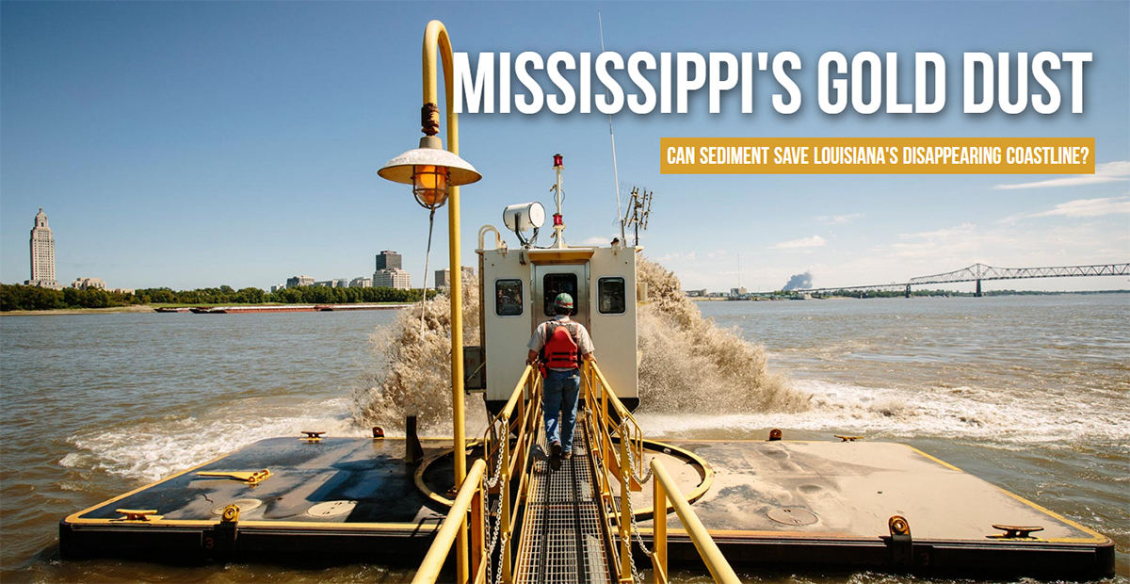
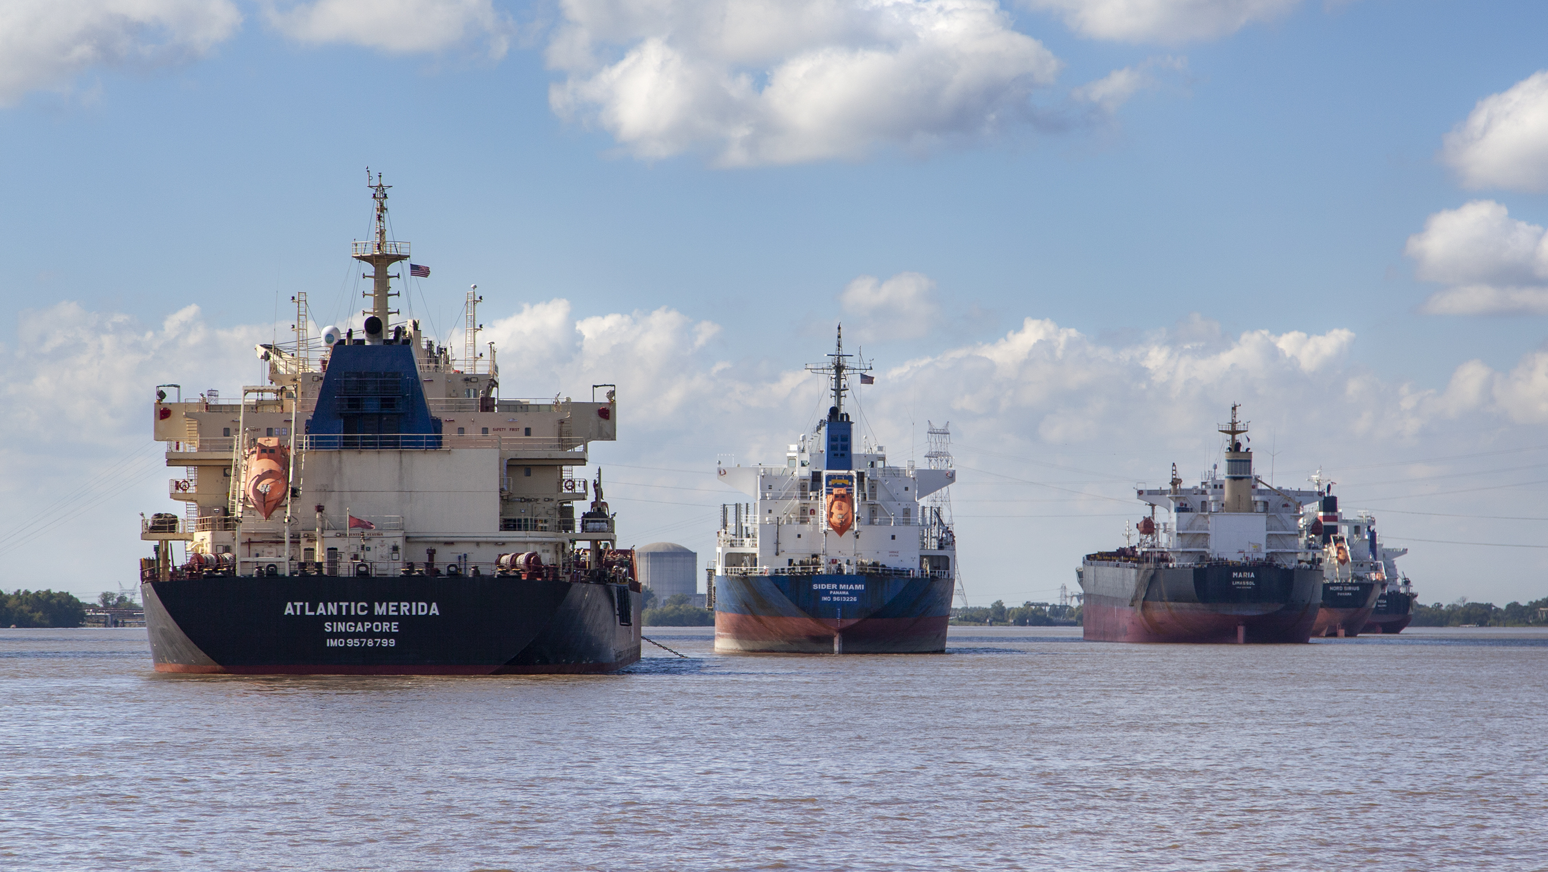
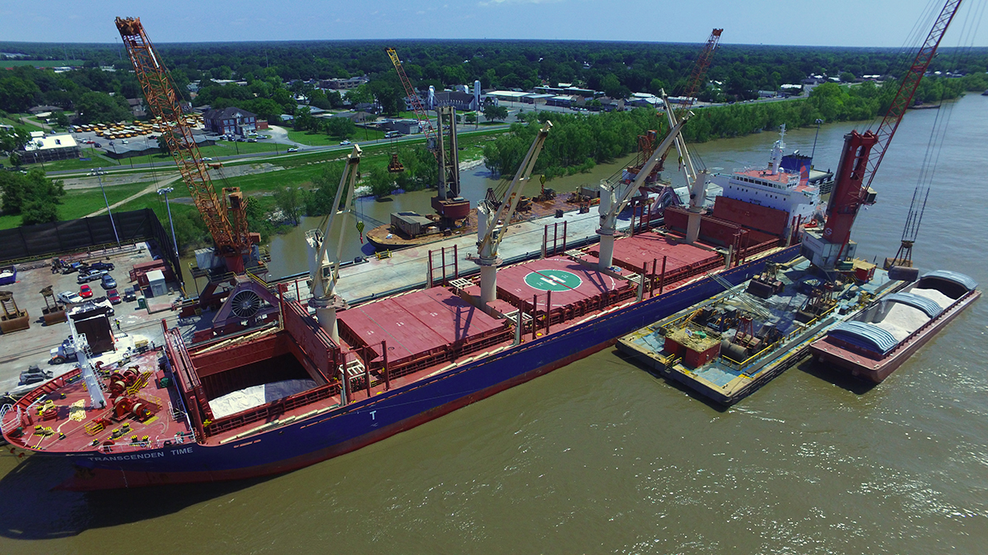
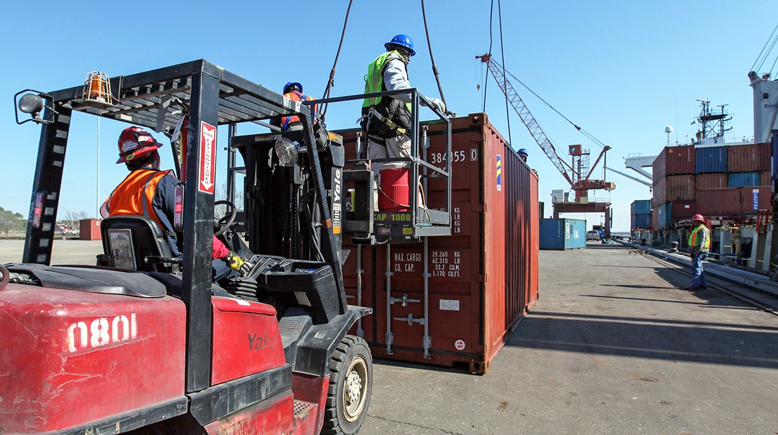
MS River Ship Channel Deepening Project Benefits
Increased Tonnage & Values Created by Deepening the LMR to 50 Feet
Year | Tonnage | % of 2011 | Value
2019 | 13,275,808 | 5.3% | $ 8.8B
2020 | 17,053,228 | 6.8% | $11.4B
2021 | 19,142,248 | 7.7% | $12.8B
2022 | 20,186,758 | 8.1% | $13.5B
2023 | 22,275,778 | 8.9% | $14.9B
2024 | 24,364,798 | 9.8% | $16.3B
Source: The Economic Impact of Deepening the Mississippi River to 50 Feet, Dr. Tim Ryan

Slide 6
Contact Information:
Paul G. Aucoin
paucoin@portsl.com | 985.652.9278

