Slide 1
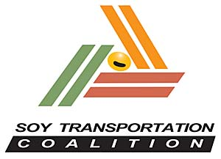
Hydrographic Services Review Panel FAC
Transportation: Connecting U.S. Farmers with the World
Mike Steenhoek, Executive Director
August 27, 2019

Slide 2
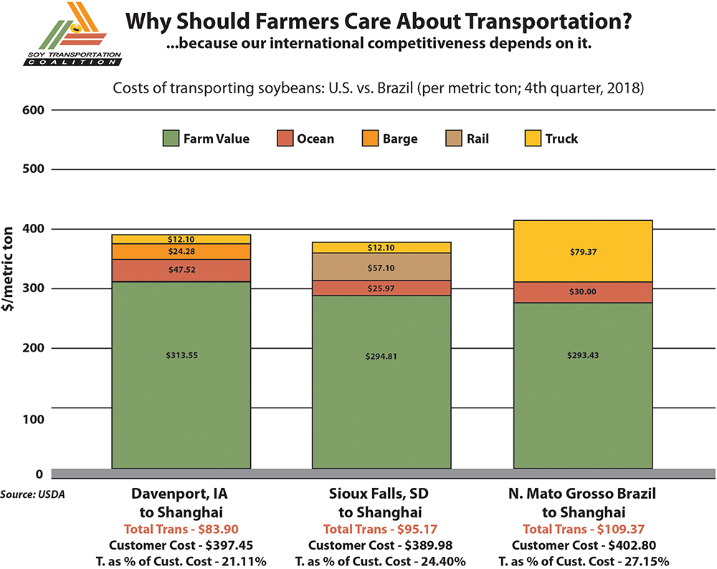

Slide 3
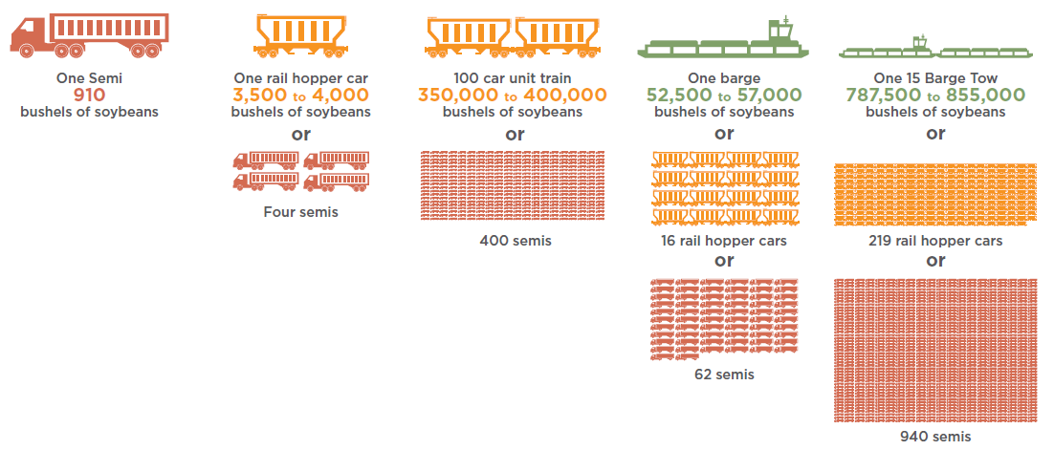
Cargo Capacity: Truck vs. Rail vs. Barge

Slide 4




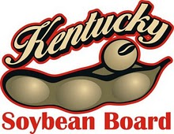







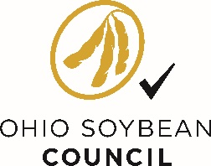

The Soy Transportation Coalition – Farmer funded & farmer led
Established in 2007. Comprised of 13 state soybean organizations, the United Soybean Board, & American Soybean Association.
MICHIGAN SOYBEAN
PROMOTION COMMITTEE

Slide 5
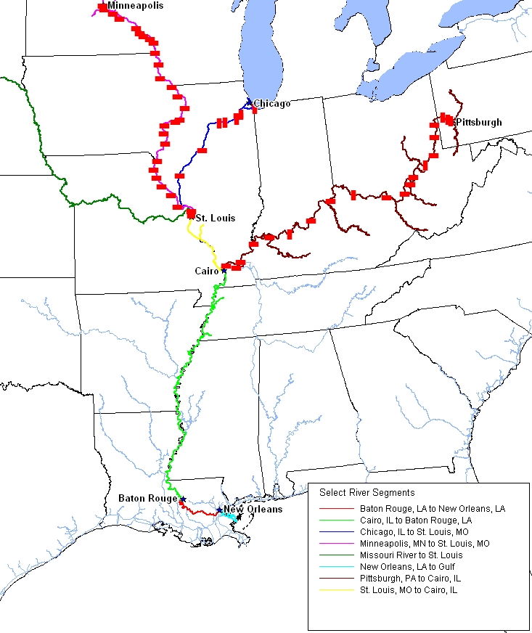
America’s Rivers: An Efficient Maritime Highway
Mississippi Gulf (Baton Rouge to Gulf of Mexico): 60% of U.S. soybean exports; 59% of U.S. corn exports; #1 export region for both commodities

Slide 6
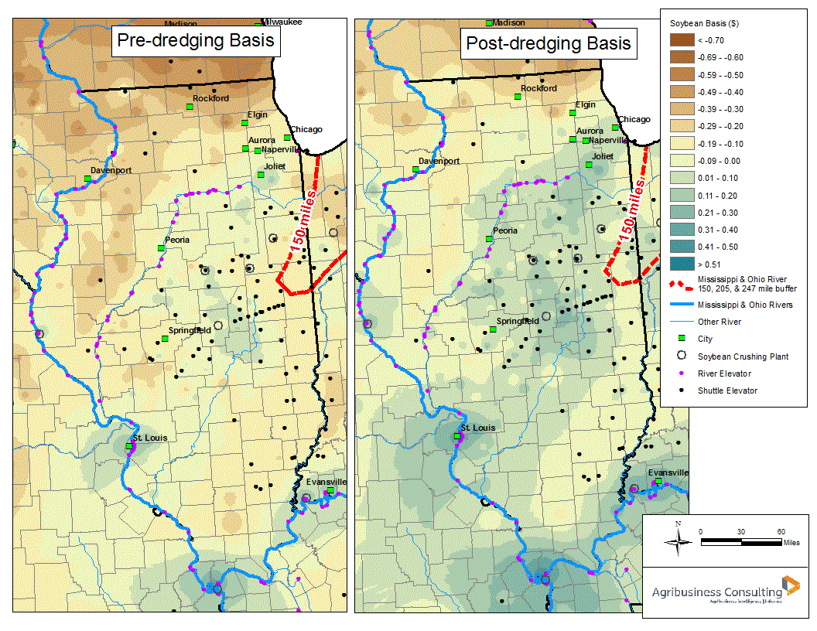
Dredging Lower Mississippi River: Impact on Midwest Agriculture
Illinois soybean farmers would receive $77 million more for the value of their soybeans post dredging the lower MS River. U.S. soybean farmers - $461 million more

Slide 7
Thank You
Soy Transportation Coalition
1255 SW Prairie Trail Parkway
Ankeny, Iowa 50023
515-727-0665
515-251-8657 (fax)
www.soytransportation.org
Mike Steenhoek, Executive Director
msteenhoek@soytransportation.org

