Slide 1


Mark Wingate, P.E.
Hydrographic Services Review Panel FAC
US Army Corps of Engineers
Hydrographic Services Review Panel USACE, New Orleans District: Supporting the River Transportation System and Flood Protection of the Lower Mississippi River
August 27, 2019, New Orleans, LA

Slide 2
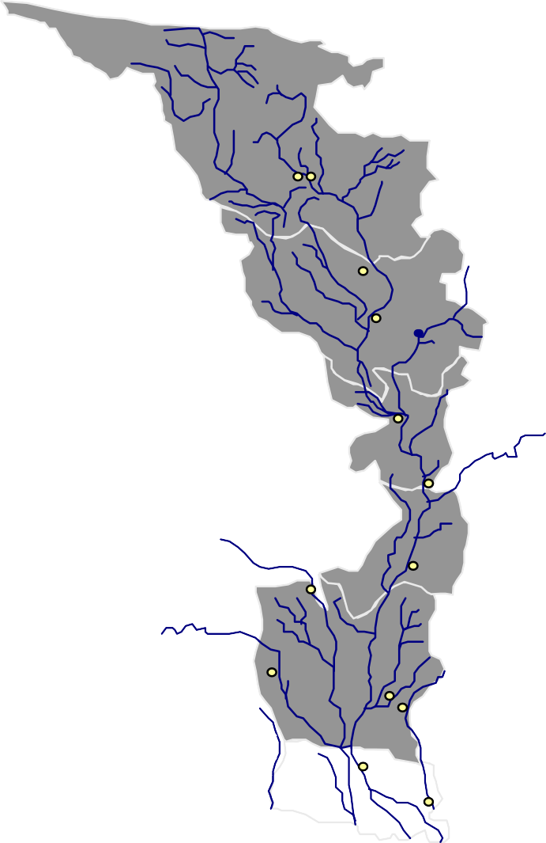































About the New Orleans District
MN
2,800 miles of navigable waterway
973 miles of MR&T levees
325 miles of hurricane risk reduction levees
5 of the nation’s 15 busiest ports
18 locks and control structures
15 pumping plants
4 recreation areas
8,000 annual regulatory actions
ND
MI
WI
ST. PAUL
MINNEAPOLIS
DUBUQUE
IA
IL
ROCK ISLAND
IN
KS
ST. LOUIS
MO
KY
CAIRO
OK
AR
TN
MEMPHIS
LITTLE ROCK
AL
VICKSBURG JACKSON
MS
SHREVEPORT
LA
TX
BATON ROUGE
NEW ORLEANS

Slide 3


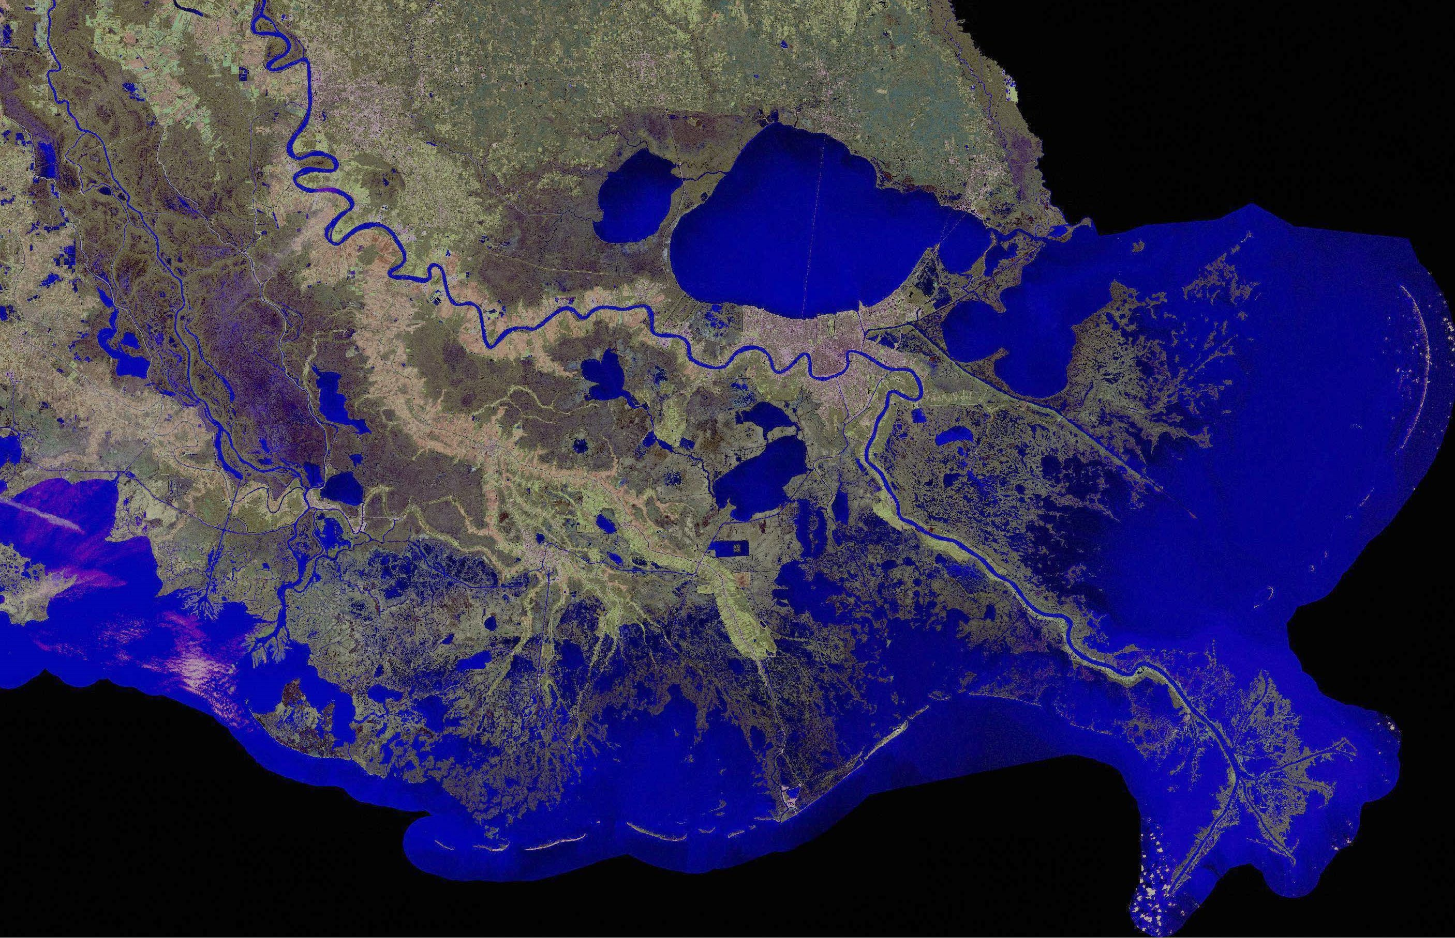










































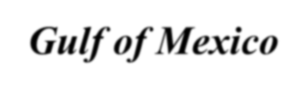
Usage of NOAA Navigation Services, products & services
Maintaining Navigation on the Mississippi River…
Mile 233.8 AHP
Mile 232.4 AHP
Mile 255.2 AHP
Baton Rouge
CHANNEL CONDITIONS:
AS OF 16 AUG 19, THE PILOTS INCREASED THE MAX DRAFT TO 45’
_{R}B_{o}a_{u}to_{g}n_{e} Front
Port of Baton Rouge #8
Medor a
Redeye
Sardine Point
Granada
Mile 168.3 AHP
Port of South Louisiana #1
Mississippi River Southwest Pass Dredge Status:
ONGOING:
Bayou Goula
Alhambra Philadelphia
Mile 115 AHP
Port of New Orleans #4
Smoke Bend
New Orleans
NEWPORT: 9 Jun 19 – 9 Nov 19
STUYVESANT: 14 Jun 19 – 04 Oct 19
CR MCCASKILL: 24 Jul – 20 Sep 19
CAPTAIN FRANK: 28 Jul – 20 Sep 19
RS WEEKS: Hopper Dredge Disposal Area (HDDA) Dredging
Deep Draft Crossings
Rich Bend
Belmont
Mile 81 AHP
Fairview
Port of Plaquemines #12
Mile 104.5 AHP
Deep Draft Crossings Dredge Status:
HURLEY – Redeye crossing (Mile 224)
WALLACE MCGEORGE – Alhambra crossing (Mile 191)
JADWIN – Smoke Bend (Mile 175)
WHEELER (Call Out #6-2019): Medora
New Orleans Harbor
Head of Passes (Mile 0)
HOPPER CUTTERHEAD DUSTPAN
Southwest Pass
crossing (Mile 212)
Gulf of Mexico
Mile 22 BHP

Slide 4
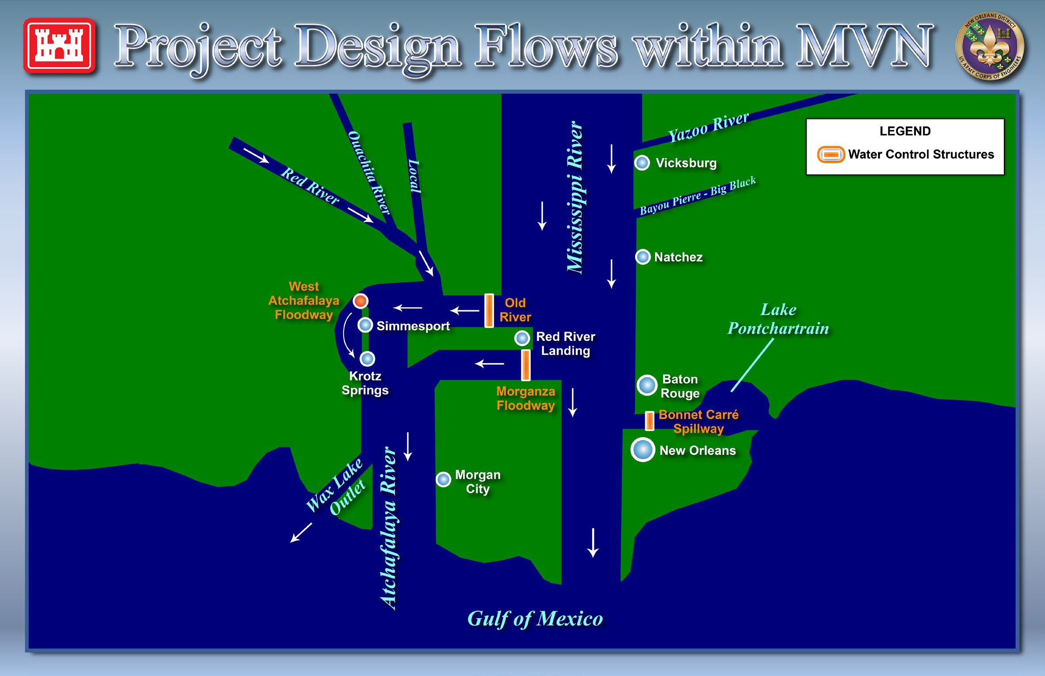
Usage of NOAA Navigation Services, products & services
While Providing Flood Risk Management to Southeast Louisiana

Slide 5
Requests for NOAA Navigation Services data, products, and services
Enhancing USACE/NOAA’s relationship and current cooperative endeavors:
eHydro Database: Corps-provided hydrographic data
Southwest Pass Inland Electronic Navigation Charting (IENC) Overlay Program
Coordinating Comprehensive Mississippi River Hydrographic Surveys

Slide 6
Contact Information:
Mark Wingate, P.E.
Deputy District Engineer (DDE/DPM) US Army Corps of Engineers
New Orleans District
Mark.R.Wingate@usace.army.mil (504)863-2204

