Slide 1
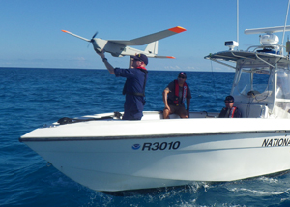
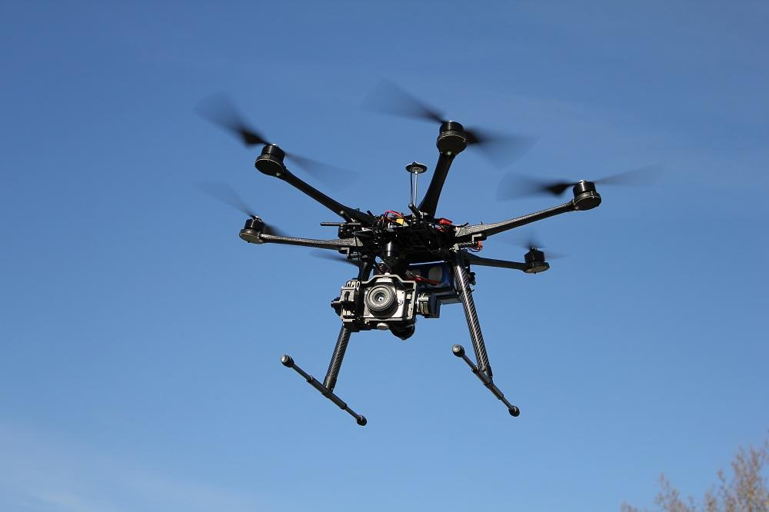
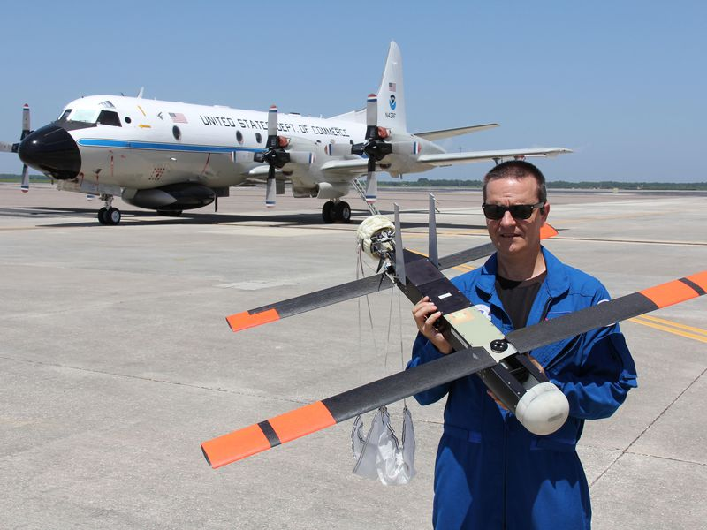
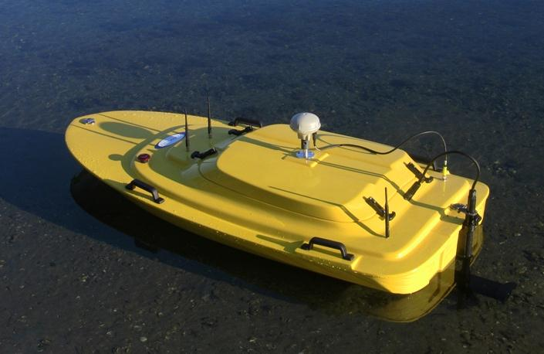
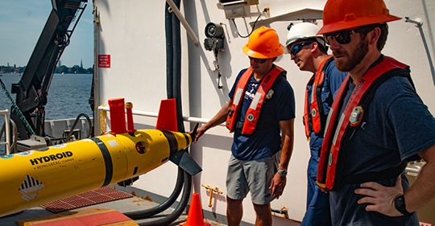
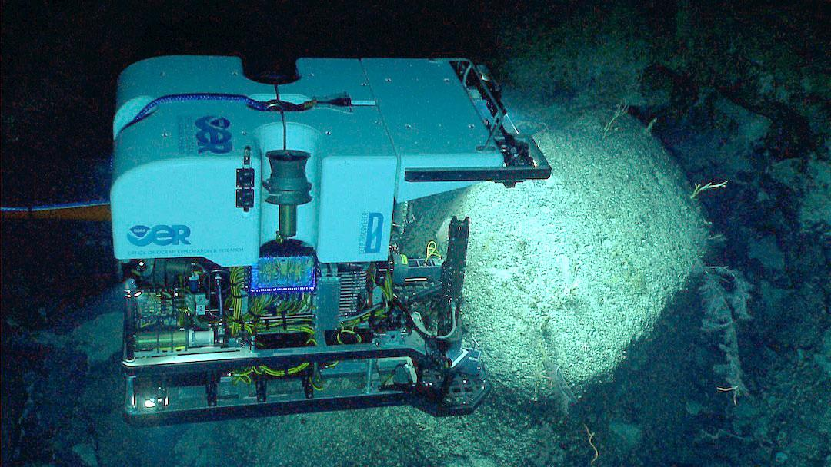


NOAA Unmanned Systems (UxS) Update
Tim Gallaudet, Ph.D., Rear Admiral, U.S Navy (Ret.)
Assistant Secretary of Commerce for Oceans and Atmosphere / Deputy NOAA Administrator
August 28, 2019

Slide 2
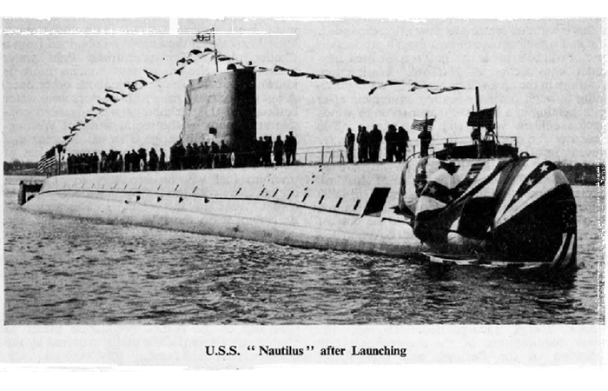

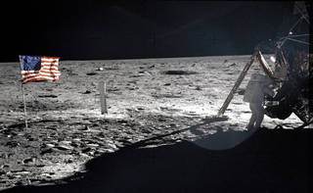
Why UxS?

Slide 3
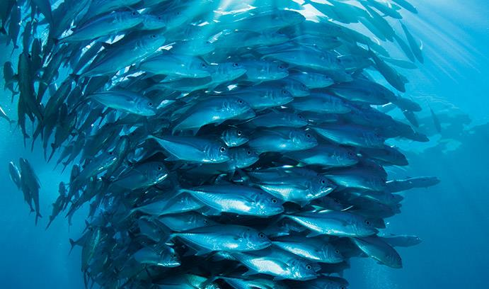
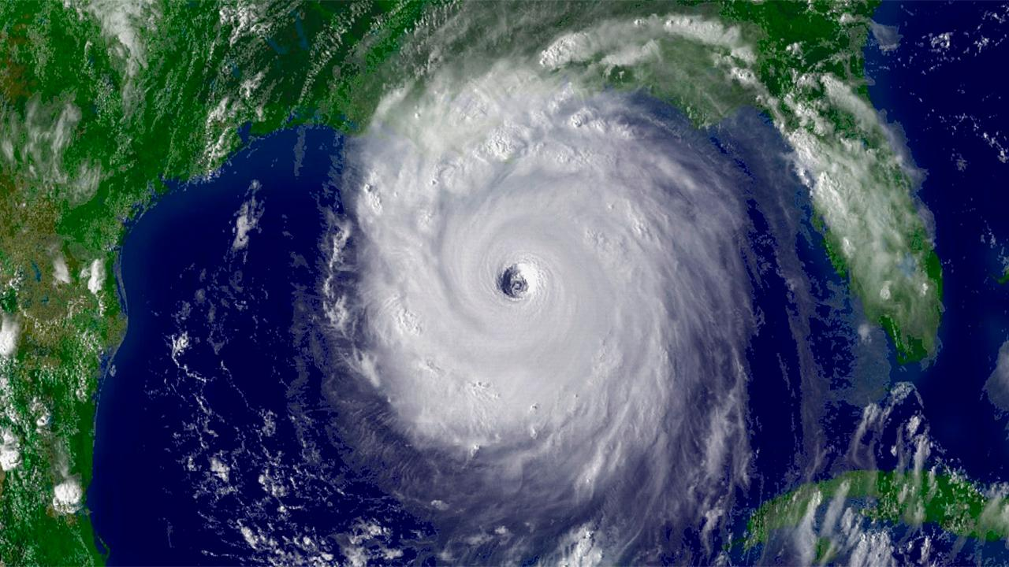
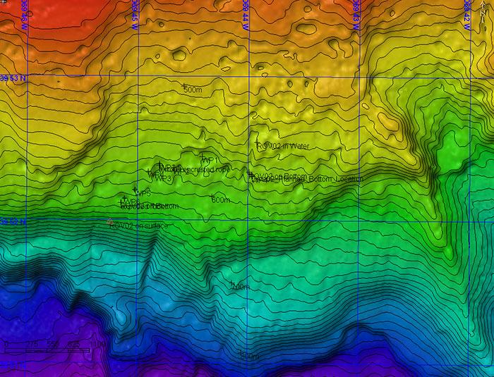
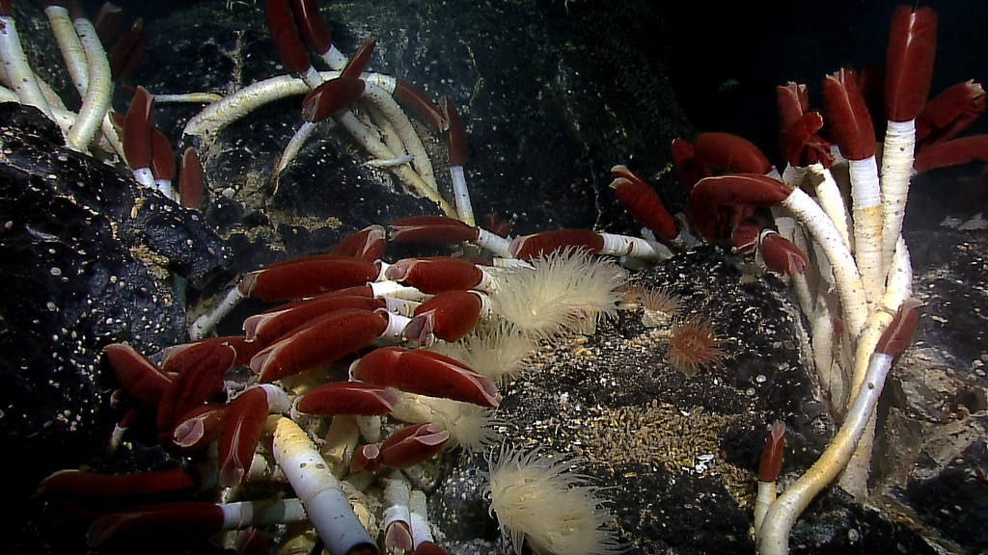
UxS Serving NOAA Missions
Fisheries
Weather and Climate
Mapping
Ecosystem Assessment

Slide 4
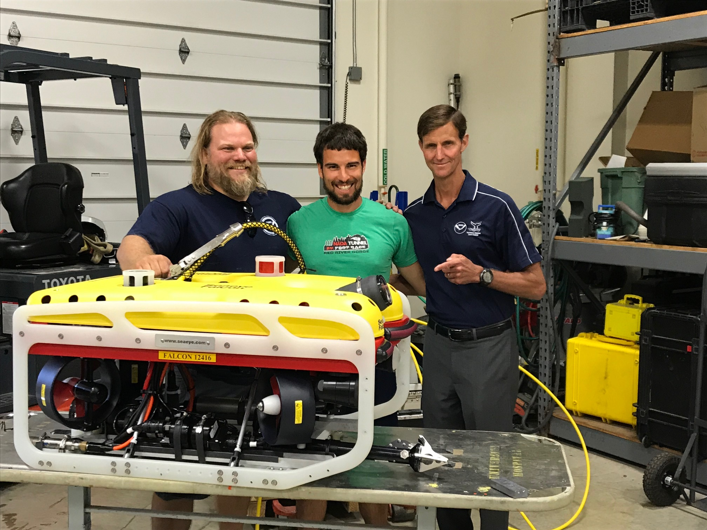
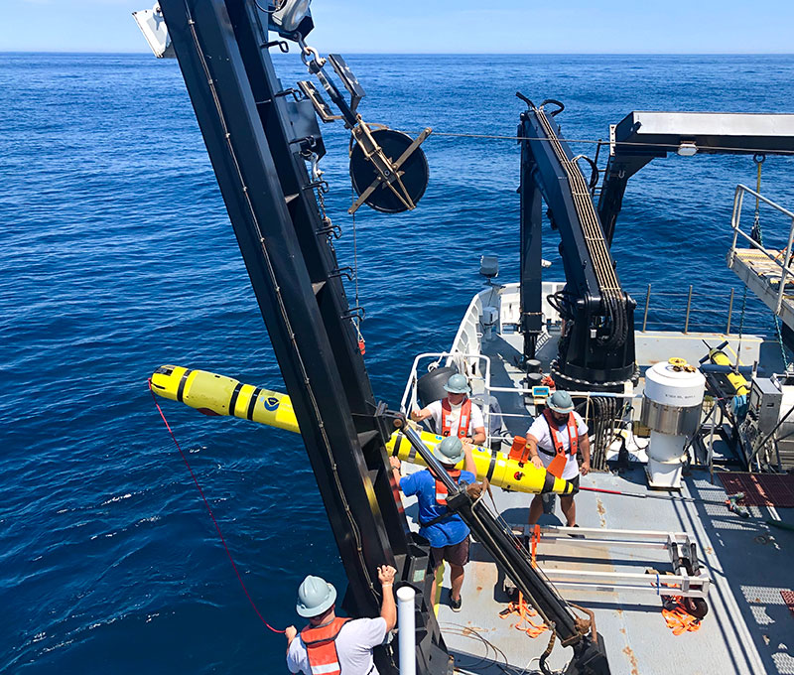
NOAA UxS Program Drivers
FY20 NOAA Budget Increase
CENOTE Legislation
NOAA Blue Economy
Decades of experience

Slide 5
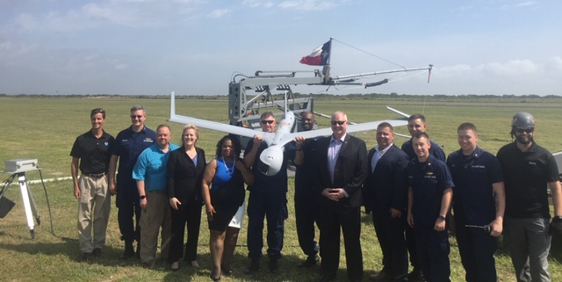
NOAA UxS Strategy
Consolidate core functions to ensure efficient organizational structure
Advance research and innovation
Accelerate UxS Research-to-Operations
Strengthen and expand UxS partnerships inside and outside of NOAA
Promote a NOAA workforce that is proficient in all aspects of UxS

Slide 6
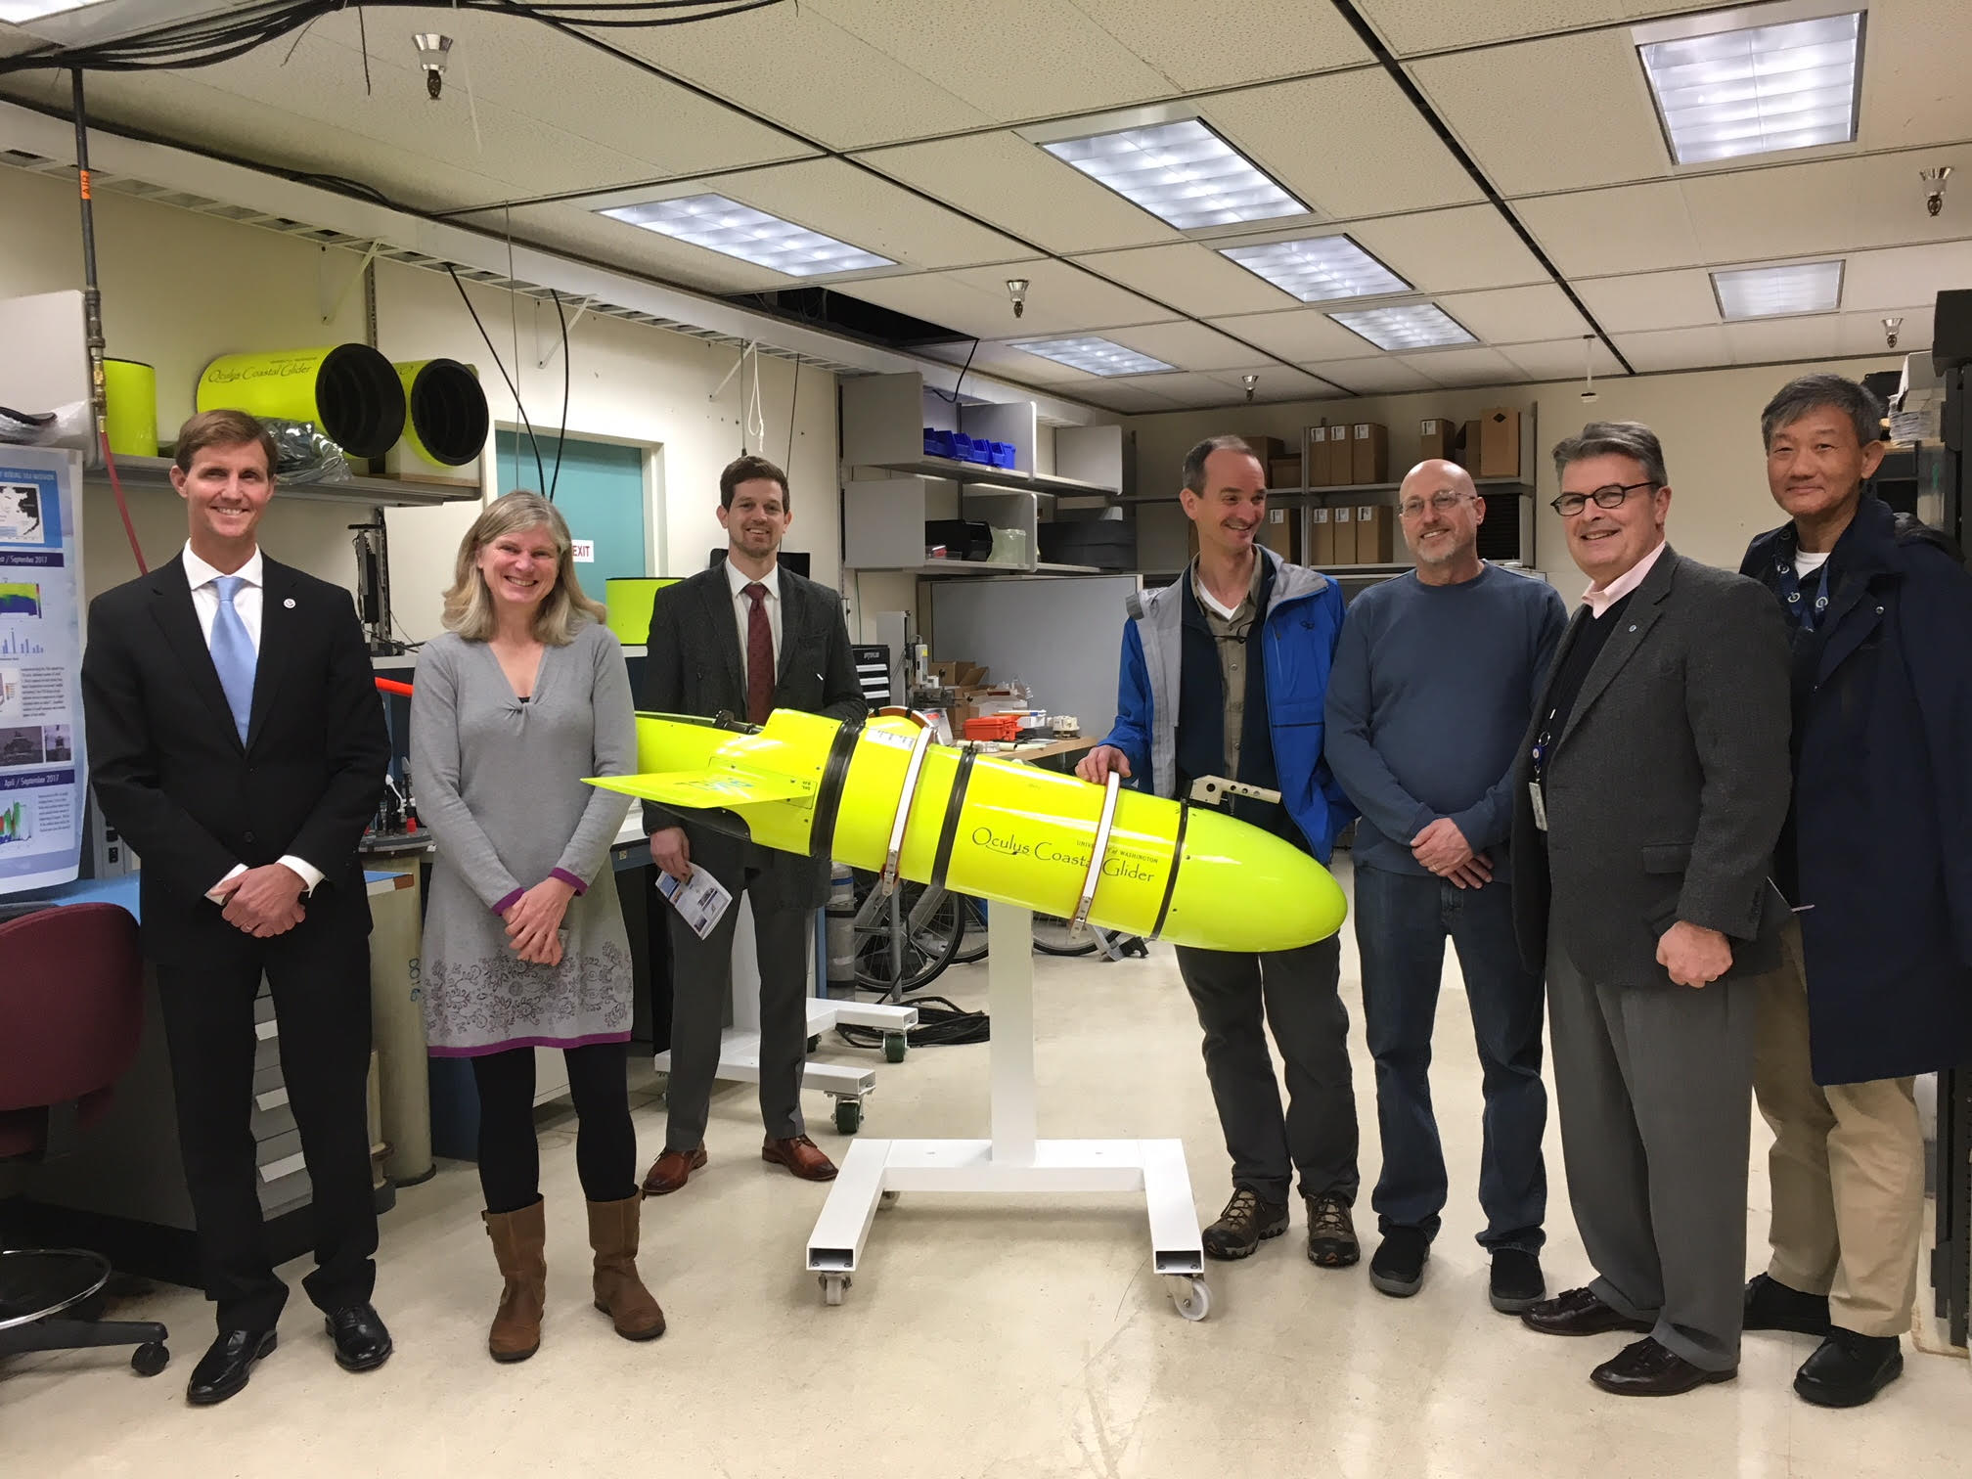
NOAA UxS Way Ahead
“Transform the agency by exponentially increasing its capability and efficiency through use of UxS in virtually every NOAA mission area”

