Slide 1
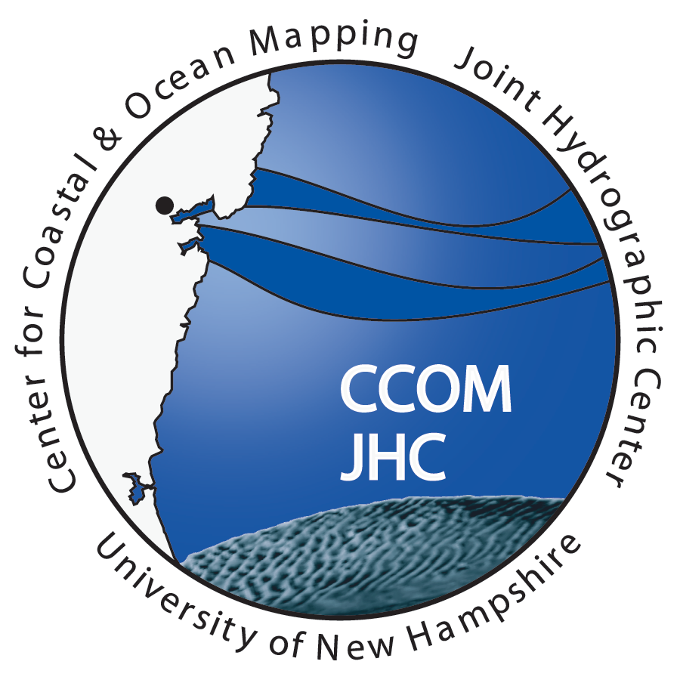
Andy Armstrong
NOAA – UNH Joint Hydrographic Center
The Autonomous Surface Vessel Research and Development Program at the NOAA – UNH Joint Hydrographic Center/Center for Coastal and Ocean Mapping

Slide 2
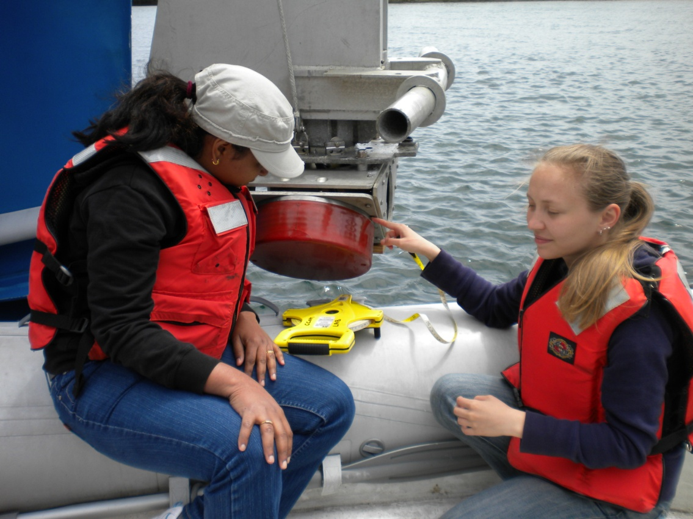
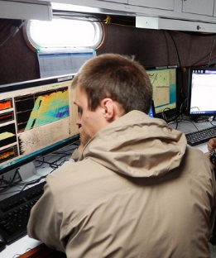
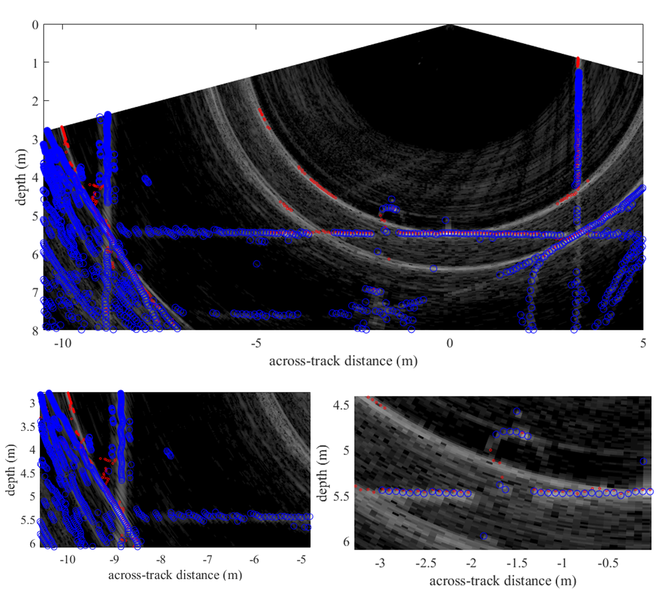
The NOAA-University of New Hampshire Joint Hydrographic Center
A National Center for Research and Education in Hydrography and Ocean Mapping founded in 2000
Notes:
Center Goals:
To be a world leader in the development of hydrographic and ocean mapping technologies and approaches.
To expand the scope of ocean mapping clients and constituencies through the development of innovative applications and collaborative work with both the private sector and government.
To educate a new generation of hydrographers and ocean mappers who can meet the growing needs of both government agencies and the private sector.
The Center is funded by a competitively awarded cooperative agreement with NOAA’s Office of Coast Survey
49 Industrial Associates from all sectors of the hydrographic and ocean mapping industry are partners with the University of New of New Hampshire’s complementary Center for Coastal and Ocean Mapping
There are 171 graduates of the UNH Ocean Mapping educational program working around the world.

Slide 3
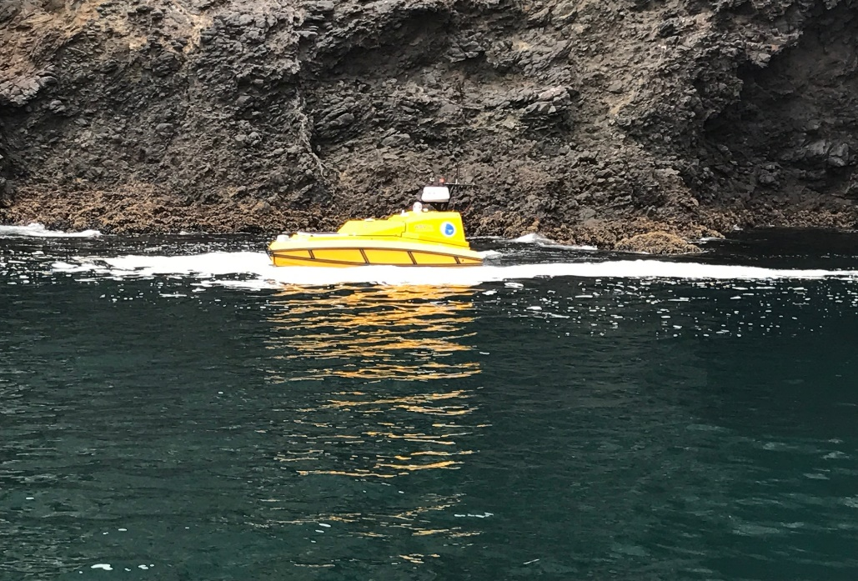
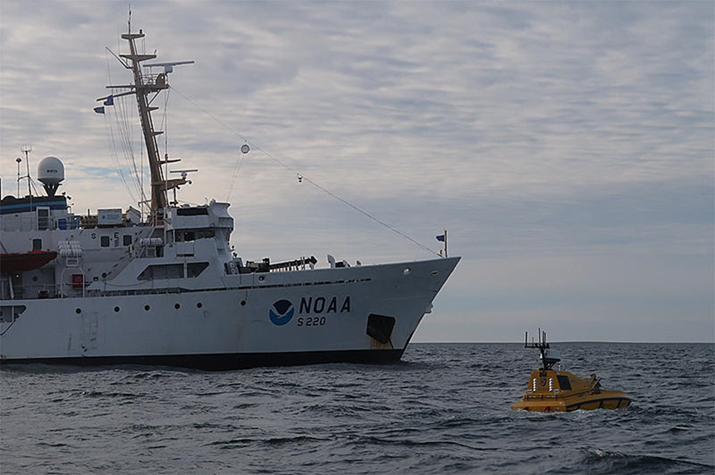
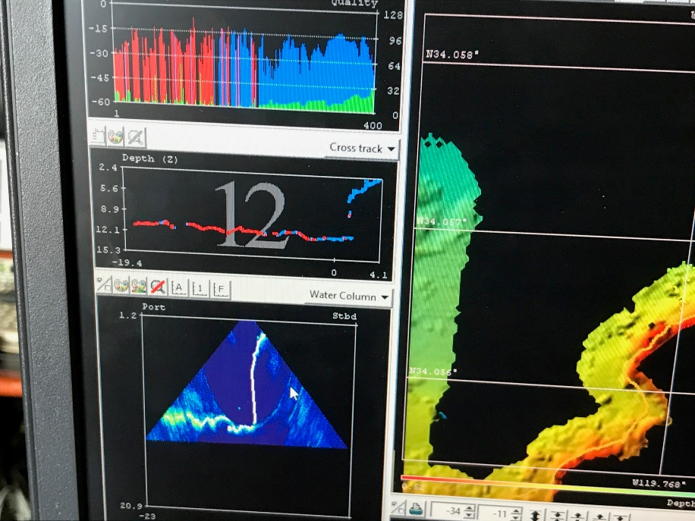
The NOAA-University of New Hampshire Joint Hydrographic Center
Ship-based “Launch Hydrography” scenarios
Increase productivity by adding platforms
Operate in areas of risk to humans and larger craft
Notes:
The ASV research program at JHC includes investigation and development of supporting technology for multiple ASV operating scenarios. In Juneau, Larry reported on some of our ASV work, including a project with NOAA Ship Fairweather off Point Hope in the Arctic, and a NOAA Integrated Ocean and Coastal Mapping project with the Ocean Exploration Trust in California’s Channel Islands. These two projects centered around ship-borne launch hydrography, where the ASV replaces or supplements a traditional manned survey launch.

Slide 4
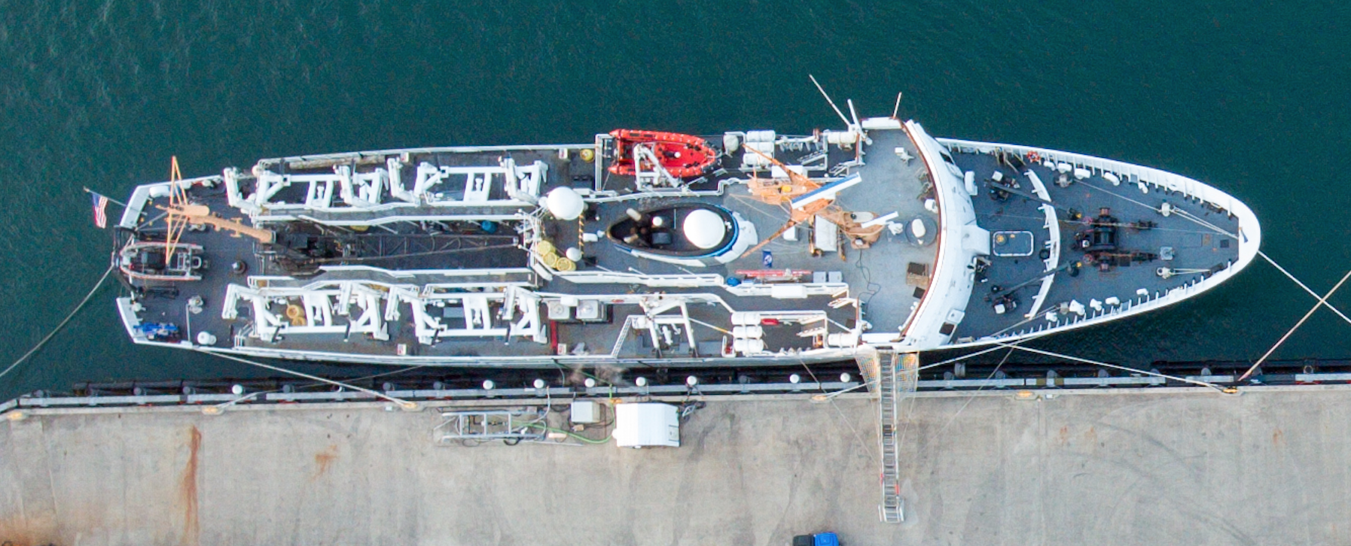
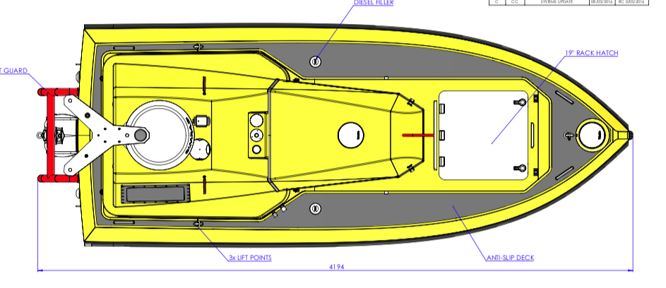
The NOAA-University of New Hampshire Joint Hydrographic Center
Fairweather Reimagined
MUST IMPROVE AUTONOMY OF NON-NAVIGATION SYSTEMS!
Knuckle Crane with Surge Compensation
Six “C-Worker 4” ASVs
Day and Night Operator Teams
One Pilot and One Survey Tech Per 3 ASVs
Up to 3X coverage increase
Photo courtesy LT Damian Manda
Notes:
Val Schmidt, who is leading the JHC ASV project developed this concept following the Arctic project with Fairweather. The key to increased productivity in this scenario is simultaneous operation of multiple ASVs with a single operating team of 2 technicians and round the clock operations in the Arctic summer. Also, Our experience has shown that a knuckle crane, with its shorter free-swinging cable length, and particularly one with surge compensation like those used launching Remotely Operated Vehicles, is a great advantage when launching and recovering ASVs in even modest seas.

Slide 5
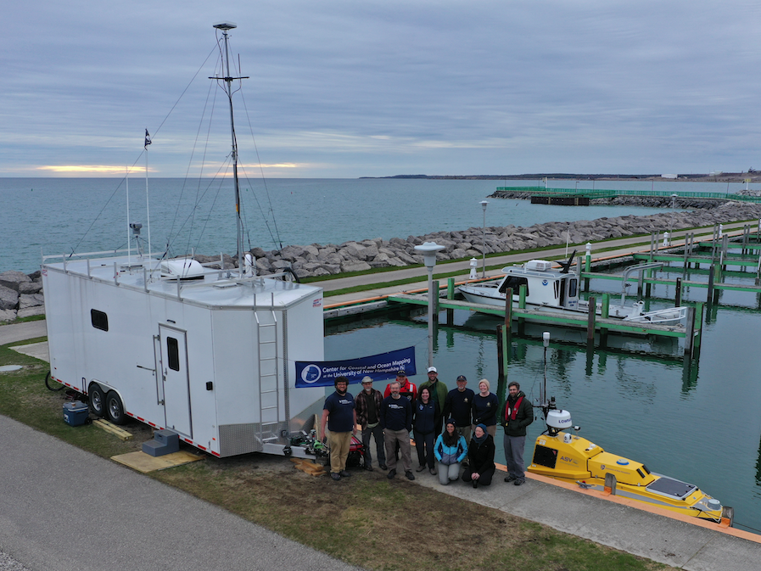
The NOAA-University of New Hampshire Joint Hydrographic Center
Shore-Based Operations Thunder Bay NMS/IOCM May 2019
“Navigation Response Team” Scenario
UPGRADES
Long Range Telemetry (Kongsberg MBR (179/144)) (>15 km)
Marine VHF Radio
AIS Receiver
360 Degree Camera System
Axis PTZ 30X optical zoom
Developed “look here” and “follow ASV” modes
New Power monitoring and control.
New ROS path following algorithm.
Testing of real-time Neural Network for Object Detection and Classification in Marine Environment (Yolo)
Notes:
During a NOAA Integrated Ocean and Coastal Mapping project at the Thunder Bay National Marine Sanctuary in Lake Michigan, our ASV team demonstrated operation of an unaccompanied ASV from a shore base. One of the main goals in this effort was to implement technology supporting unmanned hydrography at a distance and in an area of vessel traffic. Understanding the autonomy features required for truly effective unmanned hydrography has been a central part of the JHC research program. This slide lists some of the technology added to the ASV for this project.

Slide 6
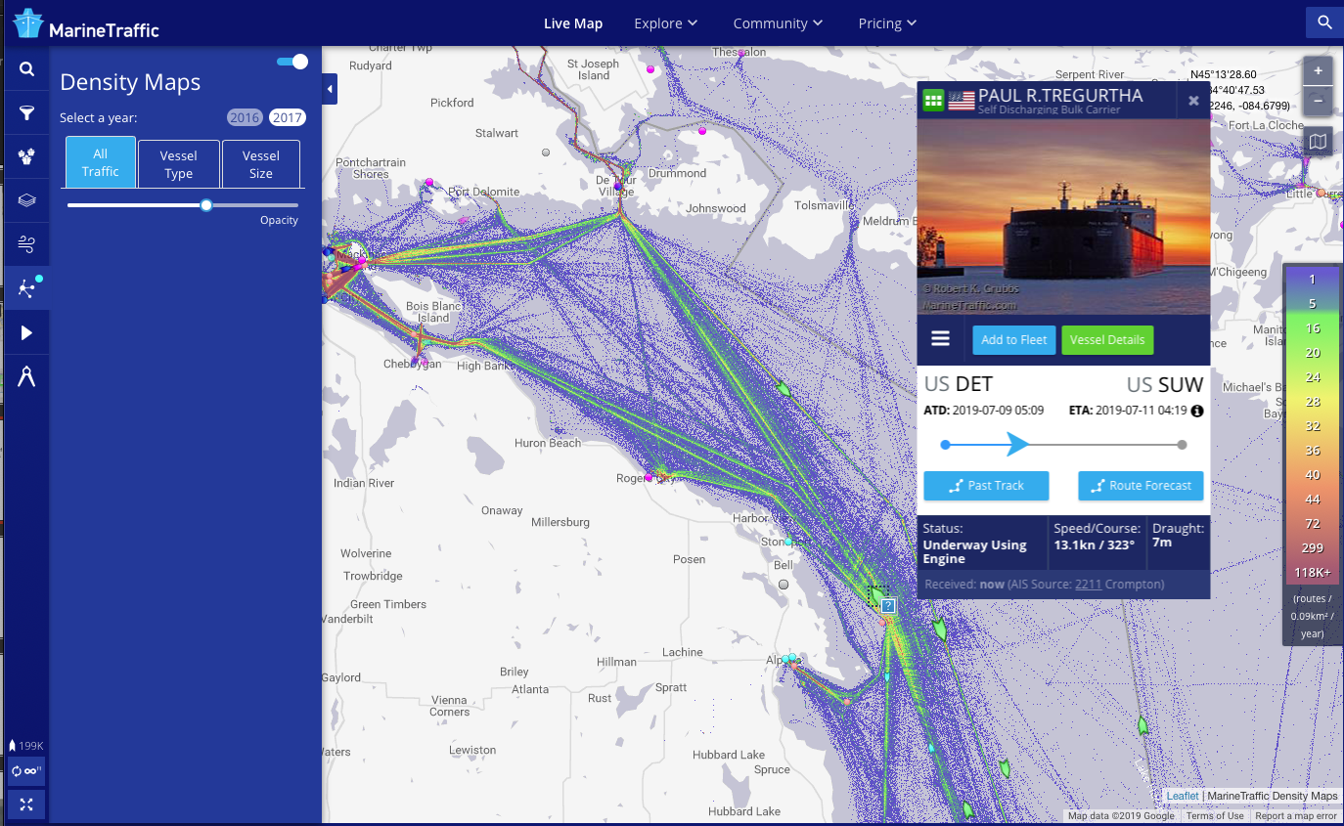
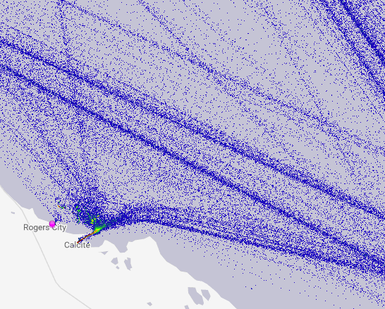
The NOAA-University of New Hampshire Joint Hydrographic Center
MarineVesselTraffic.com
ASV Operating Area
Notes:
First click—this is the Marine VesselTraffic.com website. It is up continuously – shows the historic traffic density and information on vessels underway at the time.
Second click. This shows the ASV survey area astride lake carrier traffic lanes, 6 to 8 nautical miles offshore.

Slide 7
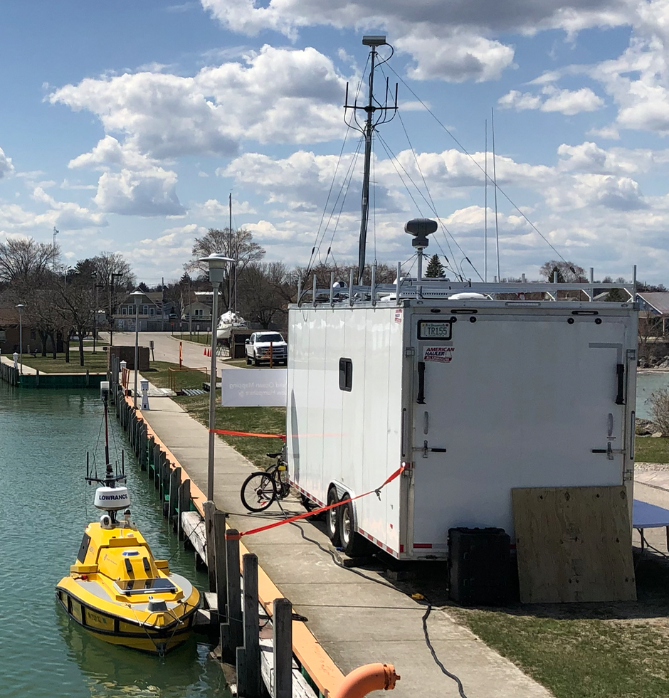
The NOAA-University of New Hampshire Joint Hydrographic Center
Kongsberg Marine Broadband Radio for system and survey control
Allowed for operations > 15 km. (24 km)
Bandwidth 5.6Mbps/.4Mbps
Maximum range varies with weather conditions
Notes:
This slide shows the new broadband radio system integrated into the ASV for the project. The base station and remote unit antennas are circled. With this system we could monitor the onboard sensors and control the ASV reliably at ranges around 8 nautical miles in normal conditions.

Slide 8
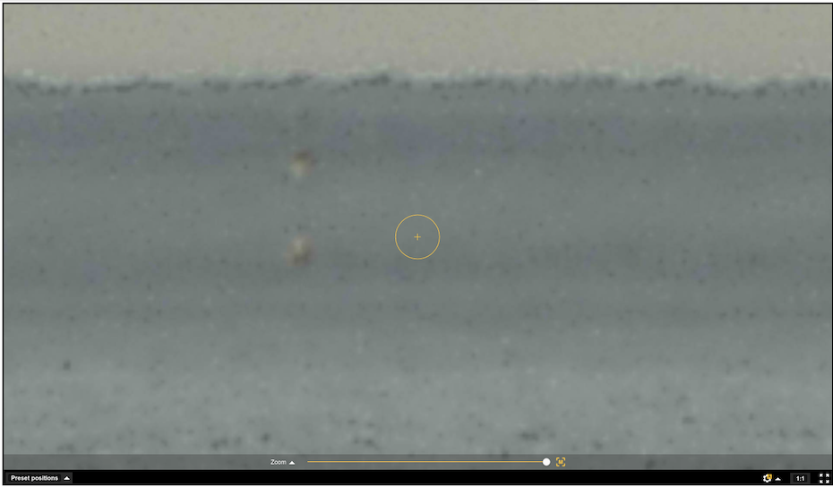
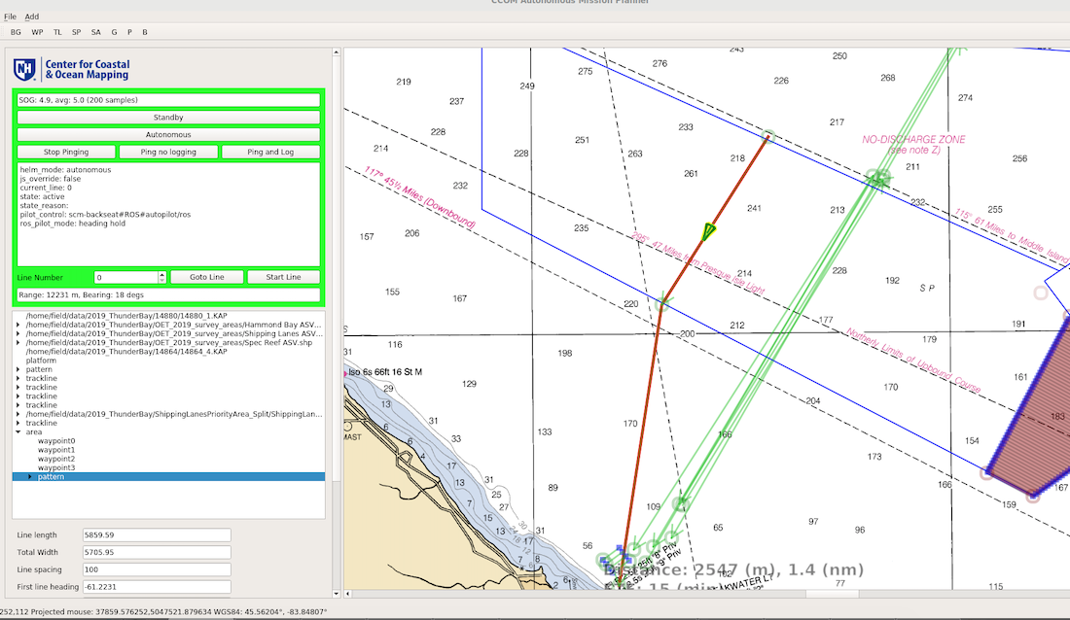
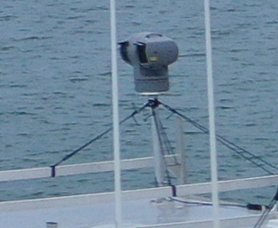
The NOAA-University of New Hampshire Joint Hydrographic Center
Axis PTZ Long-Range tracking and monitoring camera on shore
30x optical zoom, 16x digital zoom
12.2 km
Rogers City Marina
Notes:
The ASV has its own radar and camera system, but for this project we found it valuable to track the vessel optically from shore using the long range pan-tilt-zoom camera. Note that on some days we suffered from optical refraction artifacts, but were nonetheless able to track the ASV with an automatic tracking routine developed by our team.

Slide 9
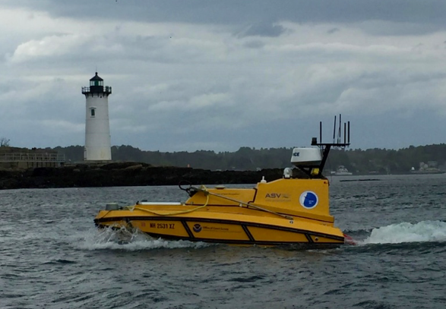
The NOAA-University of New Hampshire Joint Hydrographic Center
https://www.nationalgeographic.com/culture/2019/08/inside-search-for-amelia-earhart-airplane/
Notes:
Right now, the JHC ASV is deployed with Dr. Robert Ballard on his National Geographic expedition in Kiribati (pronounced Kiribas) searching for Amelia Earhart’s airplane. In this project we are continuing our development of ship-based operations in areas too dangerous for manned vessels. In this case, the ASV is doing high-resolution multibeam surveys along the reef edge. The expedition hypothesis is that Amelia Earhart landed the airplane on the reef edge, and that after landing, the plane fell off the reef edge and slipped some 200-m deep and the steep reef slope. When the ASV mapping locates potential targets, the ship will deploy an ROV from a safe distance and investigate the target area with video cameras.
Click on Link for National Geographic expedition website (it takes a minute to load; when sharp, scroll down to the image of the ASV being launched offshore of the search area.

Slide 10
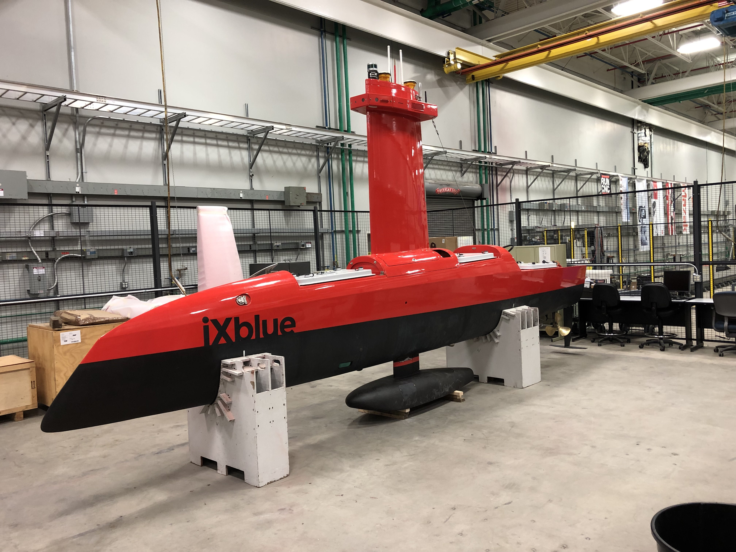
The NOAA-University of New Hampshire Joint Hydrographic Center
IXBlue DriX with launch and recovery vessel
Ship Hydrography “Wingman” or “Duckling” Scenario
https://www.ust-media.com/ust-magazine/UST025/
December 2018 – Initial Trials at UNH
October 2019 – Operational Trials on NOAA Ship Thomas Jefferson.
Notes:
The Center is engaged in collaborative ASV research and development with industrial partner IXBlue using their DriX ASV. Three characteristics distinguish this ASV: seakeeping, speed, and endurance. The DriX can operate in sea state 4 to 5, has 5 – 7 days endurance at 7 knots, and a top speed of 13.5 kts. This means the ASV can keep up with a survey ship mapping around the clock at it standard mapping speed of 9 or 10 kts. Survey capacity in this mode is doubled with minimal additional cost or staffing. Two DriX could actually be operated by the same watch team, tripling the ship’s productivity. Here it is deployed off with JHC’s Gulf Surveyor off the NH coast in December. The other picture shows the DriX on a stand at UNH’s indoor handling facility where it is housed for maintenance and installation of upgrades. Note the drop keel with the multibeam gondola. The DriX normally operates by deployment from its DriX Deployment System (DDS), which is towed behind a vessel. This avoids the need for repeated launch and recovery by crane or davit. The DDS has its own positioning and telemetry system, so the the DriX can be automatically docked into the DDS. Recognizing that a towed system would be awkward for NOAA survey missions throughout our area of responsibility, for our upcoming survey trials with NOAA Ship Thomas Jefferson, JHC and IXBlue have developed a davit adapter for the DDS, so that the DriX and DDS can be launched and recovered together in the ship’s survey launch davits, and thus deployed in place of a manned survey launch anywhere the ship may be sent.
More information on the DriX is available at the link on the slide. (don’t click for the presentation)

Slide 11
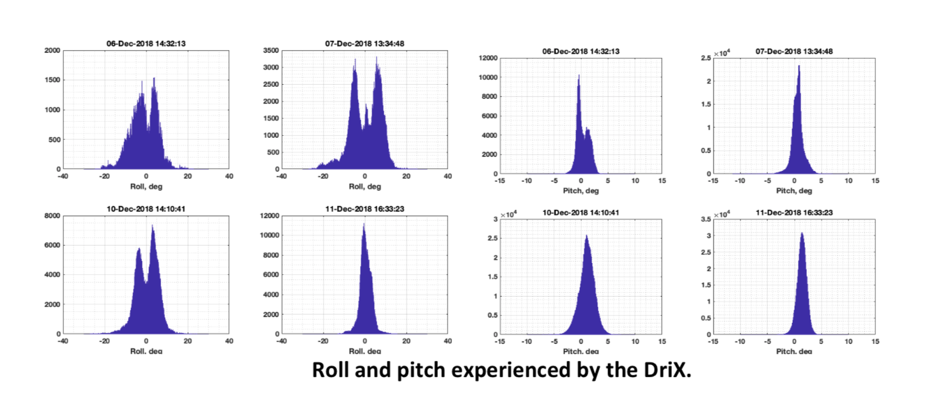
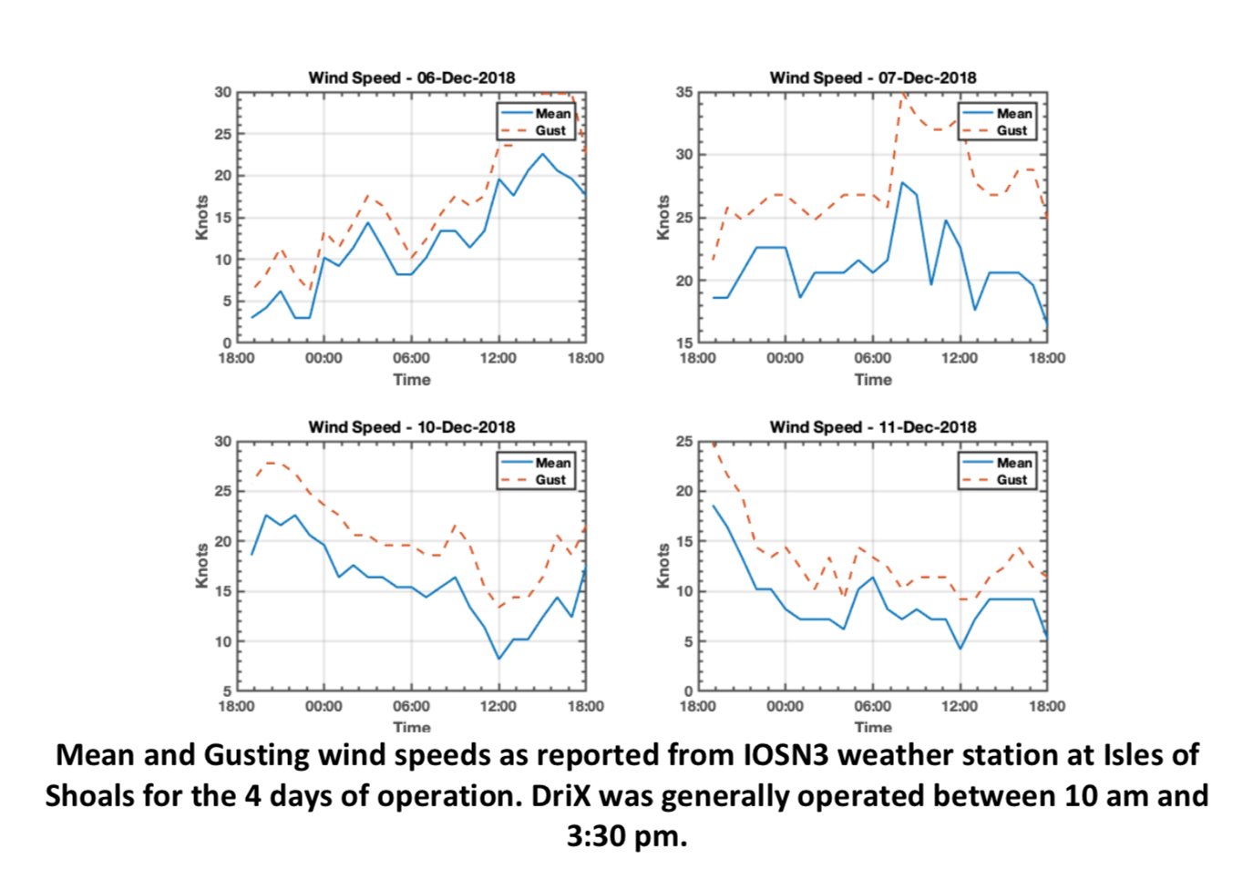
The NOAA-University of New Hampshire Joint Hydrographic Center
On a really rough day… DriX is amazingly stable
ROLL
Gusts to 35 knots
ROLL RATE
Trials at UNH – December 2018
Notes:
Three characteristics distinguish this ASV: seakeeping, speed, and endurance.

Slide 12
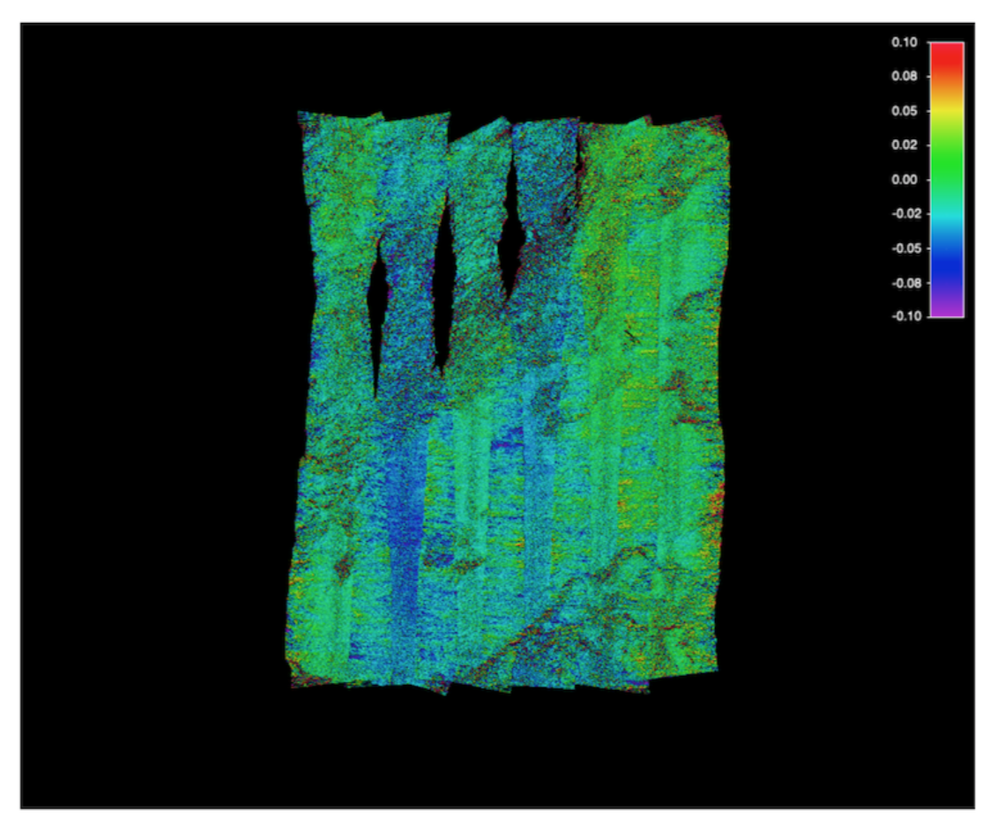
The NOAA-University of New Hampshire Joint Hydrographic Center
Reference Surface Test Area
No significant difference between 8 kt and 12 kt.

Slide 13
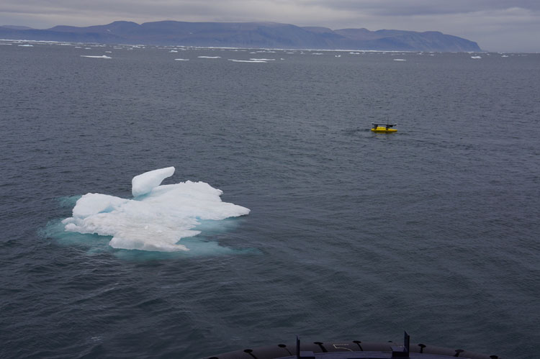
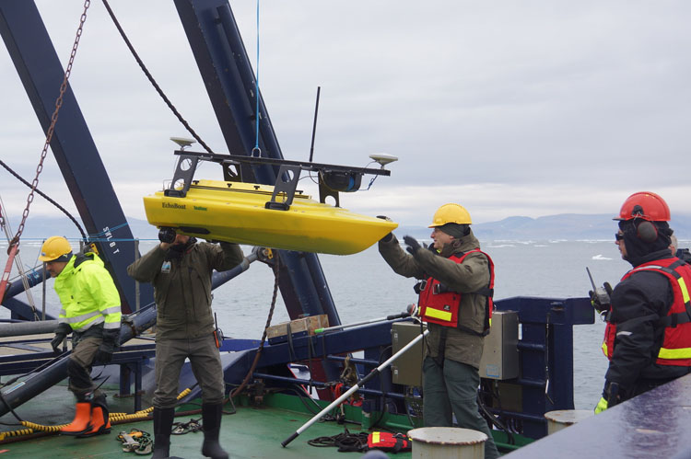
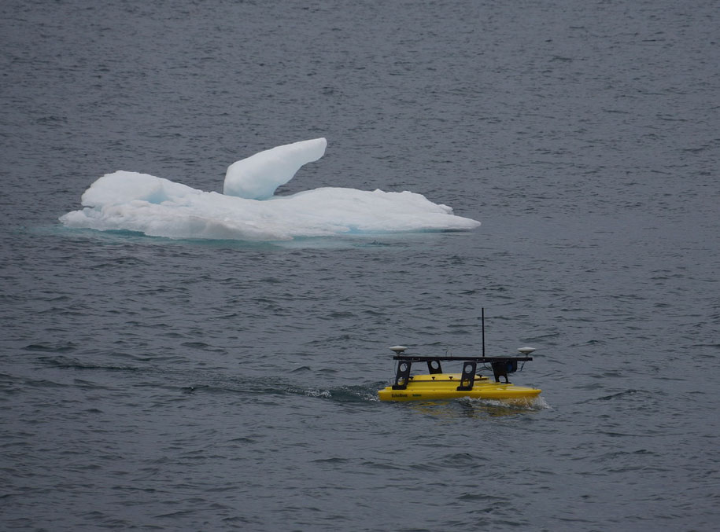
The NOAA-University of New Hampshire Joint Hydrographic Center
Seafloor Systems, Inc. “EchoBoat” aboard Icebreaker Oden at Ryder Glacier, Greenland
Larry
“Pathfinder Scenario” surveying ahead of the ship in uncharted waters
https://polarforskningsportalen.se/en/arctic/expeditions/ryder-2019
Notes:
Larry can’t be here because he is on a research and mapping cruise to rapidly retreating Ryder Glacier in Greenland. He is using a small multibeam-equipped ASV from our industrial partner Seafloor Systems, Inc. as an advance mapping vessel to lead the icebreaker safely into uncharted waters in front of the glacier.
More information on the Ryder Glacier project is available at the link on the slide (don’t click for the presenation)

Slide 14
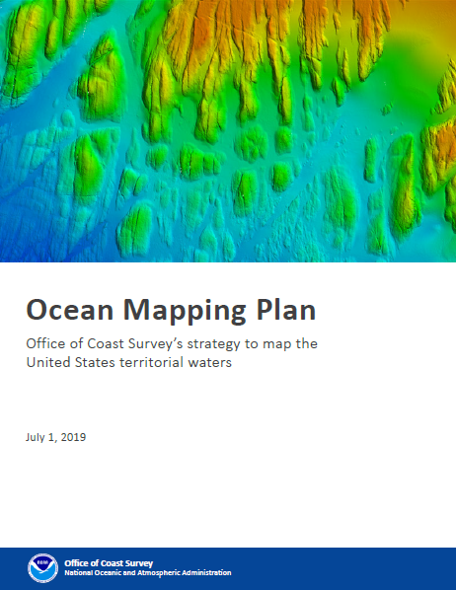
Coast Survey Ocean Mapping Plan
Defines strategic goals for enabling maritime commerce.
Lays out visionary goal to map entire EEZ.
Identifies the key Blue Economy technologies necessary to complete this mapping in our life time.
Focuses on unmanned systems and automated processes.

Slide 15
www.ccom.unh.edu
andy.armstrong@noaa.gov

