Slide 1
Hydrographic Services Review Panel FAC
Thomas S. Chance
Founder & former CEO, C & C Technologies and ASV Global (Retired)
Hydrographic Services Review Panel
USVs for Hydrographic Surveying
August 27-29, 2019, New Orleans, LA

Slide 2
USVs for Hydrographic Surveying
Contents
Unmanned, Optionally Manned, Minimally Manned
Conversion to Optionally Unmanned
Force Multiplier Examples
Line of Sight (LOS) vs Beyond Line of Sight (BLOS)
Example USVs for NOAA Hydrography
USV Lessons Learned

Slide 3
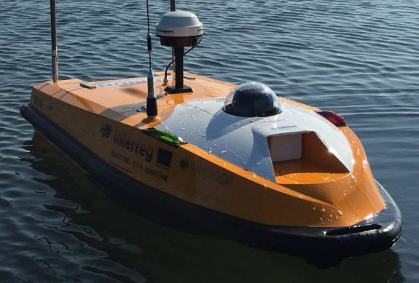
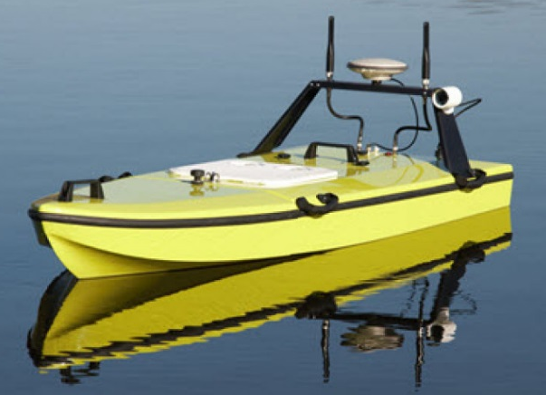
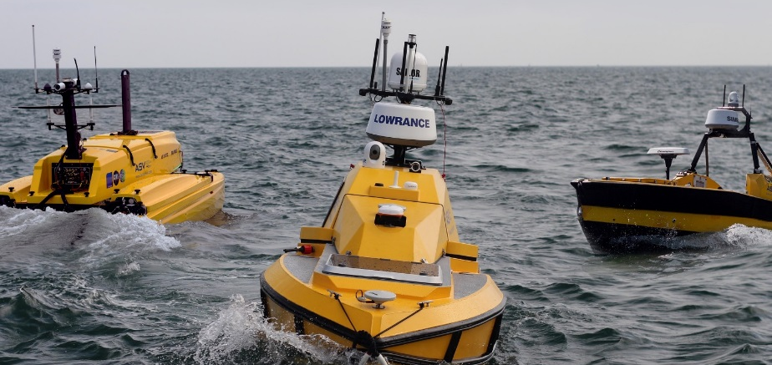
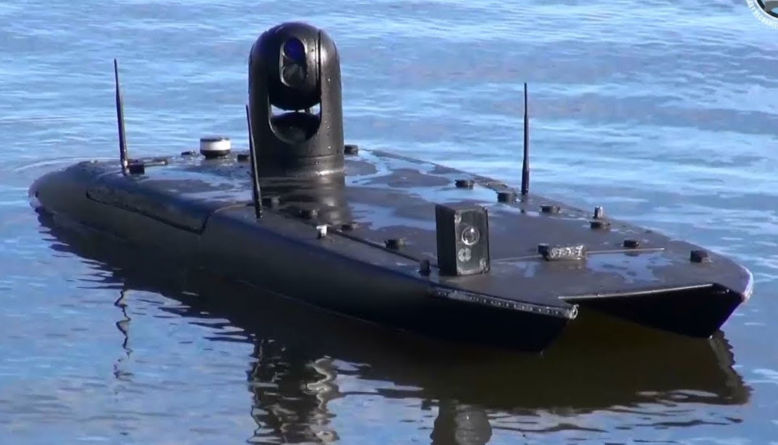
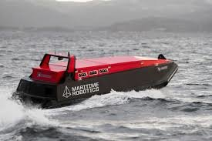
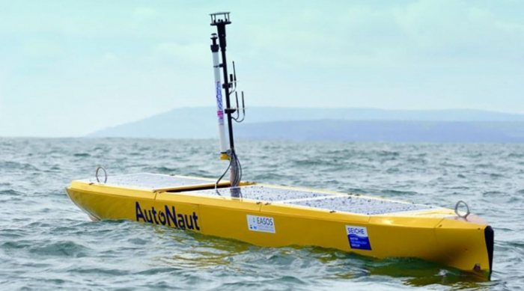
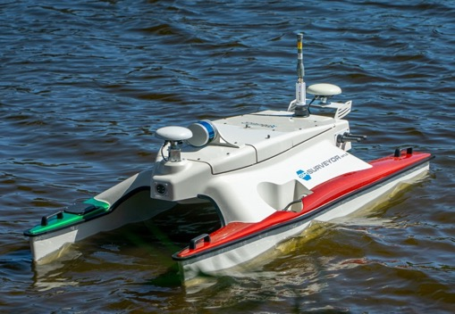
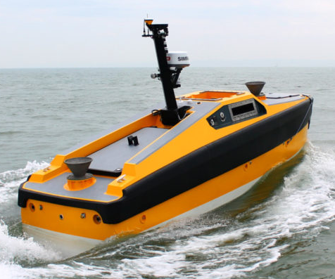
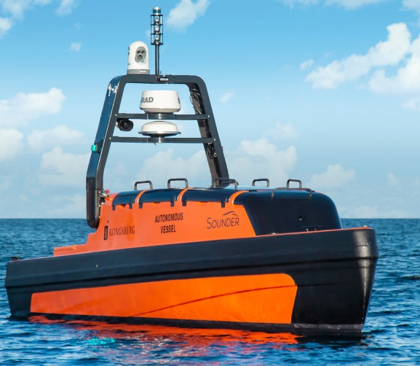
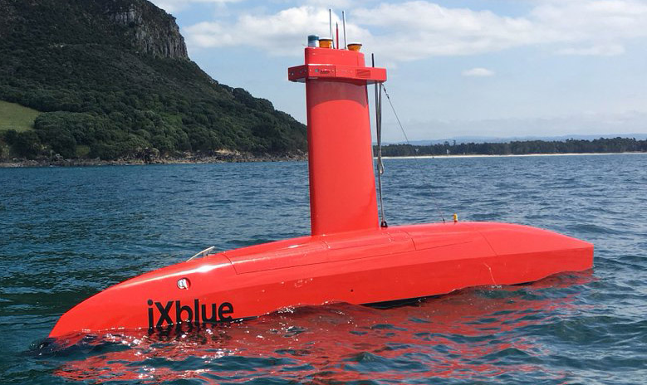
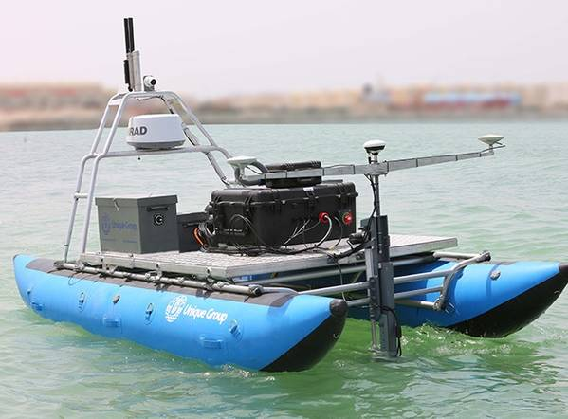
Unmanned
Ocean Alpha
CEE Hydrosystems
L3 Harris / ASV
Maritime Robotics
Autonaut
Sea Robotics
Martac
L3 Harris / ASV
Kongsberg
Maritime
IXblue
Unique Group

Slide 4
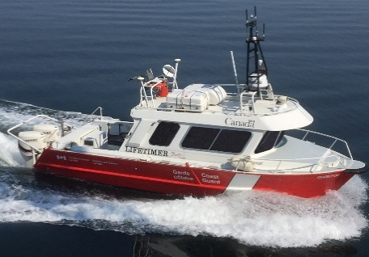
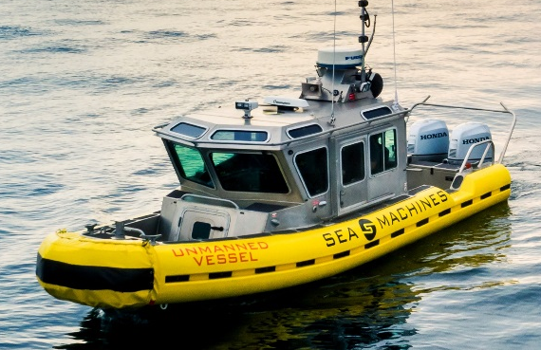
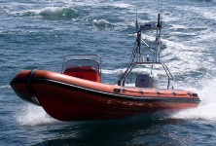
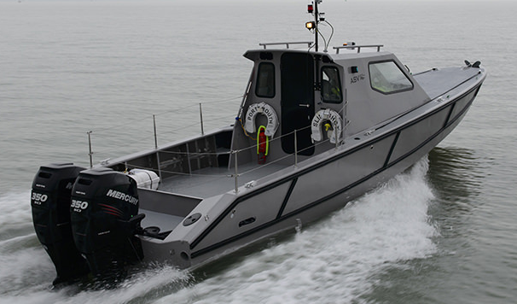
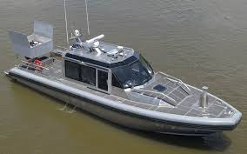
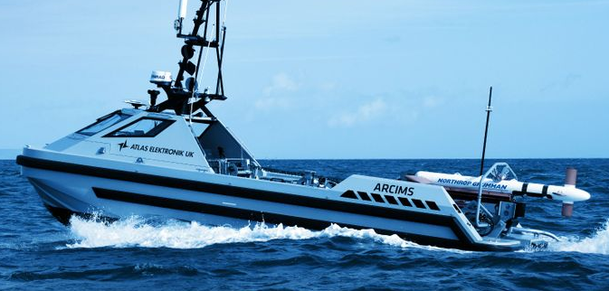
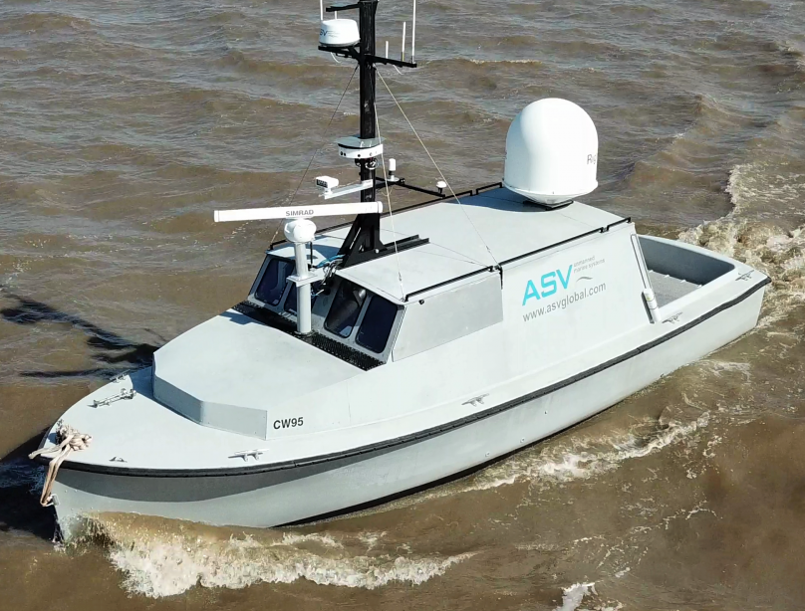
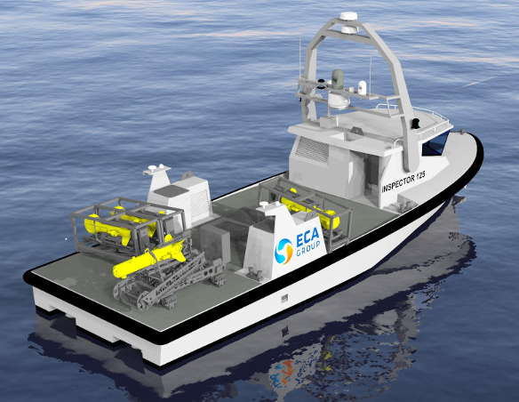
Optionally Unmanned
Sea Robotics
L3 Harris / ASV
Sea Machines
Dynautics
L3 Harris / ASV
LSA Autonomy / NOAA
L3 Harris / ASV
Atlas Electronik
L3 Harris / ASV
ECA Group

Slide 5
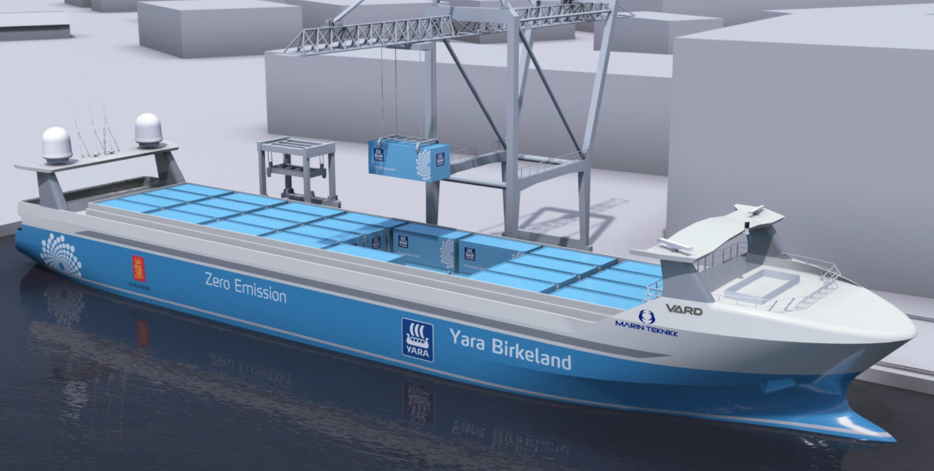
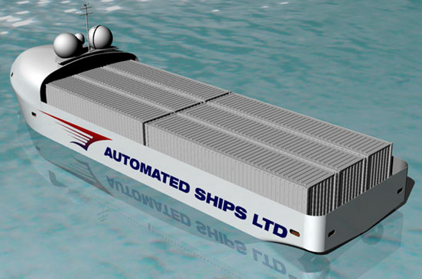
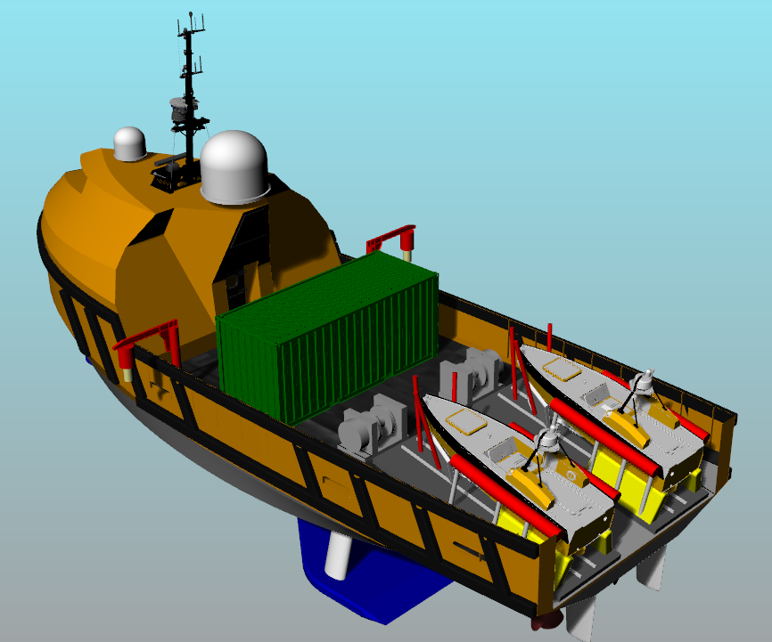
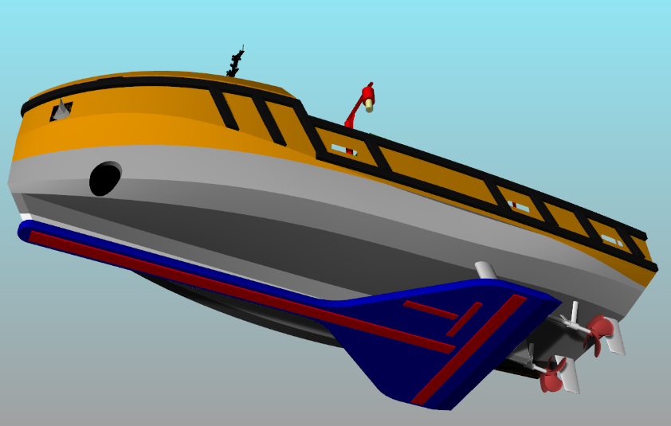
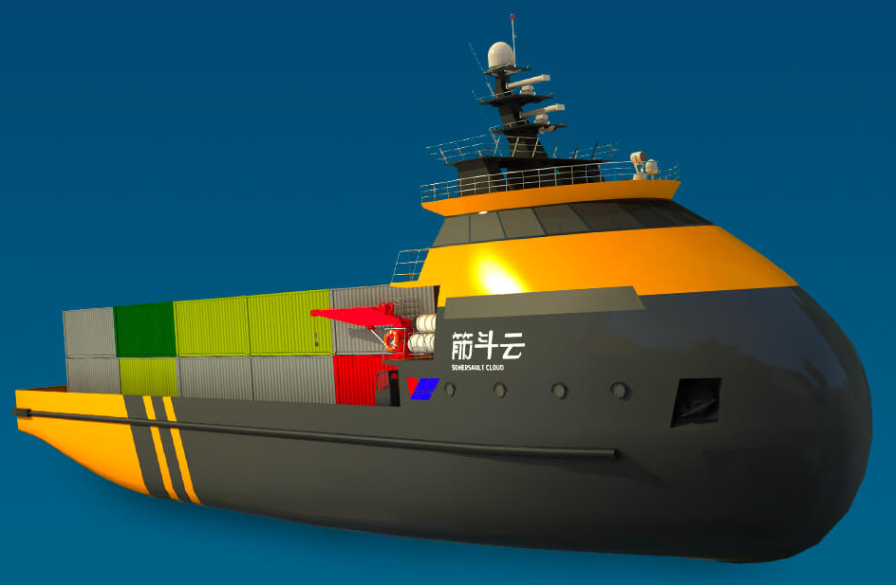
Minimally Manned
Automated Ships Ltd
(M Subs)
Kongsberg / Yara
Ocean Alpha
L3 Harris / ASV

Slide 6
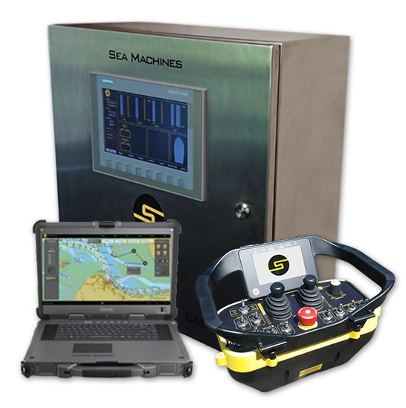
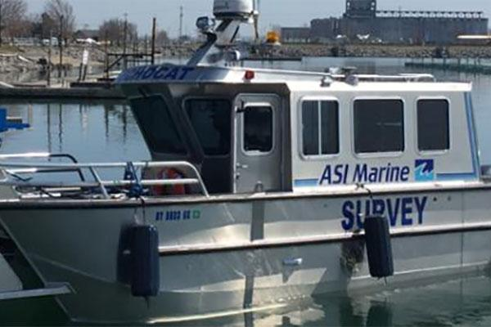
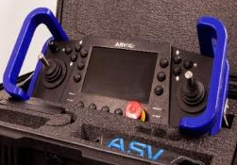
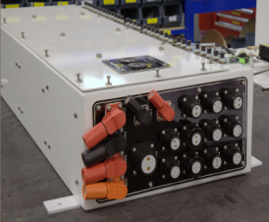
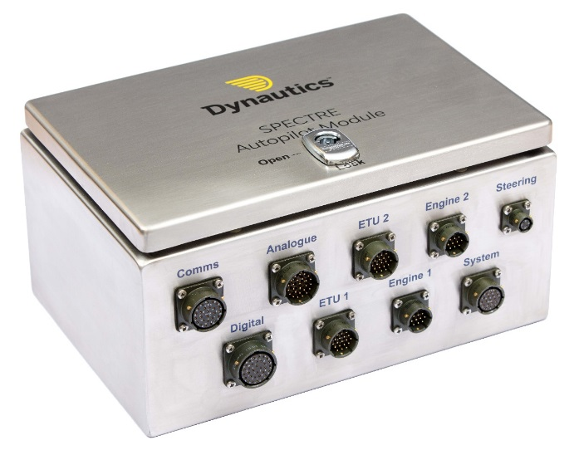
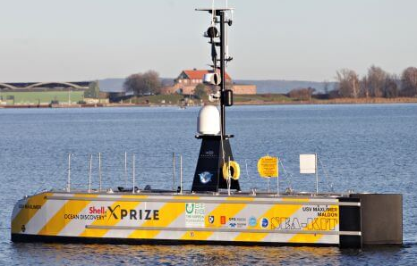
Conversion to Optionally Unmanned
Example Conversion Vendors:
Dynautics
Kongsberg Maritime
L3 Harris / ASV Global
LSA Autonomy
Sea Machines
Sea Robotics
Sea Robotics
Sea Machines
Kongsberg Maritime
Dynautics
L3 Harris / ASV

Slide 7
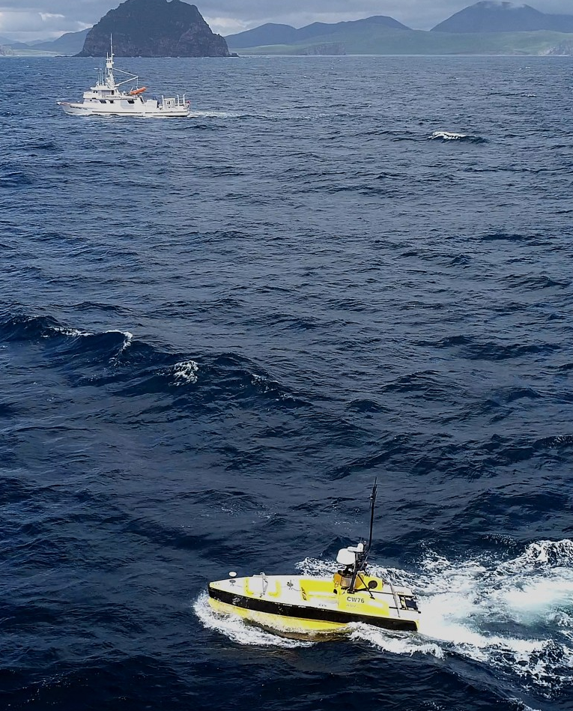
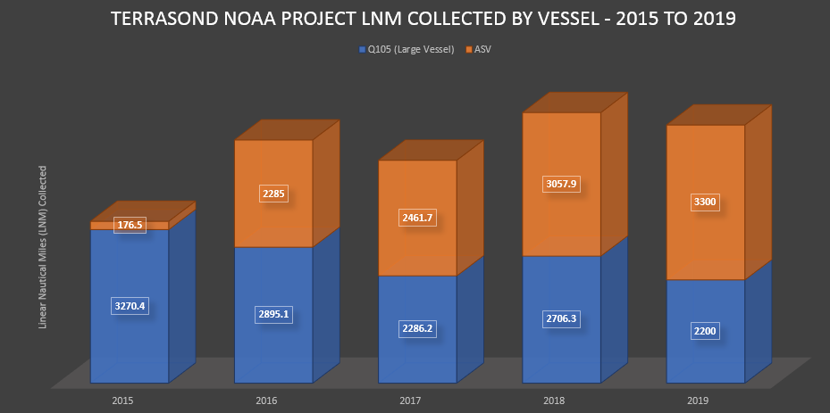
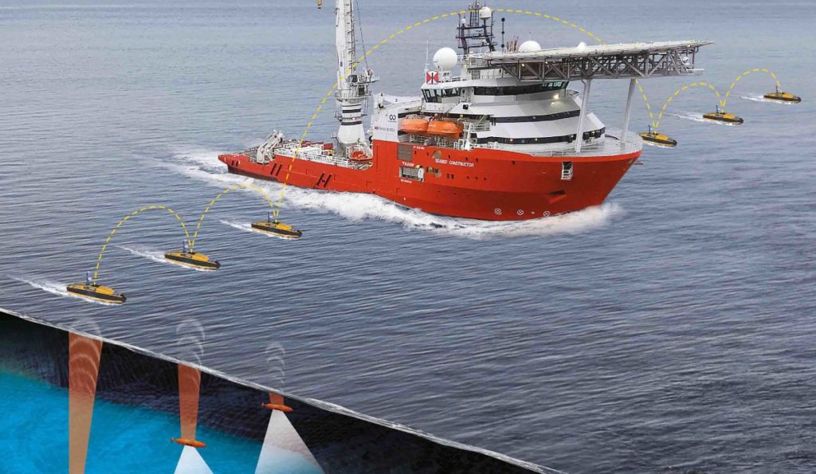
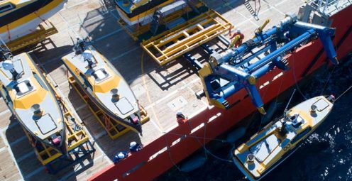
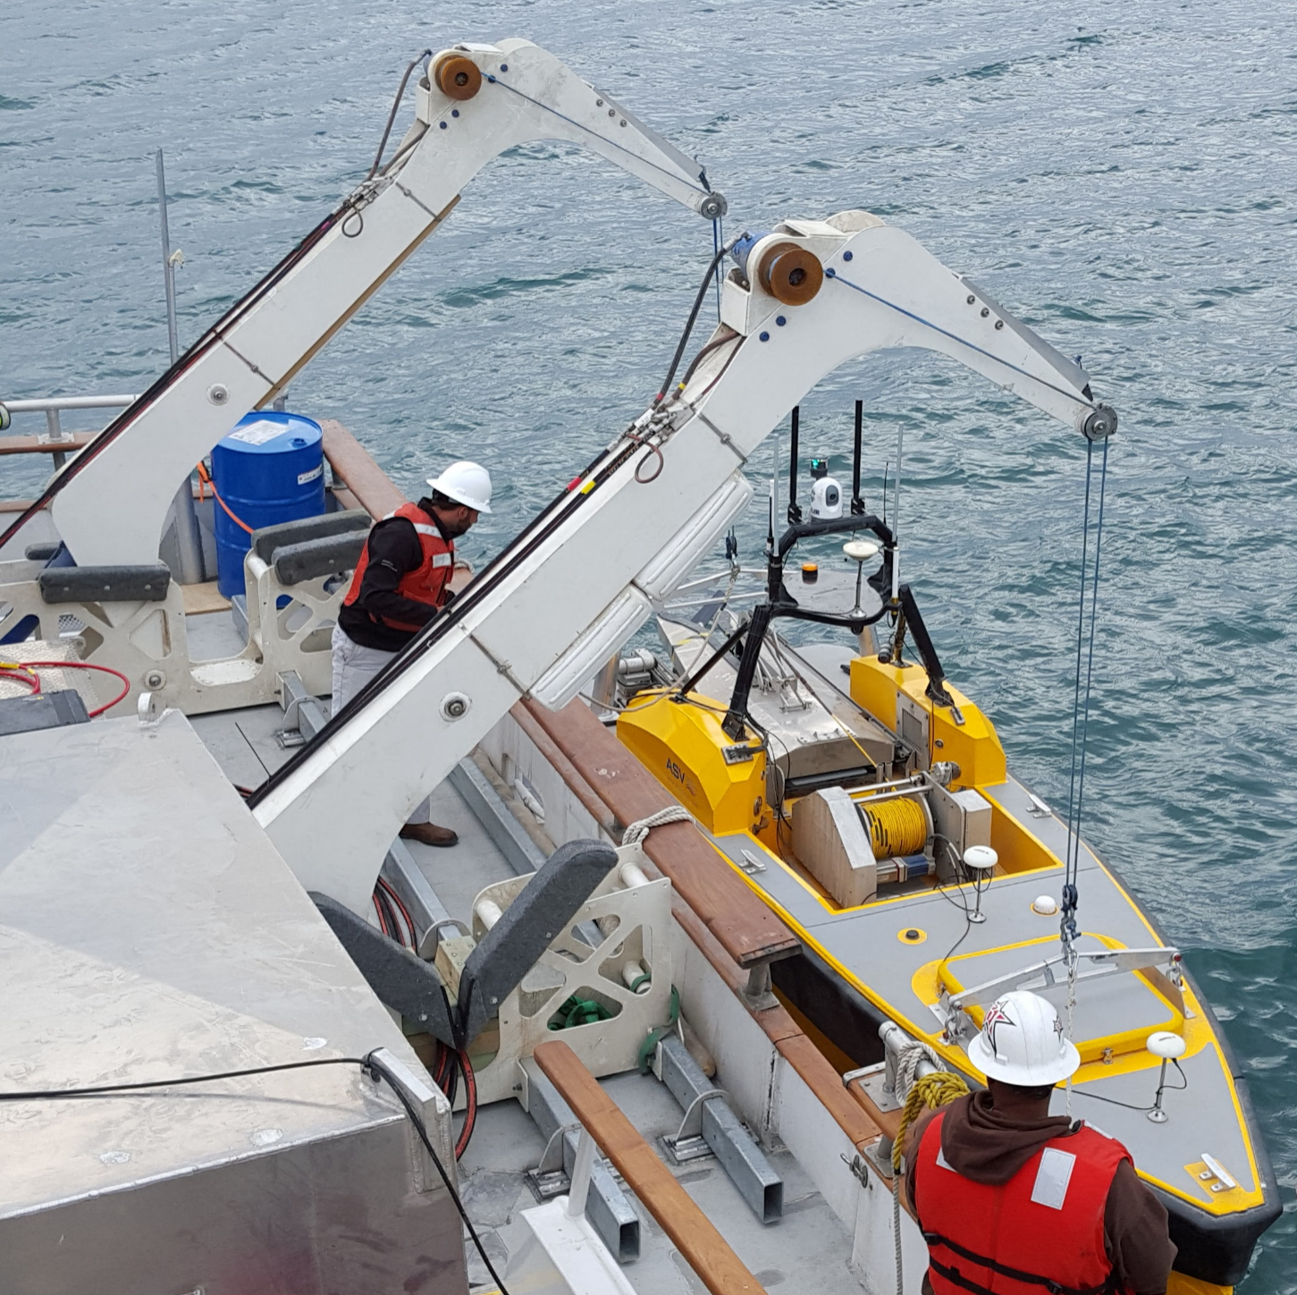
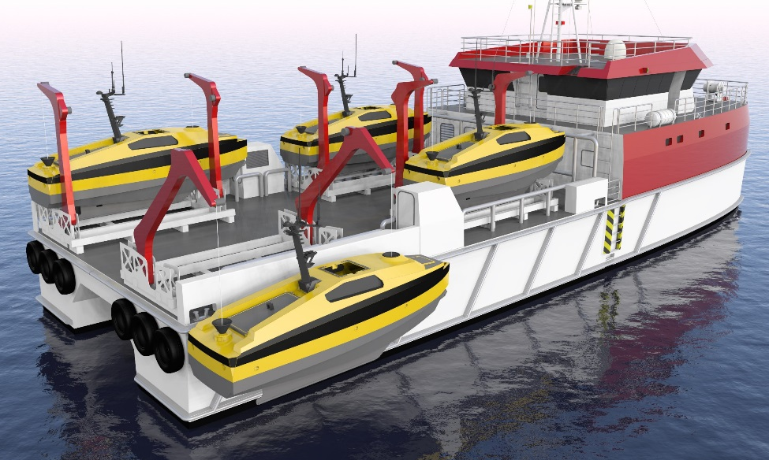
Force Multiplier Examples
Ocean Infinity
Terrasond
Ocean Infinity
Terrasond / L3 Harris - ASV
Terrasond / L3 Harris - ASV
Guardian Offshore /Ocean Infinity

Slide 8
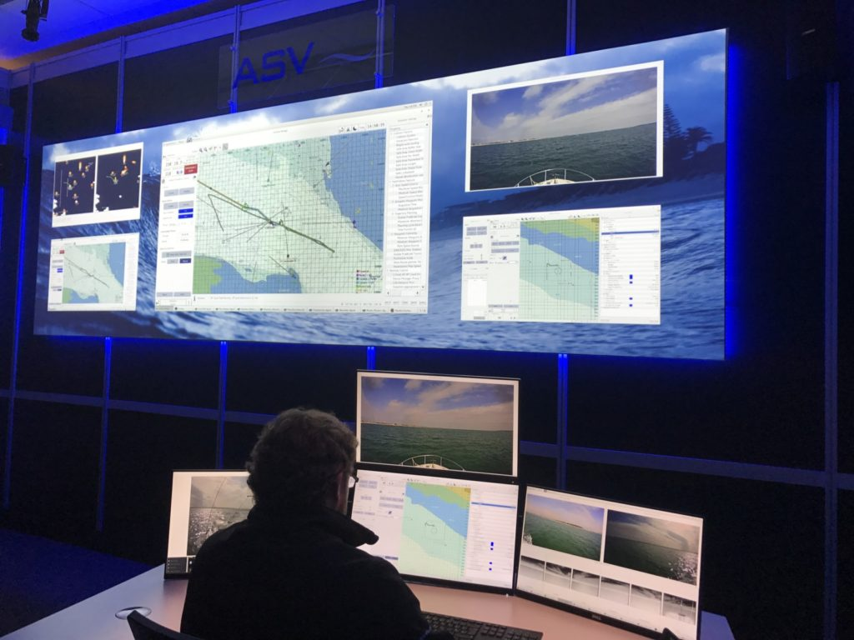
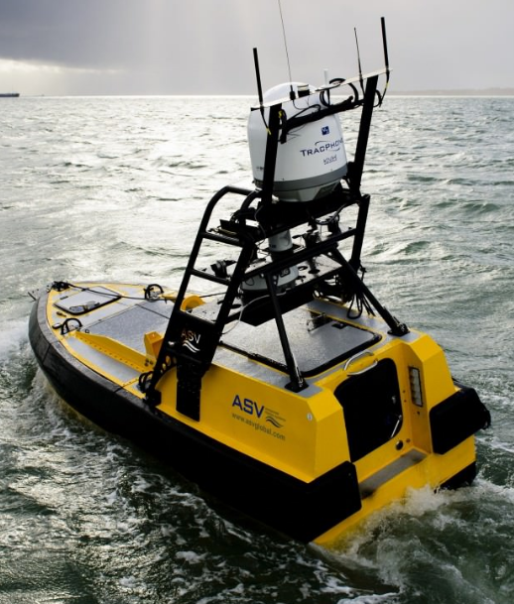
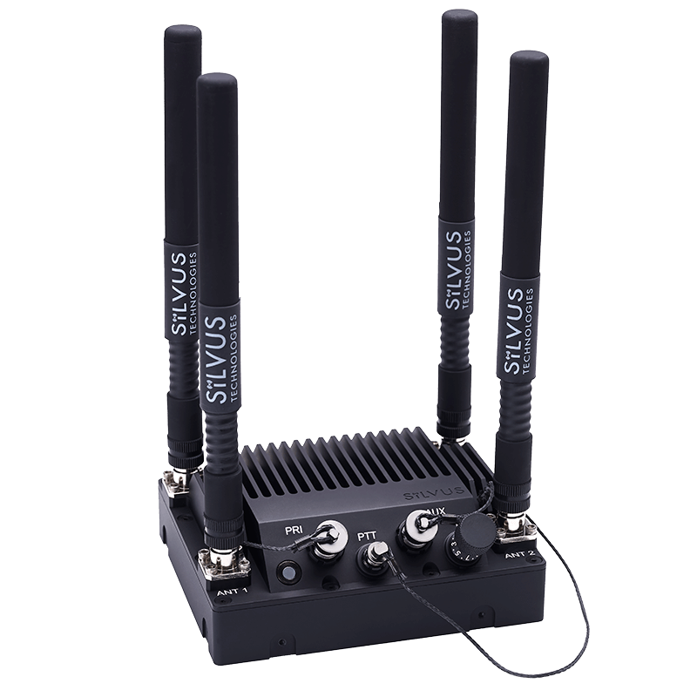
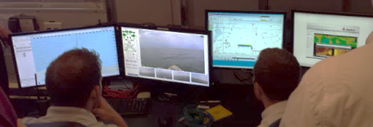
Line of Sight (LOS) vs Beyond Line of Sight (BLOS)
Waypoint Navigation / Collision Avoidance
Payload Deployment
Supervise & Control ASV Movements
Control Payload, Monitor Data
Shore Based Monitoring
Satellite Link
(Beyond Line of Sight)
Dual Radio Links
(Line of sight)
Offshore Based Monitoring

Slide 9
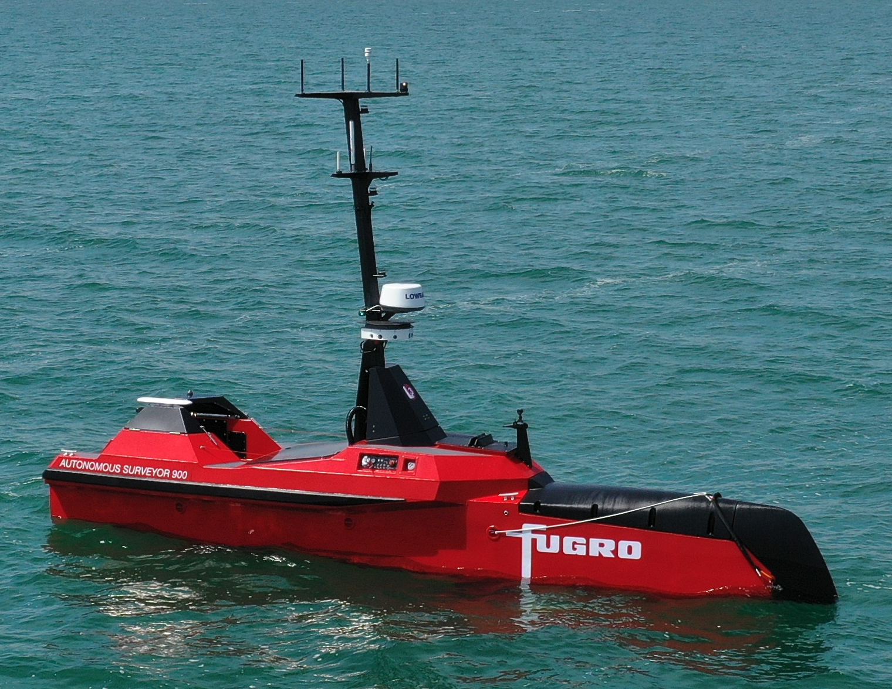
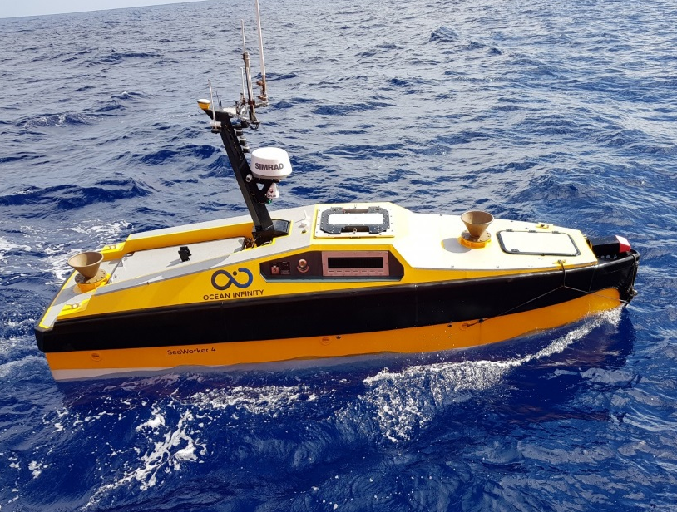
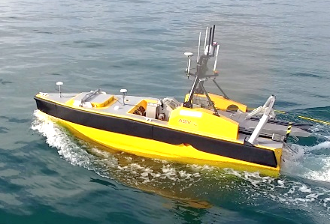
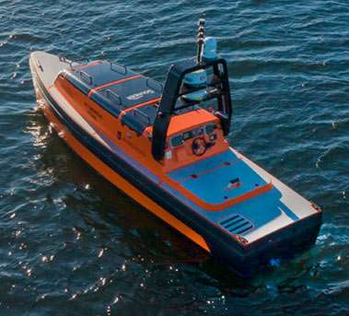
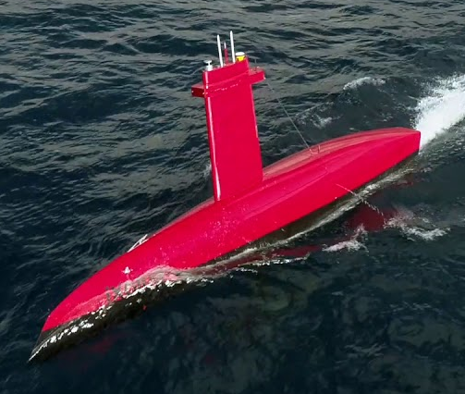
Example (Unmanned) USVs for NOAA Hydrography
Fugro
L3 Harris / ASV
L3 Harris / ASV
L3 Harris / ASV
Kongsberg Maritime
IXblue

Slide 10
USV Lessons Learned
For real survey production, a cheap USV can be very expensive
Batteries don’t cut it, go with diesel
Small (<2m) monohulls can have aeration problems
Buy one USV, have the manufacturer debug, then buy more of same
Beware of heat
Beware of water
Beware of connectors
Launch & Retrieval from mothership is 50 percent of the equation
Do not expect that it will work like a calculator from Walgreens
Hydrography is one of the easiest applications of USVs
Don’t confuse great USV graphics with years of USV experience
Make sure USV manufacturer has extensive maritime experience
COLREG autonomy has not been perfected, you must supervise
Check with the other USV users before you buy

Slide 11
Contact Information:
Thomas S. Chance
Founder & former CEO, C & C Technologies and ASV Global (Retired)
thomasschance@gmail.com / 337-654-7500

