Slide 1
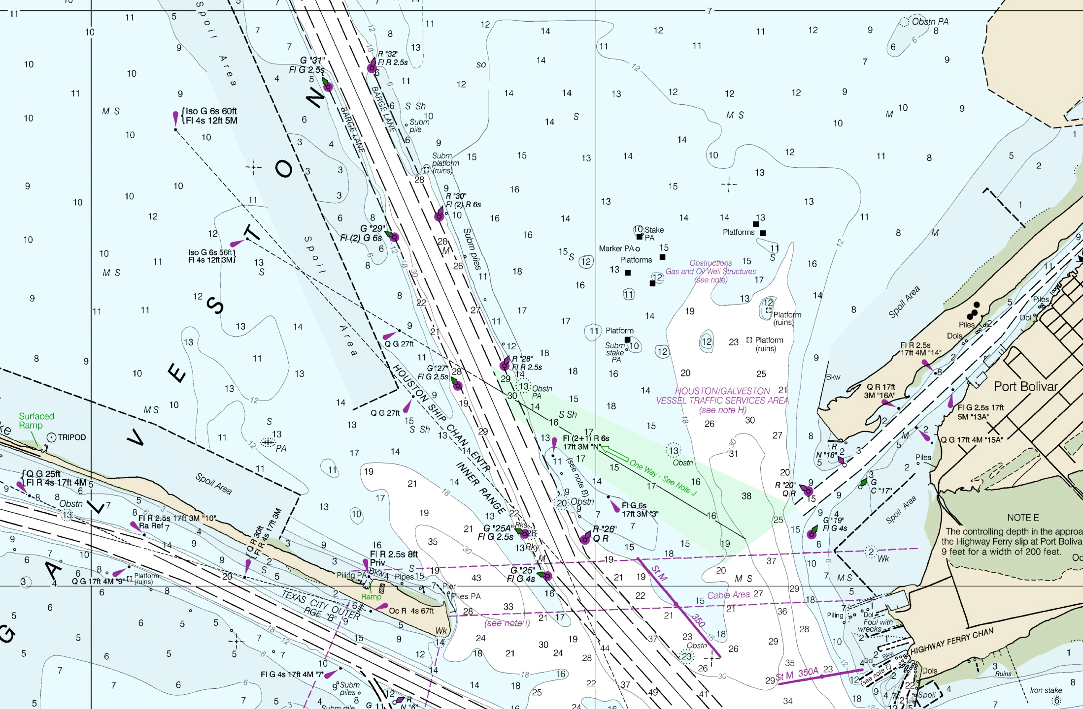
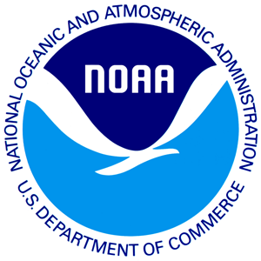
Office of Coast Survey Autonomous Systems Activities and Strategy
LT Damian Manda
Hydrographic Services Review Panel – August 28, 2019

Slide 2
Background
Office of Coast Survey
CO-OPS
Coast Survey Development Lab
Geodetic Survey
Hydrographic Systems and Technologies Branch
Development and testing of ocean mapping technologies
OMAO Ships & IT
NOAA Fisheries
Hydrographic Surveys Division
Navigation Services Division
Marine Chart Division
Centers for Coastal and Ocean Science

Slide 3
Coast Survey UxS Vision
Coast Survey UxS Vision
OCS Strategic Plan:
Integrate new and innovative technologies into
mission priorities.
Develop and utilize unmanned systems for more efficient and effective acquisition of data to support NOAA’s navigation products and services.

Slide 4
Primary Impacts and Use Cases
Unmanned Surface Vessels
Shallow water mapping (small platforms)
Dangerous or unknown situations
Long duration missions
Unmanned Underwater Vessels
Response (small platforms)
Deepwater high resolution mapping
Conversion/Multimodal
More utilization of existing platforms
Workforce preparation for next generation
Unmanned Aerial Systems
Faster shoreline
Response imagery/assessment
Shallow water bathymetry

Slide 5
UxS Strategy
Develop Enabling Technologies
Build and Maintain Operational Expertise
Operational Innovation
Collaboration

Slide 6
Enabling Technologies – Processing Automation
Data Collection
Charlene
Charlene
MBES Processing
Features Processing
SSS Processing
SHAM
Rough Cleaning
Feature QC
SSS Contact Selection
CARIS ML
SSS ML
Data QC and Metrics
QC Tools
Auto DR
Reports
Final QC
LTD, Checksum, QC Tools
Submission

Slide 7
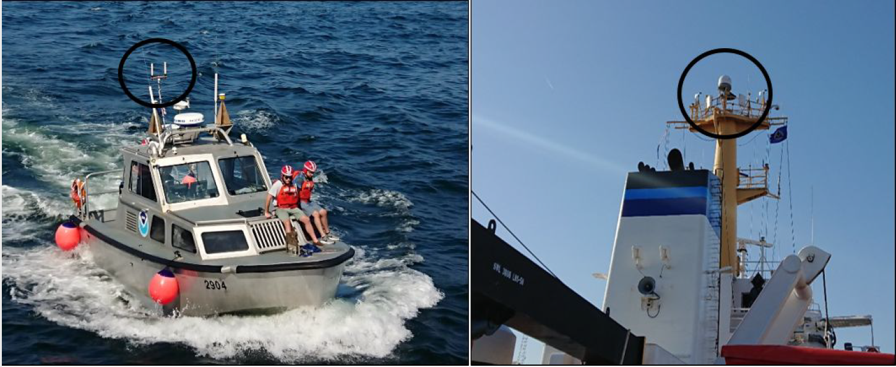
Enabling Technologies
Wireless Data Transfer

Slide 8
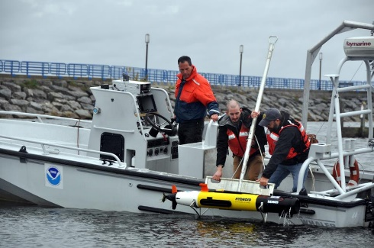
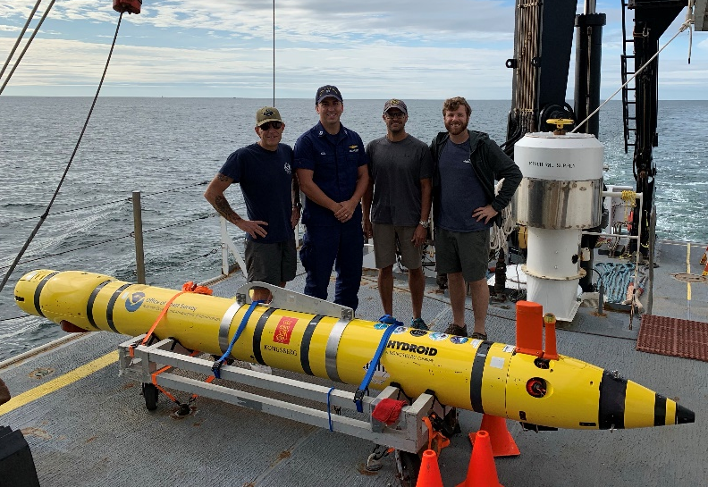
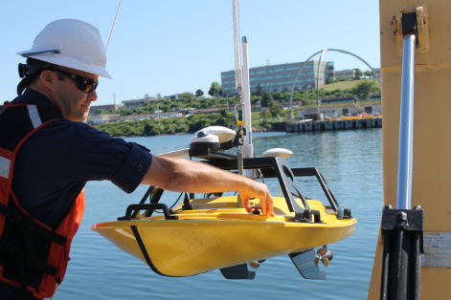
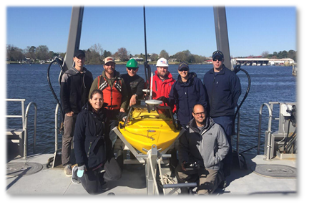
Operational Platform Expertise
Coast Survey’s Unmanned Systems In Operation or Evaluated
Navigation Response Team - Stennis, MS
Bay Hydrographer II
2019 Activities
Official transition of assets to NRT
Certification of Echoboat for NOAA survey acquisition
Operational use of REMUS 600 on NOAA Ship Okeanos Explorer, training for NRT
Team Lead arrives to NRT-Stennis, working toward full staffing
Hydroid REMUS-100
Hydroid REMUS-600
Teledyne Oceanscience Z-Boat (2)
Seafloor Systems Echoboat (2)

Slide 9
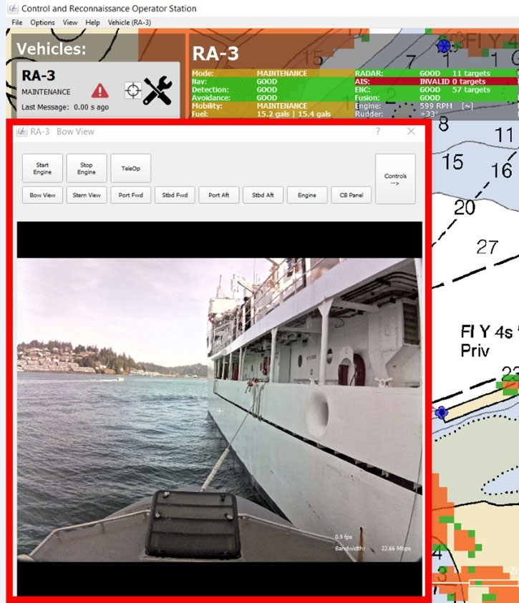
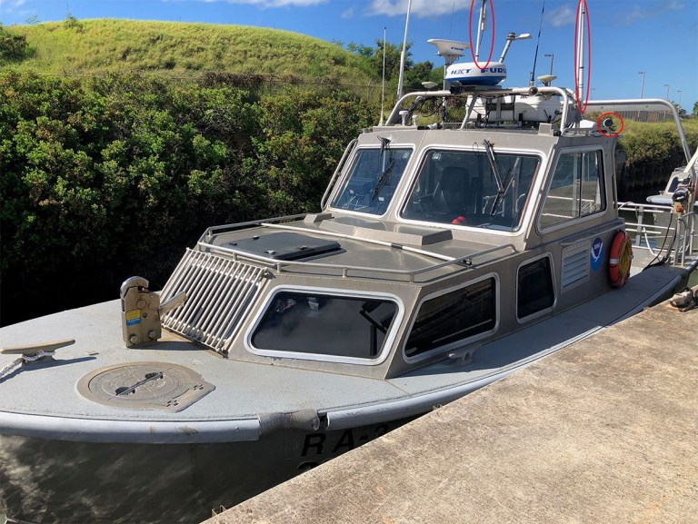
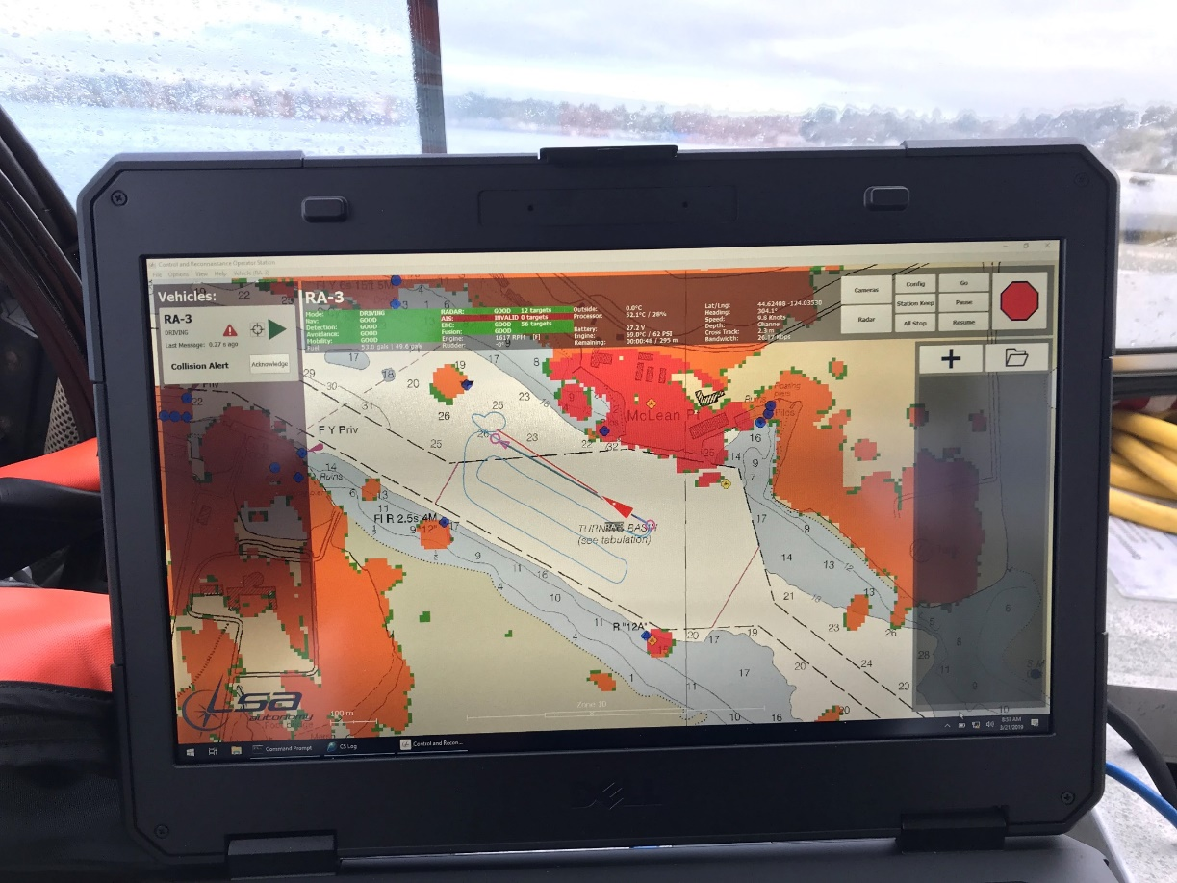
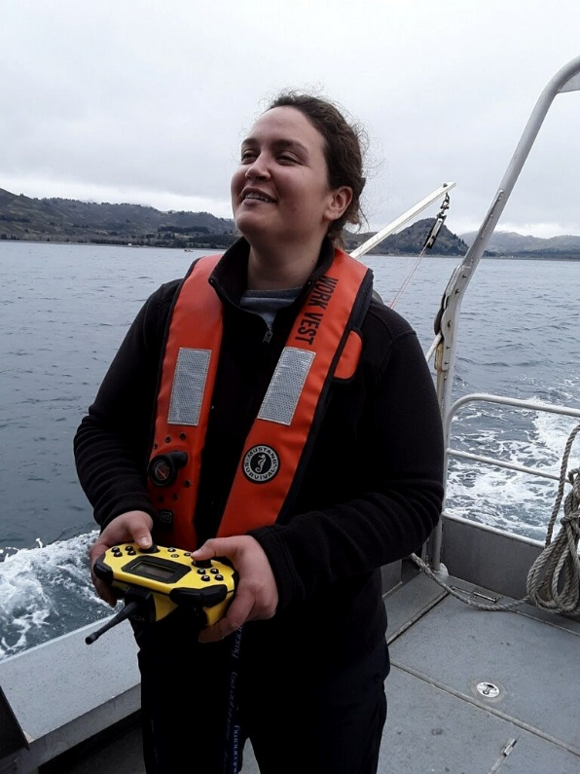
Operational Innovation
Optionally Manned Launch
Purpose
Maximize current infrastructure and expertise
Allow for expedited, moderately priced, and scalable means to integrate unmanned systems
Expected Benefits
Platform to develop and test enabling technologies & operational concepts
More effective use of survey personnel
Preparation for USV mission integration
Increased survey efficiency
Timeline
Feb 2019 – Technical acceptance of 1st launch conversion on NOAA Ship Rainier
Mar 2019 – Installation & acceptance of 2nd launch conversion
May - Sept 2019 – At-sea operational testing
Winter 2019-20 – Additional conversions

Slide 10
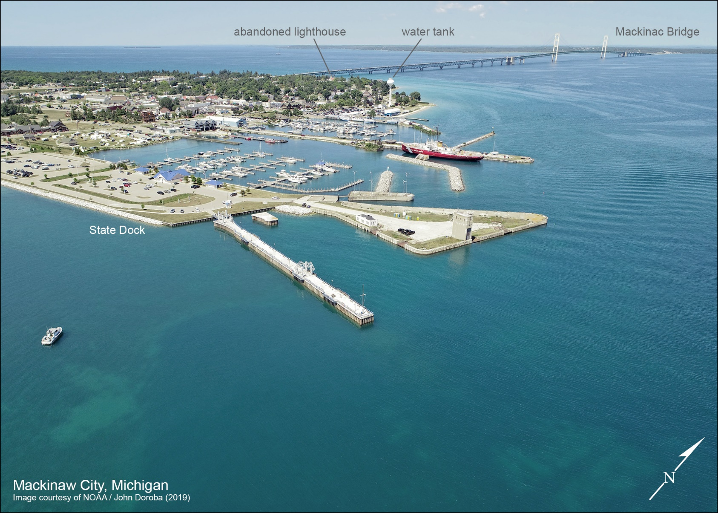
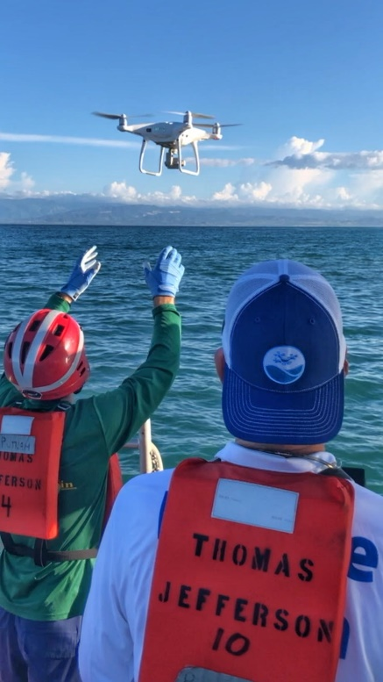
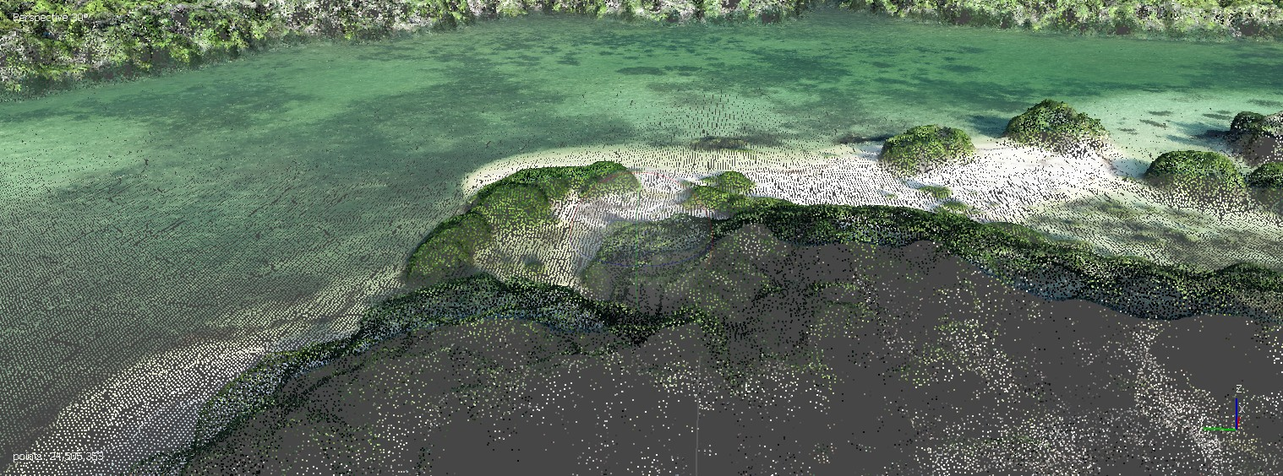
Operational Innovation
Shoreline via UAS
2019 Activities
Training program at NGS facility in Corbin, VA
Processing pipeline development
Operational Field use of UAS with NRT in Cheboygan, MI

Slide 11
Collaboration - Navy
CENOTE legislation - leverage expertise in the development and operational transition of UMS
Annex 23 to NOAA-Navy MOA
Coordinate and collaborate on hydrographic survey initiatives
Includes procurement, testing and training for unmanned systems
NAVO optionally manned launch conversion
Software collaboration and workshops

Slide 12
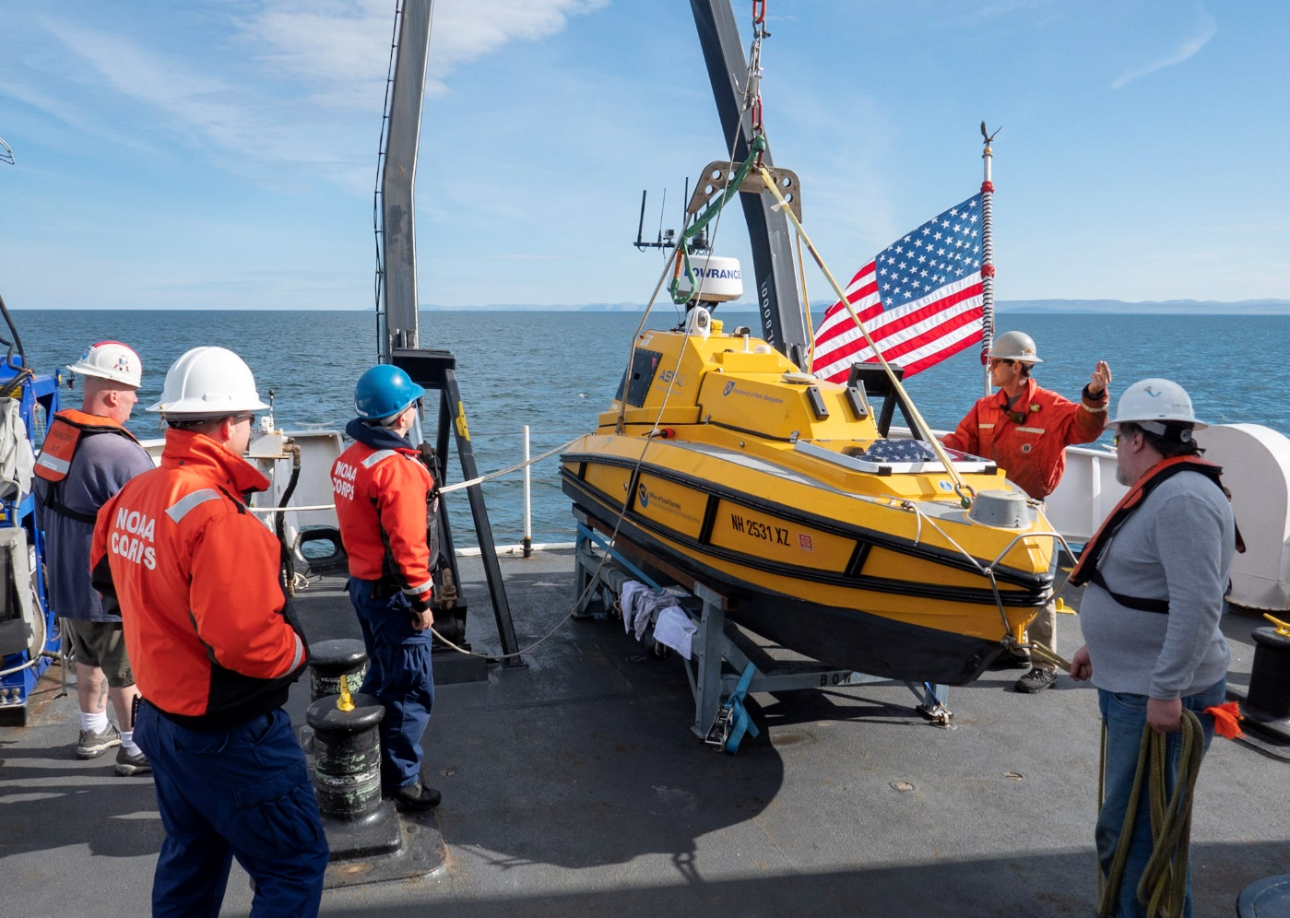
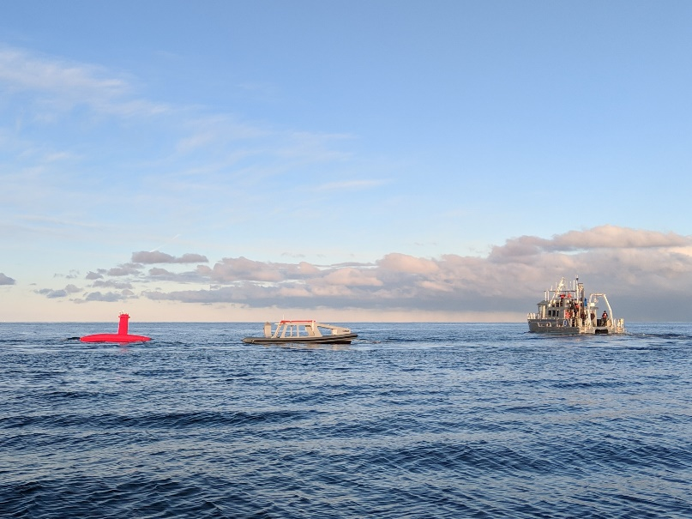
Collaboration - University of New Hampshire
Arctic USV Survey – July 2018
UNH’s ASV C-Worker 4
Collaboration with UNH CCOM/JHC, NOAA Ship Fairweather
Tested new operational models, identified and solved technical short-comings, and provided experience to the ship’s crew in the operations and support of unmanned systems.
iXBlue DriX USV
Testing and evaluation of the long endurance iXBlue DriX USV through UNH’s industrial partners program
Field Trial in NH Dec 2018
Meets NOAA survey requirements at 12 kts

Slide 13
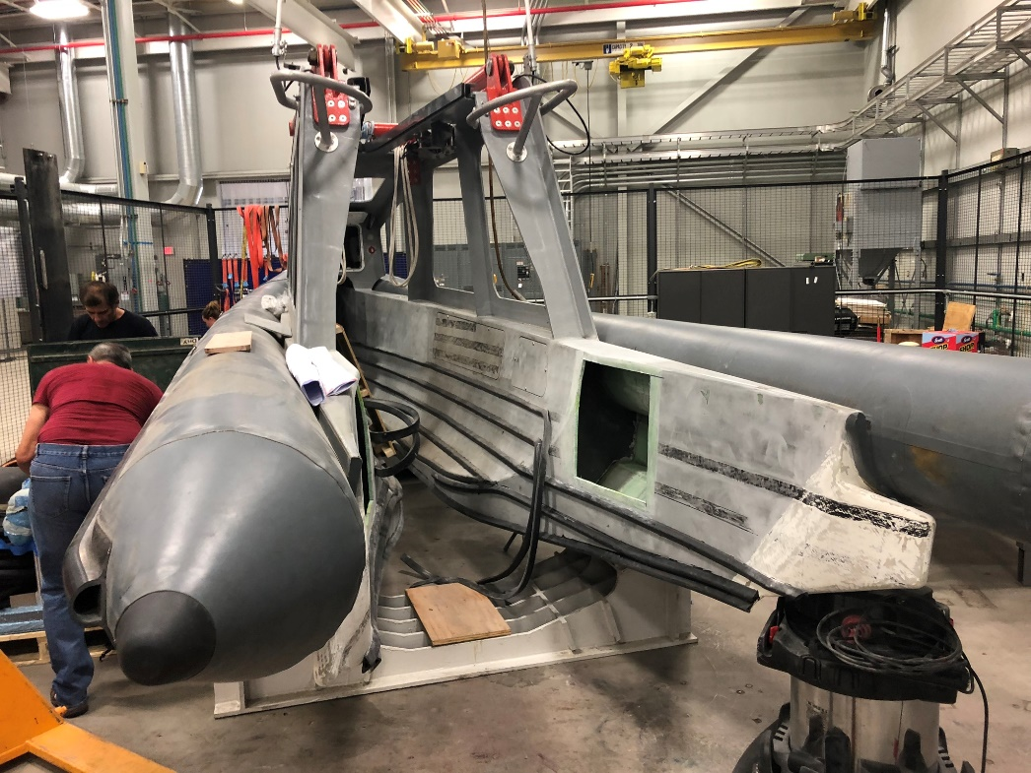
Collaboration - University of New Hampshire
2019 Activities
C-Worker BEN
Shore based C-Worker operations in Thunder Bay NMS
Pacific Islands mapping projects
Robotics system improvements for the C-Worker
Machine learning application to camera image recognition
Testing of processing algorithms to improve survey efficiency
DriX
Testing of launch and recovery system on NOAA Ship Thomas Jefferson
Investigation of survey methodologies in conjunction with Thomas Jefferson

Slide 14
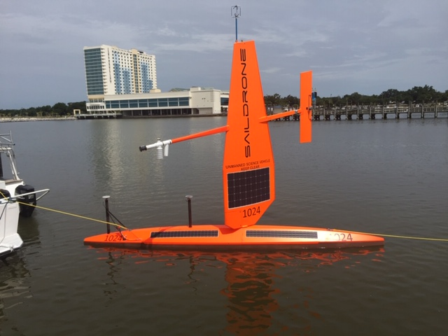
Collaboration – University of Southern Mississippi
2019 Activities
Saildrone
Integration of MBES on Saildrone
Survey tests in Gulf of Mexico
Identification of benefits to charting mission, concept of operations
C-Worker 5
Outfitting and use for training

Slide 15
Activities Summary
Strategy
Develop Enabling Technologies
Activities - Software Development (Charlene, SSS, SHAM), Data Radio Installations
2019 Goal - Reduce shipboard data processing effort 50% from 2017 level
Build and Maintain Operational Expertise
Activities – UxS Operational Team in Stennis, UAS Training
2019 Goal – Team fully staffed and resourced to conduct Coast Survey and inter-disciplinary missions, OCS specific UAS training for field units
Operational Innovation
Activities – Optionally-manned Launch Conversions, Shoreline UAS
2019 Goal – Operational use of launch in unmanned configuration, UAS shoreline field use
Collaborate
Activities – SailDrone CRADA, Navy, USM and UNH partnerships
2019 Goal – Integration and operation of seafloor mapping sonar on SailDrone. DriX testing aboard Thomas Jefferson.
✓
✓
✓
✓
✓

Slide 16
Roadmap
2019
Operational Testing of Optionally Manned Launch
IT infrastructure for remote data transfer
2020
6 operational optionally manned launches
Continued reduction in manual data processing
2021
Enable UxS team to manage multiple simultaneous deployments
Expand use of UxS in complex environments, persistent deployments
Begin testing situation and navigation improvements for USVs
Shoreline mapping via sUAS widely used
OCS training program for sUAS
Develop and test collaborative mission behaviors

Slide 17
LT Damian Manda
NOAA Hydrographic Systems and Technologies Branch
damian.manda@noaa.gov

