Slide 1
NOAA Fleet Recapitalization Update
Captain Rick Brennan

Slide 2
Class “B”
Primary mission: Charting and Surveying.
  Secondary mission: Assessment and Management of Living Marine Resources (no trawl) and Oceanographic Research.
Organic handling of multiple launches or small craft, both manned and unmanned.
Infrastructure to support unmanned systems.
Program Status
Class B IPT has met and the Top level requirements for Class B are being finalized.
Developing Milestone 1 documentation, anticipate DOC approval before end of FY19.
Investigating various acquisition approaches with NOAA contracting to expedite procurement schedule.
  Includes working with Carderock to develop a hull shape that minimizes bubble sweep down an improves sensor performance. One version, which is being model tested, is a modified and extended FSV hull form.

Slide 3
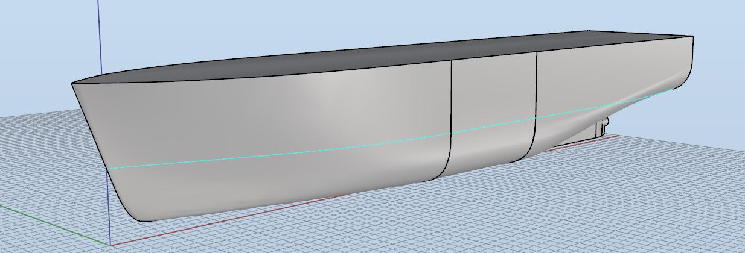
Modified FSV Hull being evaluated for use as a Class B
12.6 m parallel midbody plug added
Skeg simplified to ease construction

Slide 4
Modified FSV Hull being evaluated for use as a Class B
12.6 m parallel midbody plug added
Skeg simplified to ease construction

Slide 5
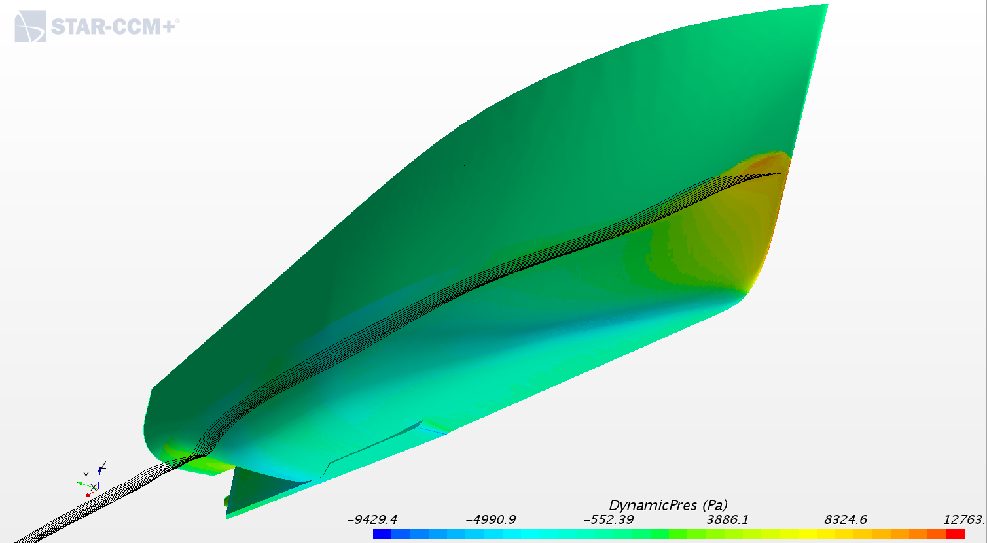
CFD Model Screen Shot showing stream lines along the hull

Slide 6
Original FSV Model

Slide 7
Modification of FSV Model

Slide 8
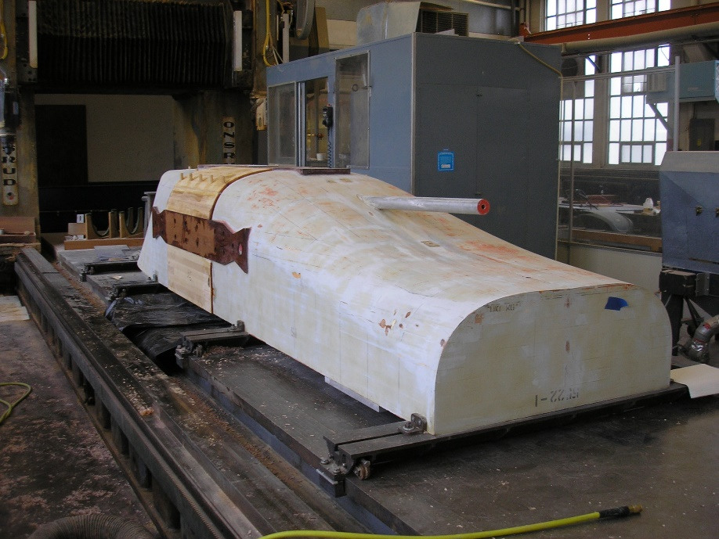
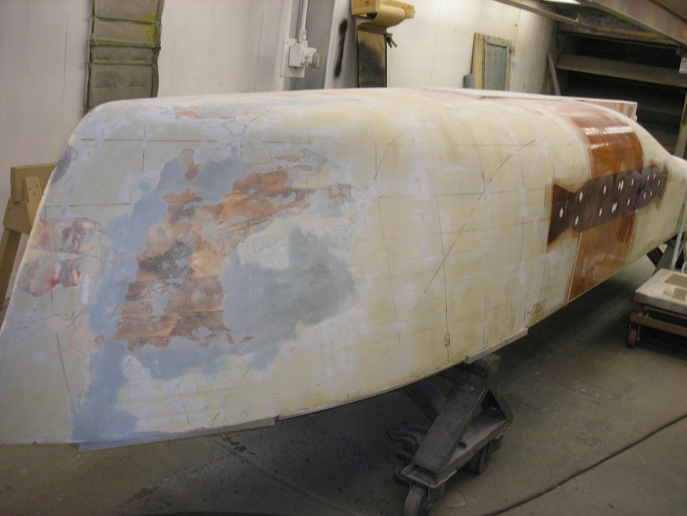
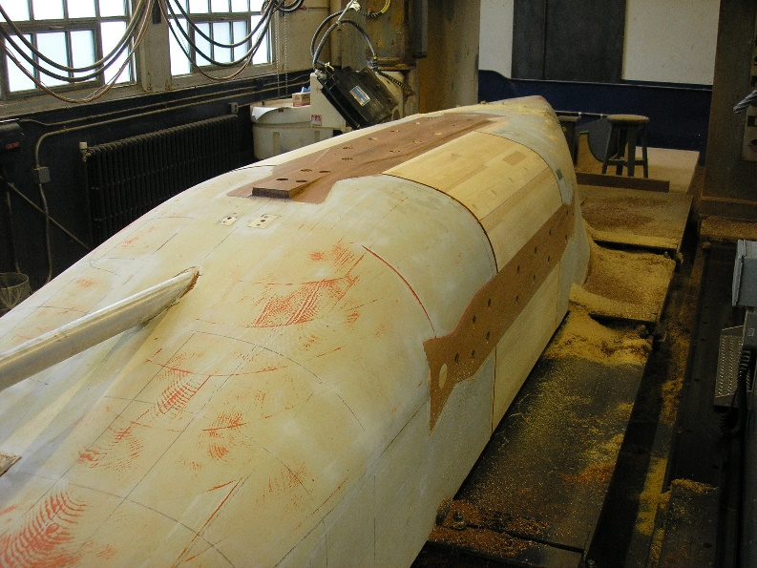
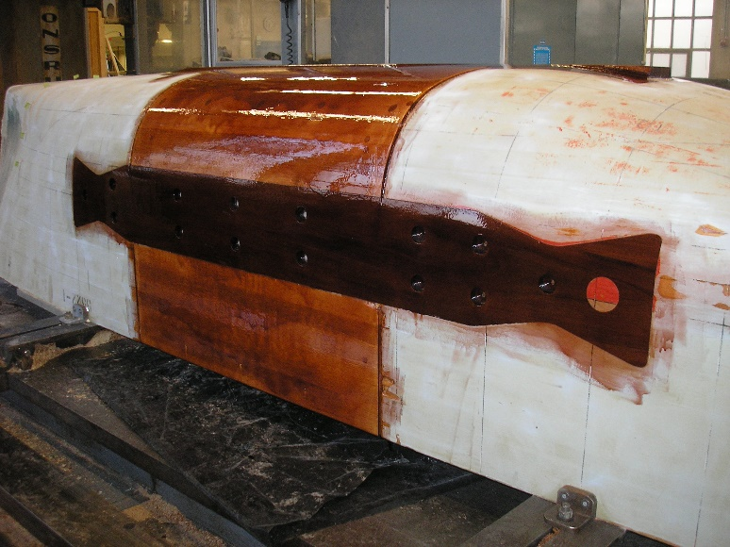
Modification of FSV Model (cont.)

Slide 9
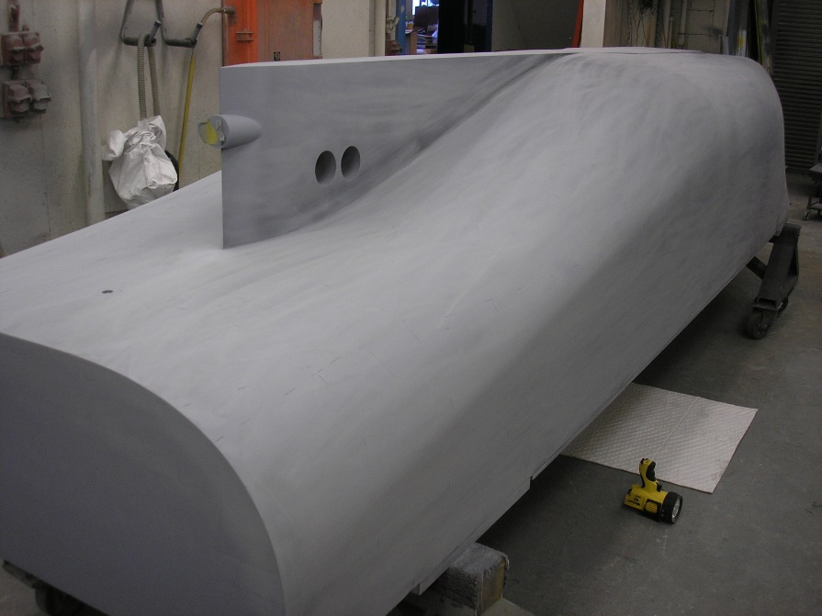
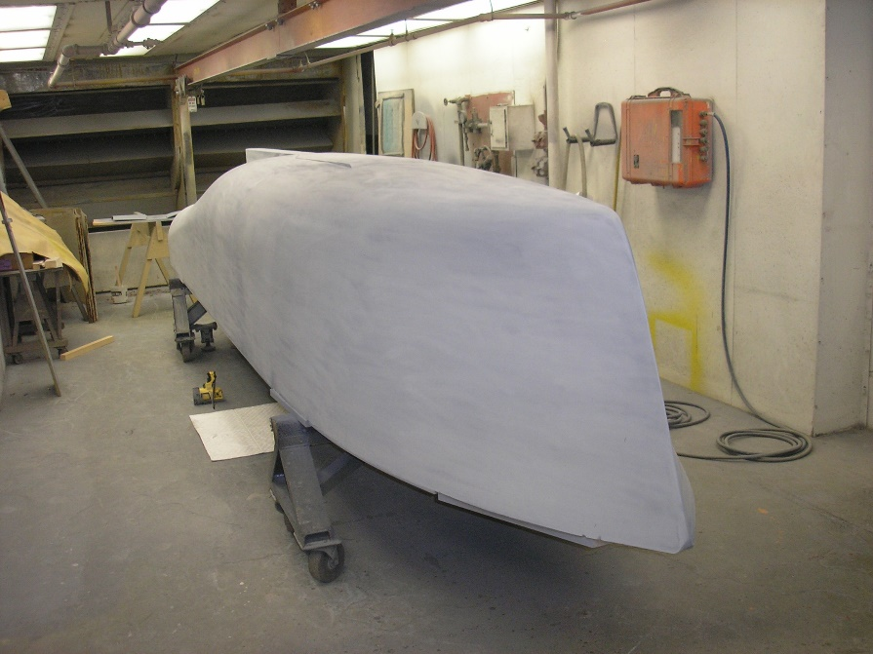
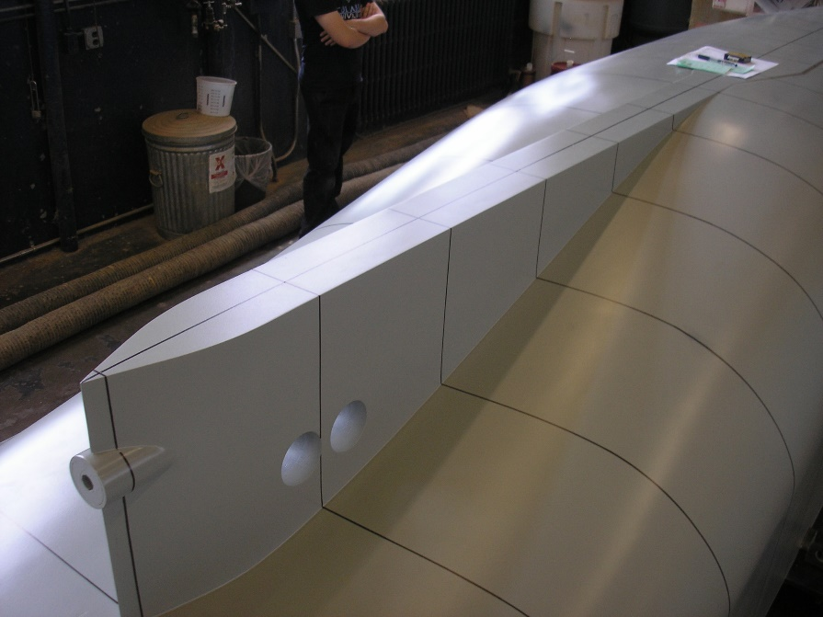
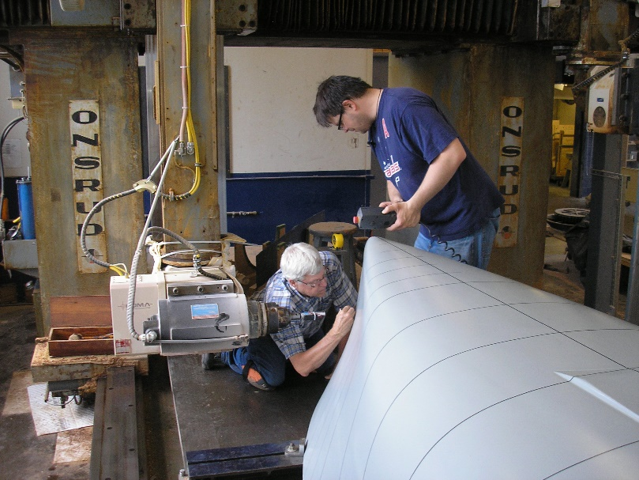
Modification of FSV Model (cont.)

Slide 10
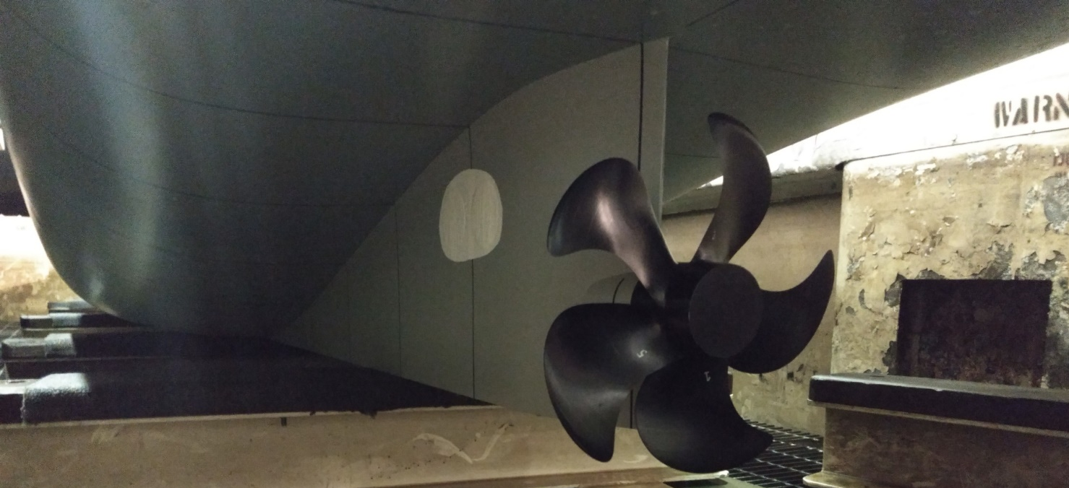
Modification of FSV Model (cont.)
Summary of changes to FSV Hull
 | Original FSV | Modified FSV
Displacement (@ Design Draft) | ≈2,400 tonne | ≈3,250 tonne
Length, Waterline | 61 m ≈200 ft | 73.6 m ≈241 ft
Beam | 15 m | 15 m
Draft, Design | 5.9 m ≈19.4 ft | 5.4 m ≈17.6 ft

