Slide 1
Sea Hunter and Maritime Autonomy
Dr. Timothy Barton Mr. Charles Fralick
Maritime Chief Engineer Maritime Systems Solution Architect
Dr. Robert Touchton
Chief Autonomy Scientist
Leidos, Inc.
This research was developed with funding from the Defense Advanced Research Projects Agency (DARPA). The views, opinions and/or findings expressed are those of the author(s) and should not be interpreted as representing the official views or policies of the Department of Defense or the U.S. Government.

Slide 2
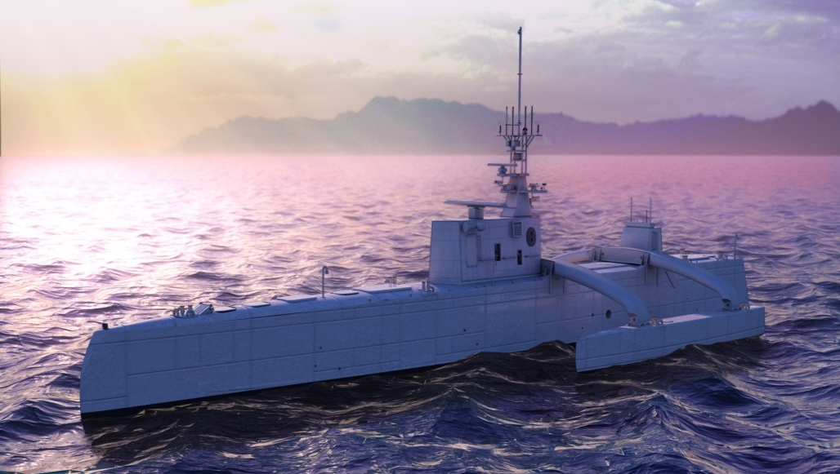
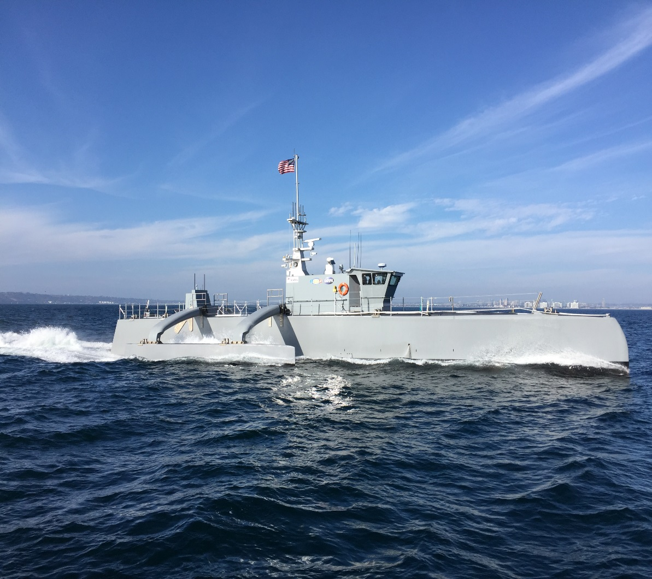
The ACTUV Program – The Sea Hunter Medium Displacement Unmanned Surface Vessel (MDUSV)
Early testing of COLREGS autonomy on surrogate vessel - Pathfinder
Artist’s concept during design phase
Sea Hunter
Purpose: | Key Technologies: | Metrics:
Build and demonstrate an unmanned surface vehicle with ocean-spanning range, months of endurance, and substantial payload
Demonstrate high-level autonomy for independent operations under sparse supervisory control
Demonstrate game-changing approach to anti-submarine warfare (ASW) track and trail mission
Demonstrate utility for additional Navy missions
  Advanced autonomy for highly reliable surface collision avoidance while tracking evasive submarine target. Advanced electro-optical / infrared (EO/IR) capability
  Diverse set of ASW sensors for robust track and trail at standoff of up to a few miles
  New payload technologies
  Alternative missions:
    Survey
    Logistics
    Surveillance
    Other
  Compliance with International Maritime Organization Rules for Preventing Collisions at Sea (COLREGS), including vessel classification
    Propulsive and maneuvering overmatch versus next-generation diesel-submarine threat; high-assurance
    Endurance and reliability to complete ≥ 70-day missions
    Unit production cost less than $20M
Notes:
Pulled from 20120730_TEMPLATE_TTO_Overview_20120719_0959

Slide 3
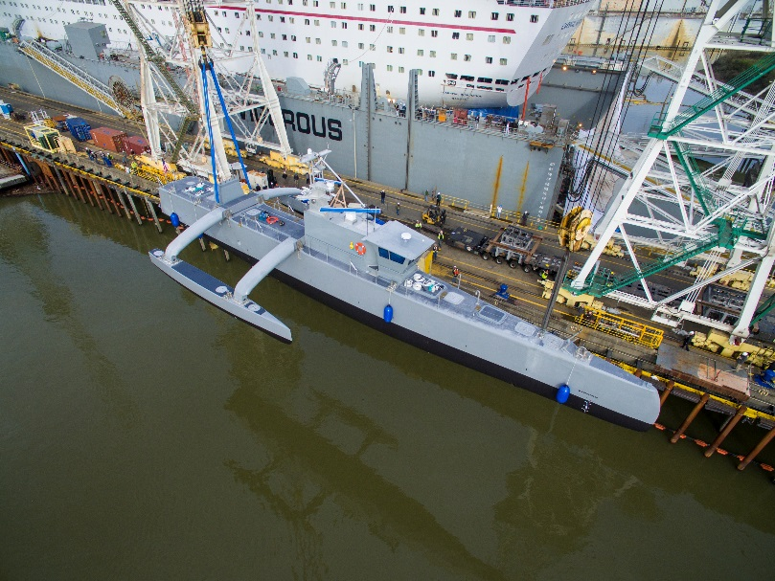
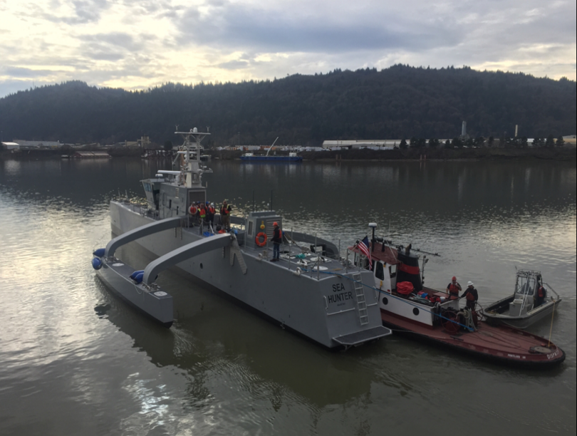
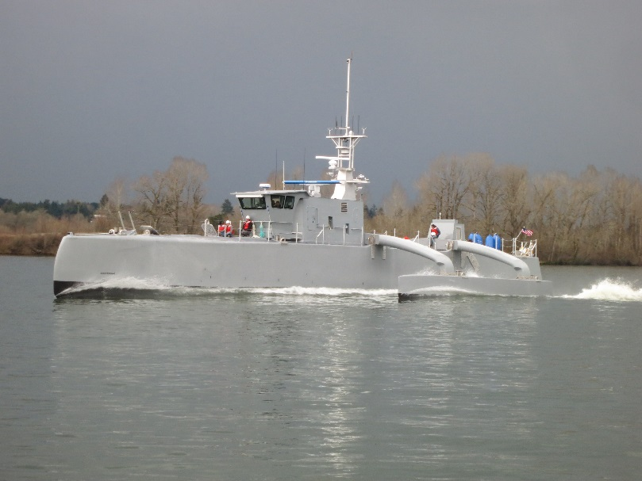
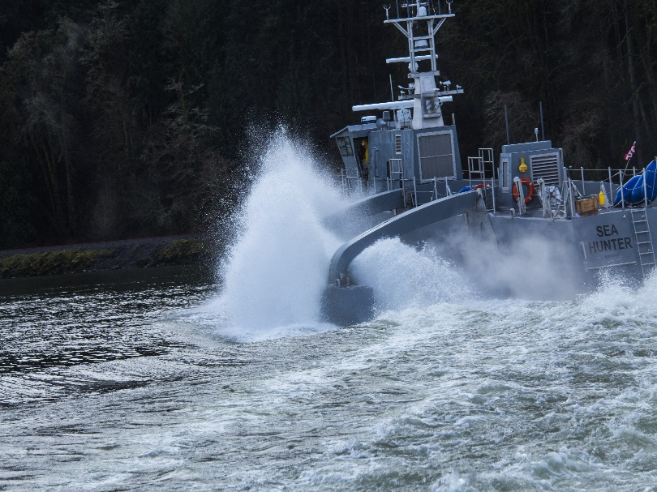
Sea Hunter Initial Testing
January 2016

Slide 4
Sea Hunter Initial Testing
January 2016
Please see: http://www.darpa.mil/work-with-us/actuv-christening-media-kit
ACTUV Speed & Maneuverability Tests

Slide 5
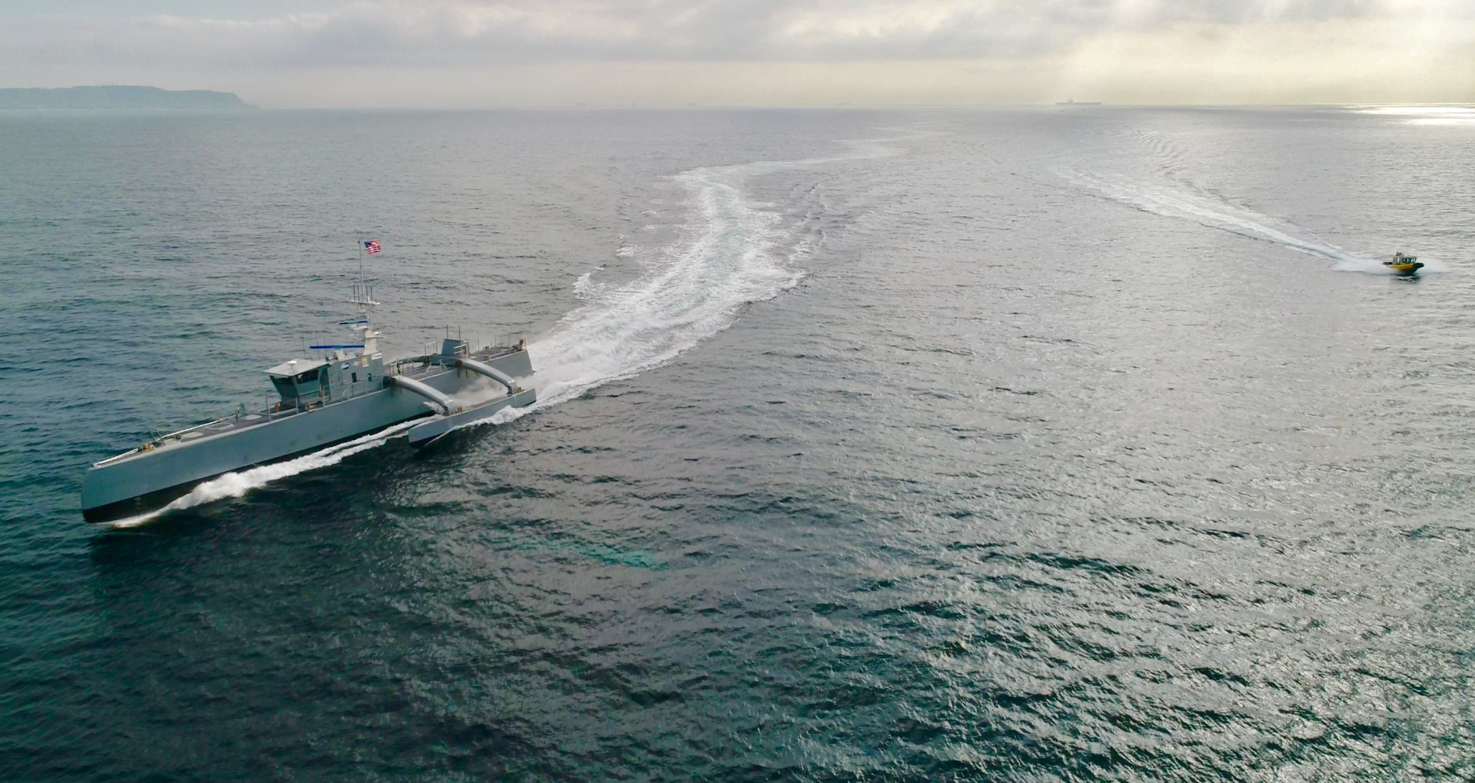
Sea Hunter Sea Trials
January 2017
Sea trials: Mature technology, demonstrate reliability and performance, and build trust in autonomous behaviors, vessel, vessel sub-systems, and remote supervisory control

Slide 6
General Autonomy Implementation
Many Government and commercial organizations have autonomy implementations on un-manned systems and platforms
  The logic and autonomy behaviors are typically straight-forward – it is how they are implemented within the system context that is important
  Typically complex and centralized – makes fault tolerance difficult
  Hard to manage organizational intellectual property (IP)
  Typically does not adhere to standards for interfaces and services – difficult and not cost effective to upgrade, improve, or to include “best of breed” solutions – vendor lock
  Typically include information assurance (IA) and anti-tamper (AT) measures as after thoughts; difficult and not cost effective to integrate and modify as risks and threats change
Desire autonomy implementations that reduce cost, risk, and schedule:
  Open systems architecture (OSA) and standards compliance
  Distributed hierarchical autonomy (DHA)
    Modular and distributed functionality – centralized supervisory autonomy, sub-system autonomy is specialized
    Supports fault tolerance
    Supports strong IA/AT features and multi-level security applications
    Supports safety critical implementations
    Supports IP management for Government and Industry
  Reuse proven capabilities instead of custom solutions

Slide 7
General Autonomy: Module and Functionality View
Open, modular, and scalable to platform, application, and mission
Internal and external
interfaces enabled by
Open Systems
Architecture (OSA)
Intelligent Processing: Core capability for decision making, path planning, and platform safety ➔ Configurable and adaptable
autonomous behaviors (AB_{i})

Slide 8
World Model and Intelligent Processing
The World Model Module:
  Maintains situational awareness by persisting two categories of data: capabilities and state/status (past, present, and future), to include:
    Own-ship information – Ex: Position, course, and speed
    Environment information – Ex: Meteorological data
    External entities – Ex: Contacts
  Fuses data
  Feeds any autonomy decision engine to determine needed platform maneuvers and courses of action (CoAs)
  Provides situation awareness updates to the command center on request via human-machine interface (HMI) messages
Intelligent Processing Module:
  Contains the autonomy decision engines and autonomous behaviors that compute the best possible course of action given mission parameters
  Produces prioritized CoAs/routes by combining:
    Mission guidance (goals, rules, and objectives) from High Level Mission Planner
    World Model content
    CoAs/routes from Autonomy Decision Engines/Path Planners
    Contact Behavior Maps from Contact Behavior Processing
    Performance limitations from Health Monitoring
  Sends results to Intelligent Decision Support for final scrub of the results to be executed by the Platform
USV World Model Example
Multi-Hypothesis
Tracker (MHT)
Multiple Sensor Outputs
Fused Information
World Model
High Level Mission Planner
Intelligent Processing
Contact Behavior Processing
Autonomy Decision Engine 1
AB₁
Intelligent Decision Support
…
…
Health Monitoring
Autonomy Decision Engine N
AB_{M}
Platform Control

Slide 9
General Autonomous Platform / Team
Cyber-security Issues
Information assurance:
  Risk assessments and management plans
  Key distribution and validation
  Protection of data at rest
  Protection of data on the move
Anti-tamper:
  Intrusion detection: Mechanical, electrical, software/algorithms/logic/behaviors, and data
  Intrusion prevention
Autonomy behaviors:
  Autonomy behaviors will manage information assurance, anti-tamper, and corresponding responses
  Protection of own team and individual platform autonomous behaviors
  Exploitation of adversary team and individual platform autonomous behaviors
Supervisory Autonomy Controller
Intrusion Controller
Sub-System Handler 1
Sub-System Handler N

Slide 10
Summary
The DARPA ACTUV Program has produced the first long-range, long-endurance MDUSV
  COLREGs, obstacle avoidance, and mission autonomy behaviors
    Autonomy is installed and being tested
  Rigorous test program to mature technology, demonstrate reliability, and to build trust
  Currently undergoing sea trials
  Alternative missions being explored
Leidos maritime platform and collaborative team autonomy:
  Open systems architecture (OSA) and standards compliance
    Allows cost-effective and timely improvements in capability, and avoids vendor-lock
  Distributed hierarchical autonomy (DHA) – modular and distributed functionality
    Supports fault tolerance
    Supports strong IA/AT features and multi-level security applications
    Supports safety critical implementations
    Supports IP management for Government and Industry
Robust communications and cyber-security are key to effective and successful autonomous platform and collaborative team mission performance
Autonomous platforms and collaborative teams of manned and unmanned autonomous platforms can execute current missions at a lower cost and risk profile – and they can enable new missions

