Slide 1
National Geodetic Survey Update
Juliana Blackwell
Director, National Geodetic Survey
September 12, 2017

Slide 2
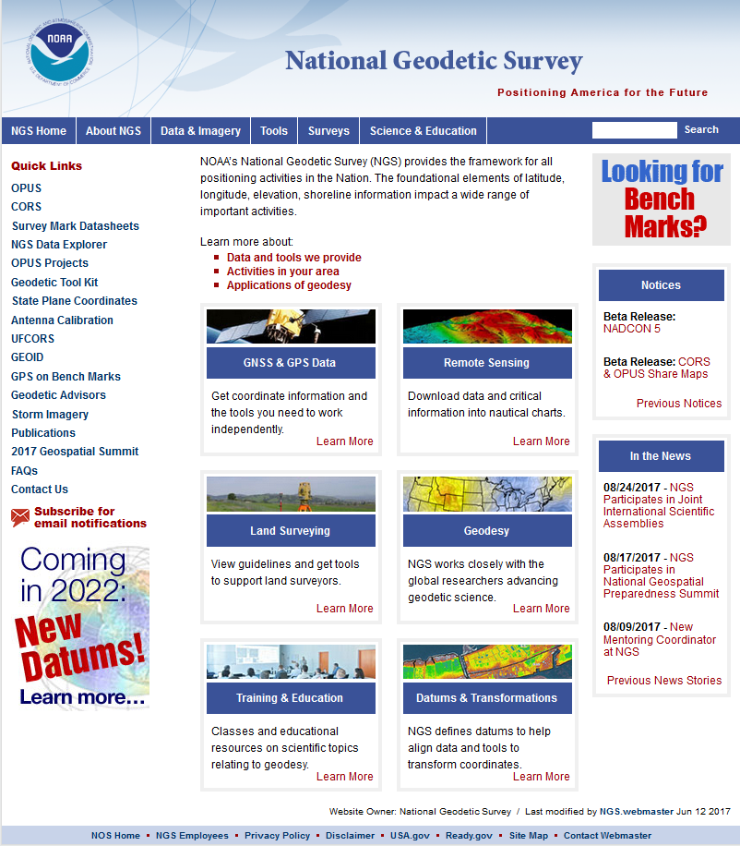
New NGS Home Page
Updated the NGS Home Page to help orient new web users
Developed new landing pages to organize the website more efficiently
https://www.geodesy.noaa.gov

Slide 3
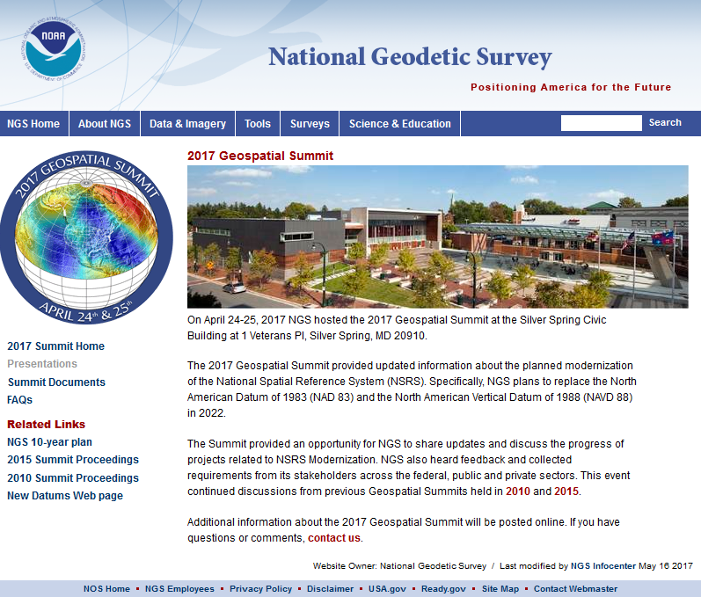
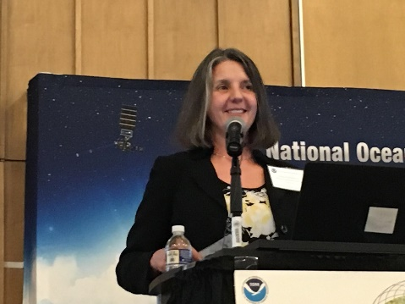
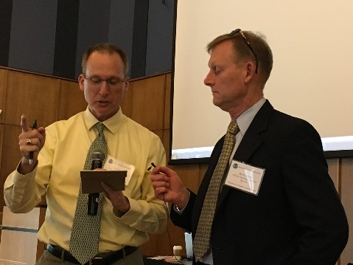
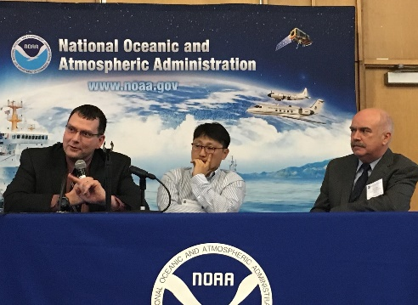
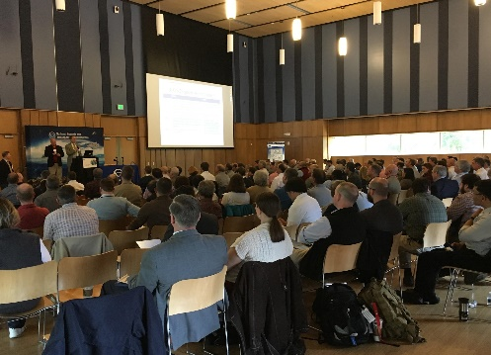
Geospatial Summit 2017 April 24-25, 2017
Webinar videos and
presentations are available
“Debriefing the 2017 Geospatial Summit”
NGS Webinar Series
September 14, 2017
Webinar Information
https://geodesy.noaa.gov/geospatial-summit/
‹#›

Slide 4
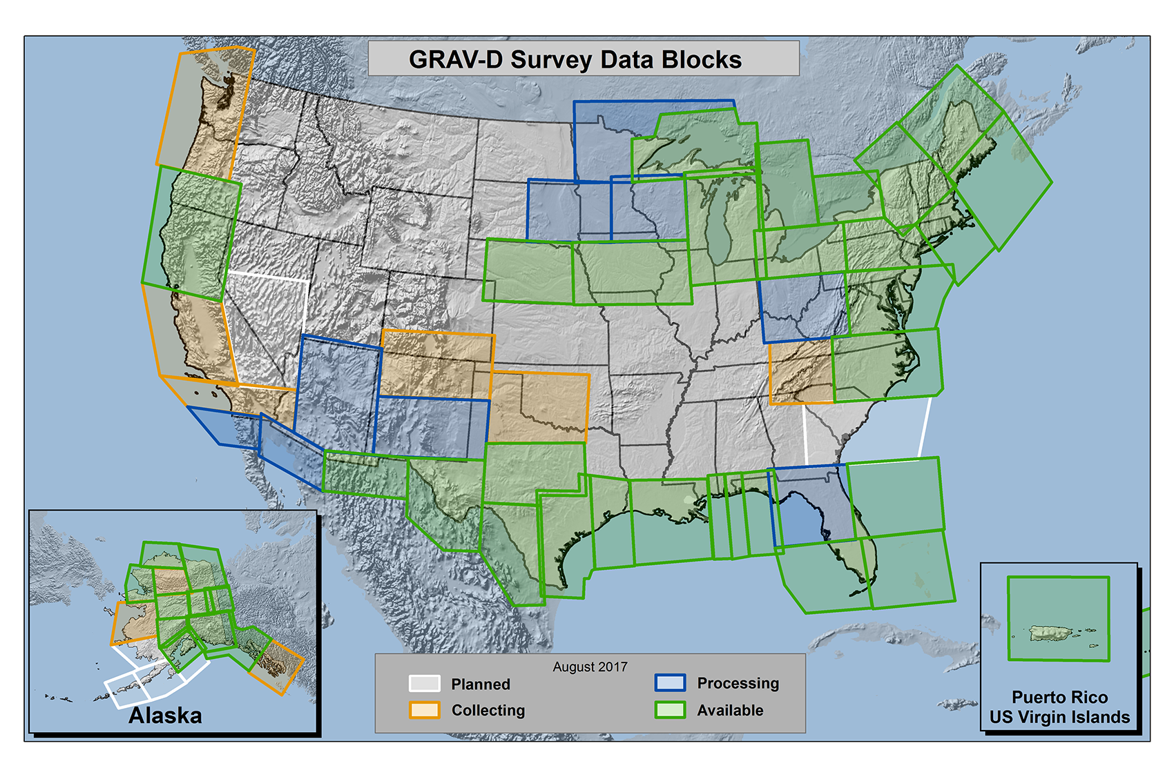
Gravity for the Redefinition of the American Vertical Datum (GRAV-D)
63% data
collection
complete
https://www.geodesy.noaa.gov/GRAV-D/

Slide 5
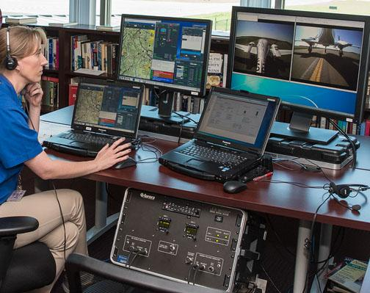
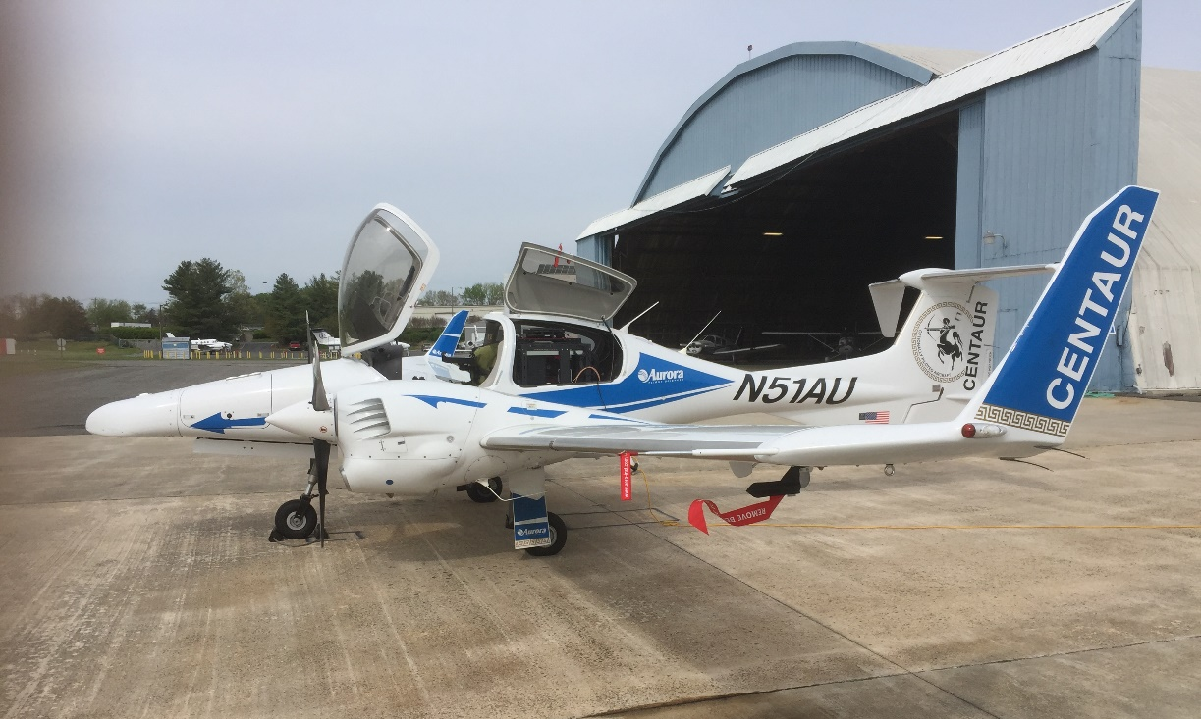
Gravity for the Redefinition of the American Vertical Datum (GRAV-D)
Aurora Centaur optionally-piloted aircraft used for GRAV-D data collection in two locations
‹#›

Slide 6
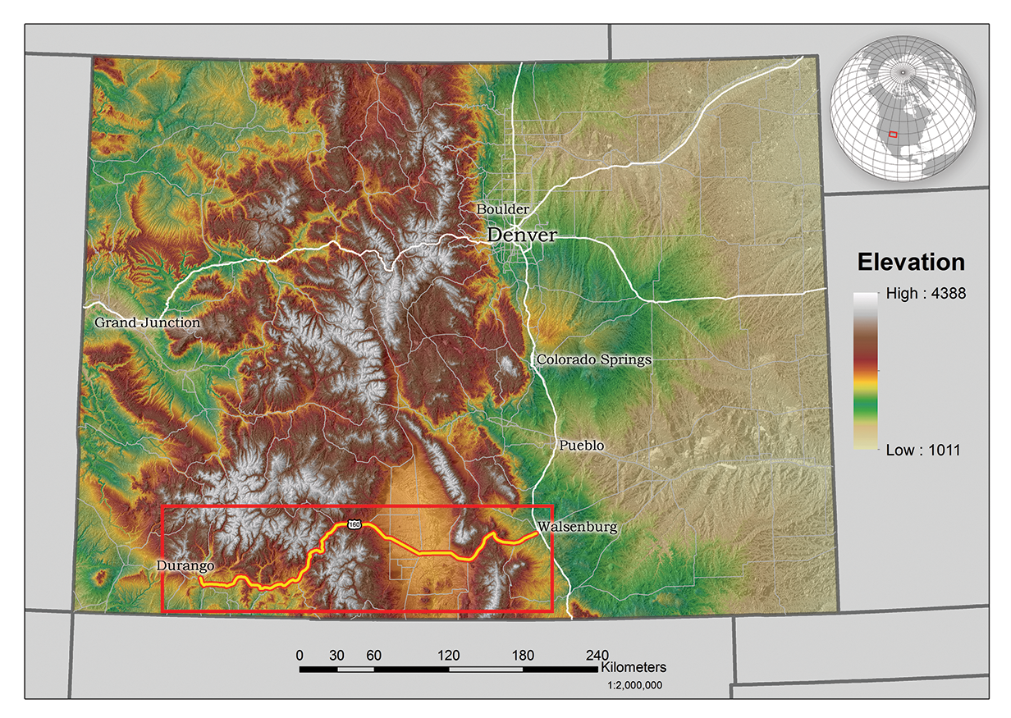
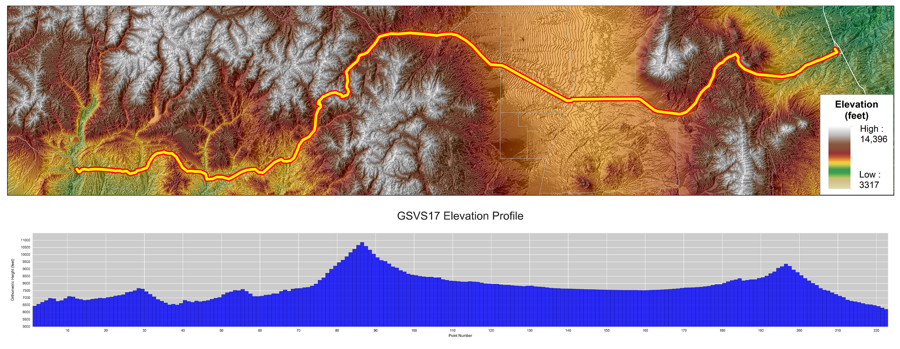
Geoid Slope Validation Survey (GSVS17)
Colorado along Highway 160 from Durango to Walsenburg
221 new monuments, 221 miles
>1250m (~4100 ft) elevation change

Slide 7
Coastal Mapping Accomplishments
As of the beginning of August 2017:
Shoreline: 5.4% compiled; 3.7% delivered to NSDE
Ports: 38 compiled, 14 delivered to NSDE
CSCAP: 33 ports analyzed for change
CUSP: 14,636 miles updated
TopoBathy LiDAR: 1846 mi² collected; 1178 mi² delivered to Digital Coast
‹#›

Slide 8
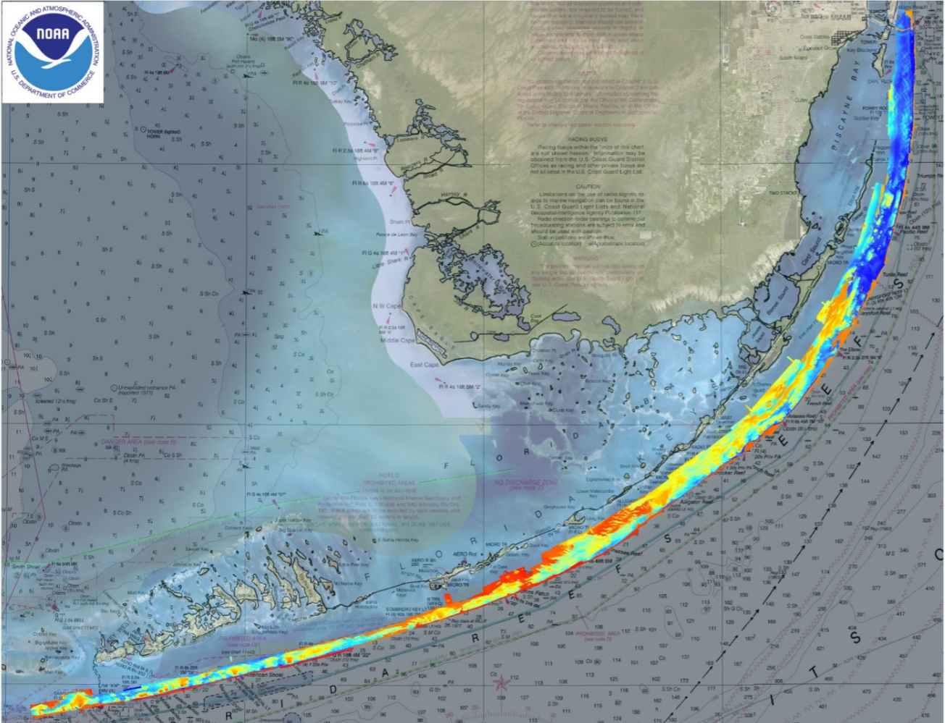
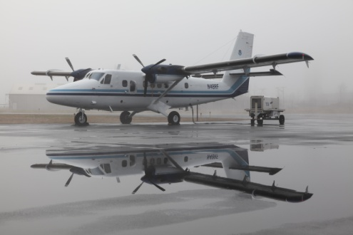
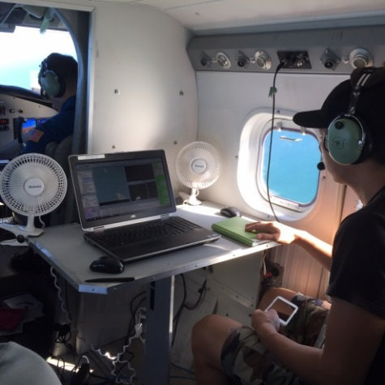
Florida Keys Lidar Survey

Slide 9
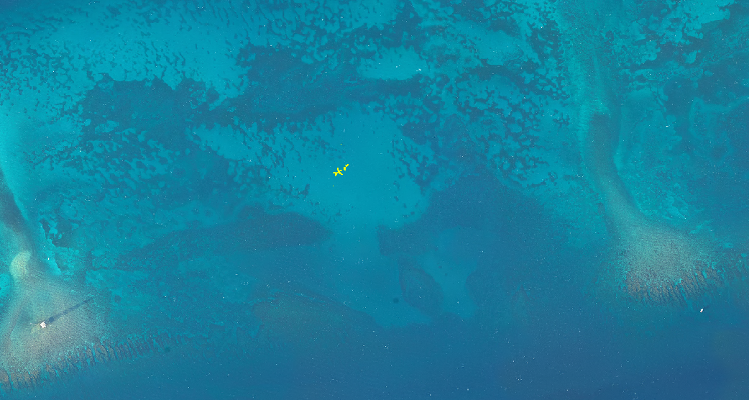
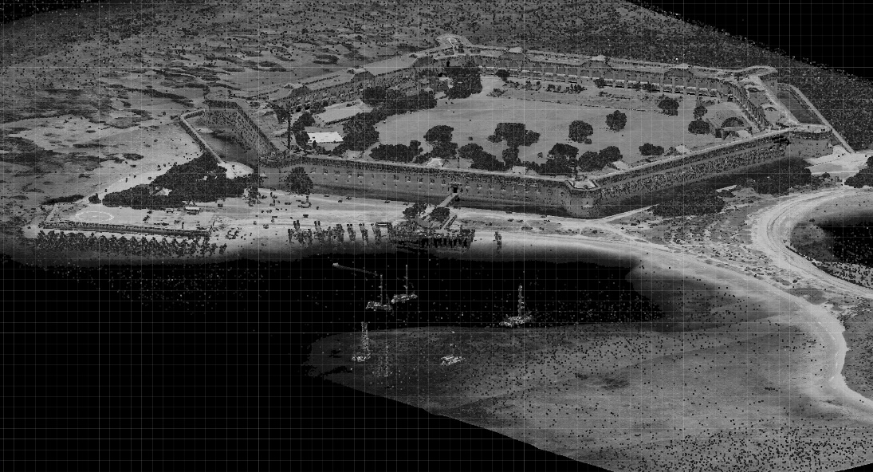
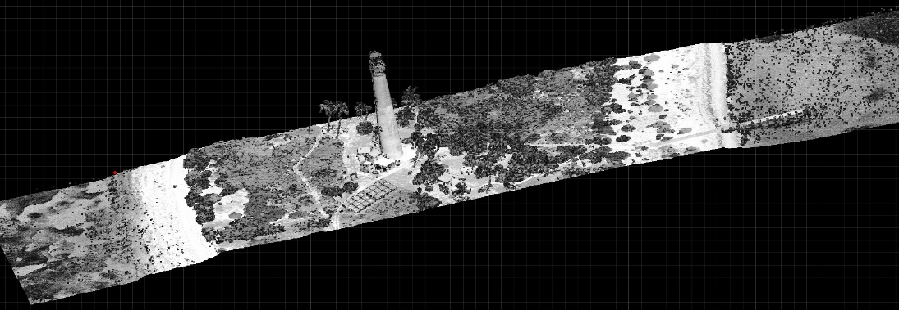
Florida Keys Lidar Survey
Fort Jefferson, Dry Tortugas
Point density of the object ranged from ~12 to 13 pts per m²
Water depth: ~7.7m
Object height: 2m
Loggerhead Key Lighthouse,
Dry Tortugas
~7.7 m
2 m

Slide 10
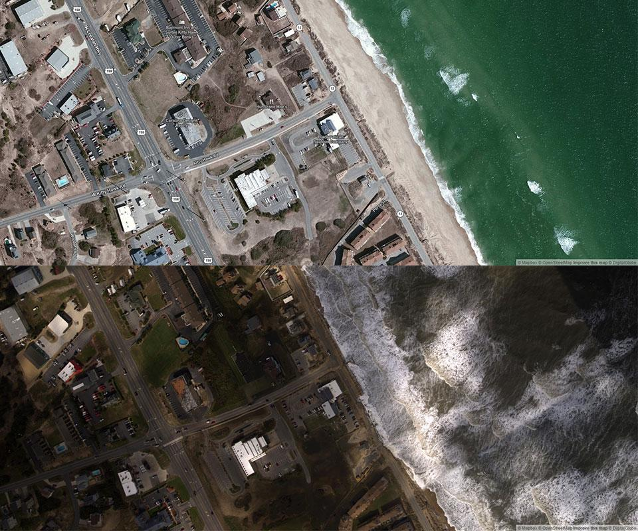
Emergency Response Imagery
Hurricane Matthew
https://storms.ngs.noaa.gov/
‹#›

Slide 11
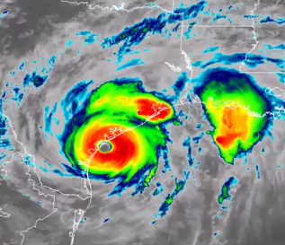
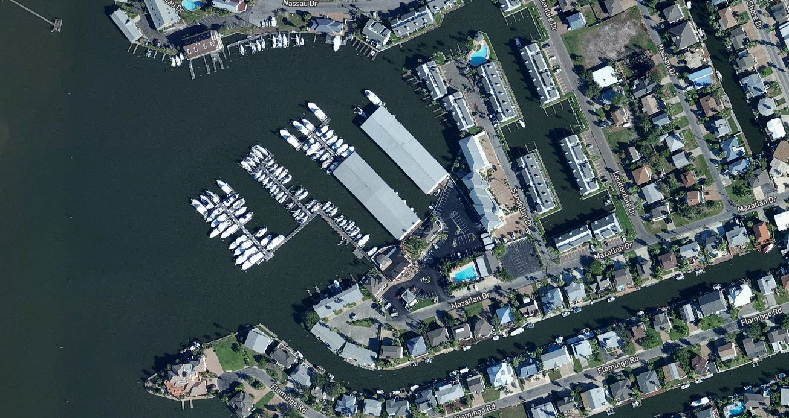
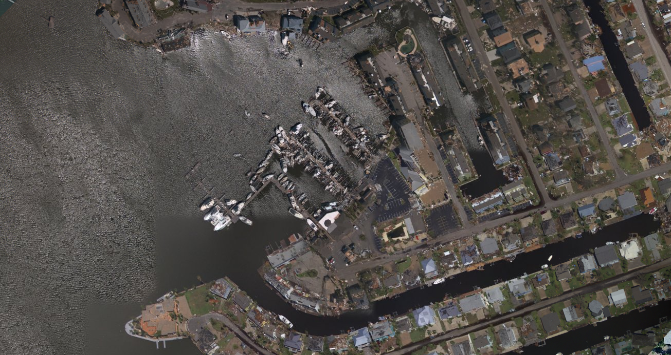
Emergency Response Imagery
Hurricane Harvey
https://storms.ngs.noaa.gov/storms/harvey/
‹#›

Slide 12
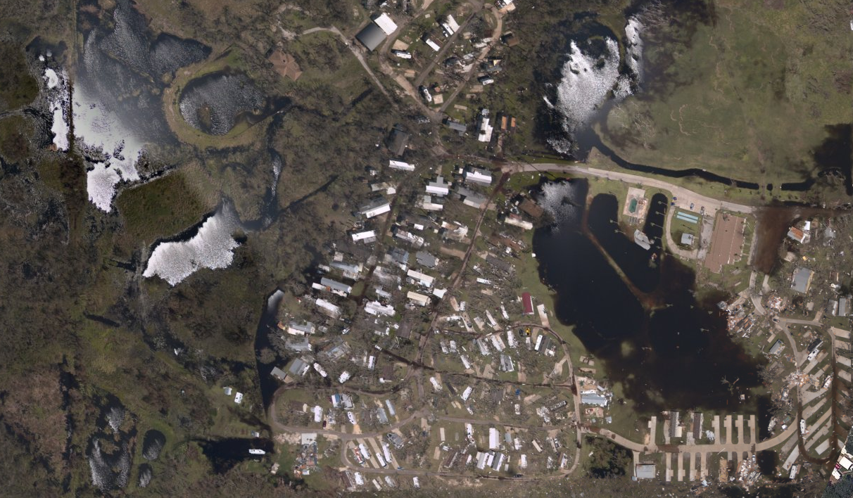
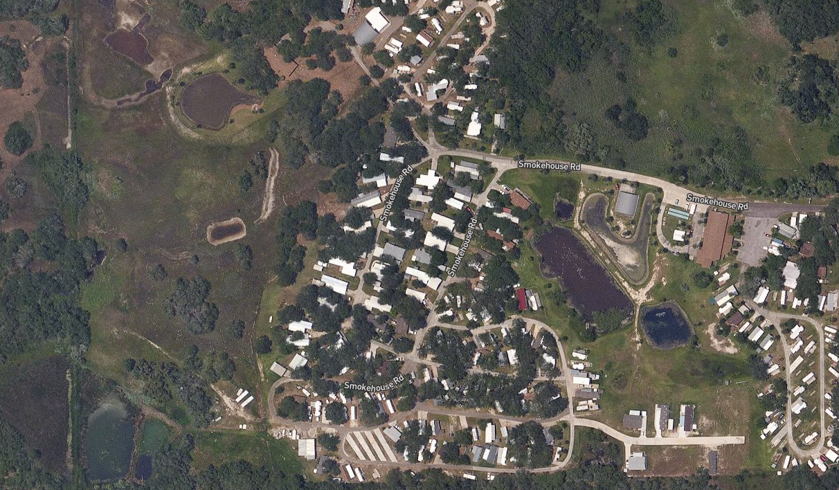
Emergency Response Imagery
Hurricane Harvey
https://storms.ngs.noaa.gov/storms/harvey/
‹#›

Slide 13
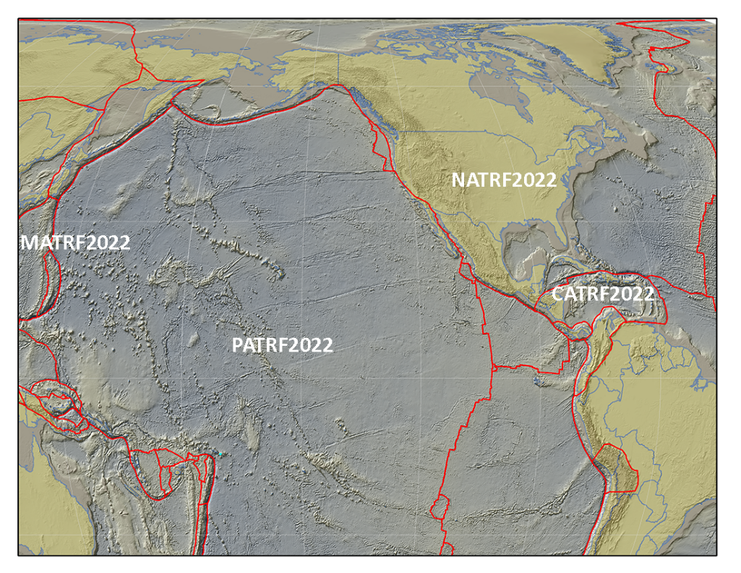
NSRS Modernization New Reference Frames
Blueprint for 2022, Part 1: Geometric Coordinates
The North American Terrestrial Reference Frame of 2022 (NATRF2022) to replace NAD 83 (2011)
The Caribbean Terrestrial Reference Frame of 2022
(CATRF2022) to replace NAD 83 (2011)
The Pacific Terrestrial Reference Frame of 2022 (PATRF2022) to replace NAD 83 (PA11)
The Mariana Terrestrial Reference Frame of 2022 (MATRF2022) to replace NAD 83 (MA11)

Slide 14
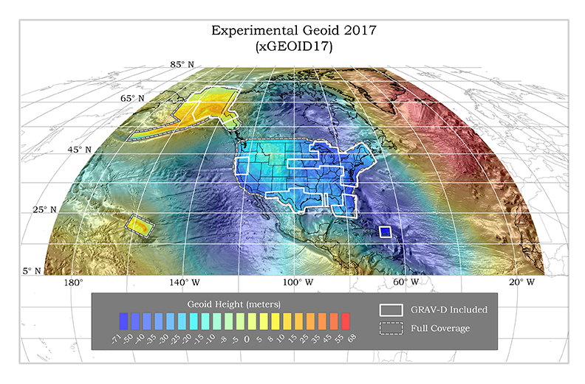
NSRS Modernization New Geopotential Datum
Blueprint for 2022, Part 2: Geopotential Coordinates
The North American-Pacific Geopotential Datum of 2022 (NAPGD2022) will include GEOID2022

Slide 15
FY18 Priorities
Host Industry Day in 2018
Define motion parameters for the Marianas Plate
Re-establish a comprehensive CORS Program
Perform a socio-economic study of the Regional Advisor Program
Update NGS Ten-Year Strategic Plan
Perform a 3D Nation study (joint effort)
‹#›

