Slide 1
International Hydrographic Organization (IHO) Arctic Maritime Spatial Data Infrastructure Project and NGA Arctic Website
Keith Dominic – Chief Maritime Navigation Division Atlantic
July 2017
Approved for public release, 17-674.

Slide 2
Approved for public release, 17-281.

Slide 3
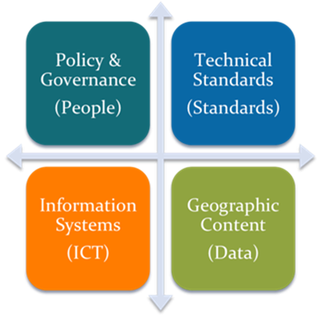
Marine Spatial Data Infrastructure (MSDI)
SDI
  “The relevant base collection of technologies, policies and institutional arrangements that facilitate the availability of and access to spatial data.”
  - The SDI Cookbook¹
Four Pillars/Components of SDI²
  Data and Metadata - comprise the information to be made accessible
  Information System/Technology - which encompasses the hardware, software and system component.
  Standards - which emphasizes the “unlocking” of geospatial data.
  Policy and Governance - which dictates the structural relationships of all those involved.
MSDI
  A MSDI is not a collection of hydrographic products, but an infrastructure that promotes interoperability of data at all levels (e.g., national, regional, international).
    Discoverability
    Accessibility
    Interoperability
    Data-centricity (Hydrographic Offices)
  Supports wider, non-traditional user-base of marine data typically used for navigation.
MSDI Pillars/Components
M
Marine
1 - http://www.gsdiassociation.org/images/publications/cookbooks/SDI_Cookbook_from_Wiki_2012_update.pdf
2 - (Presentation) Canada’s Marine Spatial Data Infrastructure, Canadian Hydrographic Conference May 2016, Fisheries and Oceans Canada
Image Credit: (DRAFT) IHO Publication C-17, Spatial Data Infrastructures: “The Marine Dimension” - Guidance for Hydrographic Offices, Ed 2.0, April 2016
Approved for public release, 17-281.

Slide 4

Data-Centric Production and MSDI
Search and Rescue
Industry and Marine Spatial Planning
Fisheries
(standardized)
Marine Spatial Data
Scientific Research
Chart Product
Bathymetry
+
Chart Geometry
Databases
4₁
4₁
4₁
4.1m
Data-centric
Production
Bathymetry
Small Scale Large Scale
Approved for public release, 17-281.

Slide 5
Arctic Regional MSDI
Support non-traditional users of Hydrographic Office (HO) data in the Arctic.
The HO assumes the role of a data provider.
Marine
Geospatial
Data
HO
ARMSDI
Arctic User-base
support
Approved for public release, 17-281.

Slide 6
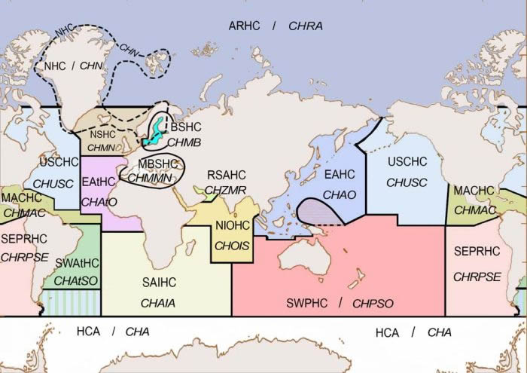
International Hydrographic Organization
Regional Hydrographic Commissions
Regional Hydrographic Commissions (RHC)
  87 IHO Member States
  Coordinates hydrographic activity and cooperation at the regional level. The RHCs are made up of IHO Member States together with other regional States that wish to participate.
  Meet at regular intervals to discuss hydrographic and chart production problems, plan joint survey operations, and resolve schemes for medium and large scale International Chart coverage in their regions.
Image Credit: https://www.iho.int/srv1/index.php?option=com_content&view=article&id=420&Itemid=379&lang=en
Approved for public release, 17-674.

Slide 7
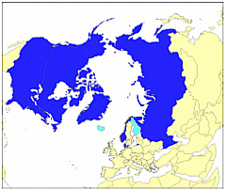
Arctic Regional Hydrographic Commission (ARHC)
ARHC Members
  Canada
  Denmark
  Norway
  Russian Federation
  United States
ARHC Associate Members
  Finland
  Iceland
ARHC 5th Meeting (Oct 2015): Denmark and U.S. proposed a regional approach to
Maritime Spatial Data.
ARHC 6th Meeting (Oct 2016) Arctic Regional Marine Spatial Data Infrastructures
Working Group (ARMSDIWG (ɑrmz - dē - wɪg)) established. Currently represented nations:
  Canada
  Denmark
  Finland
  Iceland
  Norway
  United States (NGA Chair)
ARMSDIWG1 (Apr 2017)
  MSDI Arctic Voyage Planning Guide
  Pan-Arctic Bathymetry link
  Joint Meeting with Arctic SDI
Image Credit: https://www.iho.int/srv1/index.php?option=com_content&view=article&id=435&Itemid=690&lang=en
Approved for public release, 17-281.

Slide 8
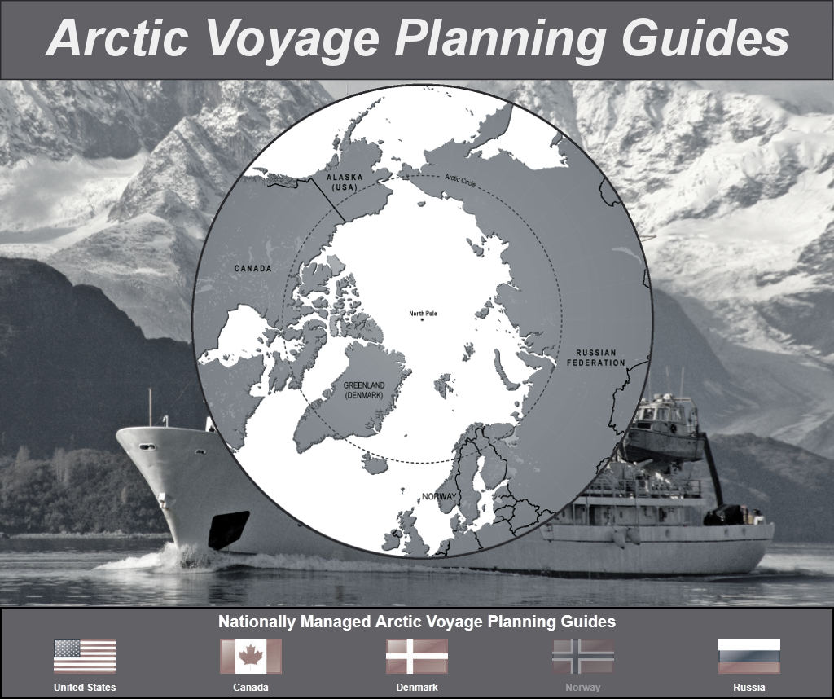
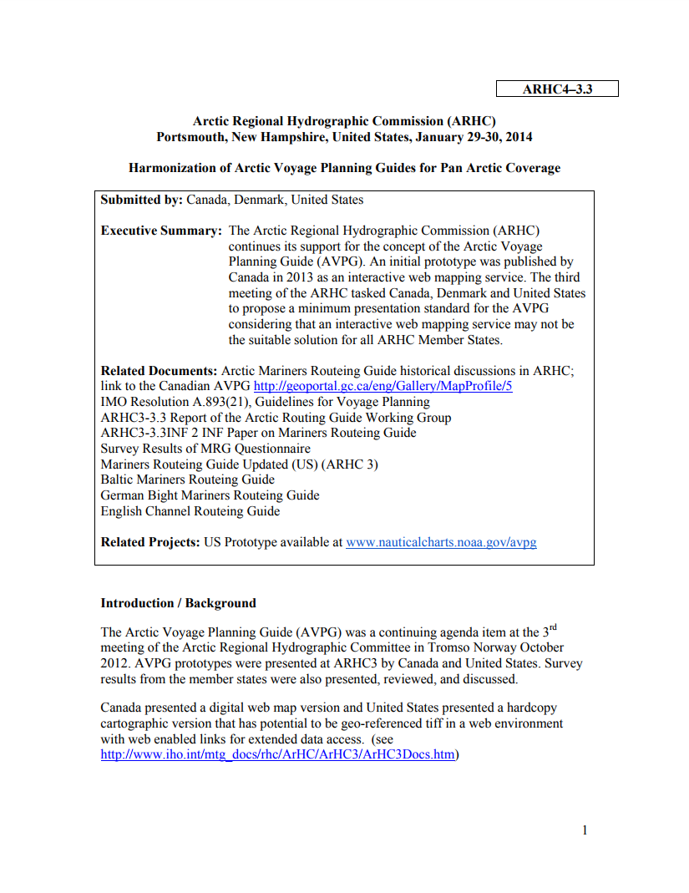
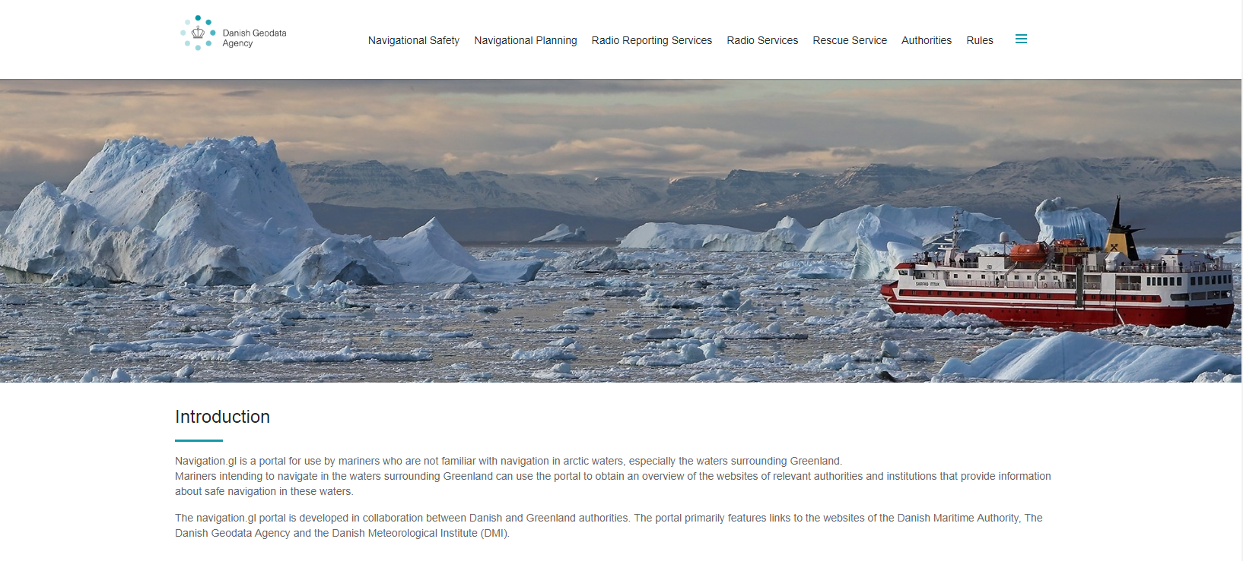
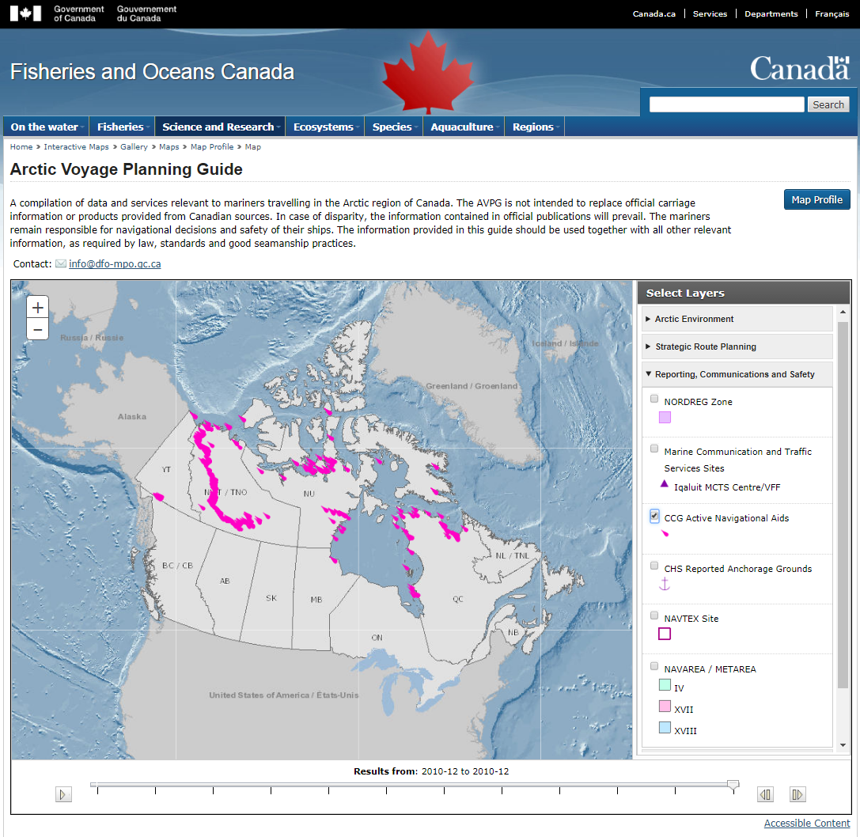
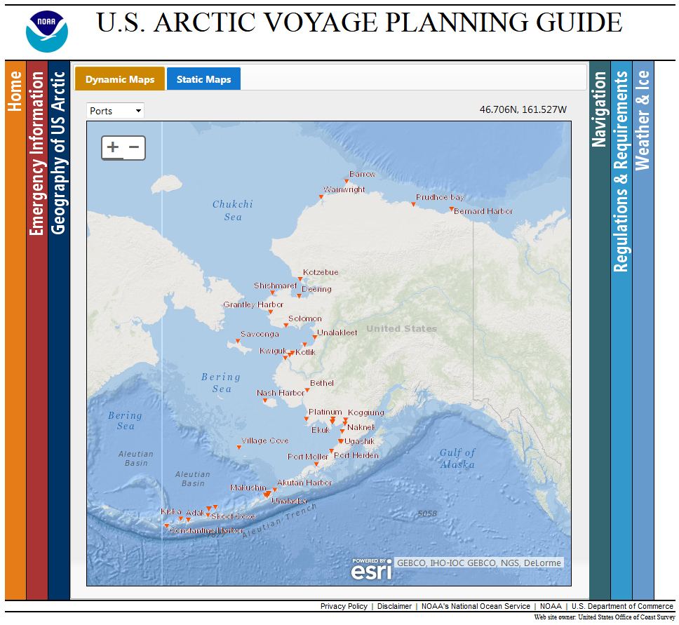
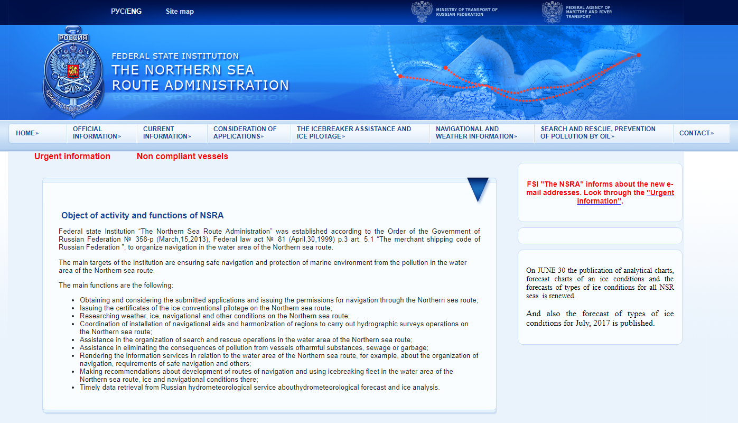
ARHC4-3.3 Harmonization of Arctic Voyage Planning Guide for Pan Arctic Coverage – pivoting from this document, but with a MSDI approach.
Image Credits - https://www.nauticalcharts.noaa.gov/avpg/
- http://www.nauticalcharts.noaa.gov/avpg/guide.htm
- http://geoportail-geoportal.gc.ca/eng/Gallery/mapprofile/5
- http://eng.navigation.gl/
- http://asmp.morflot.ru/en/celi_funktsii/
Approved for public release, 17-674.

Slide 9
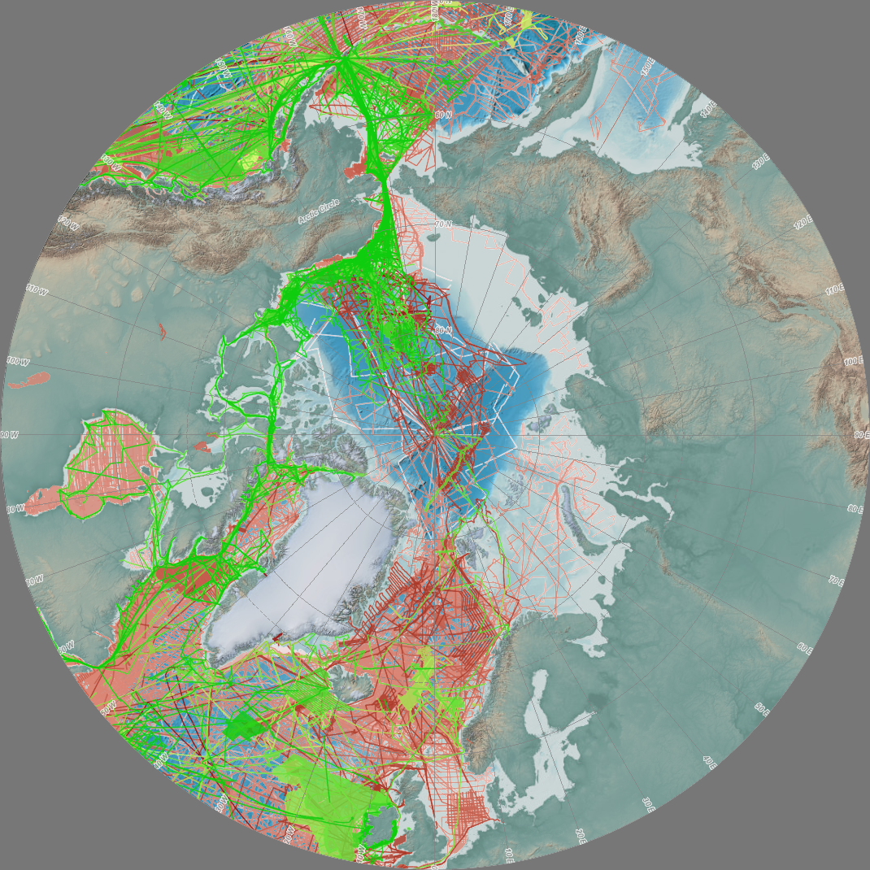
The IHO Data Centre for Digital Bathymetry (DCDB) is hosted by the U.S. National Oceanographic and Atmospheric Administration (NOAA) on behalf of the IHO Member States.
■ Multibeam Bathymetric Surveys
■ Single-Beam (Trackline) Bathymetric Surveys
Image Credit - https://maps.ngdc.noaa.gov/viewers/bathymetry/
Approved for public release, 17-674.

Slide 10
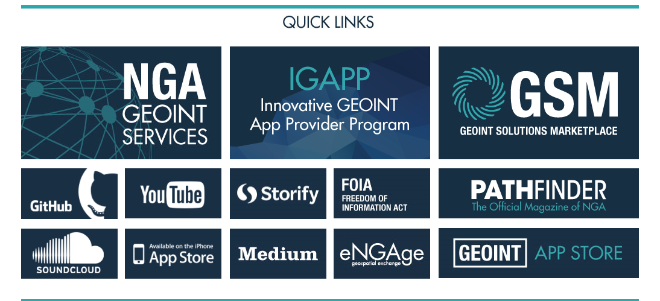
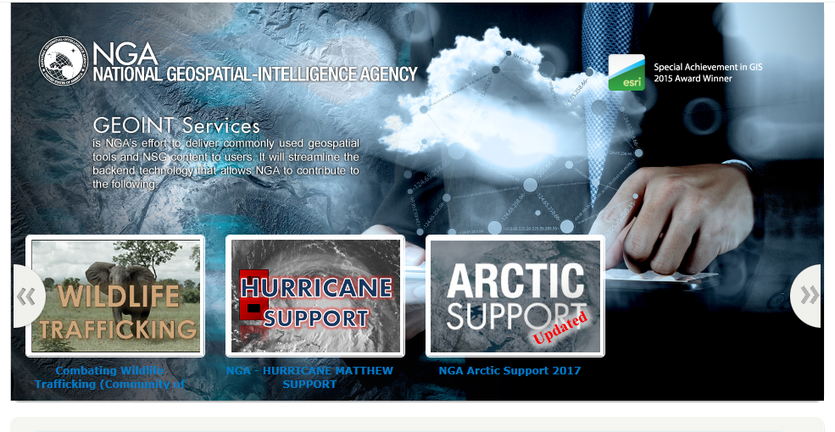
National Geospatial-Intelligence Agency (NGA) Website www.NGA.mil
Approved for public release, 17-674.

Slide 11
Arctic Data Available
  Arctic Routes
  Canadian Shipping Routes
  Arctic Currents
  Airfields
  Ports
  Bathymetric Data
  Terrain
  Oil Production Sites
  Gas Production Sites
  Oil Drilling Areas
  Oil and Gas Reserves
  Rivers
  Railroads
  Roads
  Populated Places
  Sea Ice Extents
  Estimates of Undiscovered Oil and Gas
  Search and Rescue
  Navigational Warning Areas
  Economic Exclusion Zones and Claims
  NGA Sailing Directions
  NGA Standard Nautical Charts
  Maritime Boundaries and Claims
Approved for public release, 17-674.

Slide 12
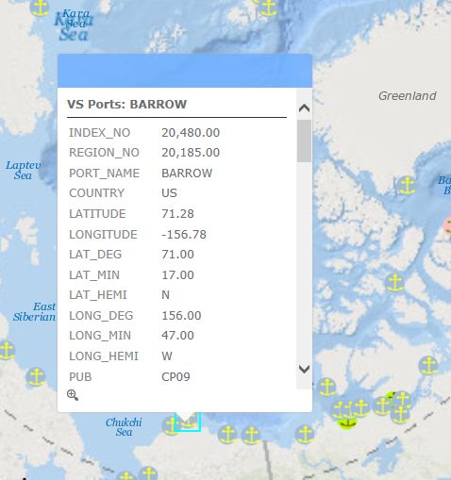
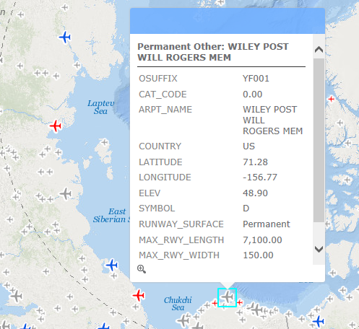
National Geospatial-Intelligence Agency (NGA) Website
Port Facilities
Airfields
Approved for public release, 17-674.

Slide 13
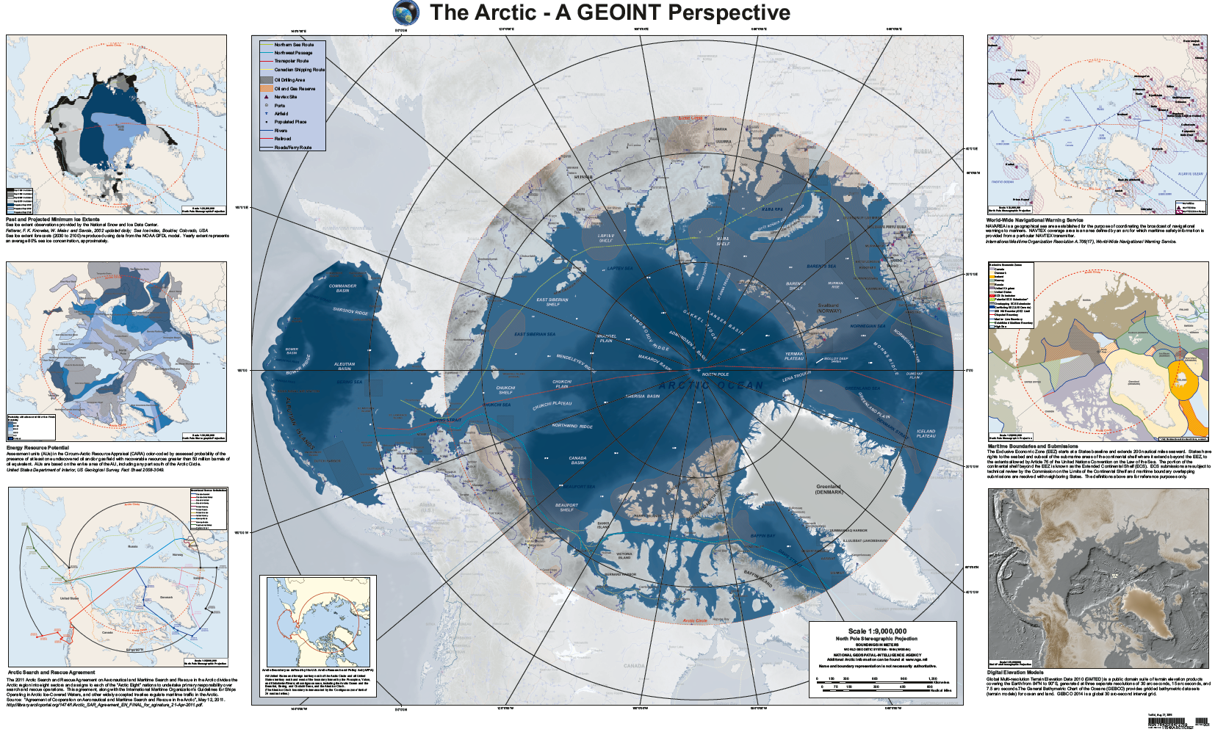
Approved for public release, 17-674.

Slide 14
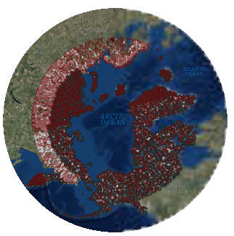
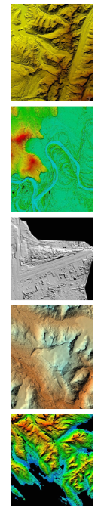
Digital Elevation Model (DEM)
The National Geospatial-Intelligence Agency (NGA) and the National Science Foundation (NSF)partnered with the University of Minnesota and other members of the academic research community, private sector and international partners to create this first-ever publicly available, high-resolution, satellite-based elevation data map of the Arctic.
Approved for public release, 17-674.

Slide 15
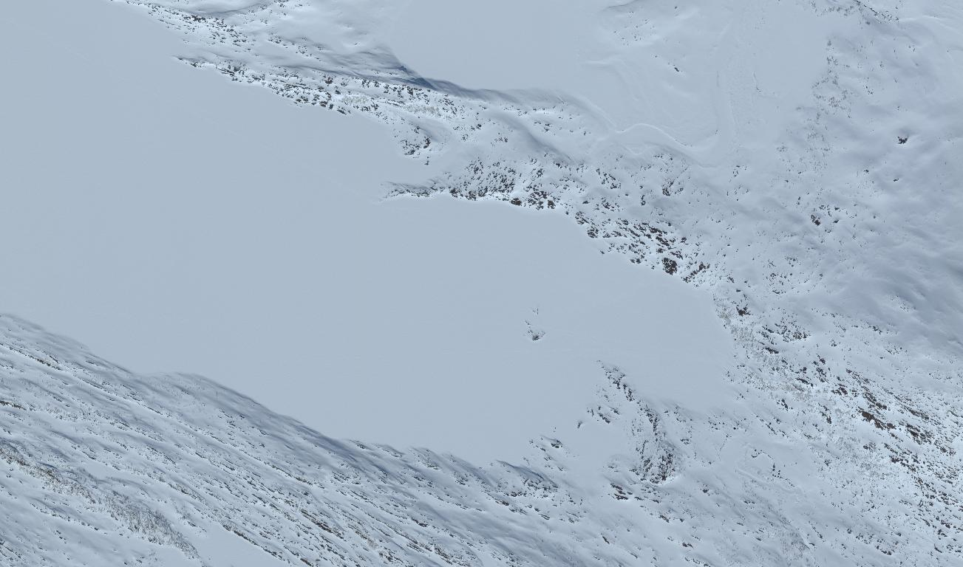
Digital Elevation Model (DEM)
Snow Machine Tracks
Padjelanta
National Park
Sweden
67.38069 North
16.791569 East
Tracks start here
Imagery Copyright 2016 DigitalGlobe
Approved for public release, 17-674.

Slide 16
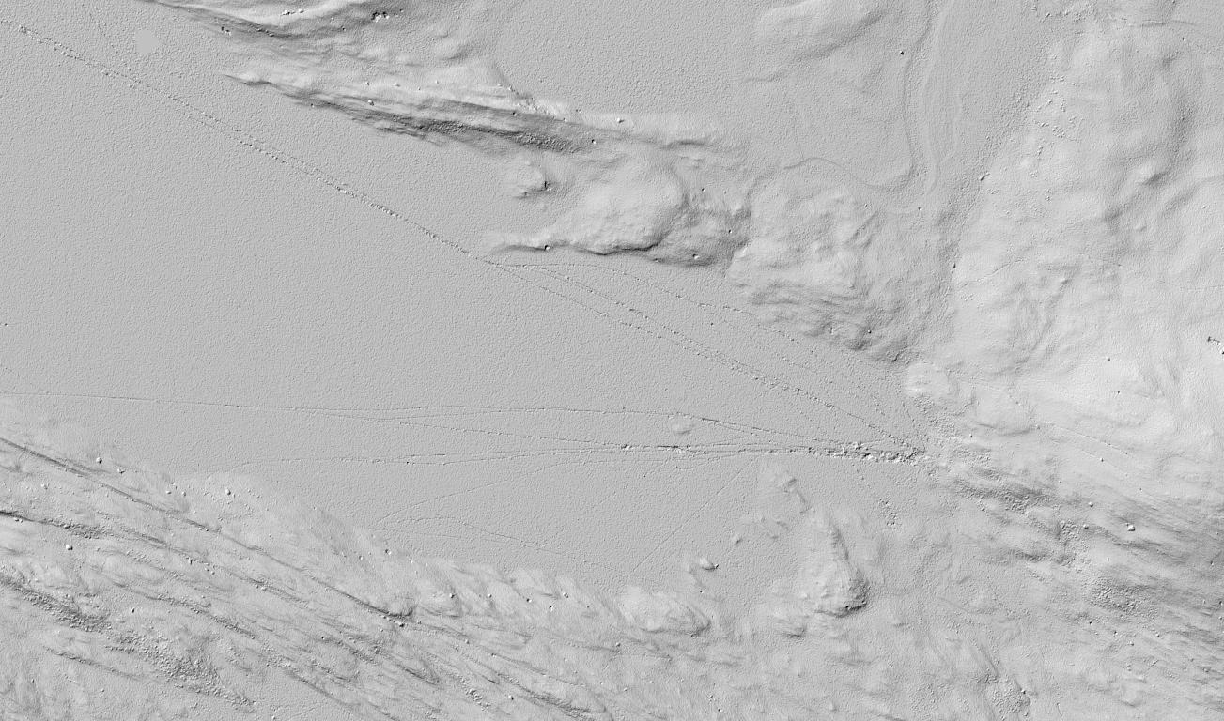
Digital Elevation Model (DEM)
Snow Machine Tracks
Padjelanta
National Park
Sweden
67.38069 North
16.791569 East
Tracks start here
Approved for public release, 17-674.

Slide 17
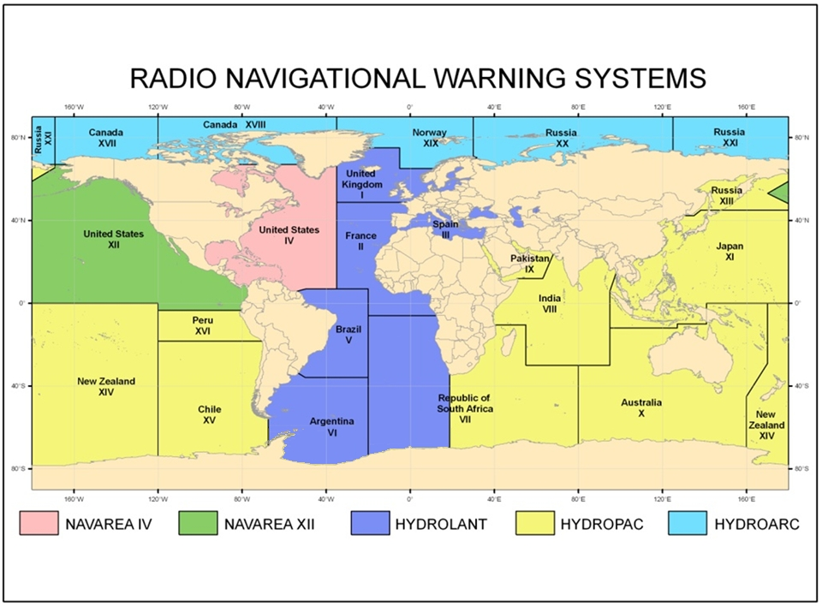
World-Wide Navigational Warning Service
HYDROARC 189/2017
AMUNDSEN GULF.
CANADA-NORTH COAST.
DNC 27.
SCIENTIFIC MOORING, TOP FLOAT 292 METERS BELOW
SURFACE, ESTABLISHED IN 70-40.87N 126-52.28W.
( 041138Z AUG 2017 )
Daily broadcast – Ice Limits
  KMZ
  HYDROARCs:
  2017 – 234
  2016 – 350
  2015 – 432
  2014 – 373
  2013 – 296
  2012 – 264
  2011– 242
HYDROARC 225/2017
EAST SIBERIAN SEA. CHUKCHI SEA.RUSSIA.
DNC 27.
1. SURVEY OPERATIONS 25 AUG THRU 15 NOV BY
M/V AKADEMIK FERSAMAN TOWING 8340
METER LONG CABLE IN AREA BOUND BY
75-10N 179-05W, 75-10N 171-17W,
72-27N 169-08W, 68-47N 169-08W,
66-56N 170-07W, 68-57N 178-20W,
71-54N 179-19E.
EIGHT MILE BERTH REQUESTED.
2. CANCEL THIS MSG 16 NOV 17.
( 231055Z AUG 2017 )
HYDROARC 211/2017
HUDSON STRAIT.
CANADA-NORTHEAST COAST.
DNC 28.
MCTS IQALUIT REMOTE STATION KILLENEK 60-25N 064-50W
MF AND HF TRANSMIT SERVICES INOPERATIVE.
( 151112Z AUG 2017 )
Approved for public release, 17-674.

Slide 18
Approved for public release, 17-674.

