Slide 1
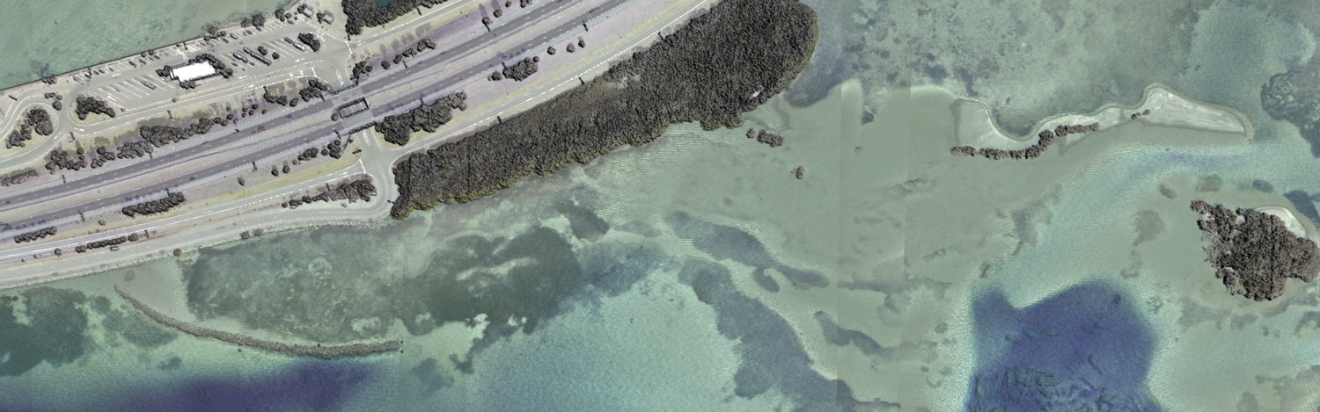
Introduction to Bathymetric Lidar:
Sensors, Capabilities, and Limitations
Carol Lockhart

Slide 2


Acknowledgements
USACE/JALBTCX for allowing us to show project data images
University of New Hampshire CCOM for providing graphics

Slide 3
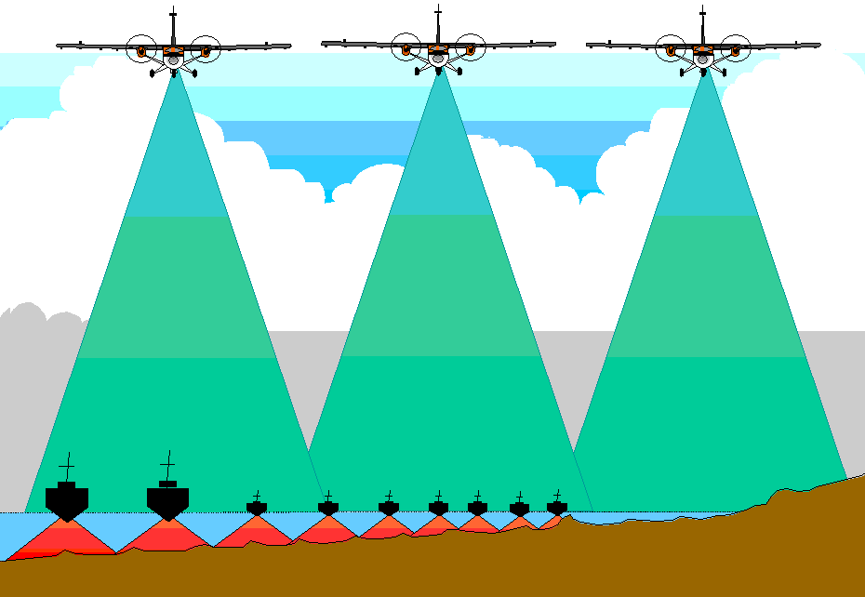
Operational Concepts
Consistent swath widths
More efficient coverage in very shallow water (<5 – 15m)
Eliminates safety concerns of boat operations in shallow uncharted water
Can be combined with multibeam for optimal survey results, efficiency & safety
Sample Project >200km²
Very Shallow Depths (3m on average)
Understand limitations
Technology | Time to Survey
Full Coverage Multibeam | 1 year
100% Sidescan Sonar (with singlebeam or skunk striped bathy) | 60 days
Bathy Lidar | 2 days

Slide 4
Bathymetric Lidar History
1st Generation (early 70’s) US: PLADS Australia: WRELADS I USSR, Sweden, Canada: Ship-borne lidar
2nd-3rd Generation (mid 70’s – late 80’s) US: AOL, HALS, ALARMS Australia: WRELADS II, RAN LADS USSR: GOI, Chaika, Markel-II Sweden: OWL, FLASH-1 Canada: CCRS, LARSEN-500, China: BLOL
Operational systems (early 90’s – today) US/Canada: SHOALS, EAARL Australia: LADS Sweden: HawkEye
Current Sensors Optech: SHOALS-3000, CZMIL, Titan Leica: HawkEye III, Chiroptera II Fugro LADS: LADS Mk III Riegl: VQ-820-G, VQ-880-G
Increased Capabilities
(higher PRF, additional Sensors, …)
Decreased Size & Weight

Slide 5
JALBTCX Lidar Program History
2012
CZMIL
Data Fusion
2005
CHARTS
Spectral Imagery
2003
CHARTS
Photogrammetry
$ / km²
1999
SHOALS
Topography
1994
SHOALS
Bathymetry
200
400
1000
3000
10000
Measurements/Sec
Slide Courtesy of JALBTCX (2012)

Slide 6
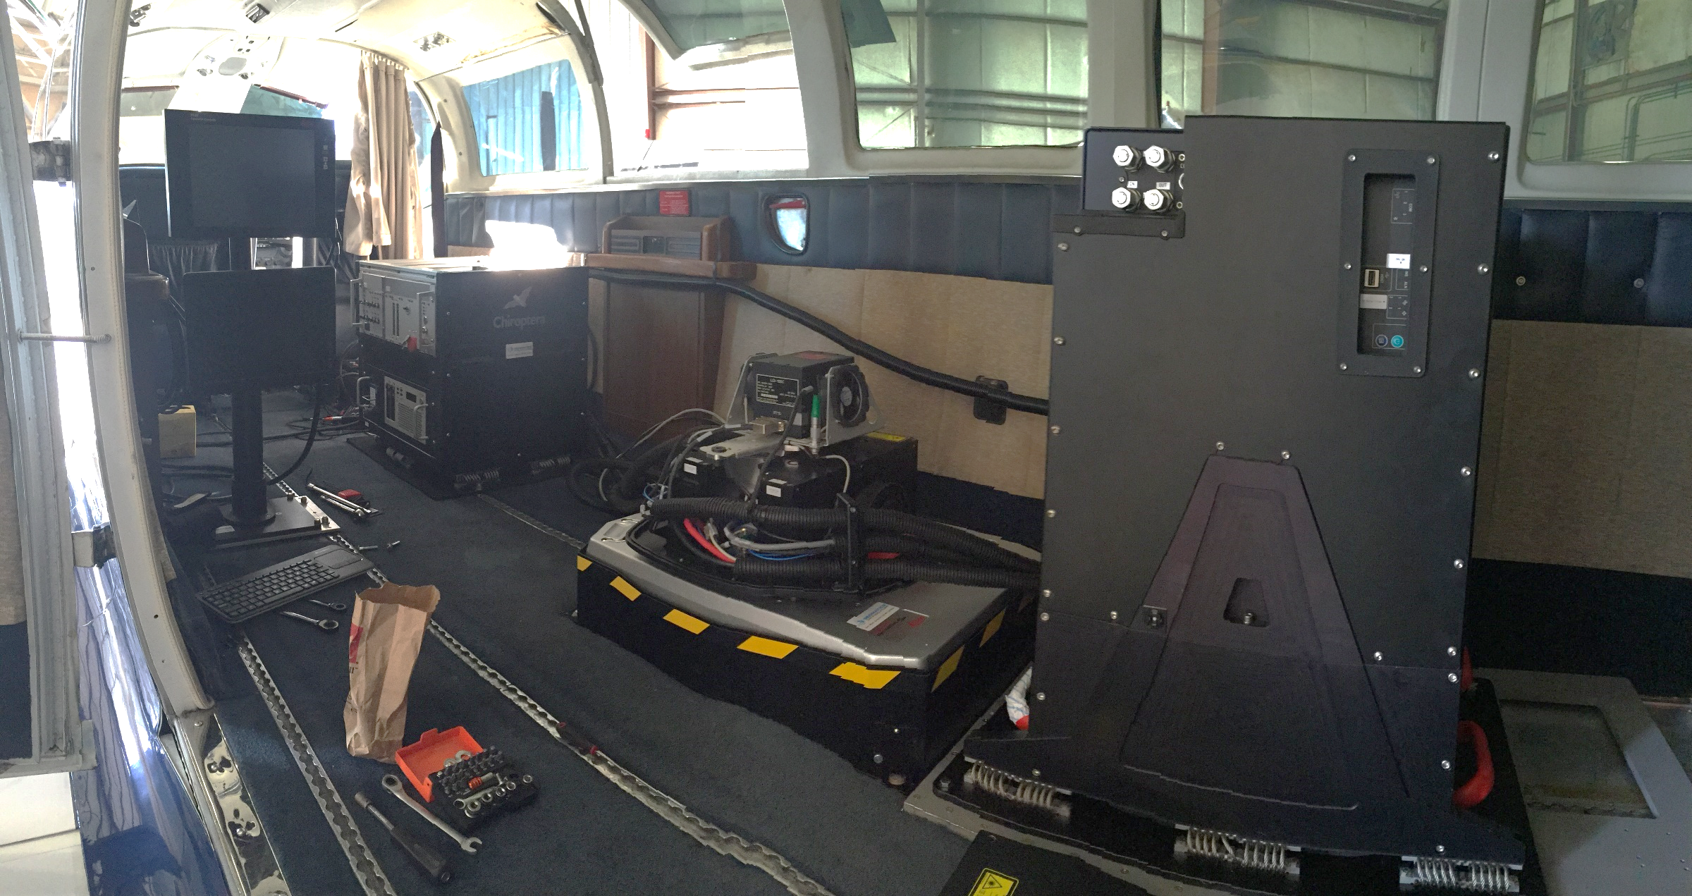
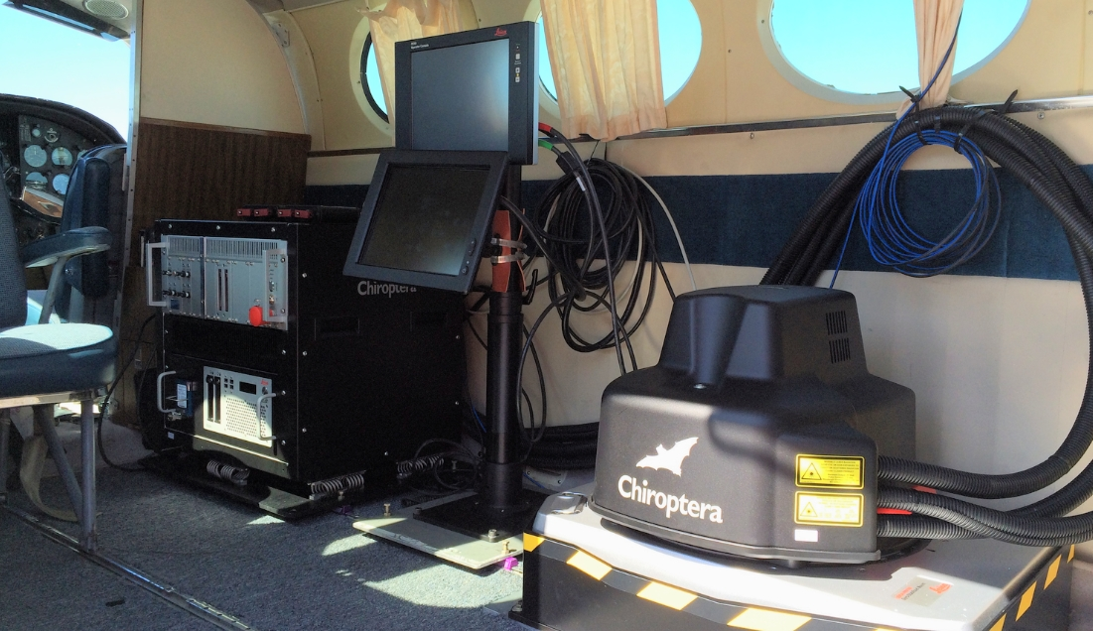
Current Sensors
Traditional / High-Power
(Deep Channel Systems)
  Optech SHOALS-1000/3000
  Fugro LADS Mk III
  Optech CZMIL
  Leica HawkEye III
Low-Power
(Topo-Bathy or Shallow Channel Systems)
  EAARL-B
  Optech Titan
  Leica Chiroptera II
  Riegl VQ820-G / 880G

Slide 7
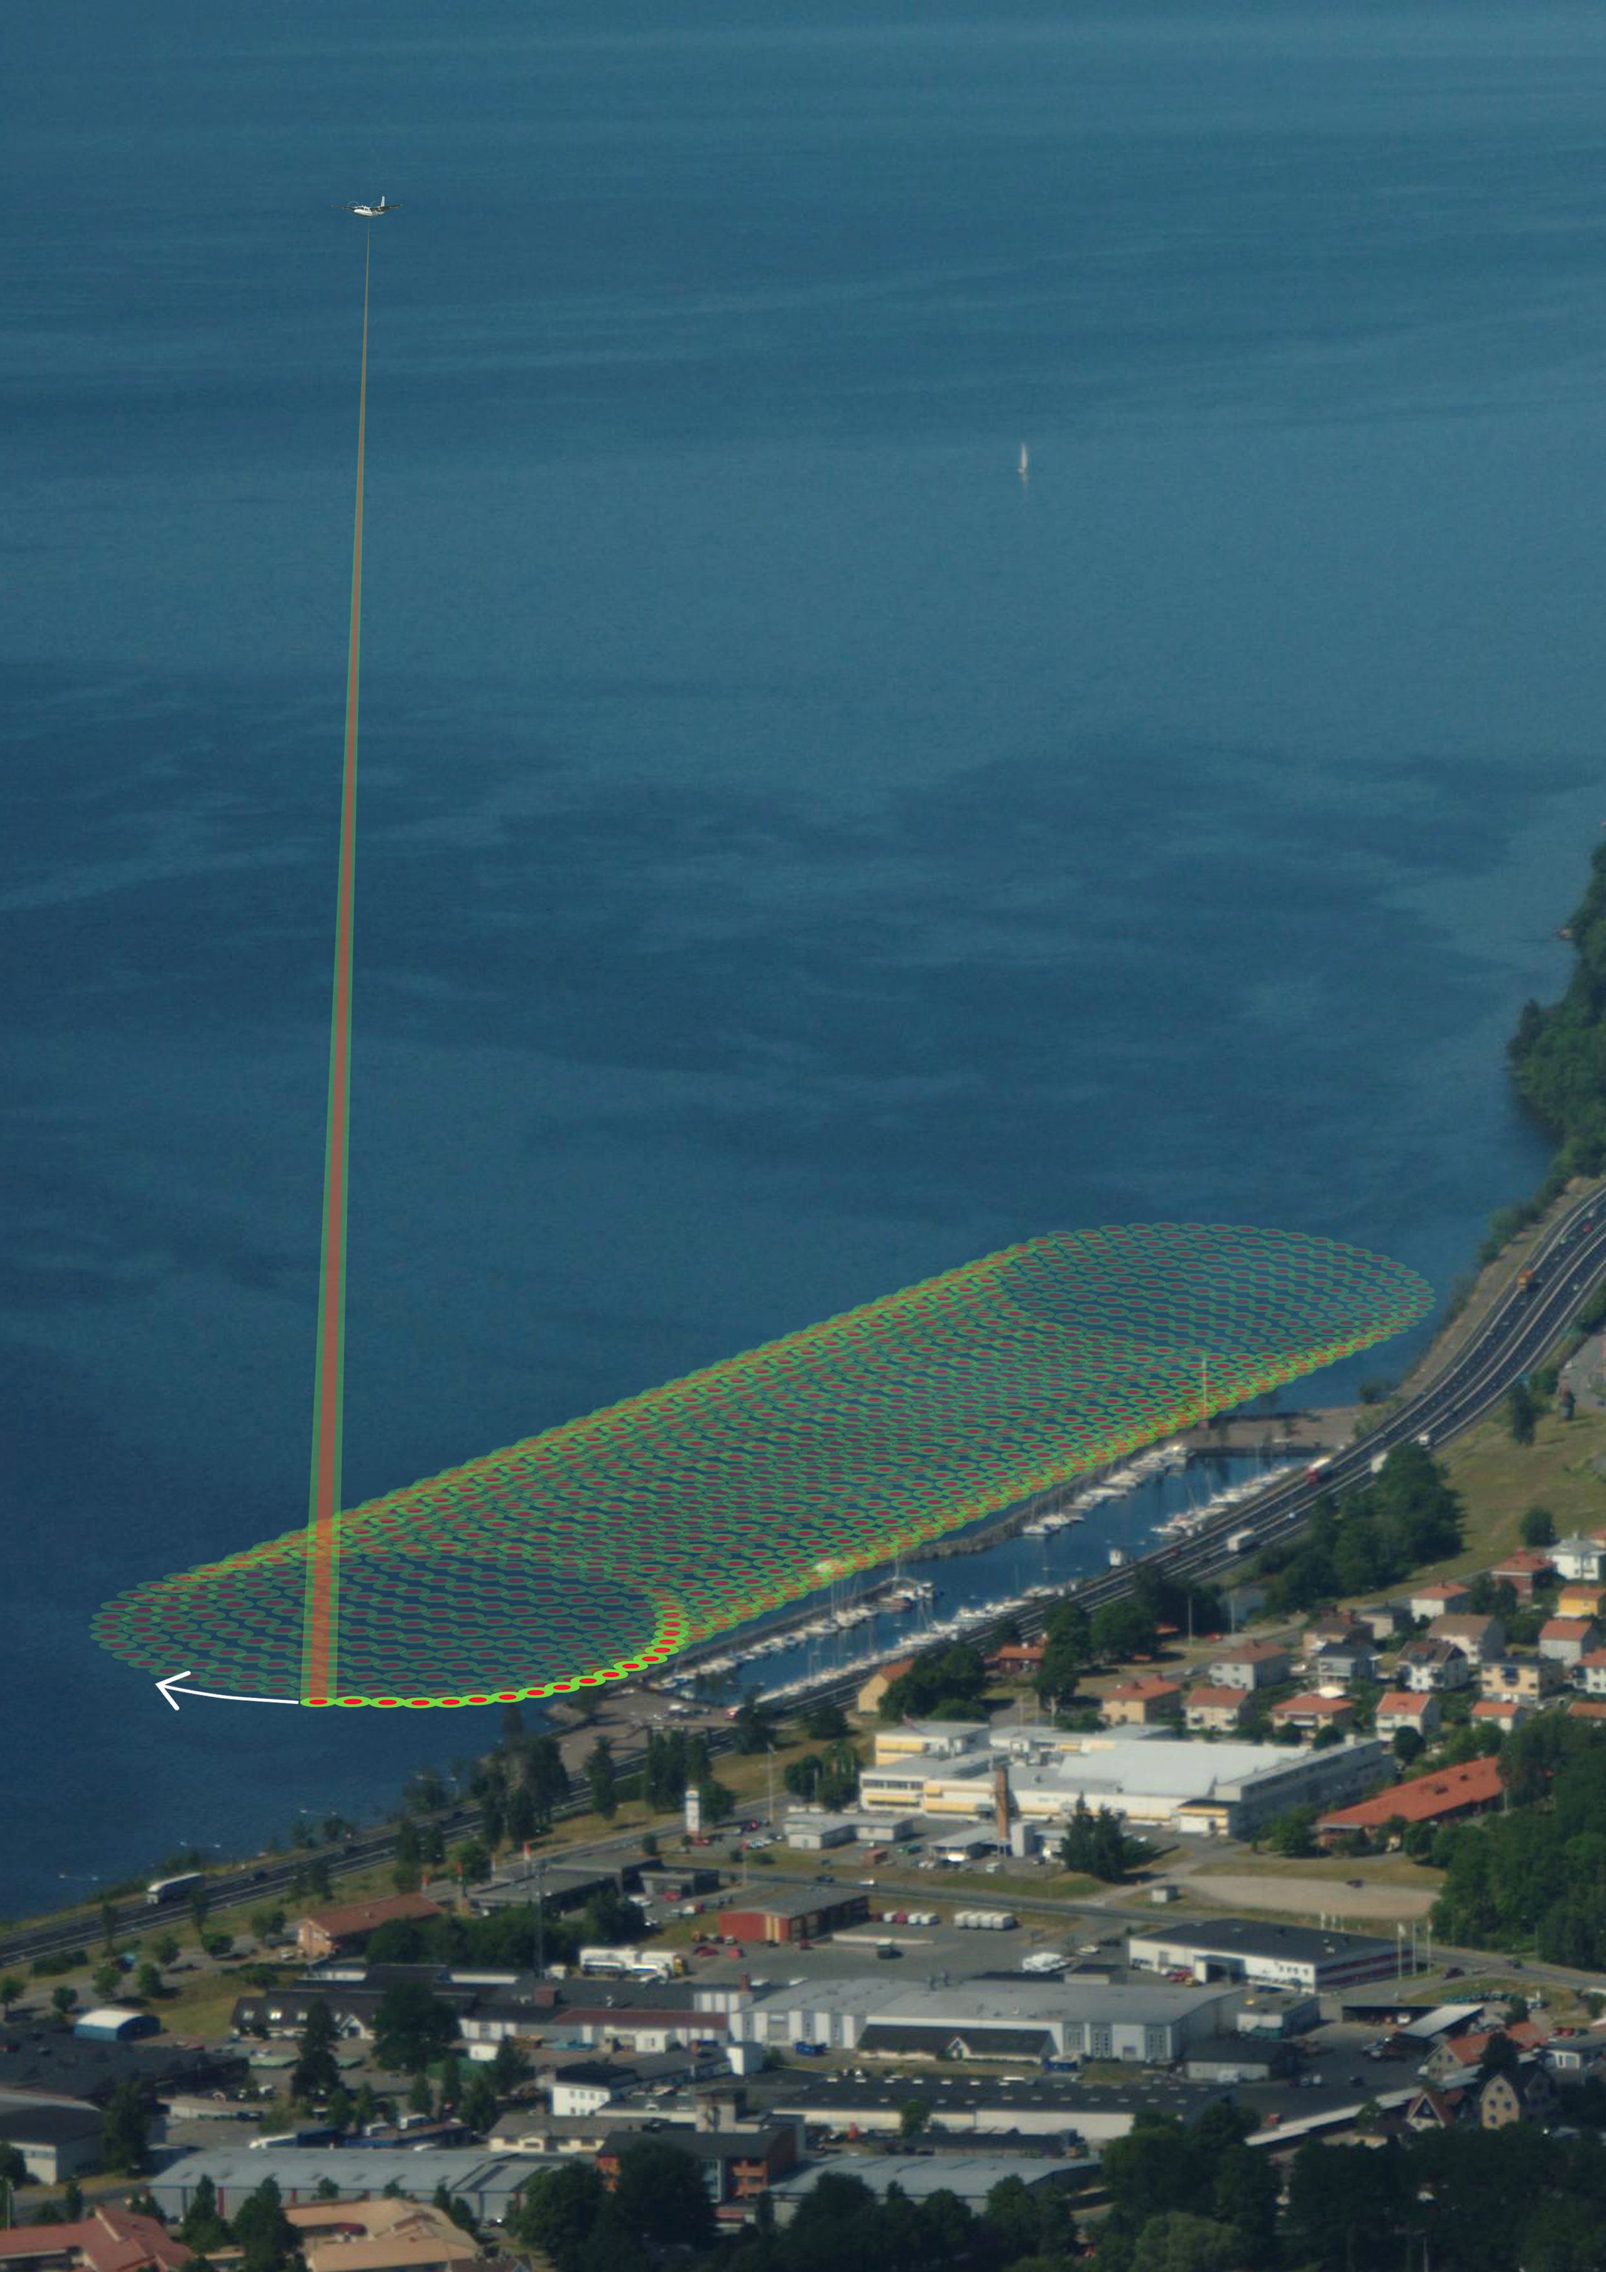
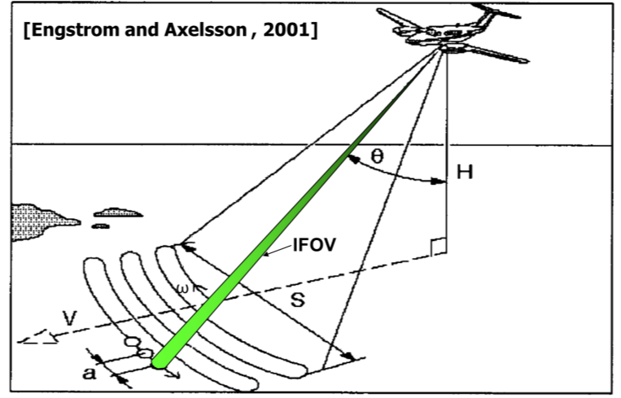
Bathy Lidar Theory
Frequency Doubled ND:YAG Class IV Laser output or Independent Lasers:
    Infrared (1064nm)
    Visible Green (532nm)
Laser fires against a scanning mirror or circular palmer scanner to create a swath of points.

Slide 8
Bathy Lidar Theory
Green (532nm)
sea surface, water column & seafloor
IR (1064nm)
sea surface
Raman Return (Red 640 to 670nm)
sea surface, upper water column
Intensity
Intensity
Intensity
Sea surface
Sea surface
Sea surface
Seafloor
Seafloor
Seafloor

Slide 9
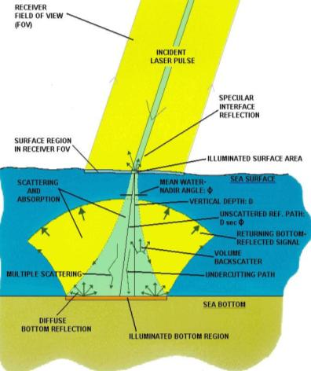
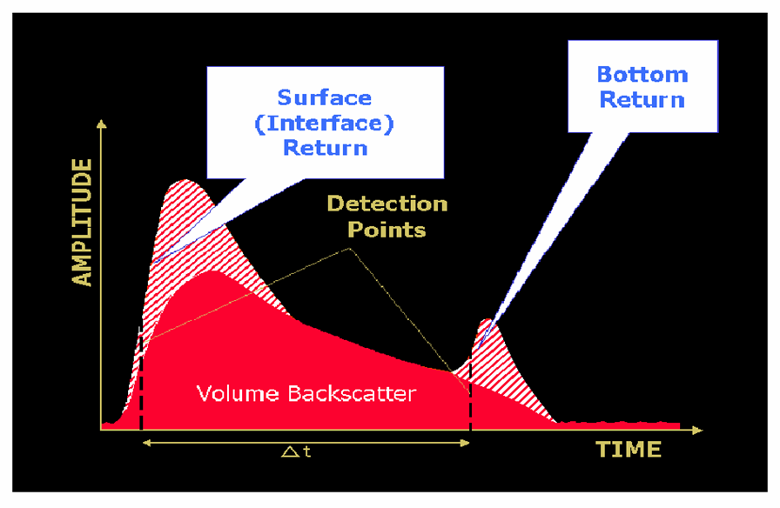
Conceptual Green Waveform
(Guenther et al., 2000)

Slide 10
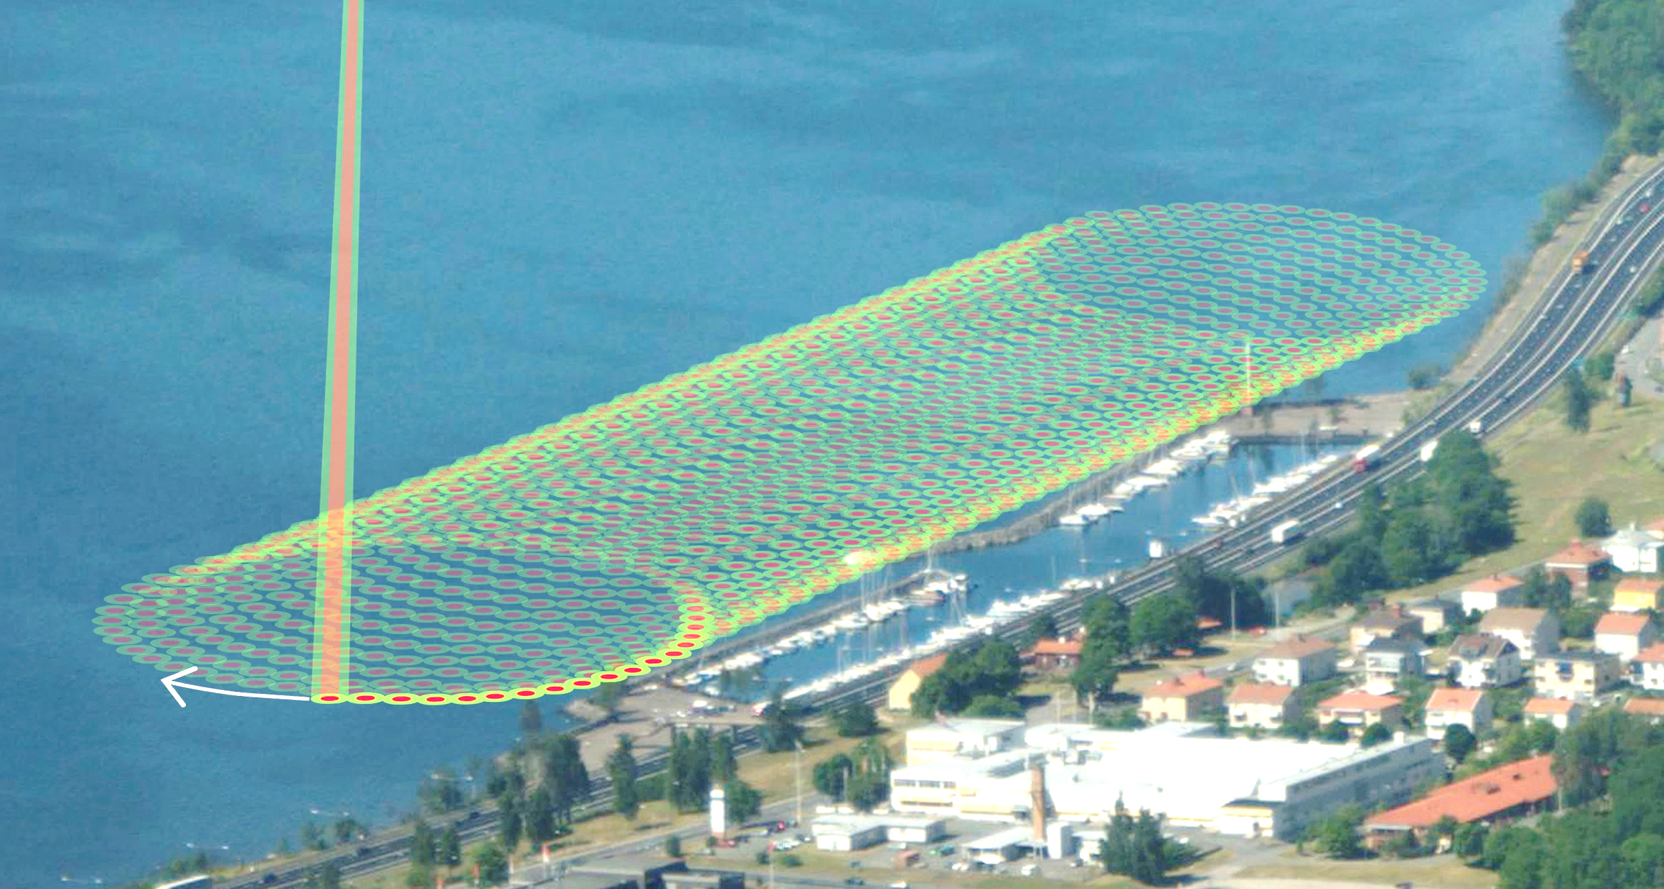
Sensor Comparisons – Scan Pattern
Line Scanning
e.g. LADS Mk III
Arc Scanning
e.g. SHOALS, Riegl VQ-820-G
Elliptical Scanning
e.g. CZMIL, Chiroptera,
Riegl VQ-880-G

Slide 11
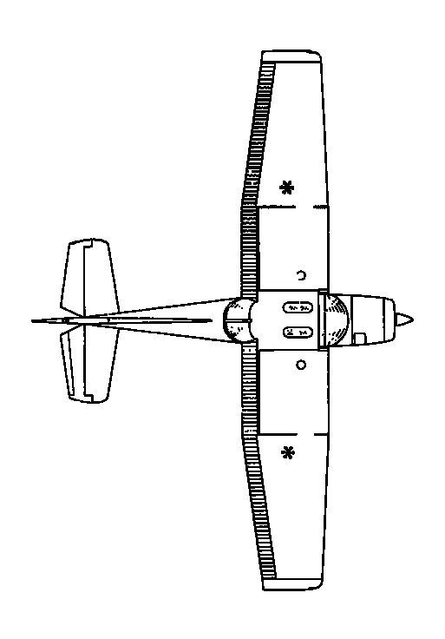
CZMIL Hybrid Approach – Conical Scanning
Graphics Courtesy of JALBTCX (2012)
3
2
4
0
1
x
5
6

Slide 12
Changes in Footprint Concept: Segmented Detection
2 - 3 m
~ 2 m
2.5 - 3 m
2 - 3 m
SHOALS / LADS
~1.2m
0.4m
~ 0.5 m
~ 0.2 m
~ 0.5 m
CZMIL
SHOALS
LADS HAS NO IR
Chiroptera II / HawkEye III
Riegl VQ-820-G

Slide 13


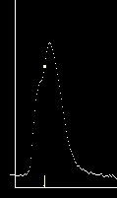
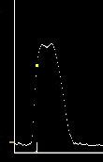
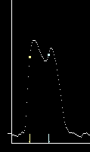
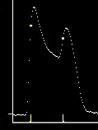
Shallow Water Discrimination
Images Courtesy of JALBTCX (2012)

Slide 14
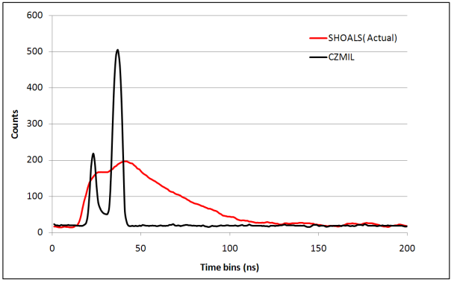
CZMIL compared to SHOALS
Ft. Lauderdale water, 25m (40mrad channel, K_{d} ≈ 0.12 m⁻¹)
Ft. Lauderdale, 1.5m (K_{d} ≈ 0.12 m⁻¹ , Shallow water channels)
P3
Higher Signal, Better SNR
Better (shorter) system response
P4
CZMIL
Better SNR and shorter system response
Detect bottom deeper
More accurate input to algorithms
Better shallow water discrimination

Slide 15
System Response Time
Actual Chiroptera waveform at 1.2 meters depth (blue) versus simulated waveform with a 20 ns response time (green)
Chiroptera
20 ns waveform

Slide 16
Deep v Shallow Sensors
 | Deep Channel Sensor | Shallow Channel Sensor
Flying Speed (knots) | 120-180 | 120-180
Flight Altitude (m) | 200 - 600 | 200 - 600m
Swath Width (m) | 60 - 585 | ~ 290m
Sounding Density (m) | 0.4 to 0.05 pts /m² | 1.5 to >10 pts /m²
PRF | 1 – 10 kHz (70kHz shallow for CZMIL) | Up to 550 kHz
Min Depth (m) | 0 / 0.2m / 1.5m | 0m
Max Depth (m) * | ~ 50 – 80m 2 – 3.5 x Secchi Depth | ~ 15m 1.5 x Secchi Depth
Depth Accuracy | IHO Order 1 or Better | IHO Order 1 or Better
Horizontal Accuracy | IHO Order 1 or Better | IHO Order 1 or Better
Power | 50A – 100A @ 28 VDC | ~30A @ 18-32 VDC
Weight | 190 – 500 kg | < 100kg
Nominal Footprint Size | 2 – 3m | ~ 40cm

Slide 17
Design Trade Off
Depth Penetration
Fixed Power
PRF

Slide 18
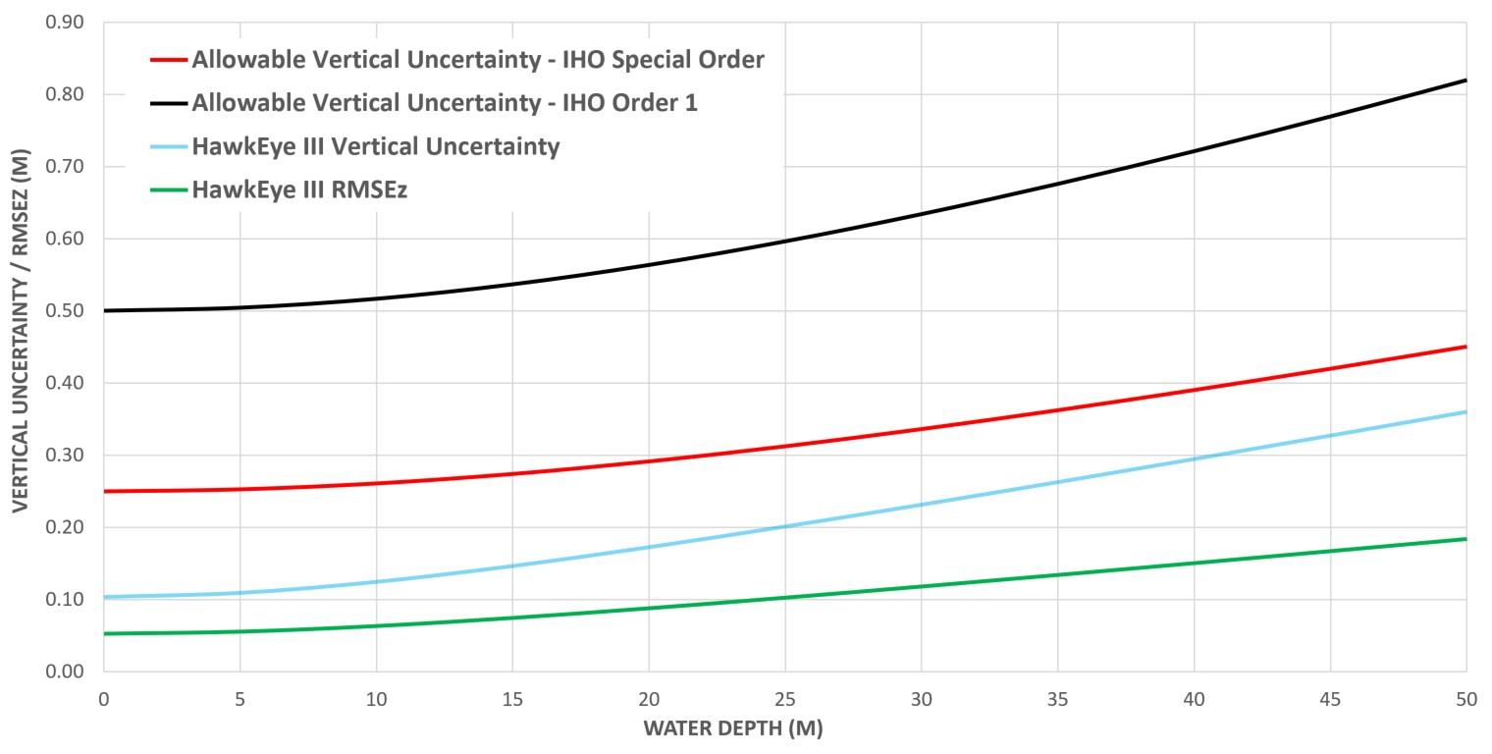
Real World Accuracy Statistics
Comparing Lidar and Acoustic Bathymetry Using TPU and the CUBE Algorithm, ILMF (2008) , C. Lockhart, D. Lockhart, J. Martinez

Slide 19
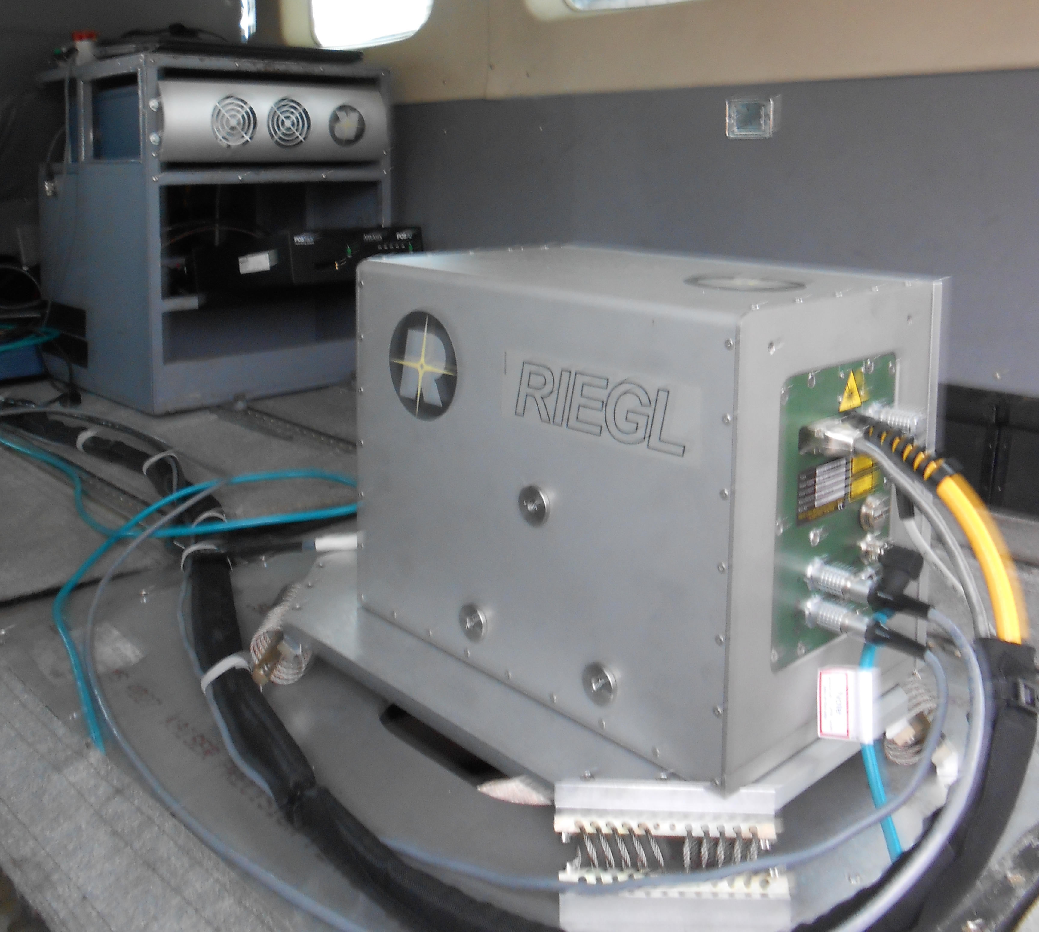
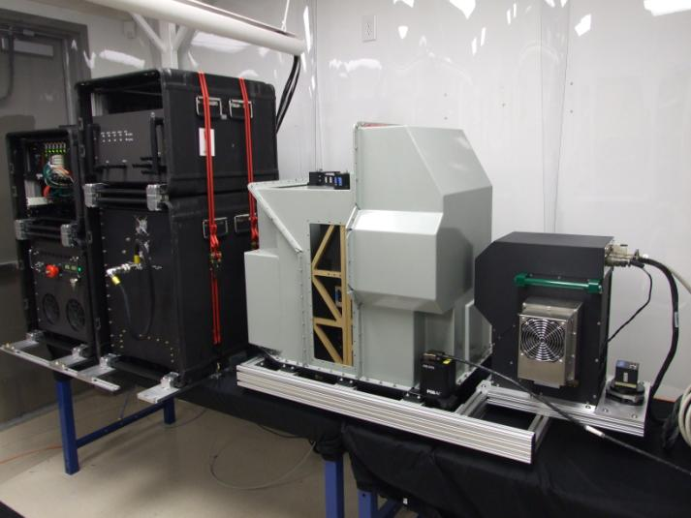
Sensors
Optech CZMIL
Riegl VQ820-G
Operator Rack
Laser Rack
Lidar Sensor Head
CASI-1500
Control Rack
Thermal Rack
T-4800 Camera
Image provided courtesy of QSI

Slide 20
Leica Modular Sensor Design
Topo Lidar Survey
(Single or Dual-Head)
Shallow Bathy
~1.5 x Secchi depth
Deep Bathy
~3 x Secchi depth

Slide 21
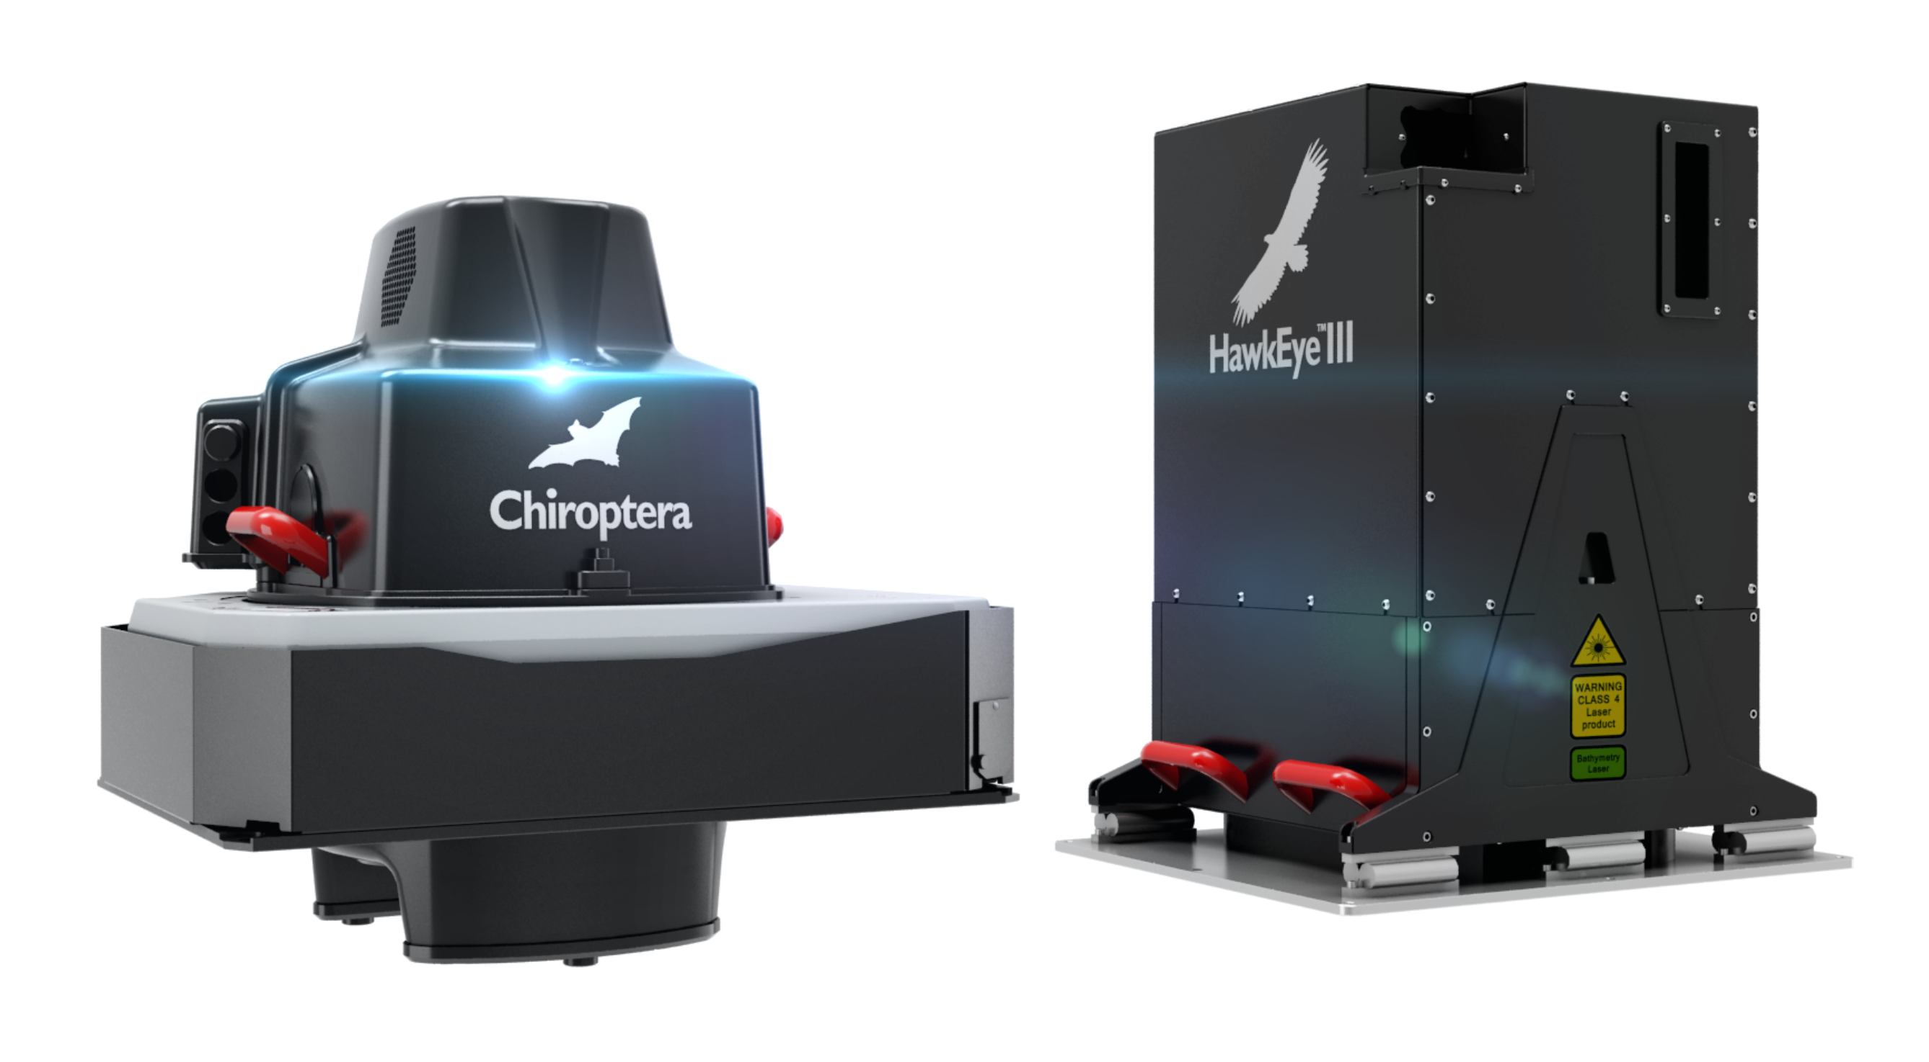

Chiroptera II / HawkEye III Sensor Heads

Slide 22

Dual Head DragonEye / Chiroptera II Installation

Slide 23
HawkEye III Installation

Slide 24
Operational Considerations: Is Lidar a Suitable Tool?
Water Clarity / Turbidity
  Seasonal
  Daily (tides / currents)
Seabed Reflectivity
  Bed type, Vegetation
Weather
  Temperature
  Rain
  Wind
  Cloud Ceiling
  Sea State
Expected Terrain & Expected Depths

Slide 25
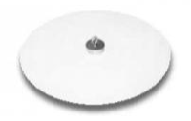
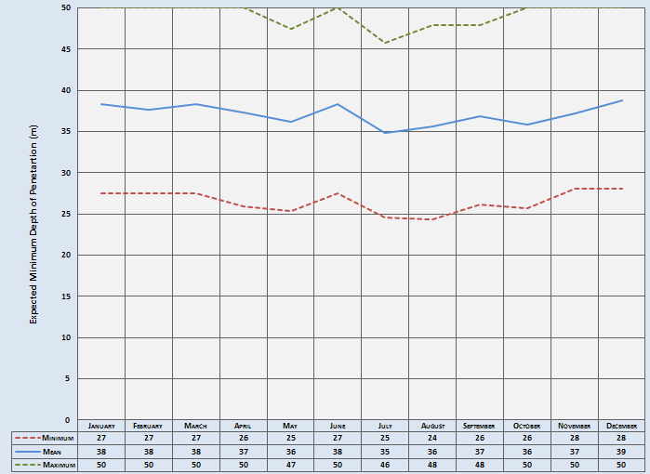
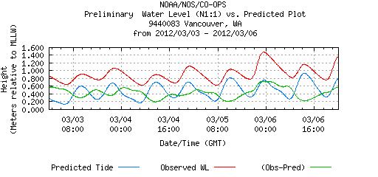
Survey Depth / Water Clarity
Depth penetration depends on:
  Turbidity
  Seafloor reflectance
Secchi Disk
High Power = 2 to 3 x Secchi Depth Low Power = 1 x Secchi Depth
Tides/Currents
Seasonal Assessment
Monthly AquaMODIS: 490nm

Slide 26
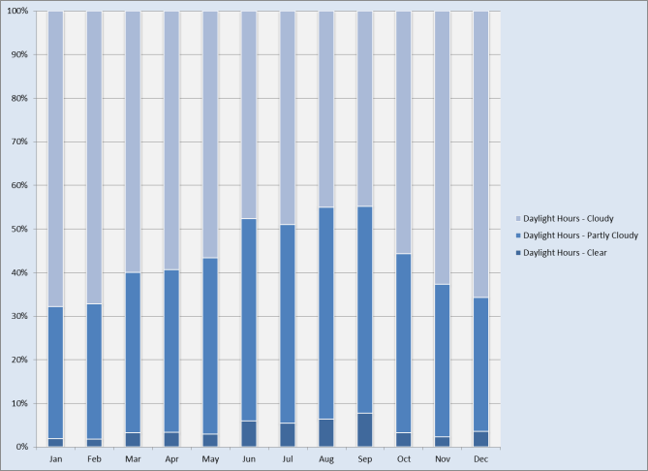
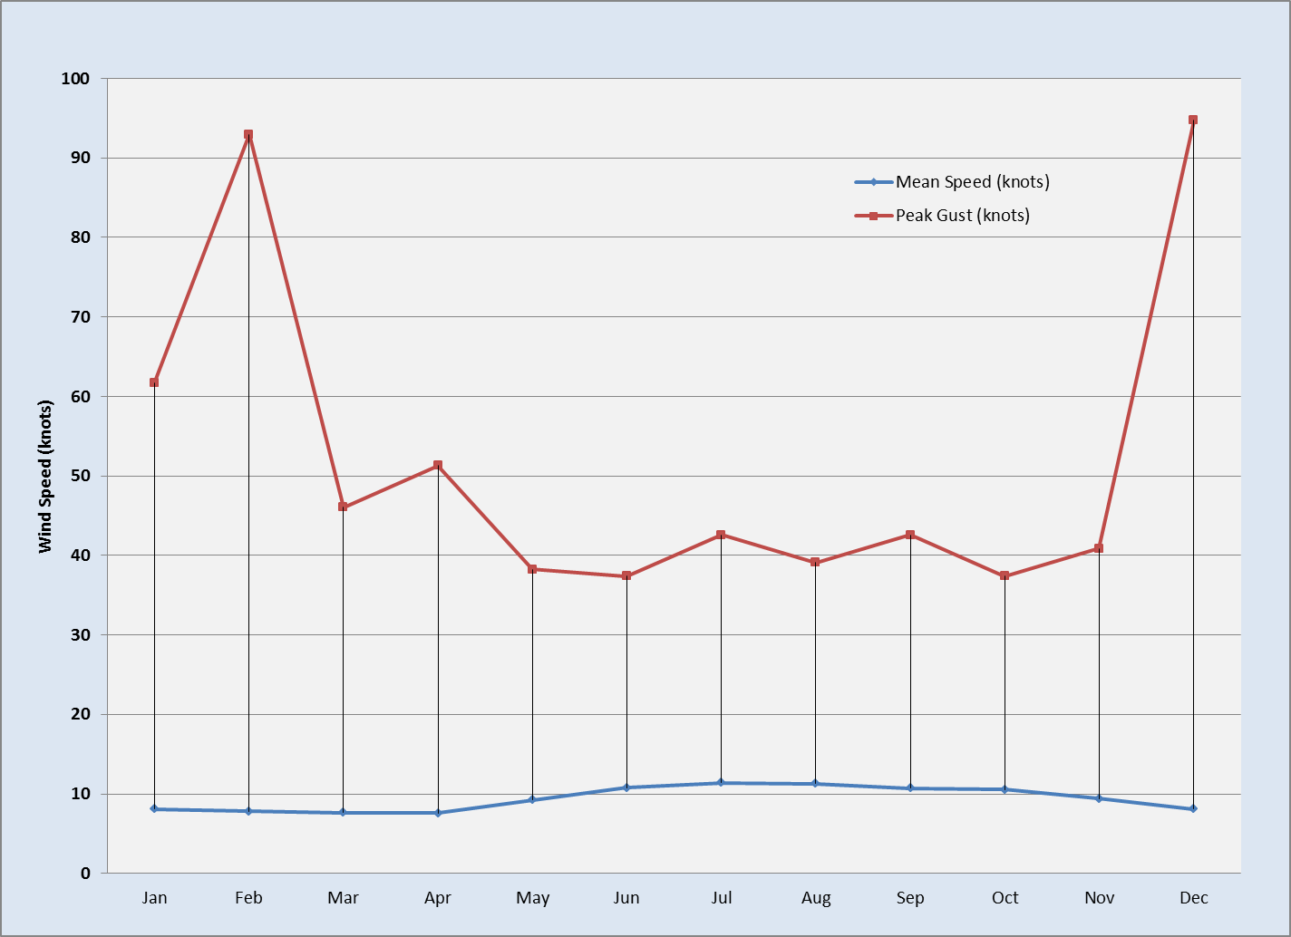
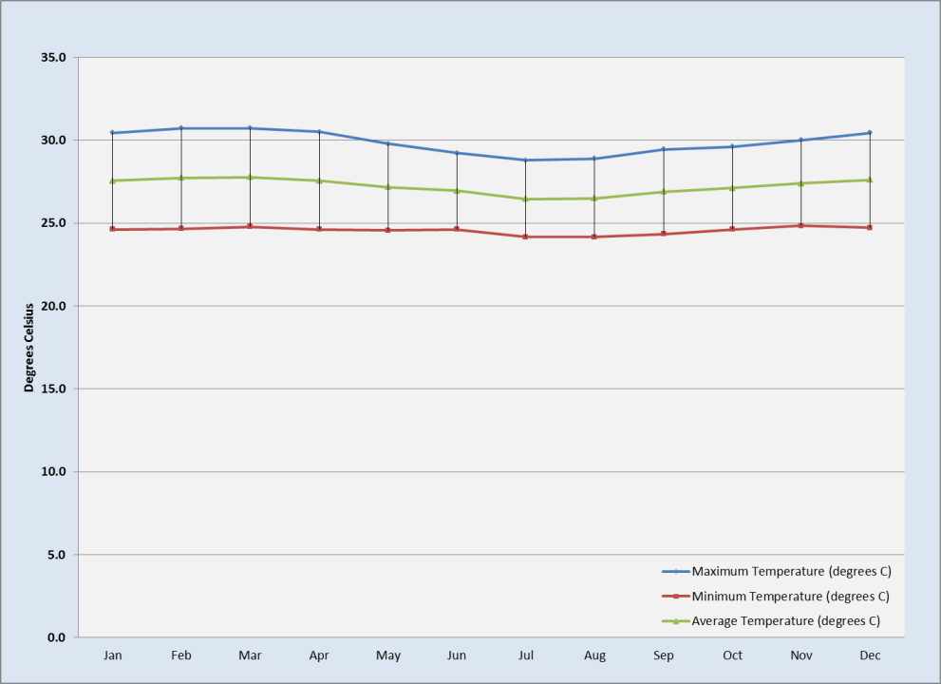
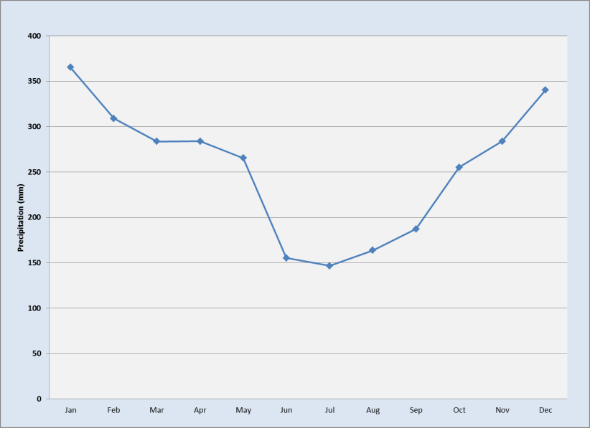
Weather
Temperature
Wind
Rain
Cloud Ceiling
Sea State

Slide 27
Additional Operational Considerations
Flight Planning Considerations Include:
  Tide range, high/low tide times
  Water quality / weather & time of year to survey
  Shape of survey area (Coastal strip or Large polygon)
  Size of survey area (maximum line lengths)
  Flying height and local terrain (Aircraft Type; Deep / Shallow Power System)
  Expected Depths (Deep / Shallow Power System)
  GPS stations and tide gauges (Single / Multi-base, SmartBASE, PPP, Tide Plan)
  Air traffic in the survey area
  Restricted airspace / special flight permits
  Operations base airport and logistics

Slide 28
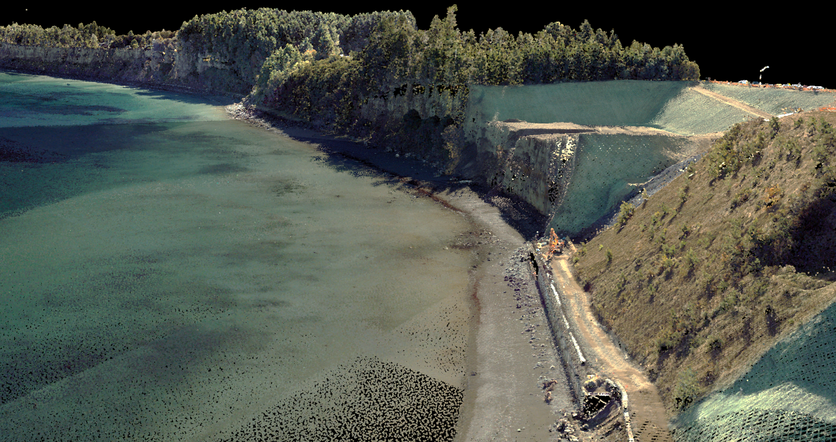
Steep Slopes Well Defined; Seamless Topo-Bathy

Slide 29
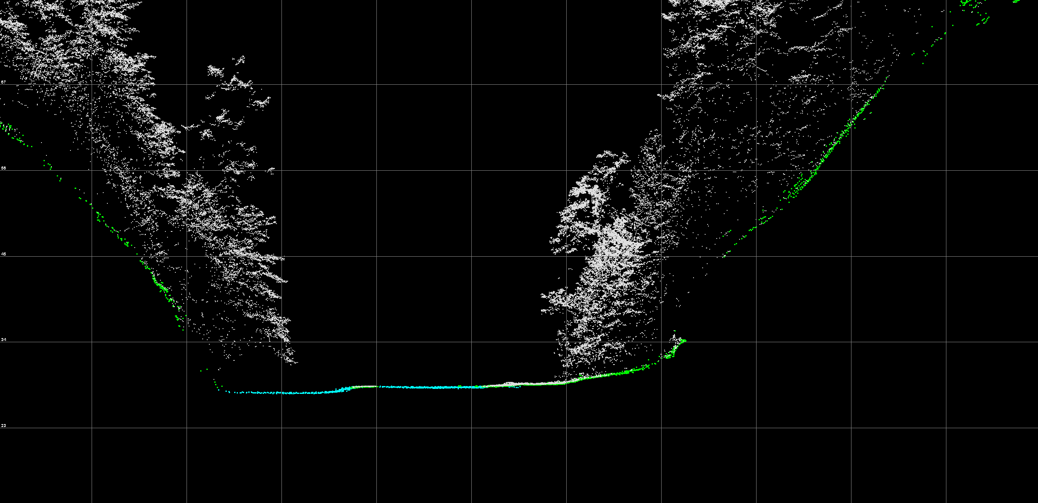
Elliptical Scan / Multiple Returns Allow Bathy Returns Under Vegetation

Slide 30
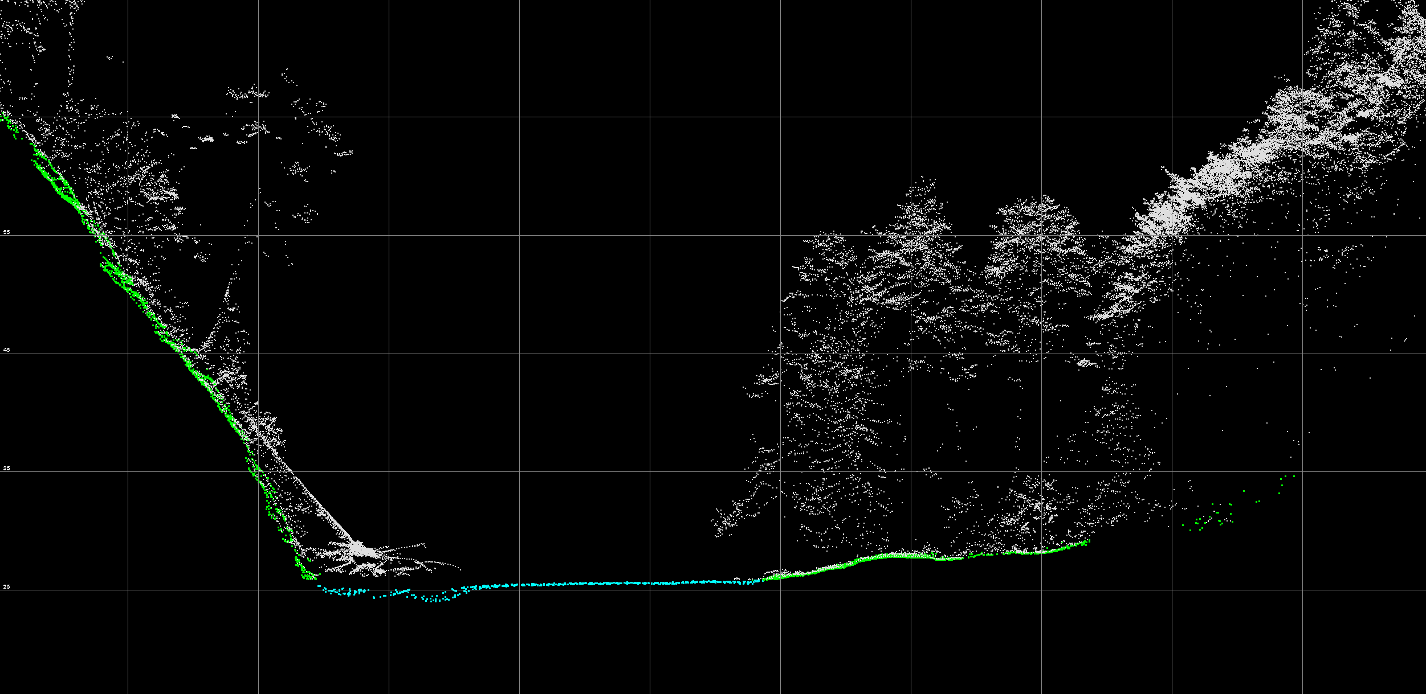
Elliptical Scan / Multiple Returns Allow Bathy Returns Under Vegetation

Slide 31
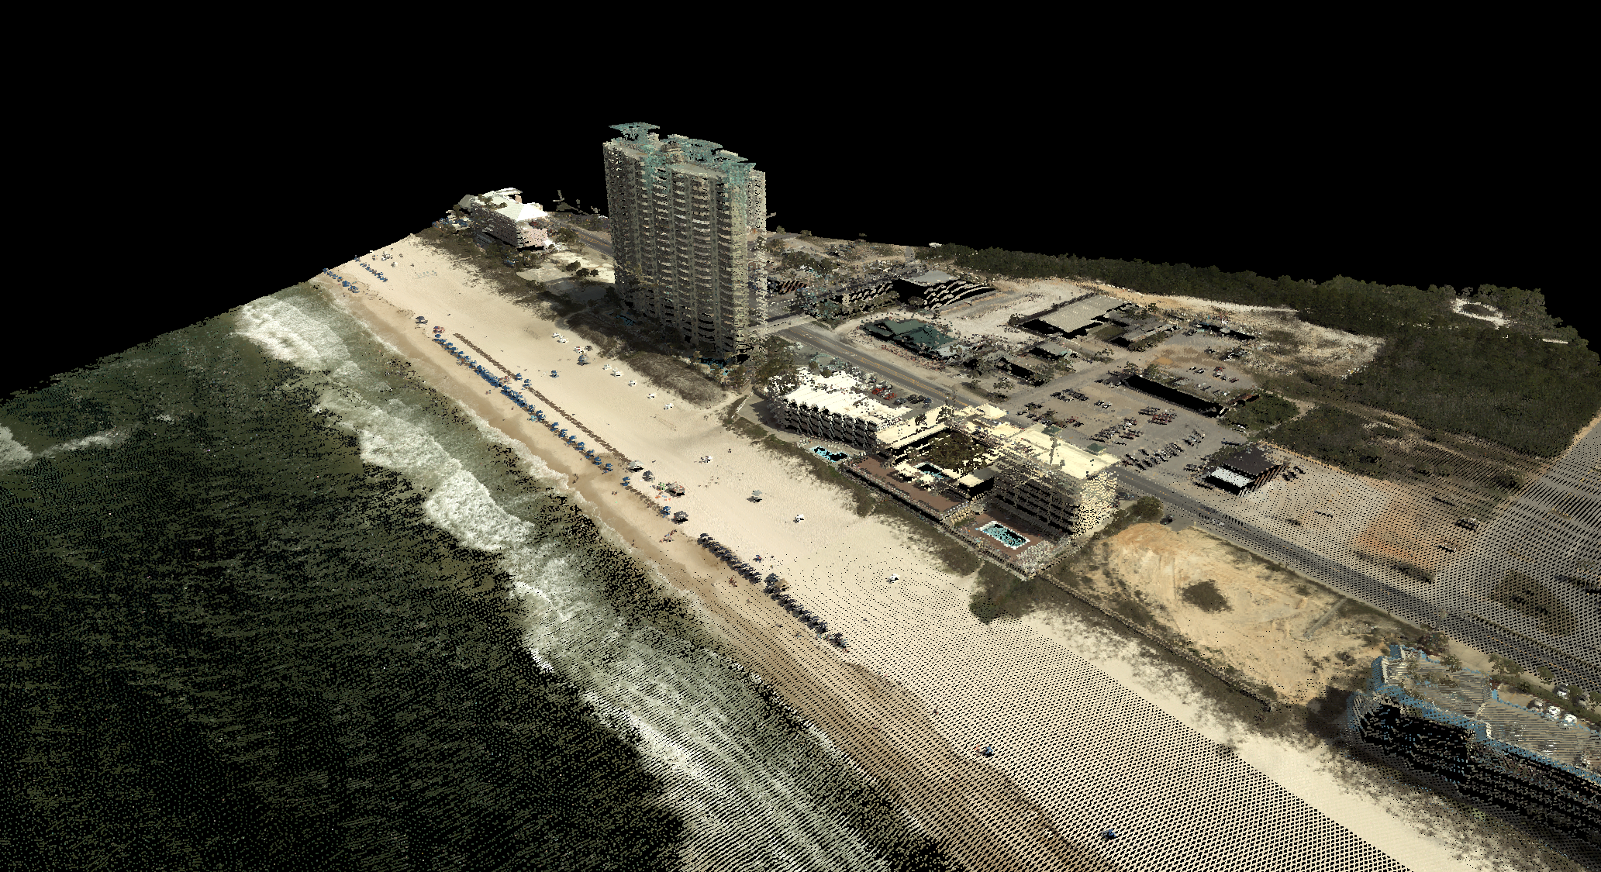
Elliptical Scan and Wave Action / Seamless Topo-Bathy

Slide 32
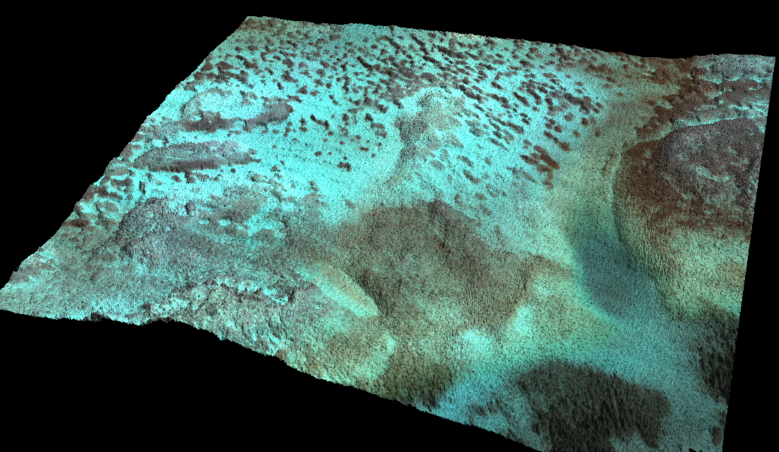
Sample Shallow Bathymetry Detail

Slide 33
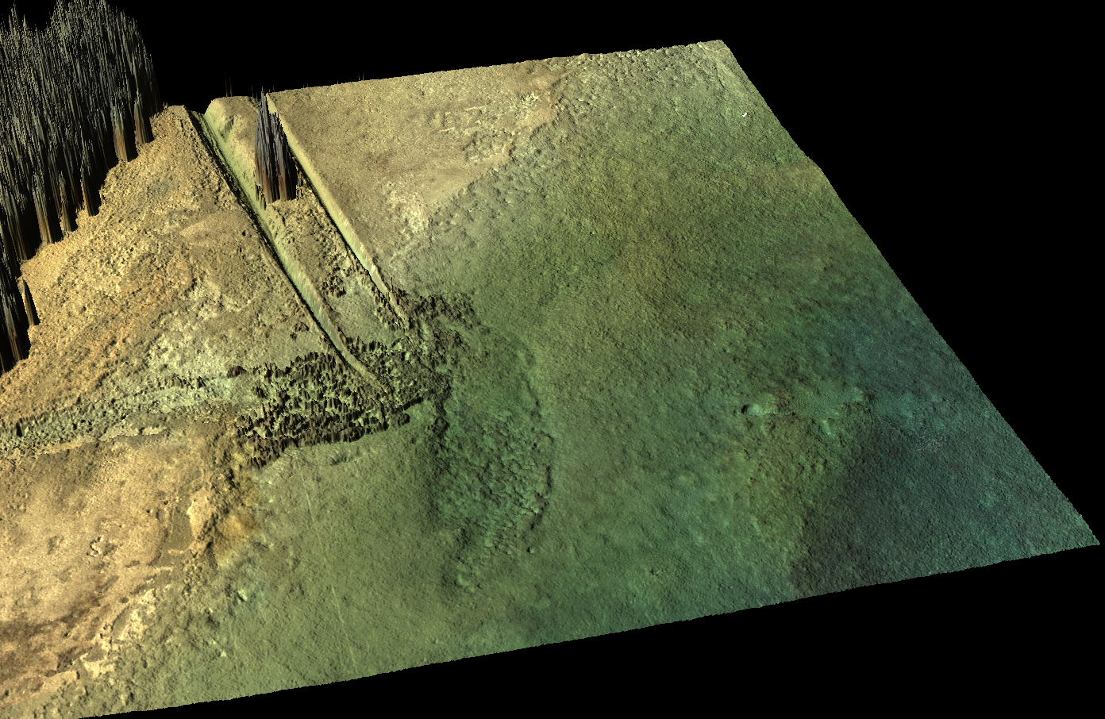
Sample Shallow Bathymetry Detail

Slide 34
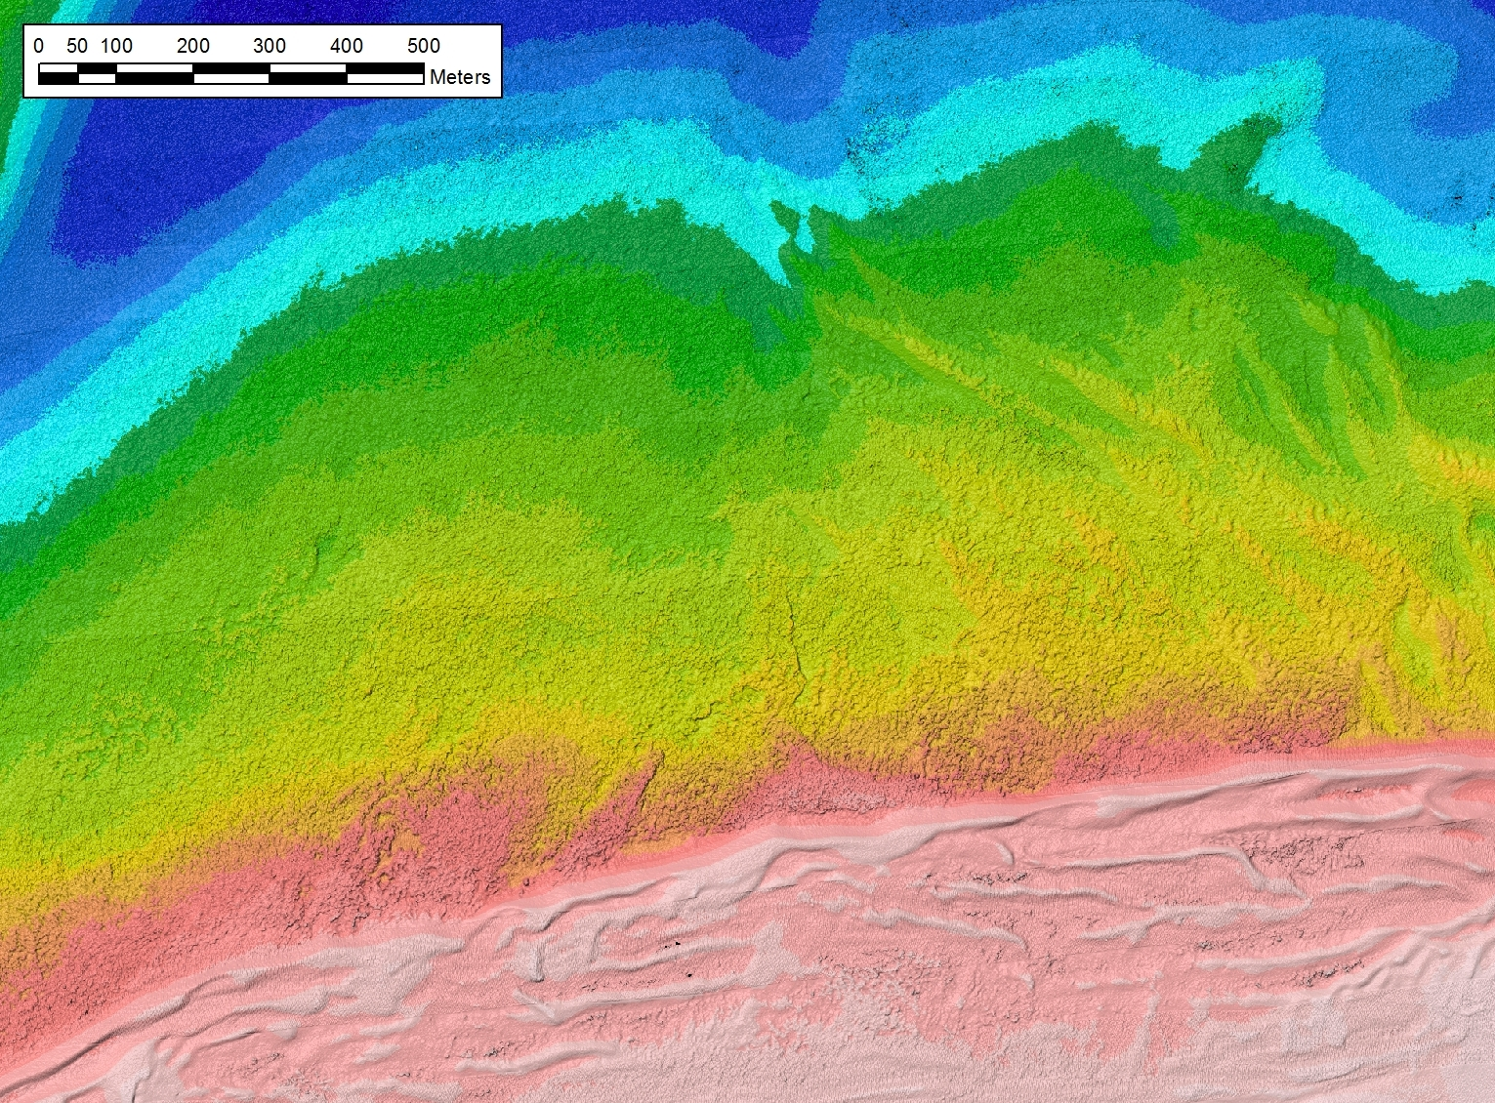
Elevation - Poel, Baltic Sea
8 lines
0.13m - 7.5m Depth

Slide 35
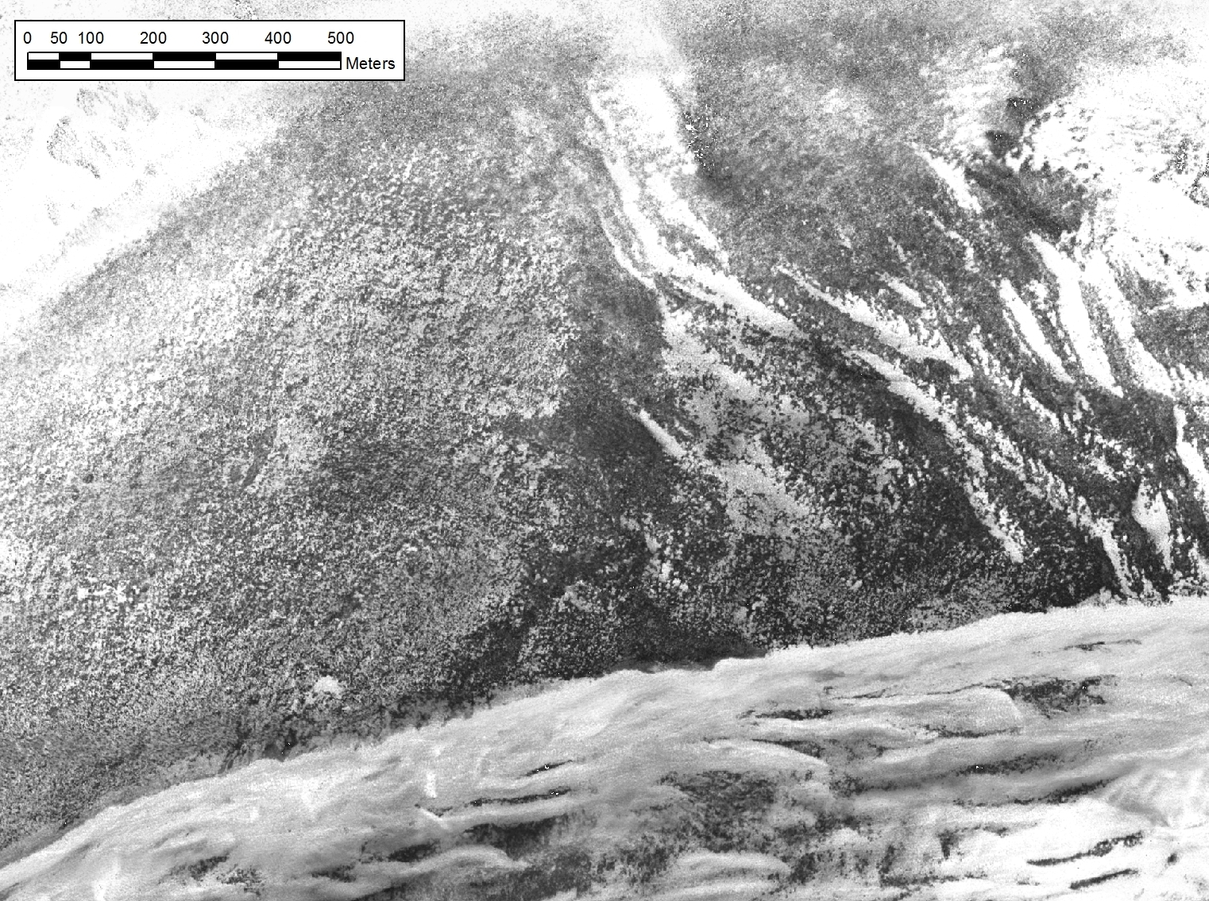
Intensity - Poel, Baltic Sea

Slide 36
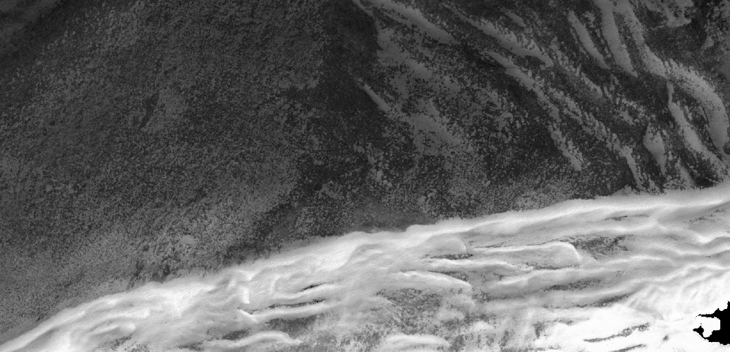
Seagrass Delineation
Raw Intensity
Corrected Intensity
Classified Image
Raster to Vector
Classify LAS

Slide 37
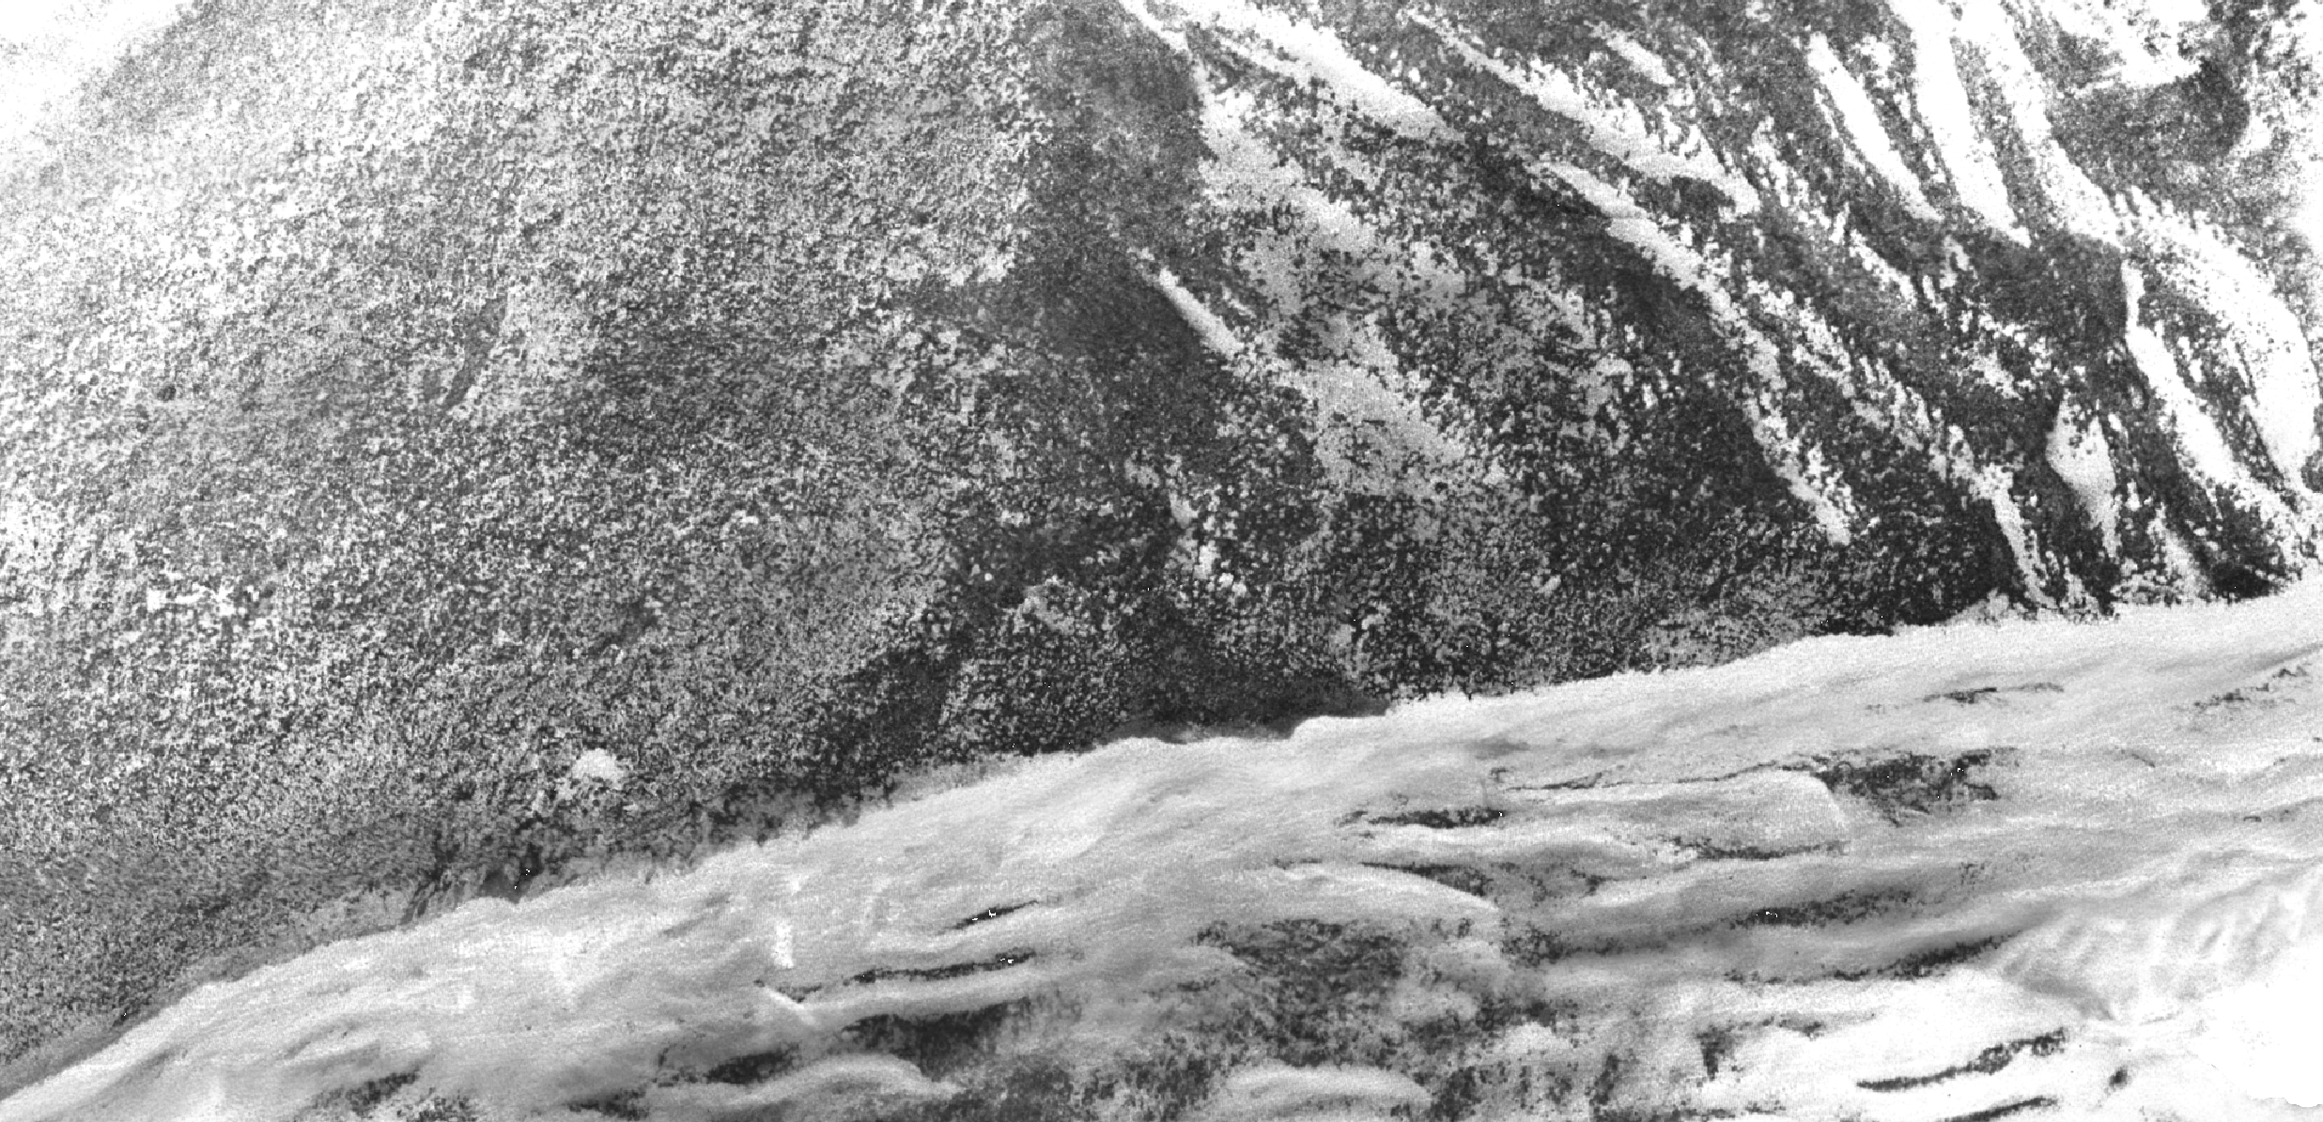
Seagrass Delineation
Raw Intensity
Corrected Intensity
Classified Image
Raster to Vector
Classify LAS

Slide 38

Seagrass Delineation
Raw Intensity
Corrected Intensity
Classified Image
Raster to Vector
Classify LAS

Slide 39
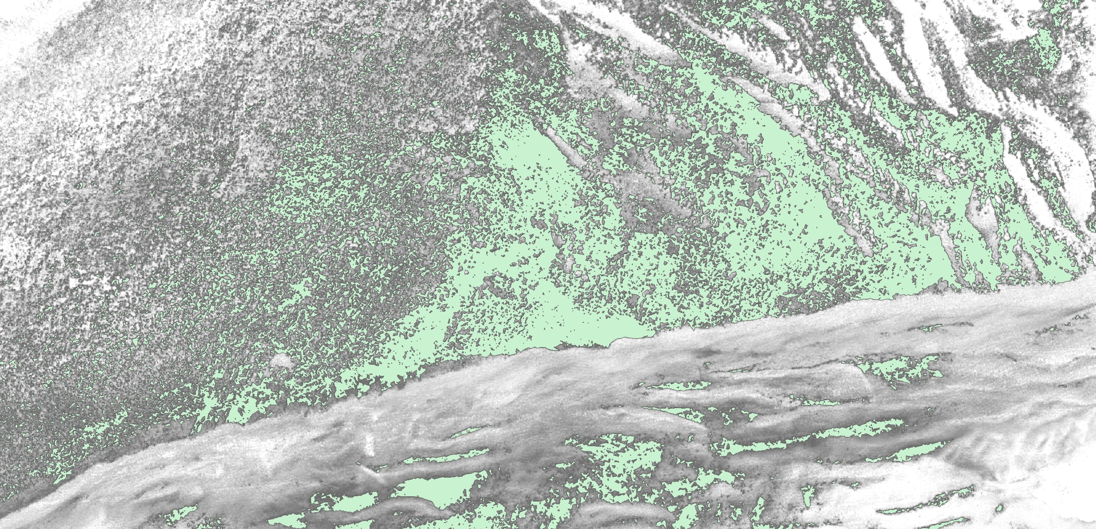
Seagrass Delineation
Raw Intensity
Corrected Intensity
Classified Image
Raster to Vector
Classify LAS

Slide 40
Intensity - Poel, Baltic Sea

Slide 41
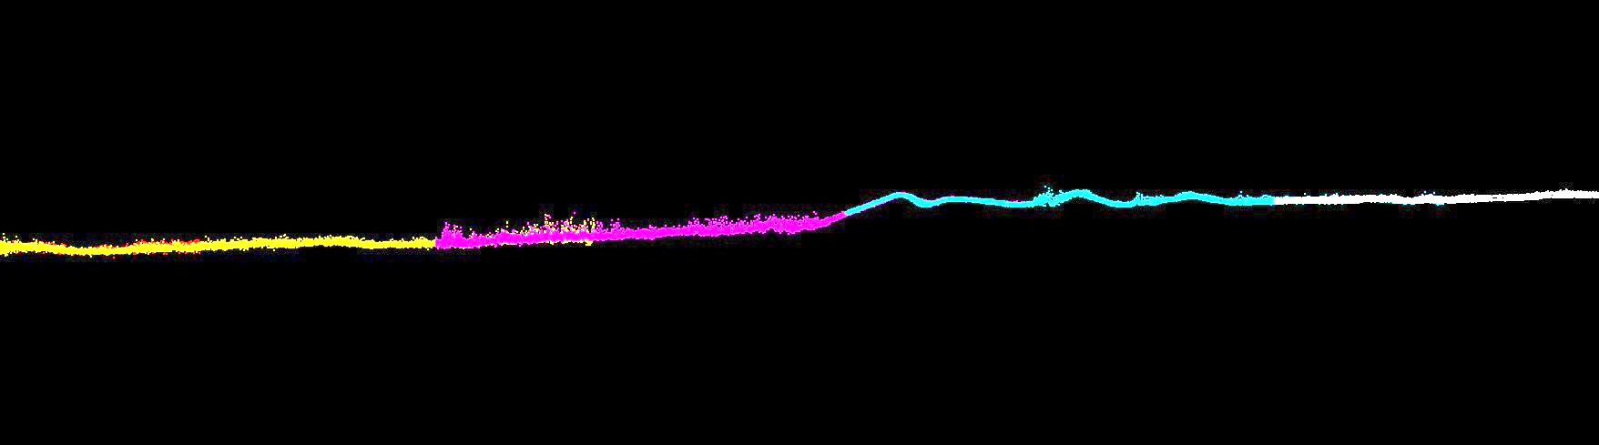
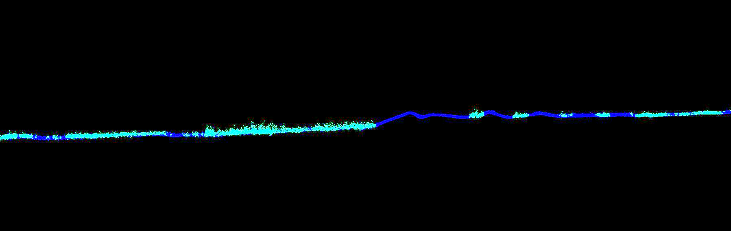
Cross Section - Poel, Baltic Sea
20x Vertical Exaggeration
Seagrass is approximately 25cm high
Colored by Flight Line
Colored by Class

Slide 42
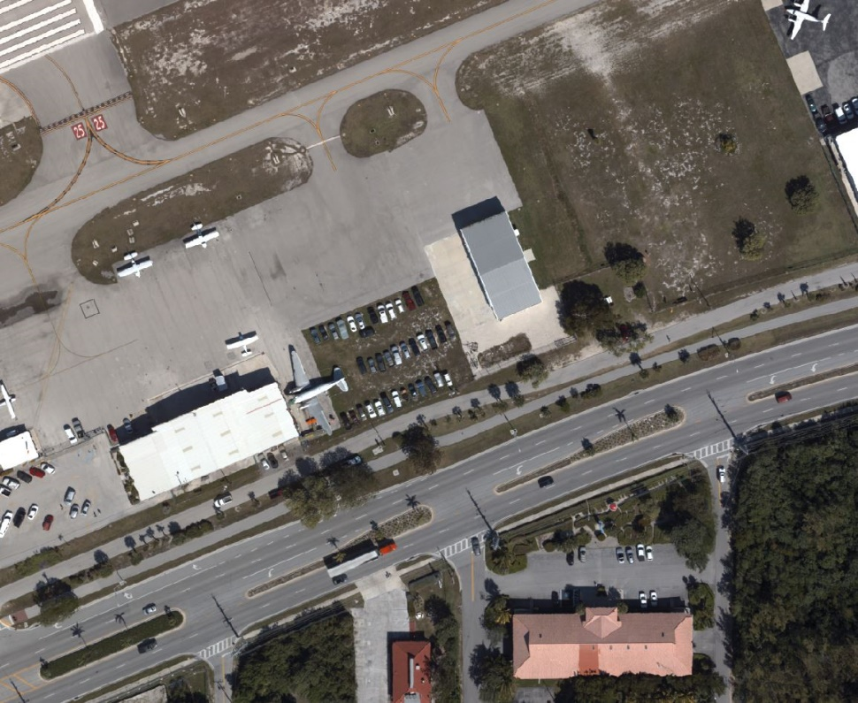
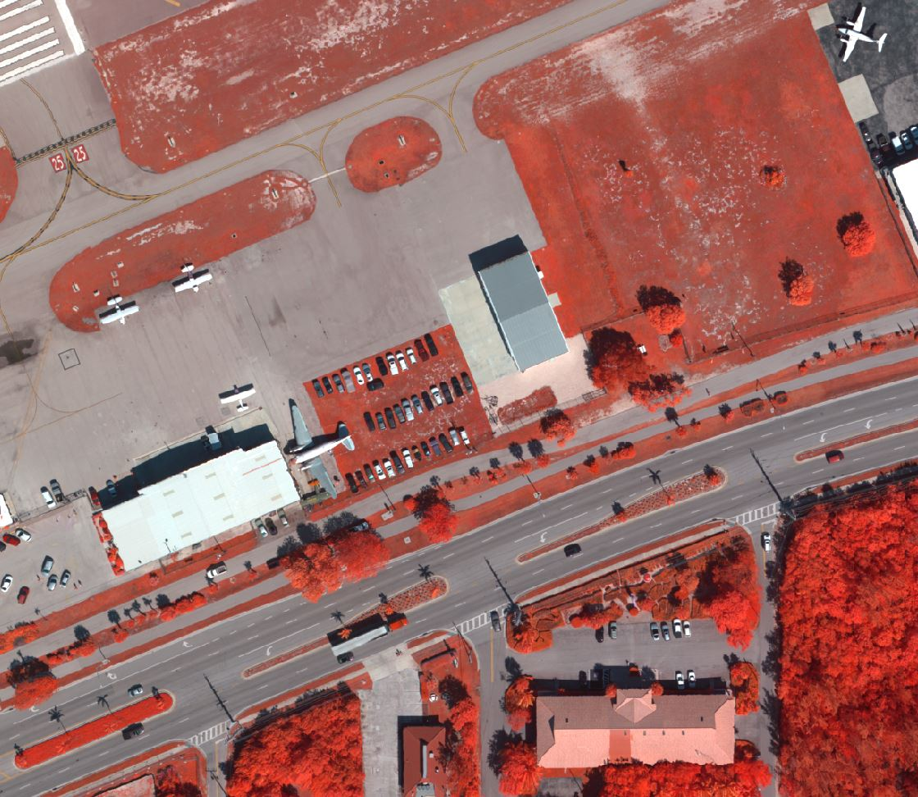
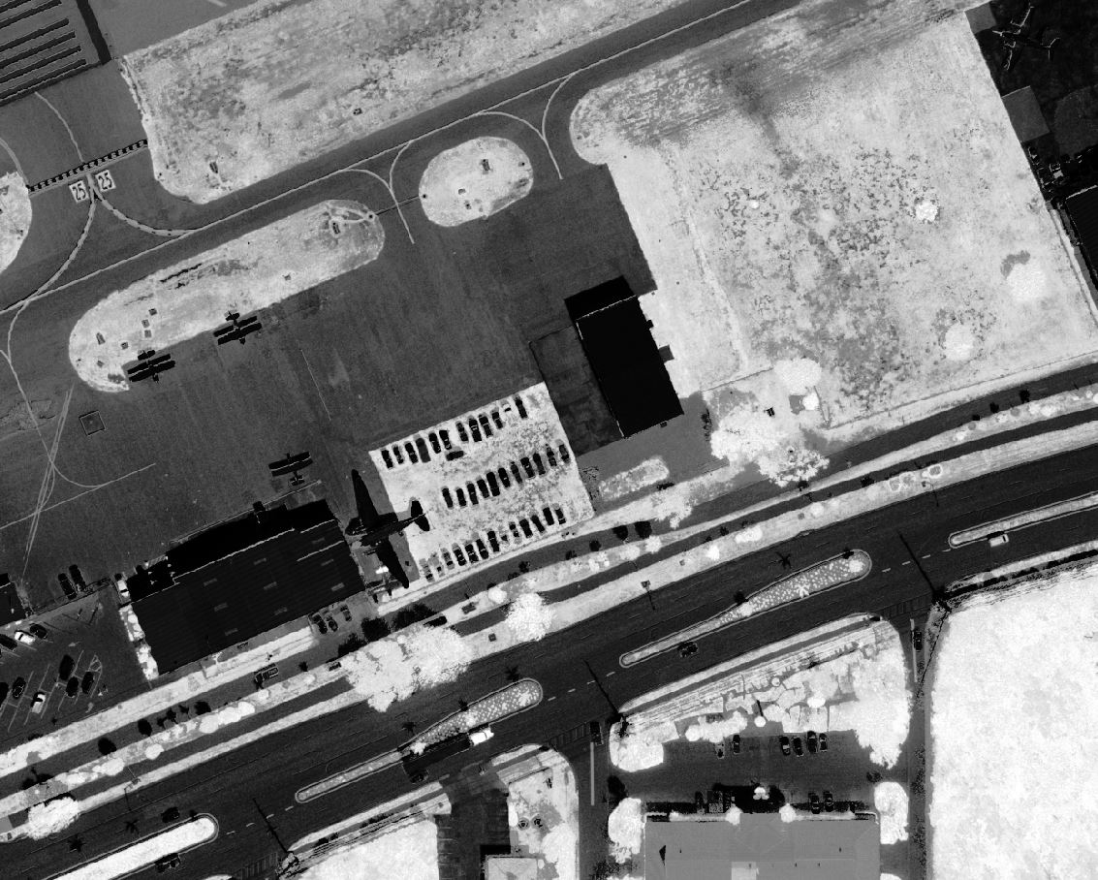
RCD30 Examples
GSD dependent on altitude: 3cm (0.1ft) to 18cm (0.6ft)
RGBN
Color Infrared
NDVI (Normalized Difference Vegetation Index)

Slide 43
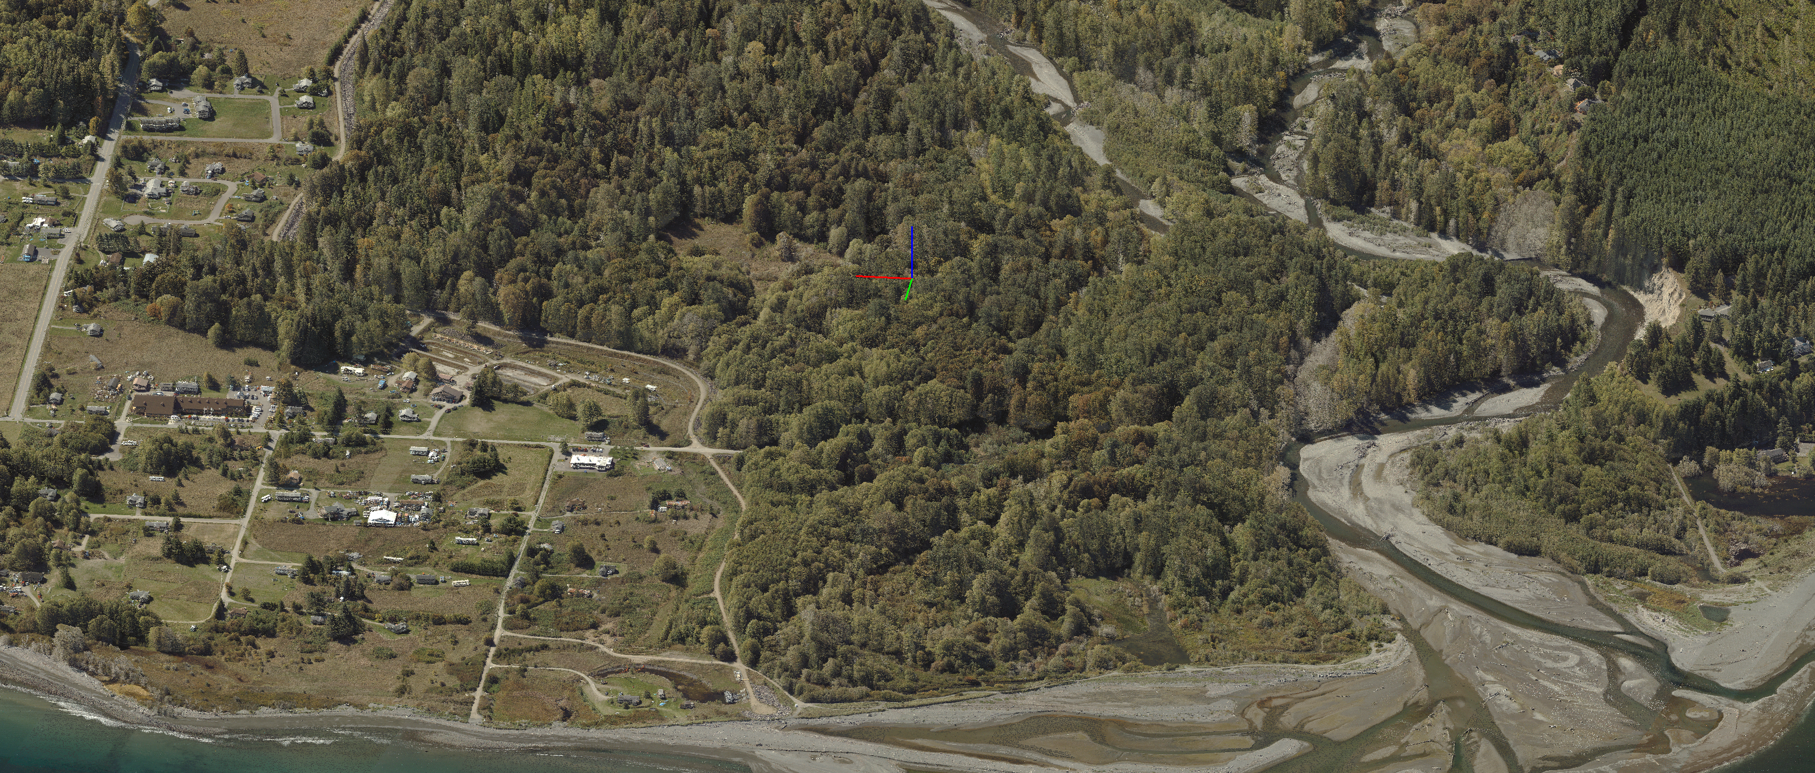
Thank You
Carol Lockhart : Carol@GeomaticsDS.com

