Slide 1
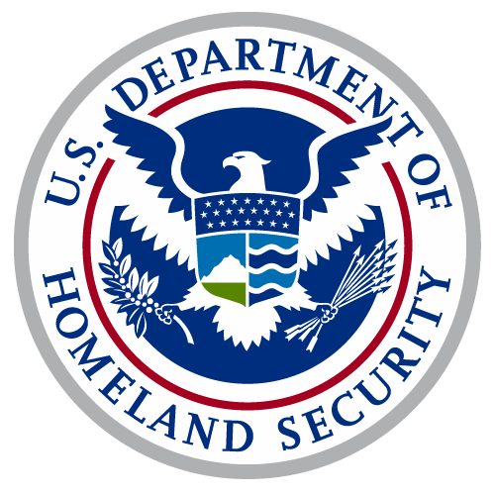
NOAA Hydrographic Services Review Panel
John P. Nadeau
RADM
U.S. Coast Guard Assistant Commandant for Prevention Policy
5 MAR 2019

Slide 2
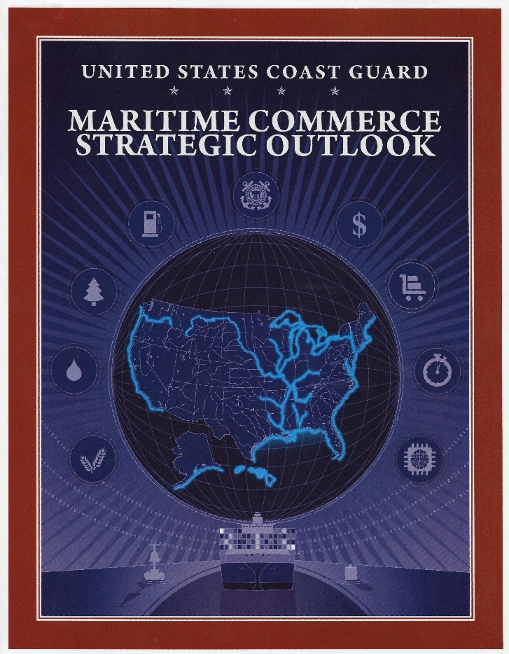
Maritime Commerce Strategic Outlook
Lines of Effort
Facilitating Lawful Trade & Travel on Secure Waterways
Modernizing Aids to Navigation & Mariner Information Systems
Transforming Workforce Capacity & Partnerships
Notes:
Facilitating Lawful Trade & Travel on Secure Waterways
Mitigate Risk to Critical Infrastructure
Build Resiliency within the MTS
Enhance Unity of Effort in the MTS
Modernizing Aids to Navigation and Mariner Information Systems
Improve Nation’s Waterways
Optimize Marine Planning
Recapitalize Aging Assets
Streamline and Update Information Systems
Transforming Workforce Capacity and Partnerships
Leverage and Ensure Effective Oversight of Third Parties
Sharpen High-Tech and Adaptive Service Competencies
Advance the Prevention and Response Operations Workforce
National MCSO goals:
Elevate maritime commerce within national economic/security conversation
Help the public understand the importance of maritime commerce and CG role
Build stakeholder advocacy at the national level for modernizing waterways infrastructure and expanding, hiring and training the prevention/response workforce

Slide 3
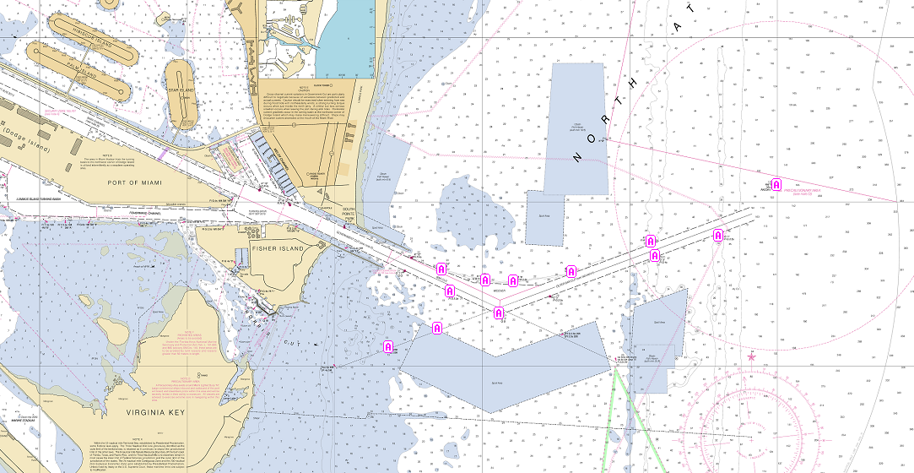
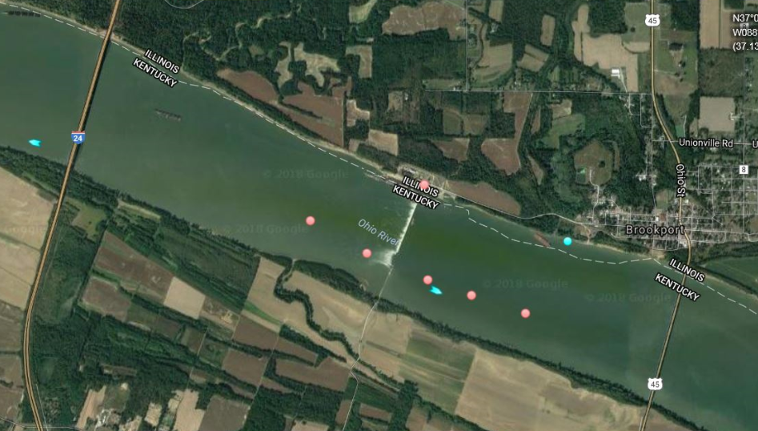
Future Navigation
eNAV
eCharts – USCG accepts NOAA ENCs ®
eATON – Preparing for and enabling the Maritime Transportation System of the future
eMSI – Enhanced delivery; PORTS Over AIS
Notes:
eCharts: The policy allows mariners to conduct paperless navigation. In 2017, the Coast Guard accepted NOAA ENCs as the only equivalent e-chart to meet domestic carriage requirements. This aligns with NOAA’s shift to make ENCs their flagship charting product and Army Corps’ focus on their Inland ENC data base. Many commercial products, including the most prevalent Inland charting product, already used ENCs.
eATON: Today, the MTS annually supports $4.6 trillion dollars of economic activity. To ensure a safe, secure and efficient Marine Transportation System (MTS) that will meet the needs of shipping in the future, the Coast Guard employs a balance of Aids to Navigation, Marine Safety Information, Standards and Regulations, Vessel Traffic Services, Navigation Technology, and Maritime Risk Management Systems.
Developing a 21st Century waterway that optimally balances these systems to meet maritime transportation needs will involve modernizing the hardware, design, maintenance and delivery of ATON based on an analysis of user requirements.
The 2017 hurricane season also showcased how AIS ATON technology can be leveraged in a modernized ATON system to continue providing a signal to mariners until physical aids can be restored.
The Coast Guard is presently conducting a series of Nationwide Waterways Analysis and Management System (WAMS) studies to define our ATON level of service policy. Studies on the Pacific Seacoast and Western Rivers are currently in progress.
Even as electronic aids and navigation systems continue to expand, it is clear that physical Aids-to-Navigation (ATON) remain a critical component in ensuring the resiliency and efficiency of our MTS.
eMSI: CG-NAV is expanding its capabilities to disseminate MSI beyond the legacy BNM and LNM systems by leveraging the capabilities of our Nationwide Automatic Identification System (NAIS). CG-NAV is working with NOAA to broadcast NOAA PORTS data via NAIS. To accomplish this, USCG is:
Partnering with NOAA and NGA to improve the methods used to exchange and process MSI.
Reviewing how BNMs are processed and disseminated with an eye towards providing mariners access to BNMs via the Internet.
Participating on a Committee on Marine Transportation System (CMTS) Future of Navigation Integrated Action Team to develop a proof-of-concept for a single website where mariners can access the MSI published by Coast Guard, NOAA, NGA, and the U.S. Army Corps of Engineers.

Slide 4
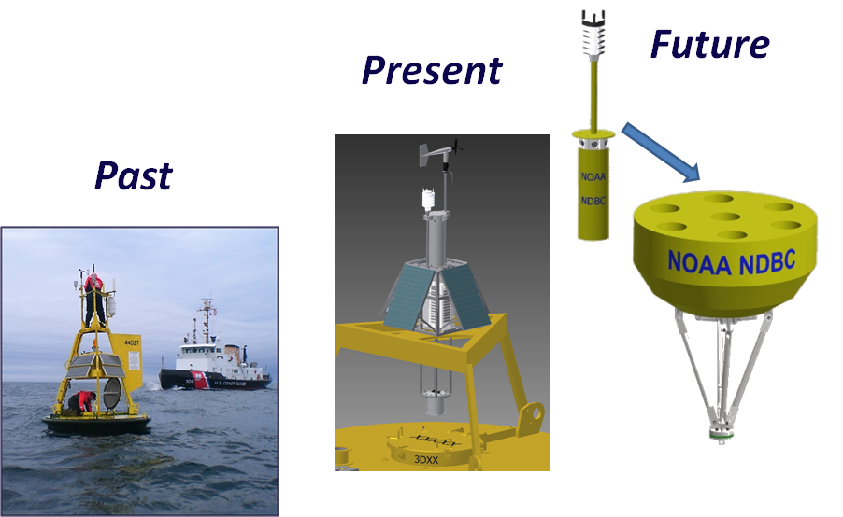
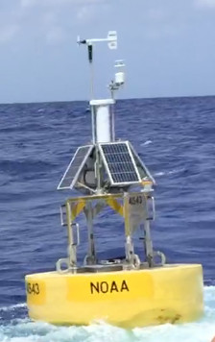
CG-NOAA Partnership
Collaborations
Navigation Rules included in each Coast Pilot
USCG / NOAA ENC ® regulations crosswalk
National Data Buoy Center
Notes:
NavRules: NOAA Coast Survey and the Coast Guard teamed up to include both the COLREGs and Inland Navigation Rules in an amalgamated format in each edition of the Coast Pilot. Now by carrying the applicable Coast Pilot, mariners meet two requirements; a two for one.
ENC Crosswalk: The Coast Guard is partnering with NOAA to reduce the chart complexity, specifically on the NOAA ENC®. ENCs are the primary chart used by the international maritime community. Because the mariner must decipher administration specific features from one nation’s waters to the next, the Coast Guard desires to align its charted regulations with standard features already defined by the IHO in their ENC product specification.
While many chart display manufactures portray nation-specific features, the Coast Guard considers it better practice to reduce the number of unique features and encode them to a standard. This will increase NOAA ENC® clarity for the mariner.
NDBC: Since 1927, the Coast Guard team provides technical expertise and coordinates the deployment, servicing and retrieval of the NOAA weather buoys by scheduling operations with USCG cutters and aircraft.
With pressures of flat or declining operational budgets, NDBC constantly works to decrease the overall cost of buoy maintenance while maintaining required performance of 80% data availability. The weather buoys, which began as very large platforms - 12Meter discus with 10M high mast - have been downsized to 3 meter or smaller over the last 20 years.
Traditional NOAA buoys hulls are being replaced with a modular design called the SCOOP Buoy should increase reliability of the equipment and decrease cost of the ship time required for servicing. These buoys are:
Less labor intensive assembly, and at-sea servicing
Allows use of ships with less lift capacity
Requires less time on station
Has expanded observing capabilities
Sealed – never open in the field

