Slide 1
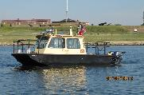
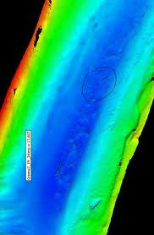
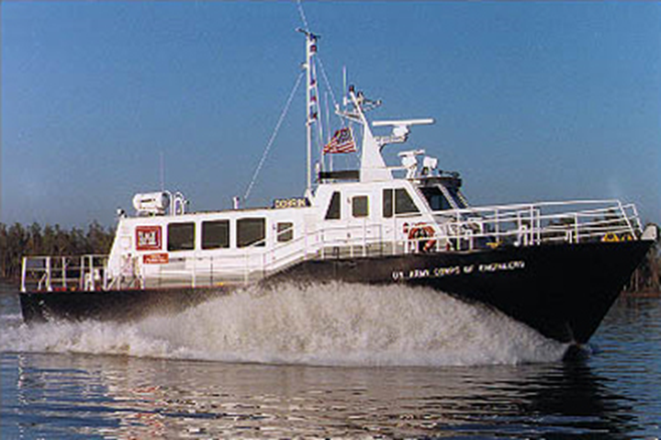
Hydrographic services review panel march 5-7, 2019
Thomas P. Smith, P.E, SES,
Chief, Operations and Regulatory Division, LRD/NAD Regional Integration Team Leader, Directorate of Civil Works,
U.S. Army Corps of Engineers

Slide 2
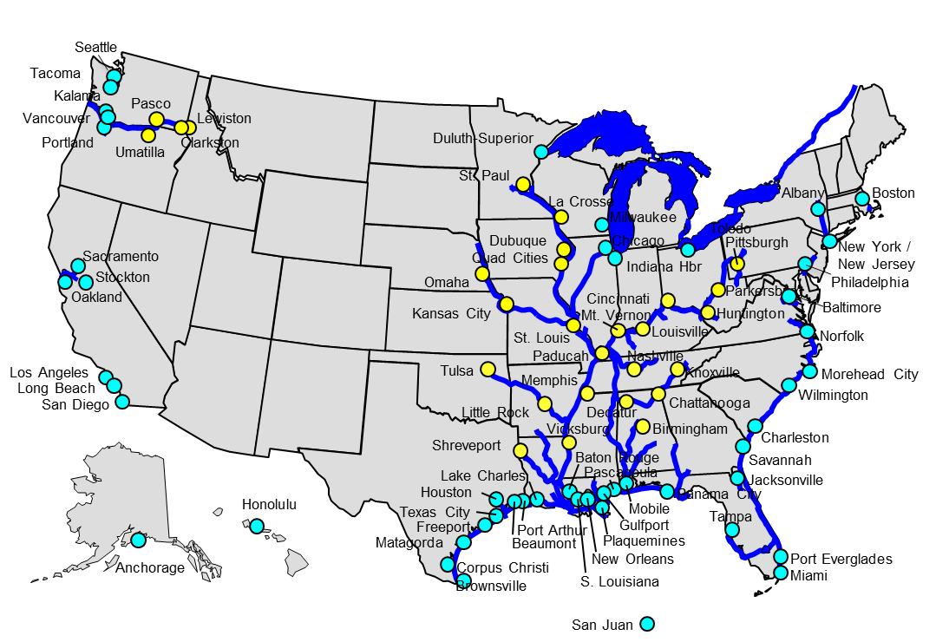
USACE Navigation Mission
Provide safe, reliable, efficient, effective and environmentally sustainable waterborne transportation systems for movement of commerce, national security needs, and recreation.
U.S. Marine Transportation industry supports ~ $2 Trillion in commerce annually
More than 48% of consumer goods in the U.S. pass through harbors maintained by USACE
Over 1.3 Billion short tons of foreign goods moved through U.S. ports/waterways in 2015
Over 900 Million short tons of domestic goods moved through U.S. ports/waterways in 2015
15% of domestic freight carried by water
13,000 miles of coastal and deep draft channels
1,067 coastal, Great Lakes, and inland harbors
40 states are directly served by USACE channels & waterways

Slide 3
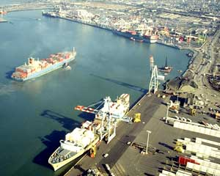
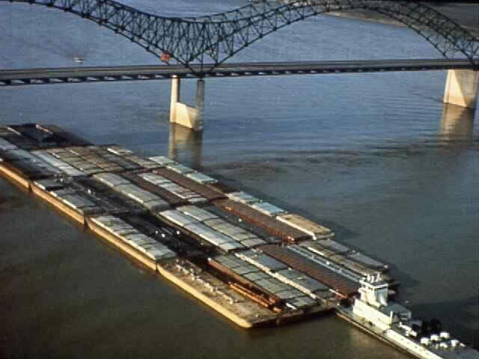
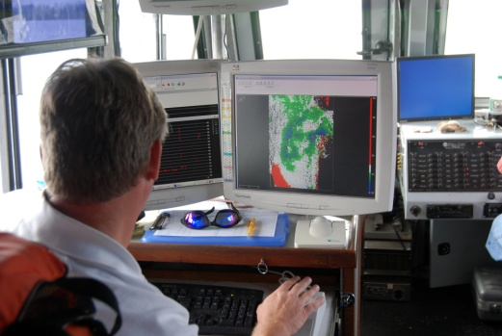
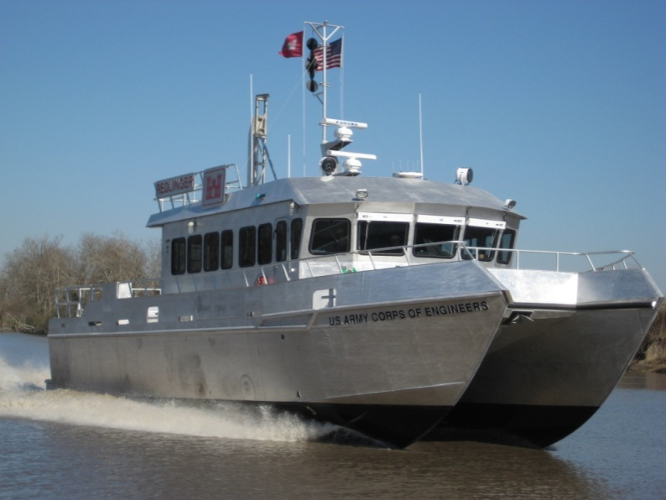
Extensive waterway Operations, maintenance and construction activities
***** Resulting in timely and accurate chart data ****
Authorized Navigation Channel Projects
High Use: > 10M tons 56
Moderate Use: 1M to 10M tons 74
Low Use: < 1M tons 938
Channel dredging averages 280M cubic yards per year
122 survey vessels
58 Multibeam systems Some vessels include; Surface LiDAR Magnetometer Side-scan | Four Atonomous Survey Vehicles
* Contractor services also used

Slide 4
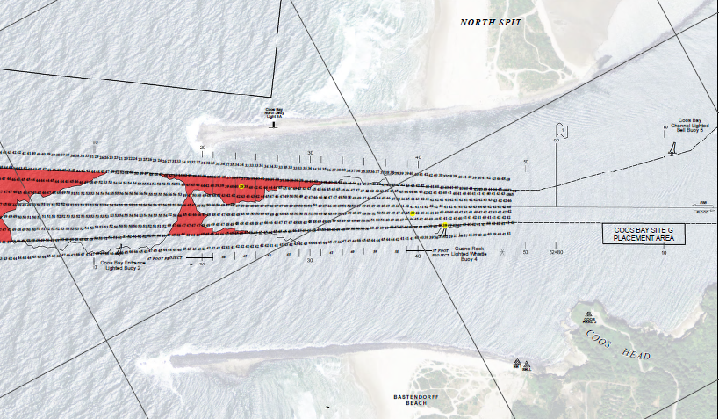
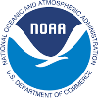
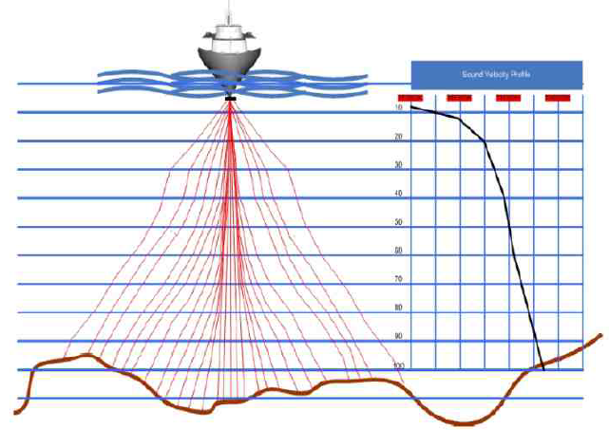
Federal Partnership: Sharing Channel Condition Data
Data availability through a single enterprise rather than multiple districts
Areas of collaboration between USACE and NOAA, in addition to continued availability of surveys and channel boundaries;
Obstruction surveys
Category Zone of Confidence (CATZOC) on NOAA charts
Consistency of information in NOAA charts and USACE survey plots
High resolution multibeam data for national dataset

Slide 5
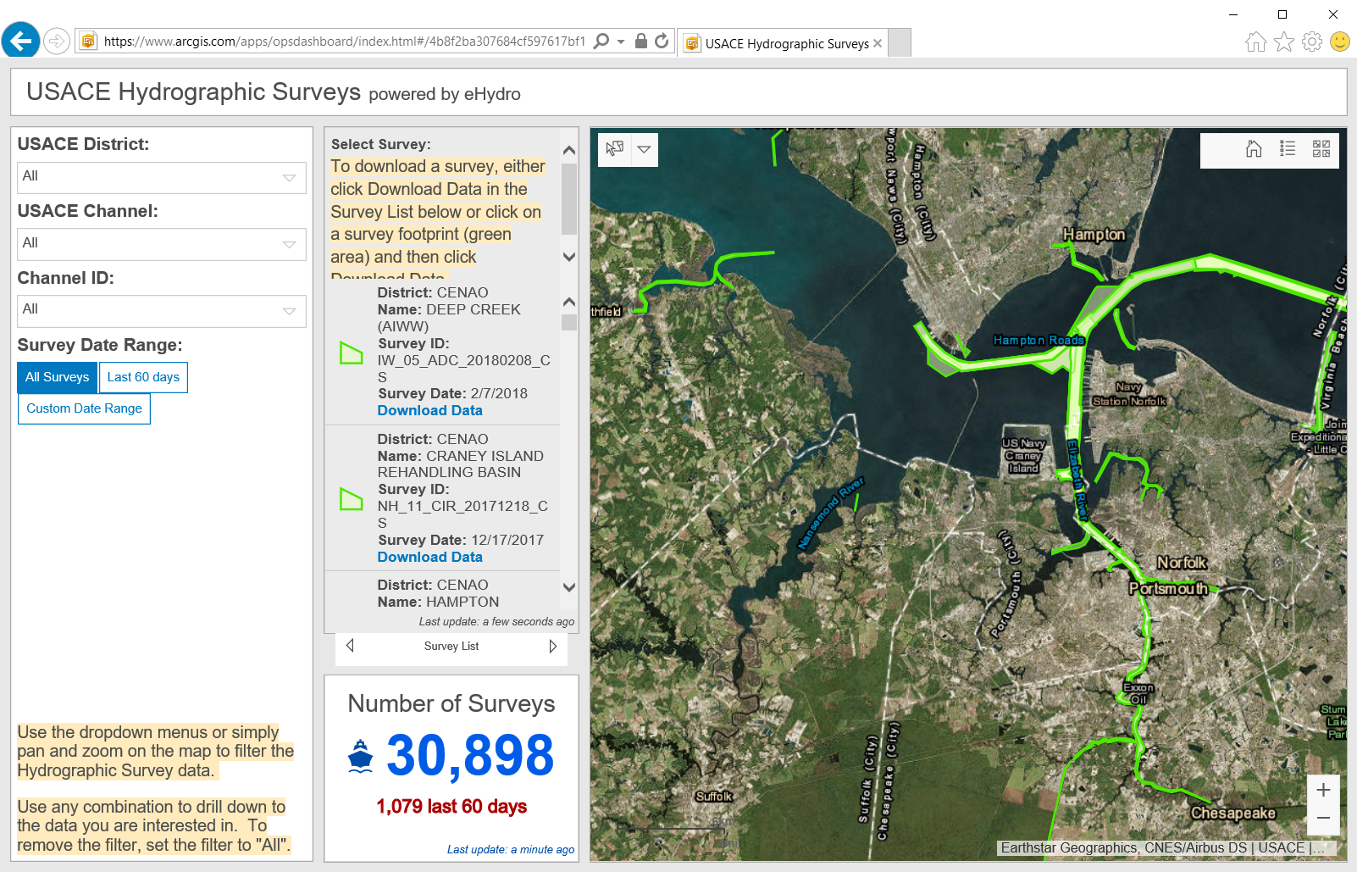
eHydro: Channel Condition Data Covering All Ports and Waterways from a Single Portal
Less cost disseminating data
Consistent format, structure, and availability
Enables enterprise performance analysis of navigation system

Slide 6
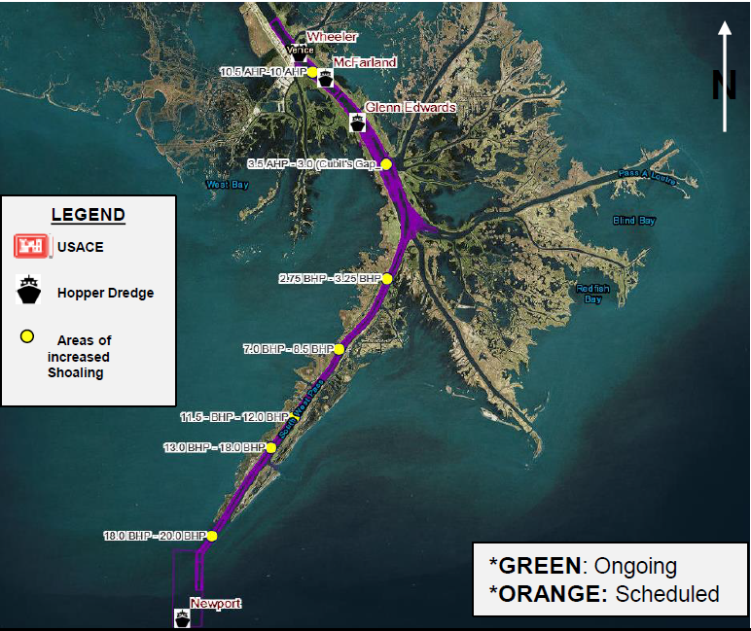
Contingency Operations at Southwest Pass: DEC 2018 - MAR 2019
Sustained high water conditions generating extensive shoaling
USACE Navigation Priority:
Continuous coordination with ports, industry, affected stakeholders
Multiple hopper dredges
Three survey vessels performing daily surveys
Surveys and shoaling polygons available in eHydro portal
Deployed assets on 22 FEB 2019
Electronic chart overlays being produced from daily surveys

Slide 7
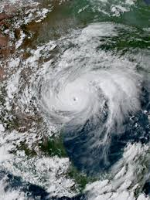
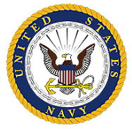
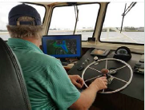
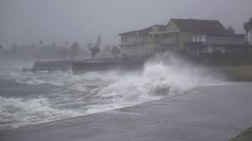
2017-2018 Emergency Response Channel Re-Openings
Multiple ports surveyed and re-opened following hurricane activity
Hurricanes
Harvey
Irma
Maria
Florence
Michael
Interagency efforts to survey and clear obstructions – most ports and channels re-opened within three days
Extremely valuable help from NOAA survey vessels clearing remote ports in Puerto Rico, and finding obstructions in Key West, FL and Wilmington, NC
Impacting
TX & LA Coasts
Florida
Puerto Rico
Carolina Coasts
AL & FL Gulf Coasts

Slide 8
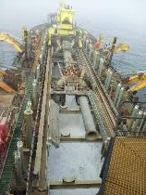
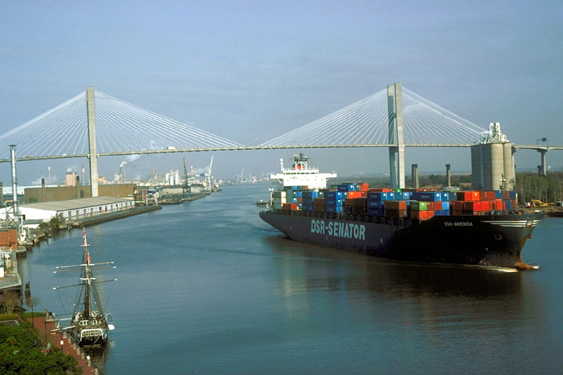
Navigation Challenges
Maintaining authorized/constructed channel dimensions
Cost of dredging
Environmental Compliance
Air and water quality requirements
Threatened, endangered, and invasive species
Dredging windows

Slide 9
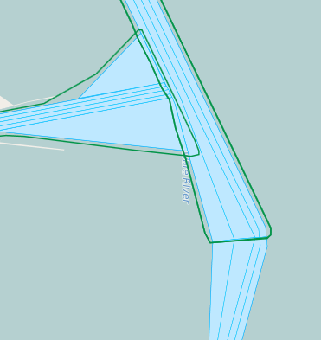
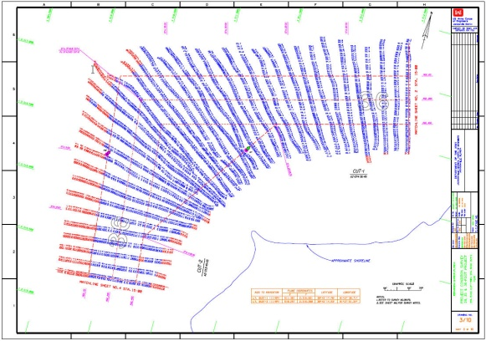
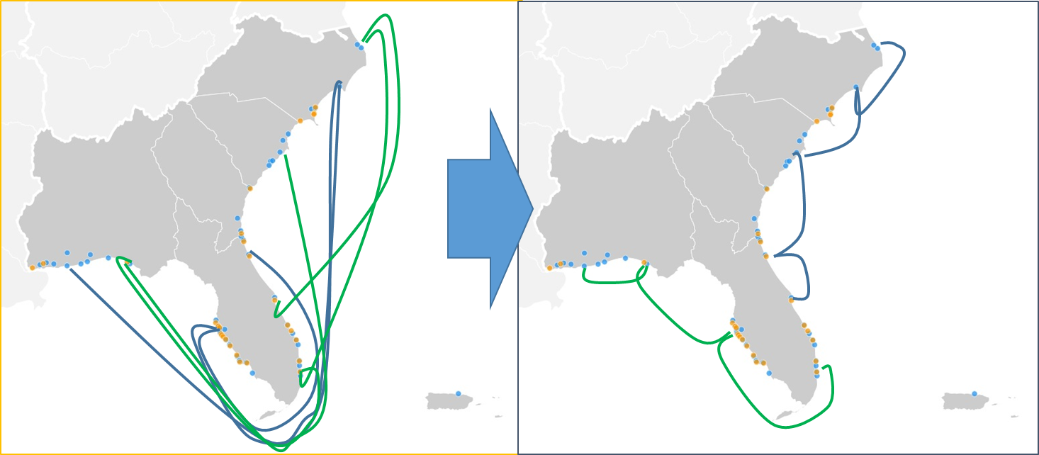
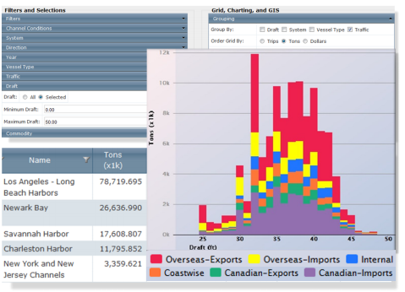
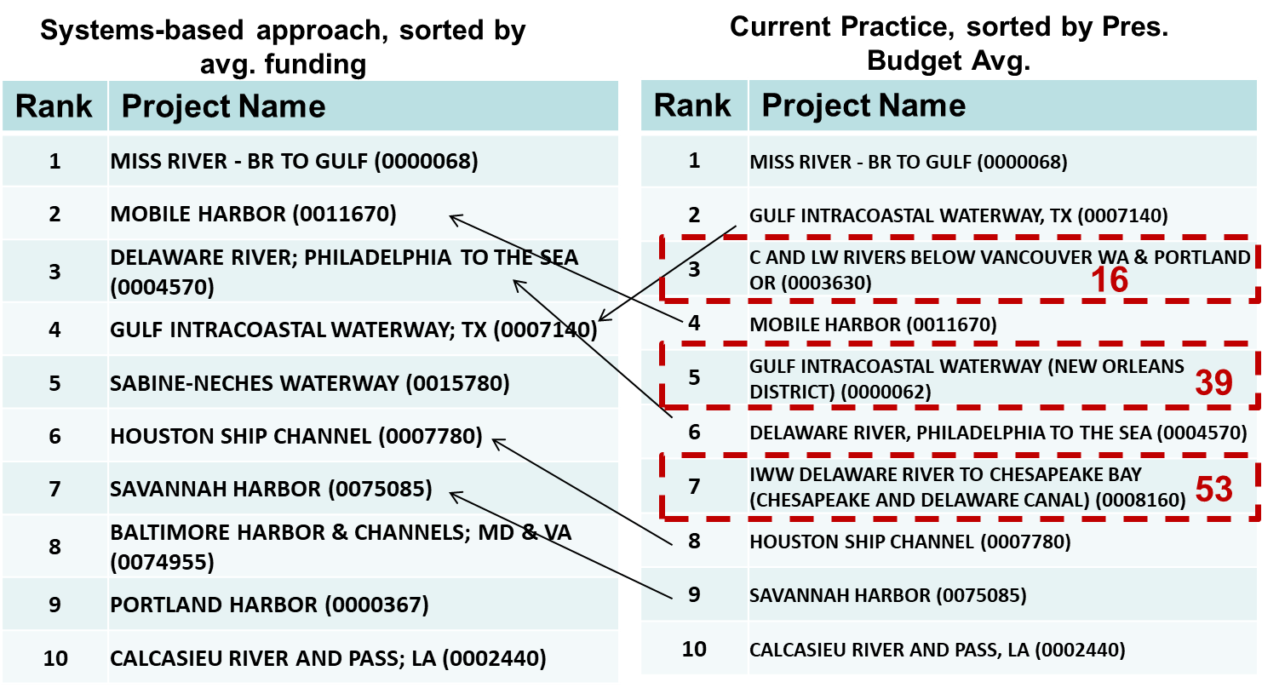
Increased cost of doing business….
More efficient use of dredging resources
Data Sources
Dredge Fleet Scheduling Recommendations
Framework
Surveys
+
Existing Tools
Dredge Project Selection Suggestions
Channel Portfolio Tool
Corps Shoaling Analysis Tool

Slide 10
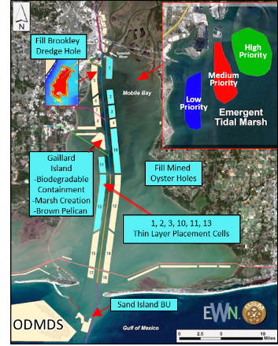
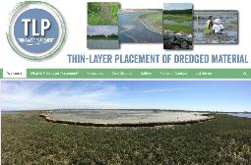
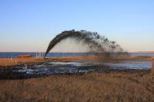
Constrained funding, Environment….
Thin-Layer Placement of Dredged Sediments
Strategic Placement of Dredged Sediments can…
Reduce Navigation Costs
Provide Ecosystem Restoration
Reduce Coastal Storm & Flood Risk
Mobile Bay Cost Savings: $6M/yr
Benefit of Wetlands: $625M (Hurr Sandy)
Wetlands can reduce average annual coastal flood impacts by 20%
10

