Slide 1
National Geodetic Survey Priorities
Juliana Blackwell
Director, National Geodetic Survey
March 6, 2019
Washington, DC

Slide 2
Priorities Outline
National Spatial Reference System Modernization
Crowdsourcing and New Hybrid Geoid Model
Product Testing
New Coordinates for CORS
Hurricane Supplemental
Geospatial Summit 2019

Slide 3
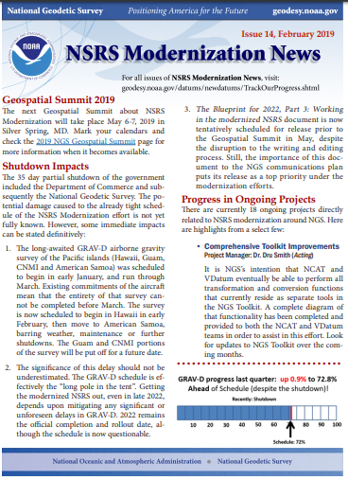
National Spatial Reference System (NSRS) Modernization
Key Activities:
Pacific GRAV-D survey in 2019 (Hawaii, American Samoa)
New Least Squares adjustment model developed and published
Blueprint for 2022, Part 3 will be released in draft form by May 2019
VERTCON 3.0 has been developed
https://www.ngs.noaa.gov/INFO/subscribe.shtml

Slide 4
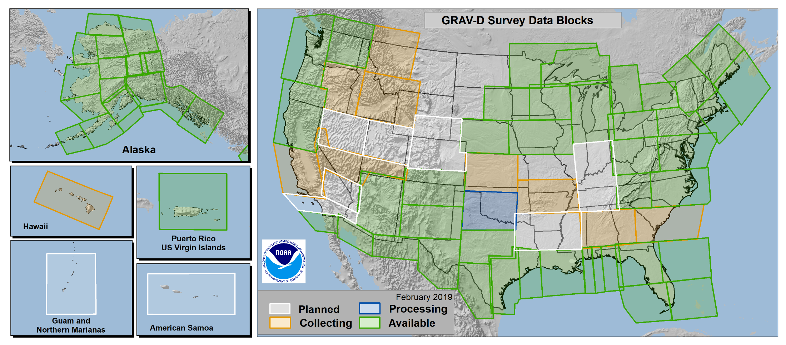
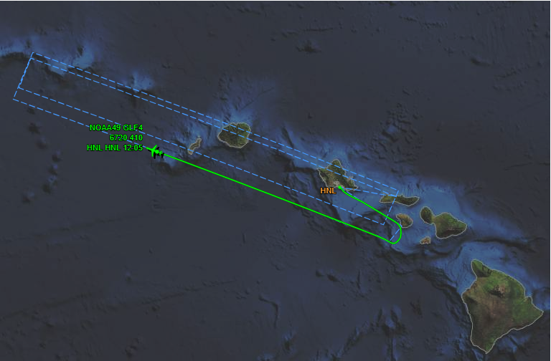
GRAV-D Progress
Over 73% complete
FY18 Milestone: Completed collection of mainland Alaska
FY19 Focus: Complete American Samoa, half of Hawaii, and continue CONUS

Slide 5
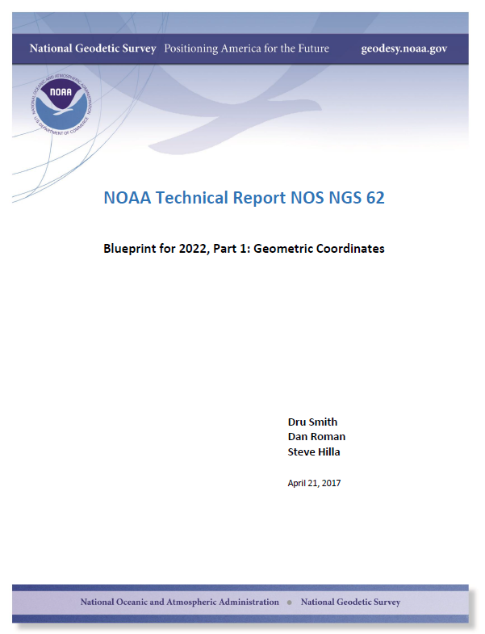
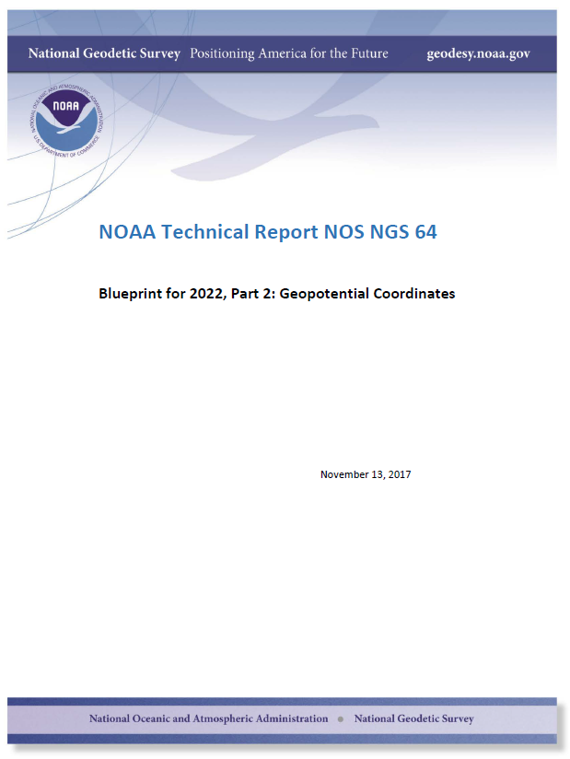
Planning Updates: Refining the Vision for 2022
NGS Strategic Plan Update
Blueprint for 2022
Technical Report Series
NGS revised the Strategic Plan in February 2019 to reflect progress and changes from the last 5 years.
Part 1: Geometric Coordinates and Part 2: Geopotential Coordinates are already released Part 3: Working in the Modernized NSRS coming May 2019

Slide 6
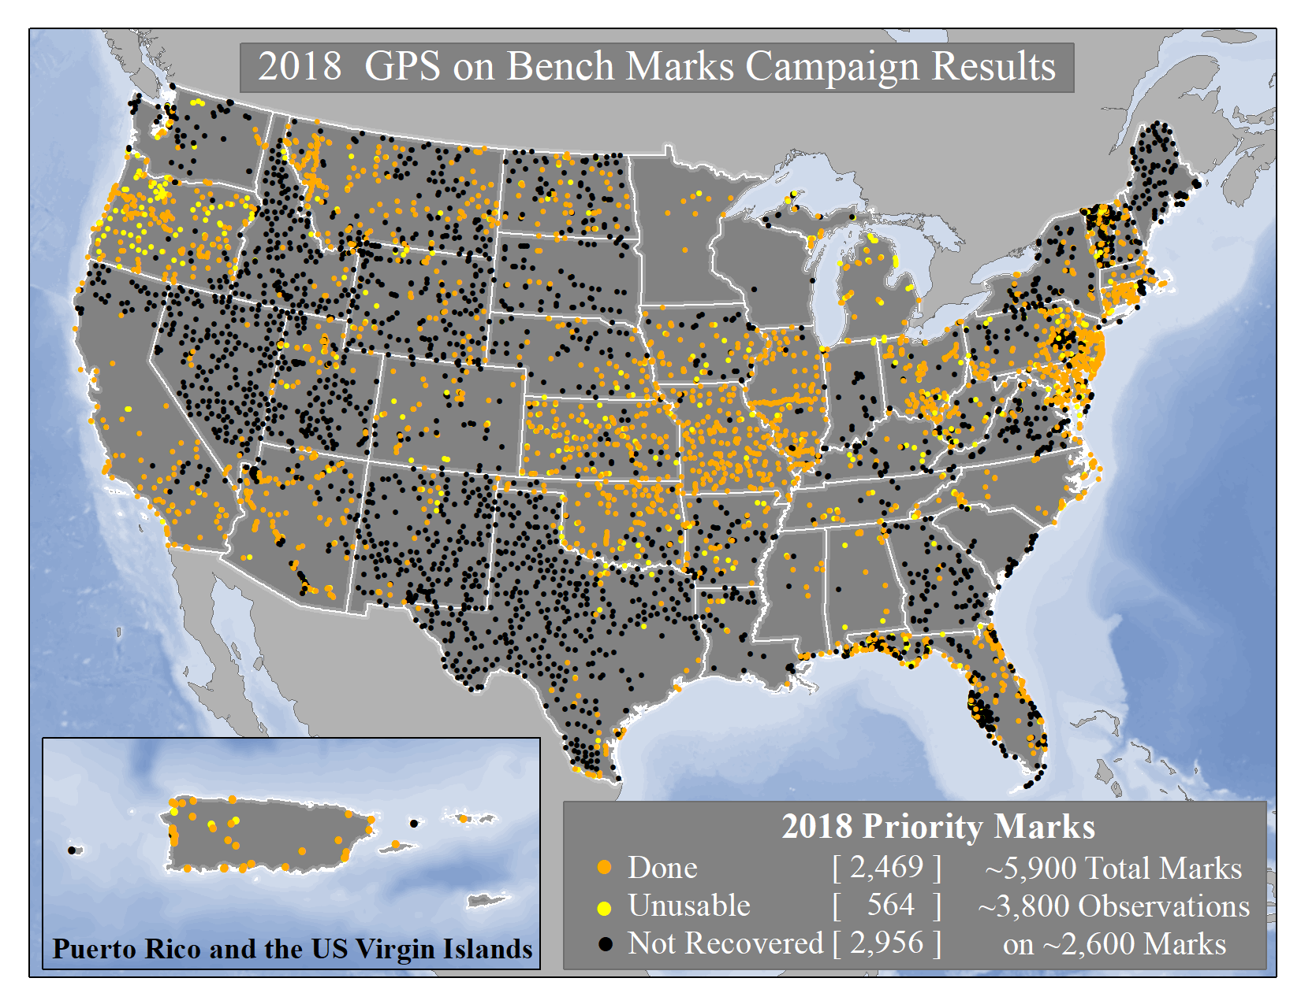
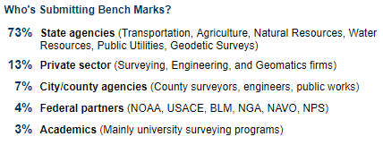
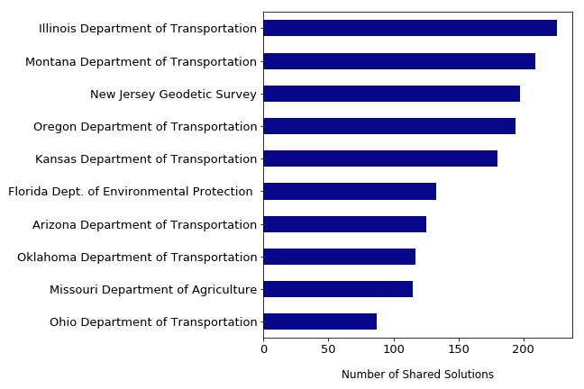
In 2018 NGS released a list of ~5,700 marks for crowd sourced data collection.
We received ~3,800 4+ hour observations on ~2,600 marks
Top 10 Submitters

Slide 7
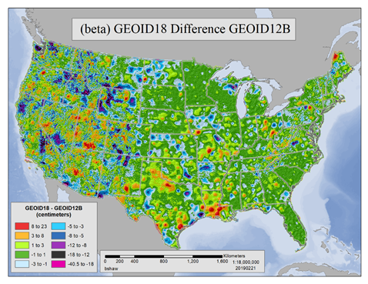
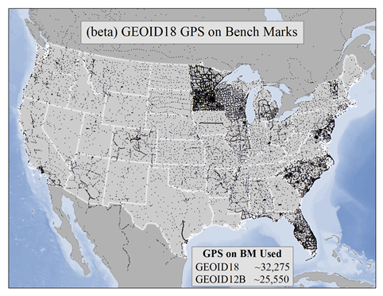
New Hybrid Geoid Model
GEOID18 to Replace GEOID12B
In early 2019, NGS will release GEOID18, a new hybrid geoid model to deliver improved GPS-derived NAVD 88 heights. It will be the last hybrid geoid model that NGS will create before NAVD 88 is replaced by NAPGD2022

Slide 8
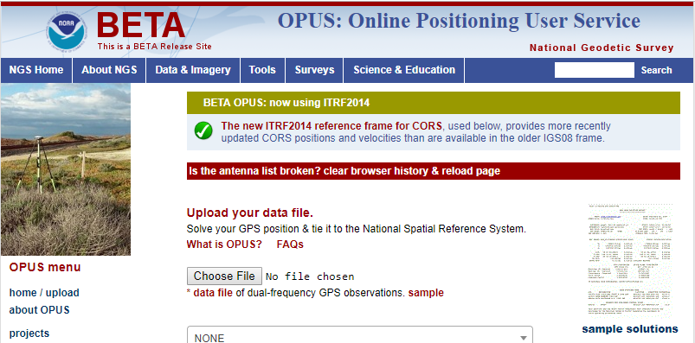
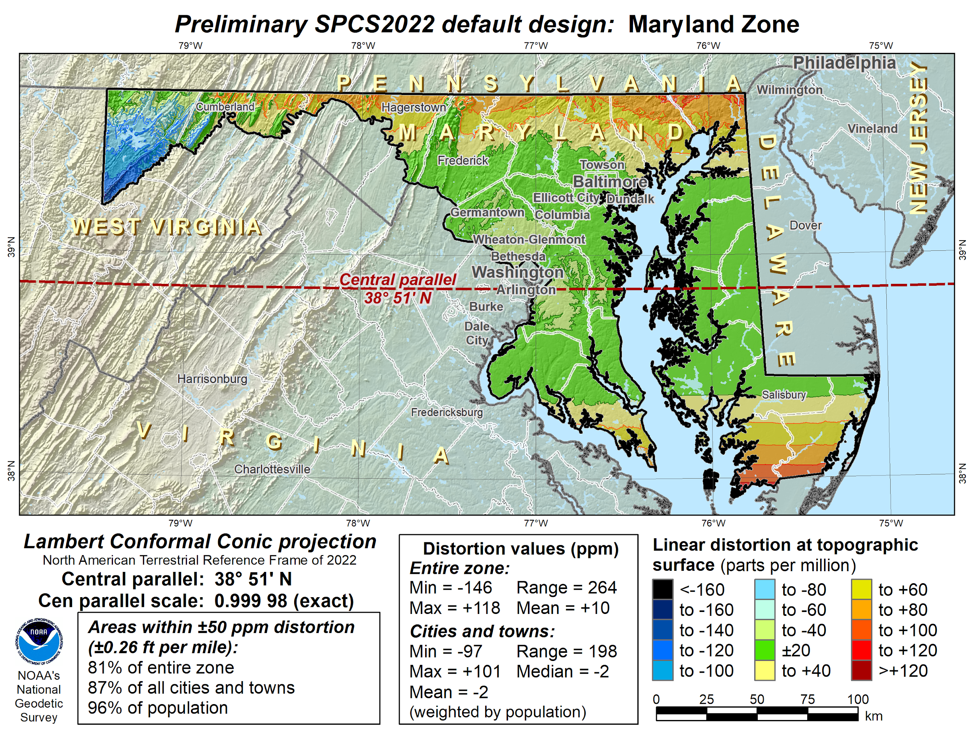
Product Testing
2018 NSRS Modernization Industry Workshop Feedback: “Give us alpha and beta products ASAP”
NGS is improving its roll-out and testing process
Beta Testing New Tools and Web Services
Future - Alpha Testing 2022 Models and Tools…
Draft Policy and Procedures via Federal Register and collaborative design process for State Plane Coordinate System for 2022

Slide 9
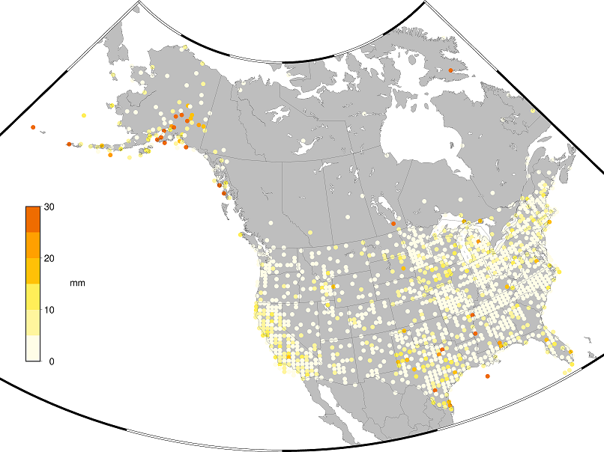
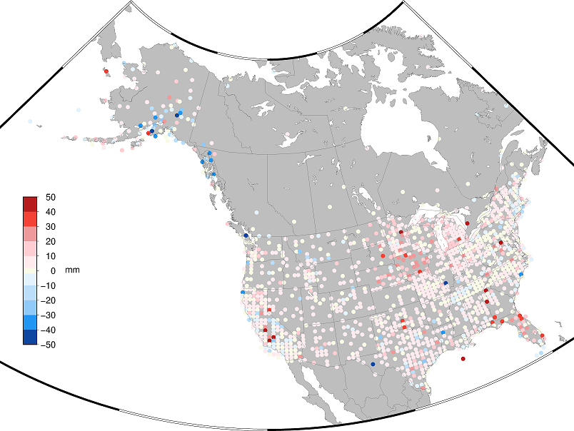
New Coordinates for CORS Network
BETA Testing of New Multi-Year CORS Solution 2
Analyzed all CORS existing between 1994 and January 28, 2017
BETA ITRF2014 and updated NAD83(2011) CORS coordinates and velocities
BETA OPUS (-S, -RS, -Projects) using new coordinates and velocities
NAD83(2011)
Horizontal
Coordinate
Change
NAD83(2011)
Vertical
Coordinate
Change

Slide 10
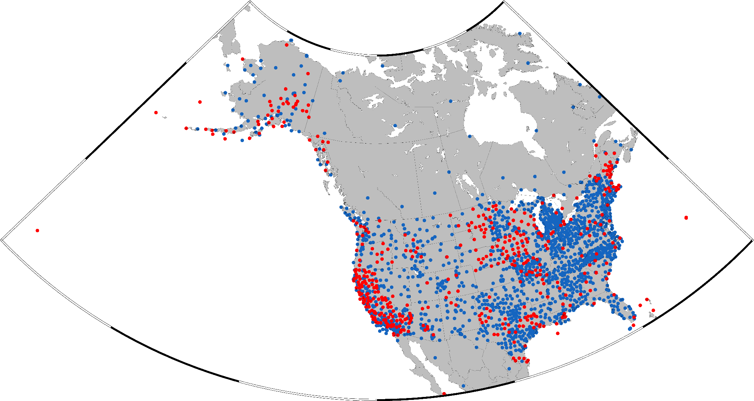
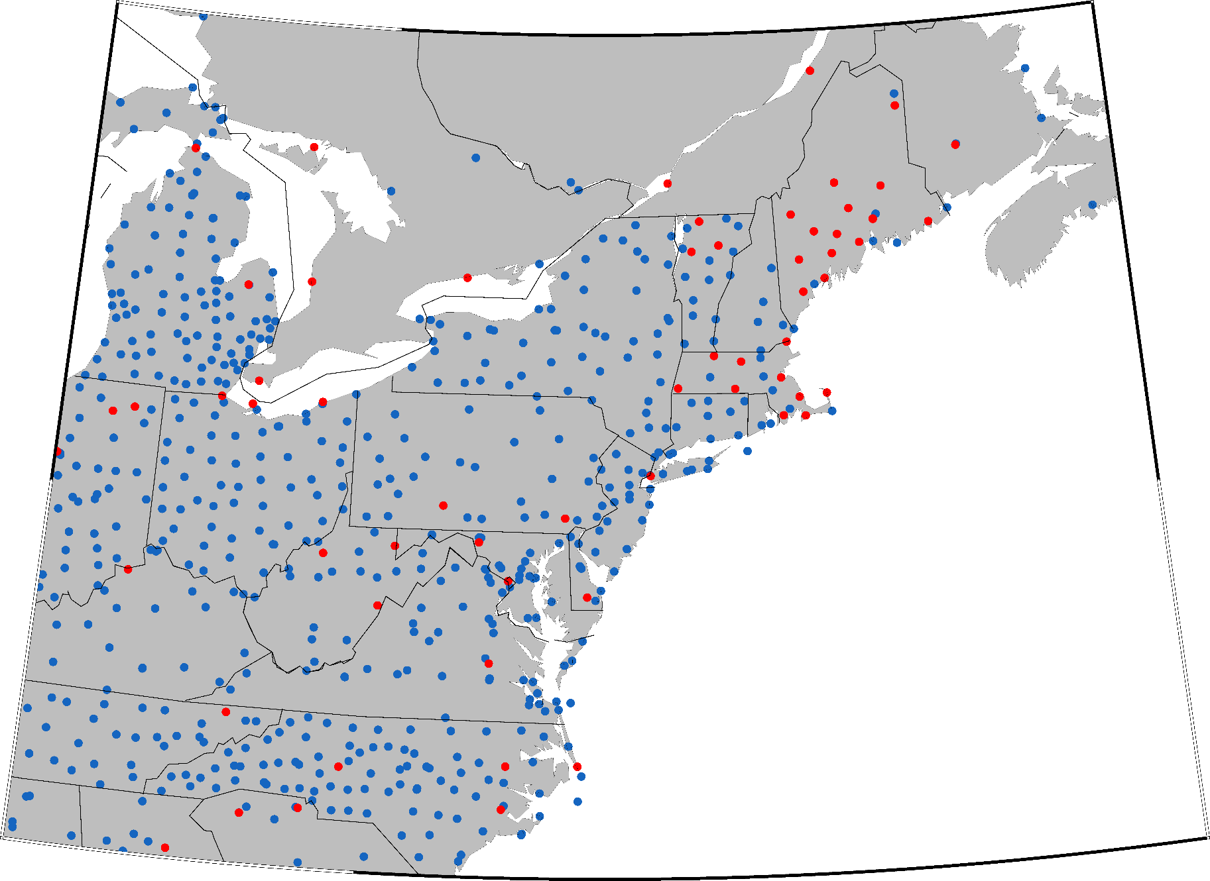
BETA Testing of New Multi-Year CORS Solution 2
https://beta.ngs.noaa.gov/CORS/coords.shtml
Blue dots: common stations in repro1 and repro2 stations (2485 stations)
Red dots: stations new in MYCS2 (554 stations)
NAD83(2011)
Horizontal
Coordinate
Change
NAD83(2011)
Vertical
Coordinate
Change

Slide 11
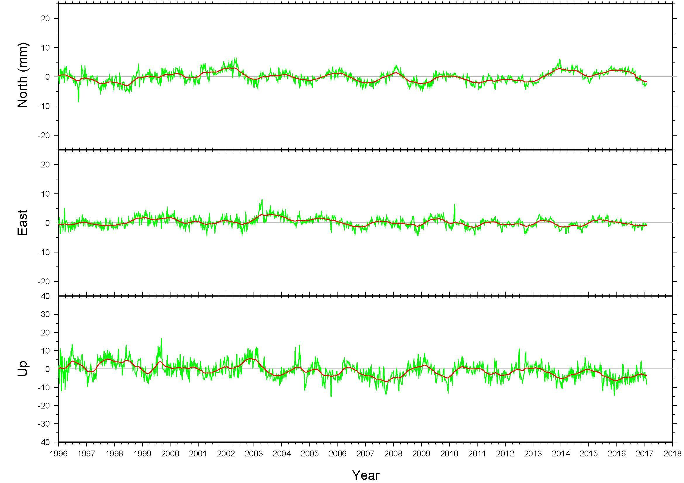
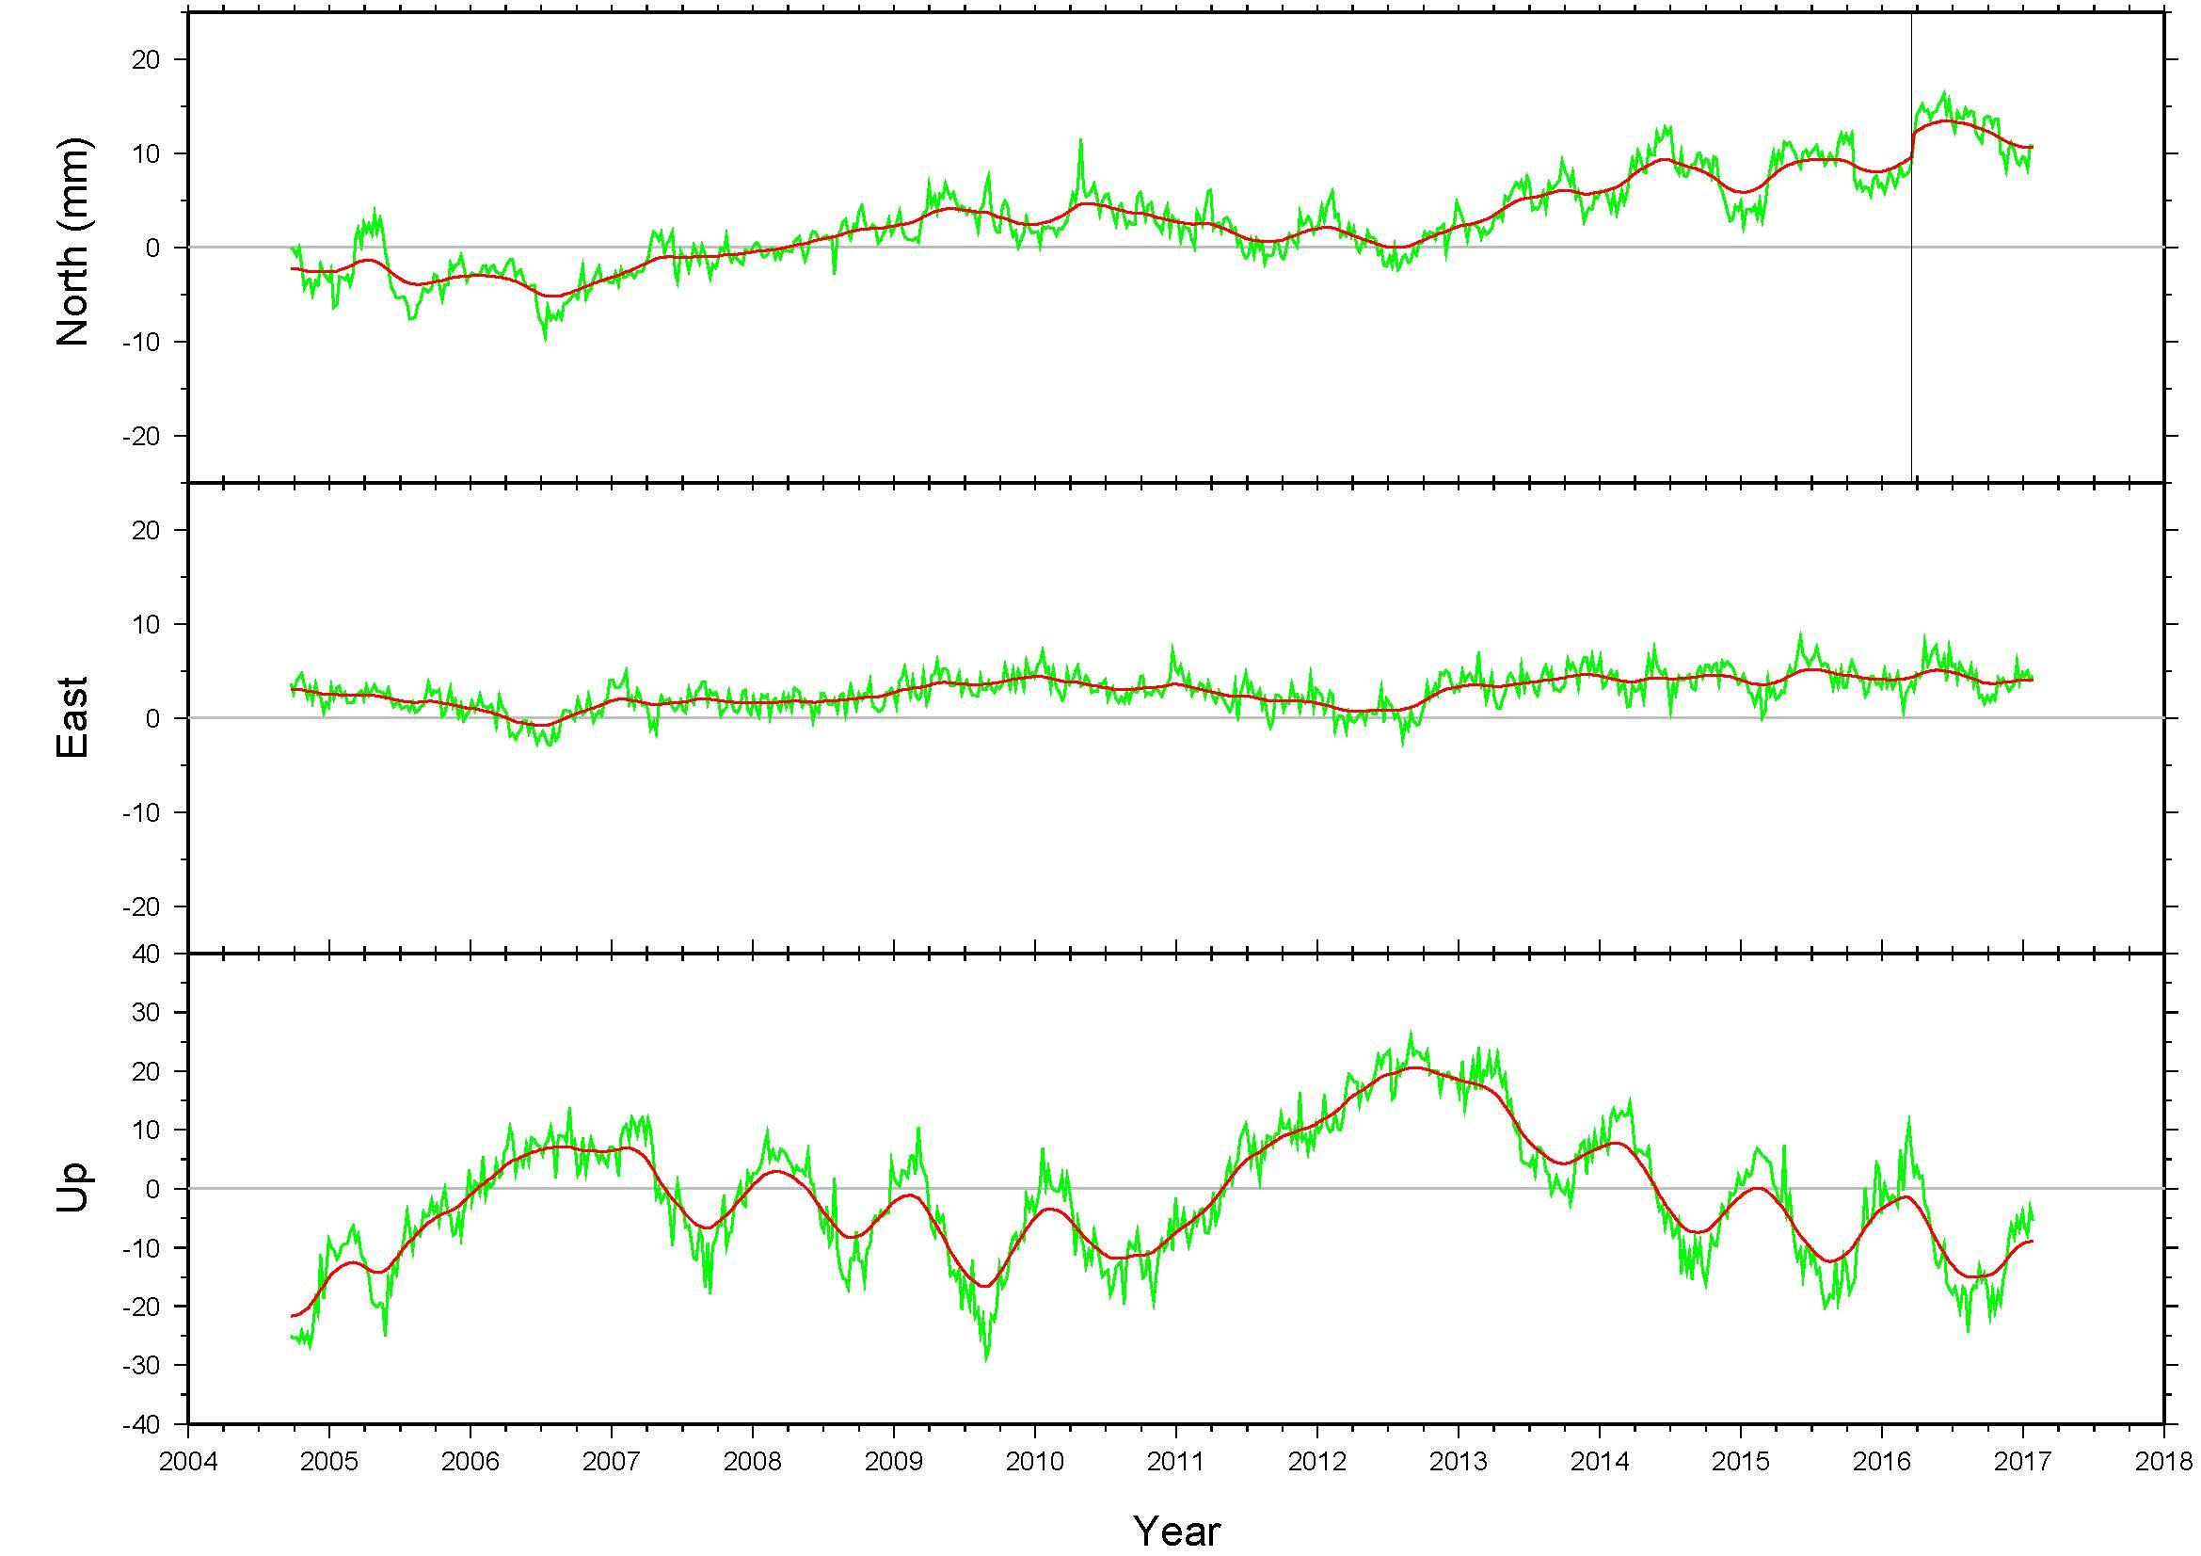
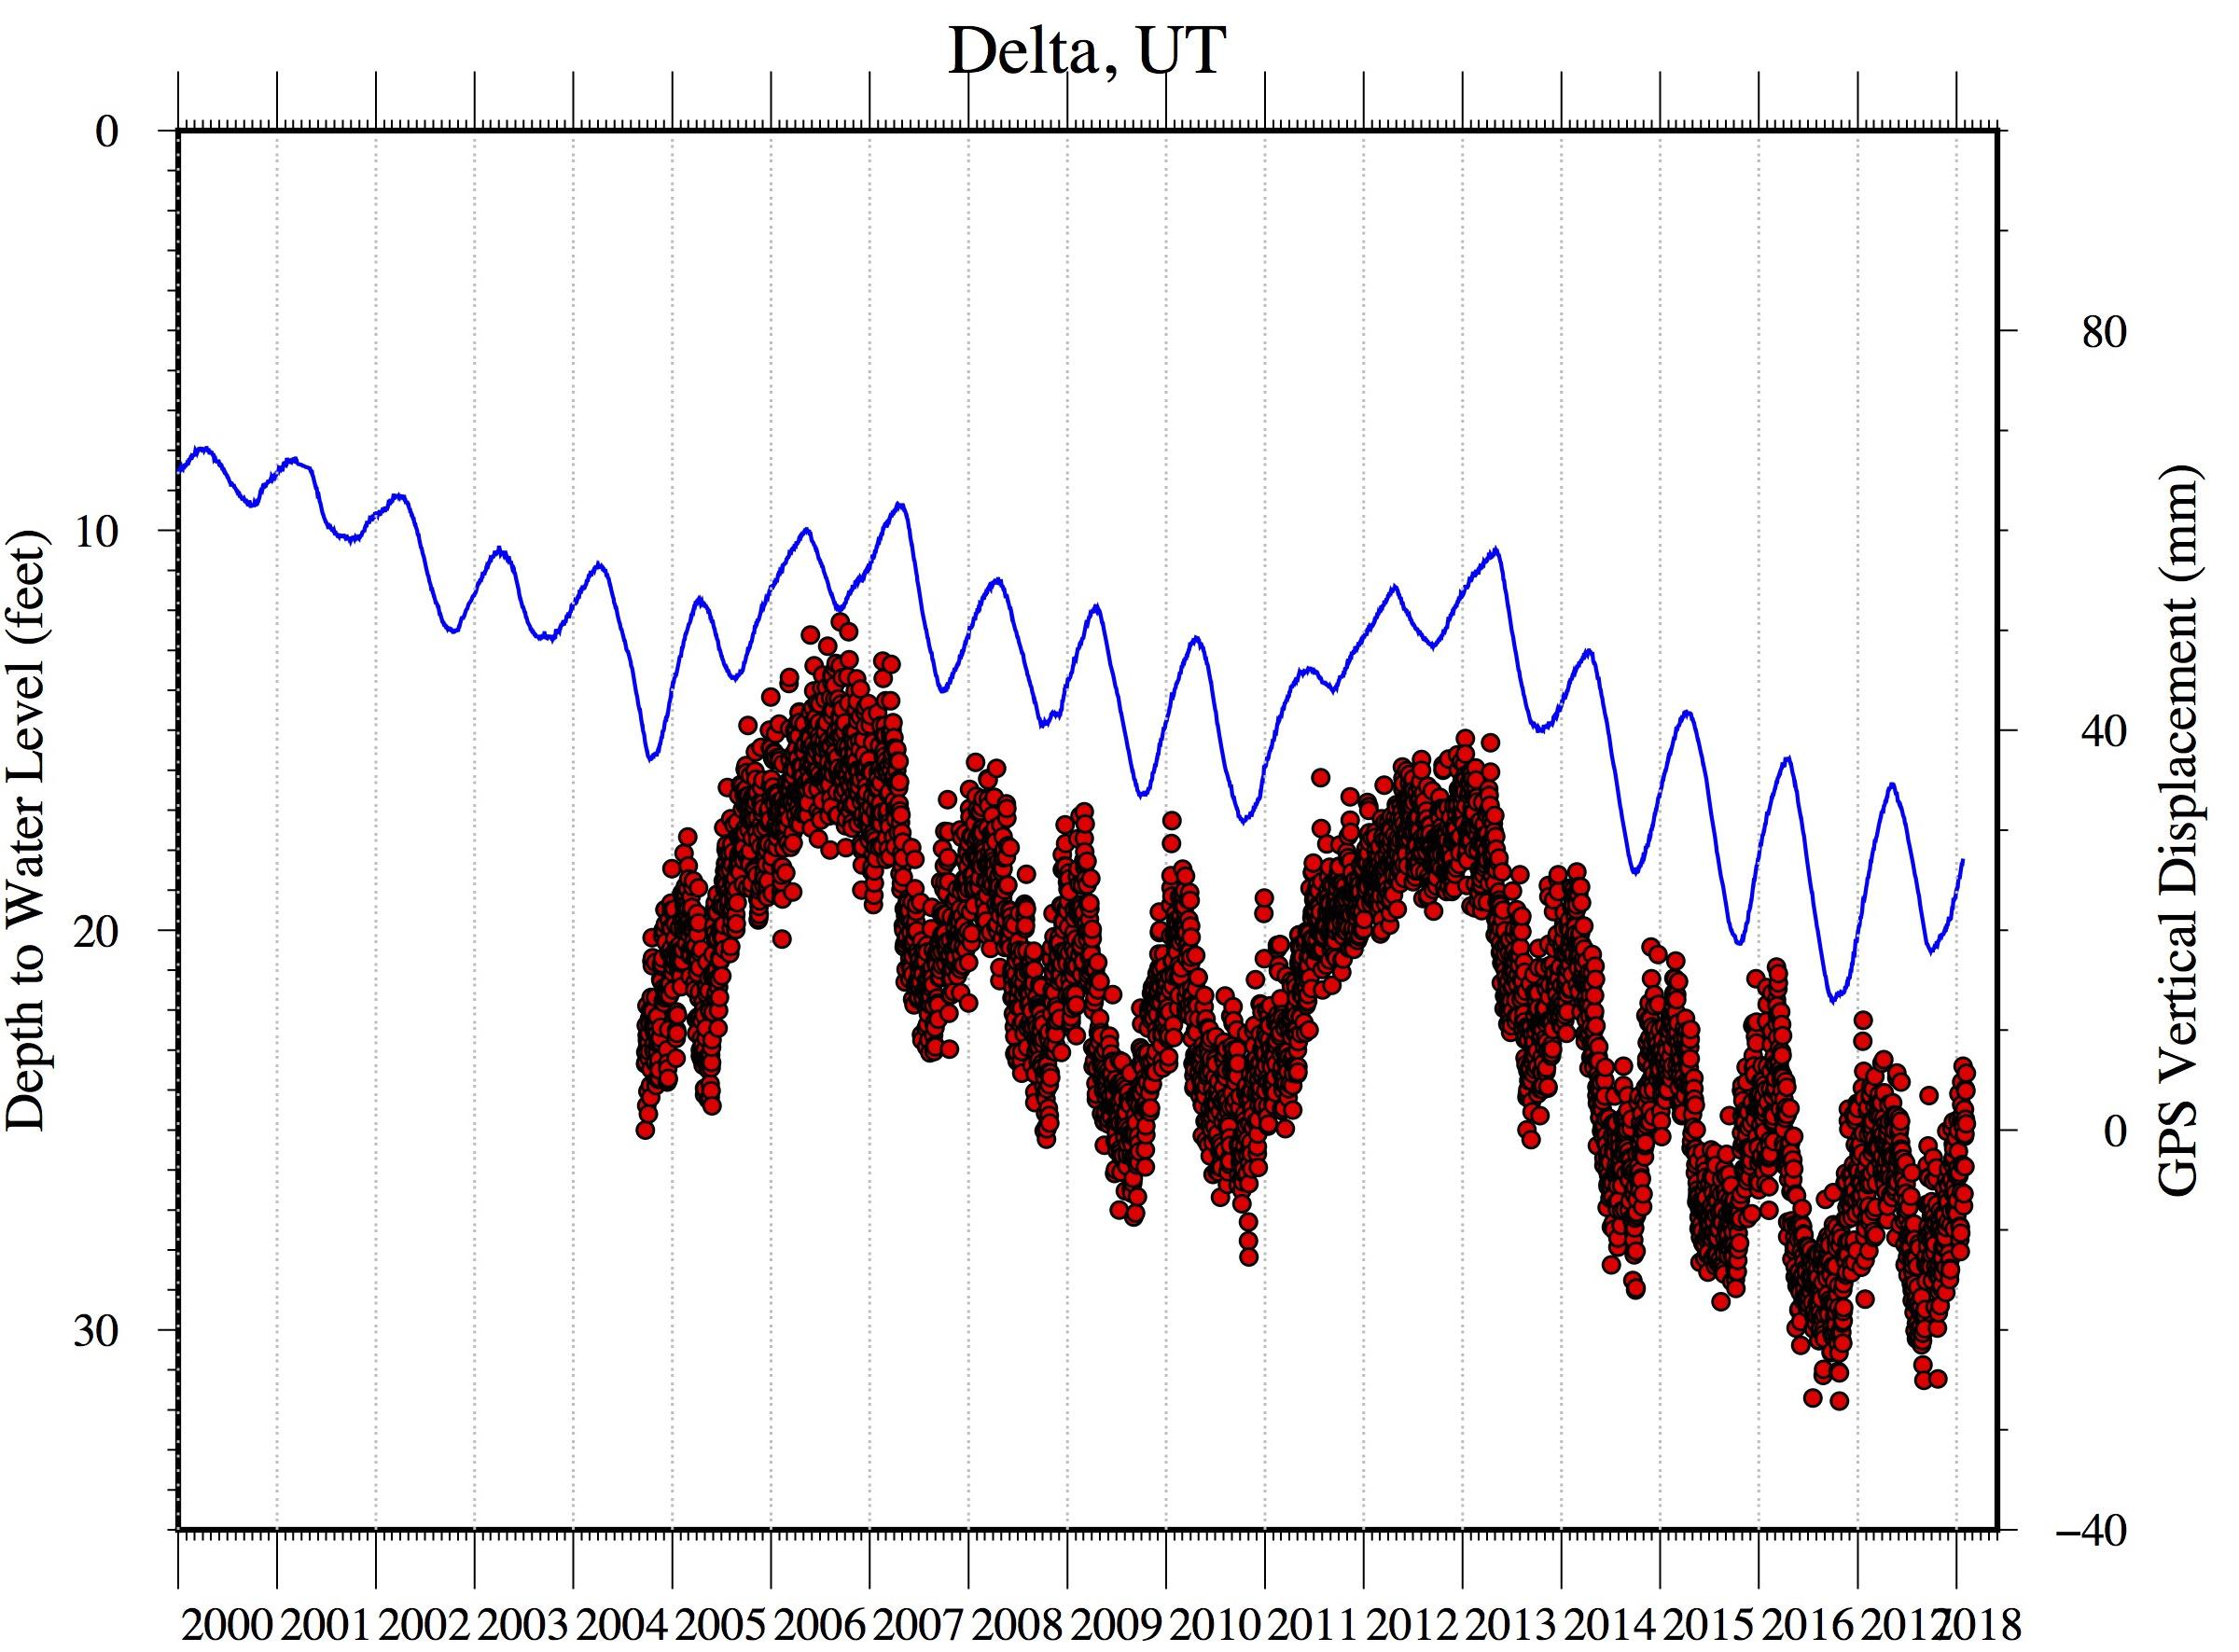
BETA Testing of New Multi-Year CORS Solution 2
GODE (Goddard Space Flight Center, MD) - variability in the Up component (as much as 5-6 mm amplitude) is due to annual and semiannual atmospheric and hydrological loading
P105 in UTAH - vertical motion (Up component) which correlates highly with the levels of water wells in the region

Slide 12
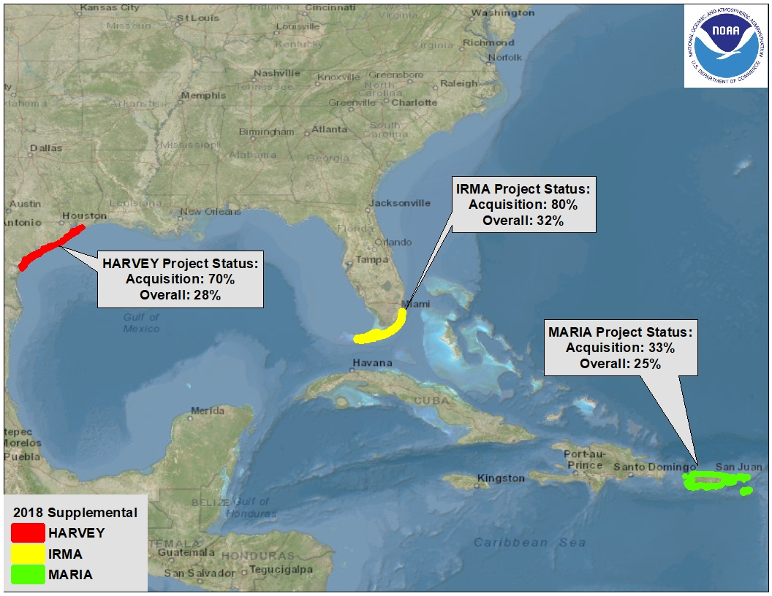
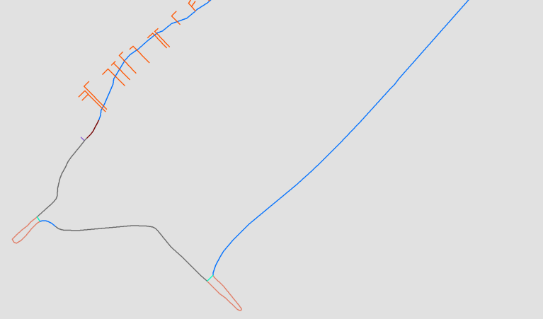
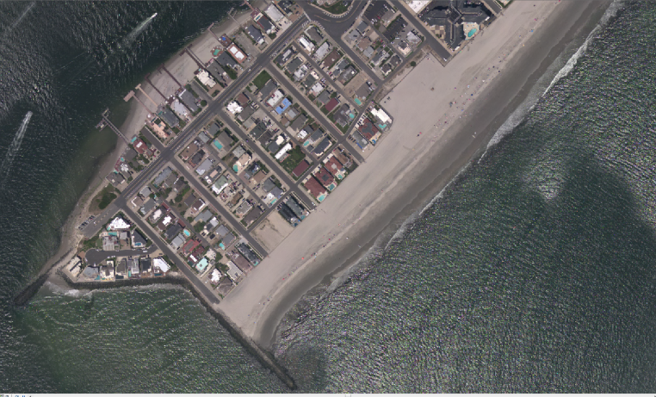
Hurricane Supplemental Progress and Outlook
Shoreline (CUSP and Charting Scale)
Ortho Mosaic Imagery
Lidar Point Cloud
(elevation)
Lidar Point Cloud (intensity)
RGB Colorized Lidar Point Cloud

Slide 13
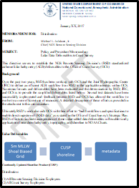
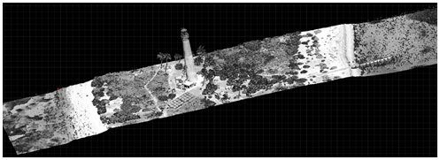
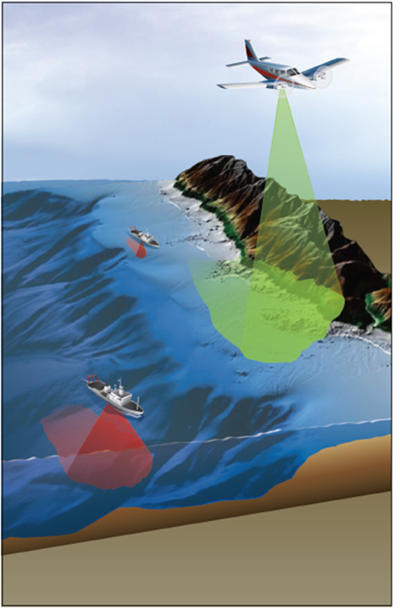
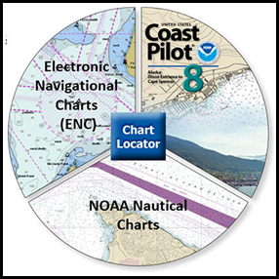
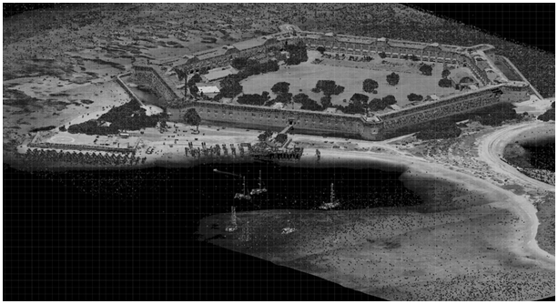
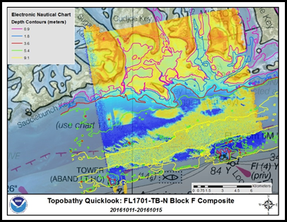
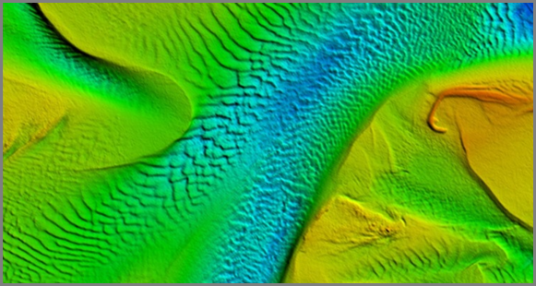
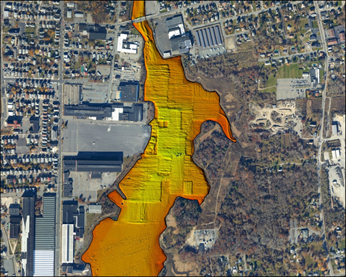
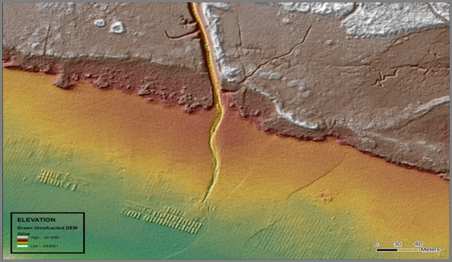
Supporting Safe and Efficient Navigation and Commerce

Slide 14
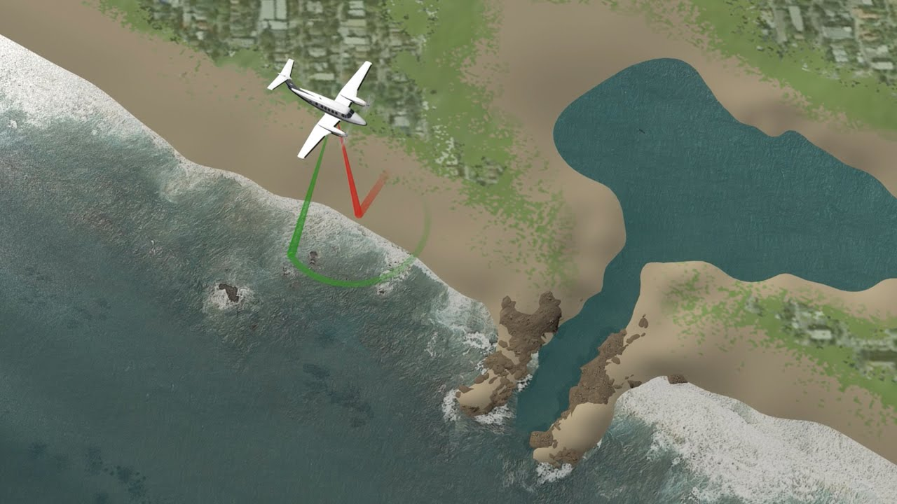
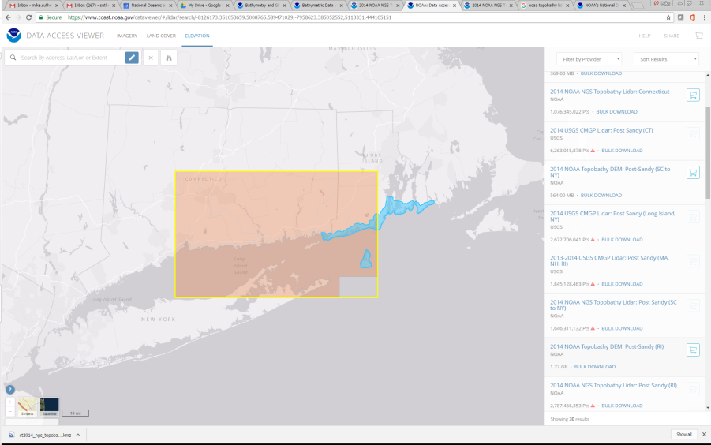
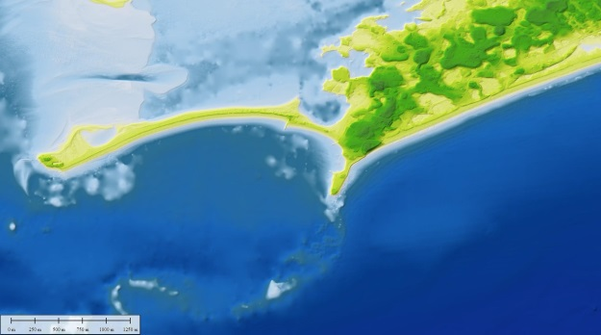
Data Dissemination, Archiving, and Topobathy DEM Development
Acquisition & Processing
Discovery & Dissemination
Long Term Archiving & Stewardship
Topo-Bathy DEM Development

Slide 15
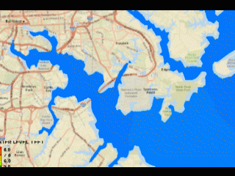
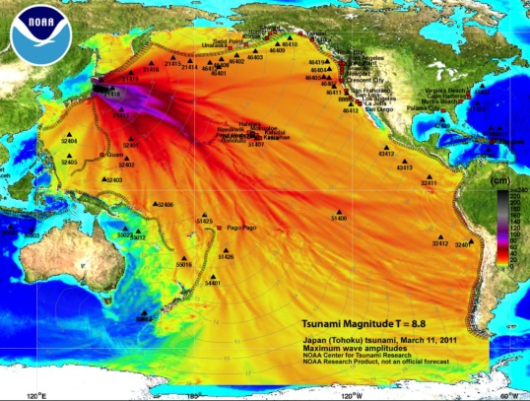
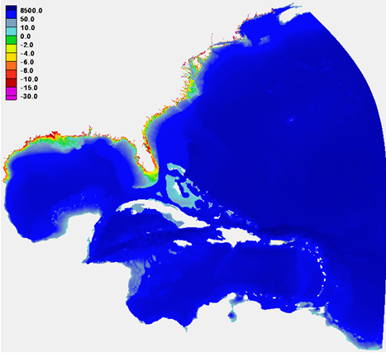
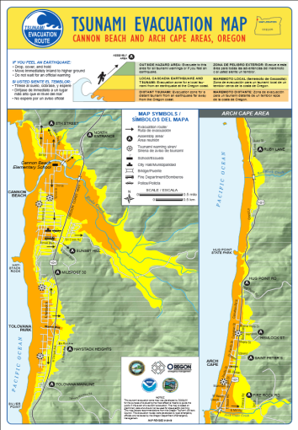
Modeling Applications
of the Data:
National Centers for Environmental Information-Boulder (NCEI) DEMs developed at the NOAA support improved tsunami and storm surge inundation modeling and mapping
Integrated topo-bathy DEM along
RI/CT border developed in the wake
of Hurricane Sandy (utilizes 2014
post-storm data)
Modeling tsunami generation, propagation, and inundation (NOAA
Tsunami Program
And National
Tsunami Hazard Mitigation Program)
Refinement of Hurricane Surge On-Demand Forecast System grids (NWS; COASTAL Act)
Improved hazards mitigation (inundation vulnerability, evacuation planning)

Slide 16
NGS 2019 Geospatial Summit
Learn About
National Spatial Reference System (NSRS) Modernization, the planned replacement of:
North American Datum of 1983 (NAD 83), and
North American Vertical Datum of 1988 (NAVD 88)
Save the Date!
May 6-7, 2019 in Silver Spring, MD
Remote attendance available
Call for Case Studies
How will replacing NAD 83 and NAVD 88 impact your work?
Send ideas to NGS.Feedback@noaa.gov

Slide 17
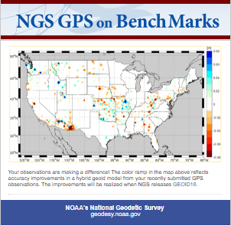
Learn more at geodesy.noaa.gov
Educational Videos (12)
Online Lessons (4)
NGS Testing and Training Center
Monthly Webinar Series

