Slide 1
NOAA’s Center for Operational Oceanographic Products and Services :
Turning Operational Oceanographic Data Into
Meaningful Information For The Nation
Richard Edwing, Director
Program Managers: Darren Wright, Laura Rear McLaughlin, Allison Allen
Hydrographic Services Review Panel Orientation
March 24, 2011

Slide 2
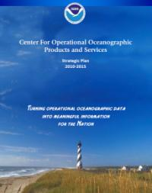
About the Center for Operational Oceanographic Products and Services (CO-OPS)
Mission
CO-OPS is the authoritative source for accurate, reliable, and timely tides, water levels, currents and other oceanographic information.
Our data, products and services support safe and efficient navigation, sound ecosystem stewardship, coastal hazards preparedness and response, and the understanding of climate change.
Vision
Everyone has ready access to tide, water level, current and other coastal oceanographic information needed for informed decision-making.

Slide 3
CO-OPS Employees and Offices
Seattle, WA
10 FTE
4 Contractor
Silver Spring, MD
86 FTE
42 Contractor
Chesapeake, VA
26 FTE
13 Contractor
CO-OPS Employees
122 FTE
59 Contractor

Slide 4
CO-OPS Organization
Maritime Services
Director
Richard Edwing
Programs
Mapping & Charting Services
Deputy Director
Ellen Clark
COASTAL
Senior Scientist
Engineering
Division
Field Operations Division
Oceanographic Division
Information Systems Division
Engineering & Development Branch
Atlantic Operations Branch
Products & Services Branch
Systems Support & Evaluation Branch
Pacific Operations Branch
Planning Monitoring & Analysis Branch
Notes:
Align the organization’s workforce, resources, and infrastructure to consistently deliver high-quality products and services.
COASTAL: Coastal Oceanographic Applications and Services of Tides And Lakes

Slide 5
CO-OPS Program Structure
A Matrix Organization
Maritime Services
Darren Wright, Program Manager
Mapping and Charting Services
Laura Rear McLaughlin, Program Manager
Coastal Oceanographic Applications and Services of Tides and Lakes (COASTAL)
Allison Allen, Program Manager
Programs
Divisions
Notes:
Align the organization’s workforce, resources, and infrastructure to consistently deliver high-quality products and services.

Slide 6
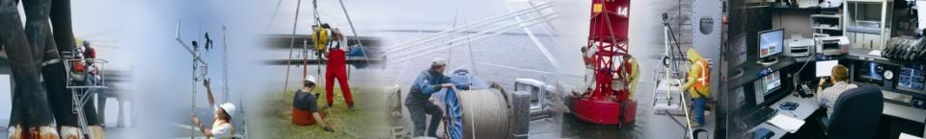
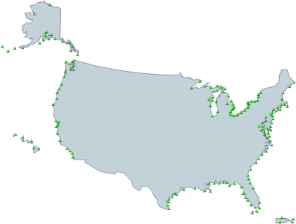
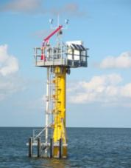
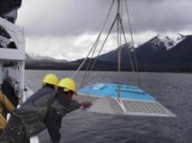
CO-OPS Observing Systems
National Water Level Observation Network (NWLON):
    Water level, wind speed / direction, barometric pressure, air and water temperature, conductivity
    Short-term water level station deployments
National Current Observations
  Short-term current meter deployments
    70 sites a year
210 NWLON Stations

Slide 7
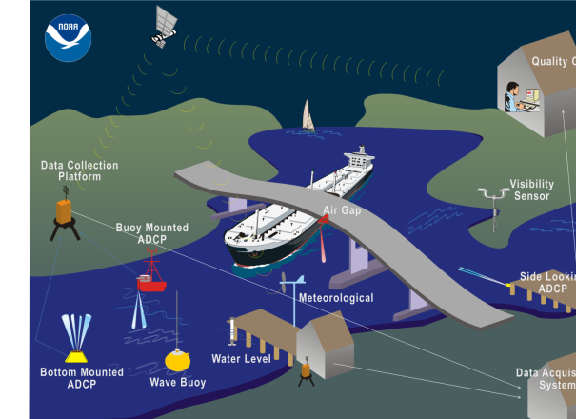
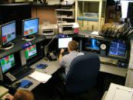
Physical Oceanographic Real-Time System
PORTS®
Measures and disseminates observations and predictions
  Water levels
  Currents
  Salinity
  Air gap
  Meteorological parameters
  Visibility
  Waves
Notes:
The Continuous Operational Real-Time Monitoring System (CORMS) is the primary system for real-time QA/QC efforts in CO-OPS.
CORMS performs thorough and robust QA/QC on all real-time data, systems, and products in the CO-OPS domain, ensuring that a reliable source of real-time data is readily available, while not disseminating data of questionable quality.
CO-OPS Data are available to the users in real-time (or near real-time) via various online graphical plots, simple text data, as well as telephone voice response.
All data and products are monitored and reviewed on a 24x7 basis, automatically and by experienced CORMS operators working on 12-hour shifts.

Slide 8
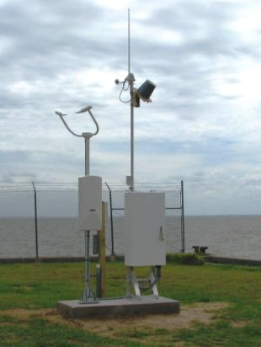
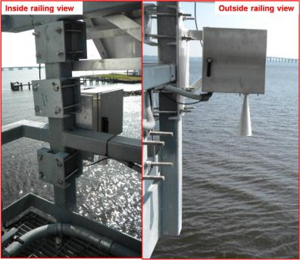
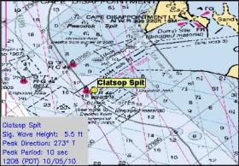
Integrating Technology to Meet User Needs
System Integration
Microwave Water Level sensors
Visibility sensors
Wave data
Notes:
CO-OPS manages the Ocean Systems Test and Evaluation Program (OSTEP) to facilitate the transition of new sensors and systems to an operational status.
Demand for real-time coastal oceanographic and meteorological data is growing quickly, so it is critical for these systems to be accurate, reliable, and cost-effective.
OSTEP tests instruments to ensure that they meet CO-OPS requirements, develops operational deployment and implementation processes, and establishes quality-control criteria.
MWWL
Recently developed microwave sensors present a potentially improved method for measuring water levels because they overcome certain disadvantages of currently-used water level sensors by avoiding contact with the water column.
Testing for possible integration of new sensors into NWLON stations.
Visibility
- PORTS® program integrated visibility sensors at Mobile Bay to help guide users in navigation-related decisions.
- The new sensor capability meets a long-standing customer request to deliver reliable visibility information during challenging environmental conditions.
- The first PORTS® visibility sensor was installed at Pinto Island, AL
- A second sensor was installed at Middle Bay Port
- Visibility data in the Mobile Bay are critical, as the bay is susceptible to heavy fog beginning in the fall at the upper end of the bay and lasting into the winter months where the middle of the bay is especially affected. This effort was made possible by partnerships among CO-OPS, the National Weather Service, Office of Coast Survey, and Alabama State Port Authority, and Alabama Power.
Waves
- In addition to visibility technology, CO-OPS has partnered with the US Army Corps of Engineers and the Coastal Data Information Program at Scripps Institution of Oceanography to integrate wave buoy data into the suite of PORTS® products.
- Four wave stations have been added to PORTS® products: San Francisco Bar, CA (San Fransicso Bay region), San Pedro, CA (Los Angeles/Long Beach region), Clatsop Spit, OR (Lower Columbia River region) and Cape Henry, VA (Chesapeake Bay South region).
- Surface waves have a profound impact on navigation, recreation and maritime commerce and with PORTS®, users can use wave information to assist with secure and safe port operations.

Slide 9
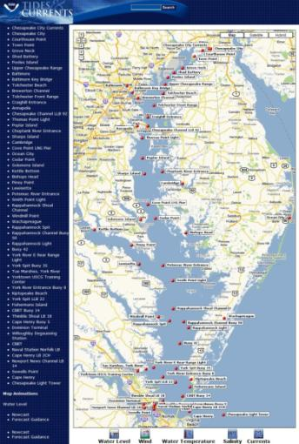
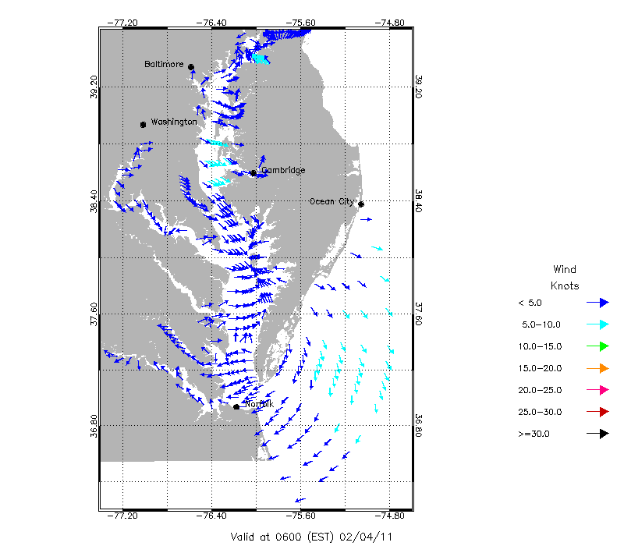
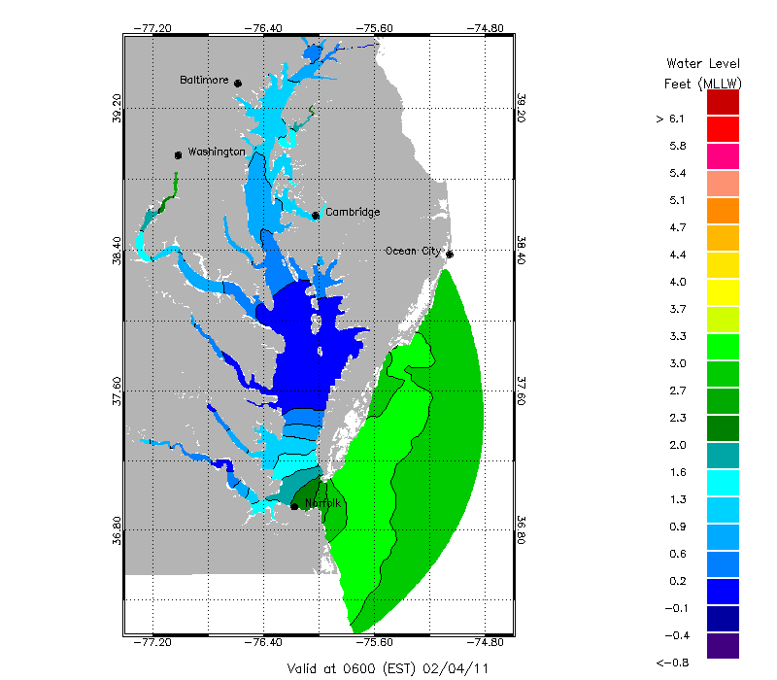
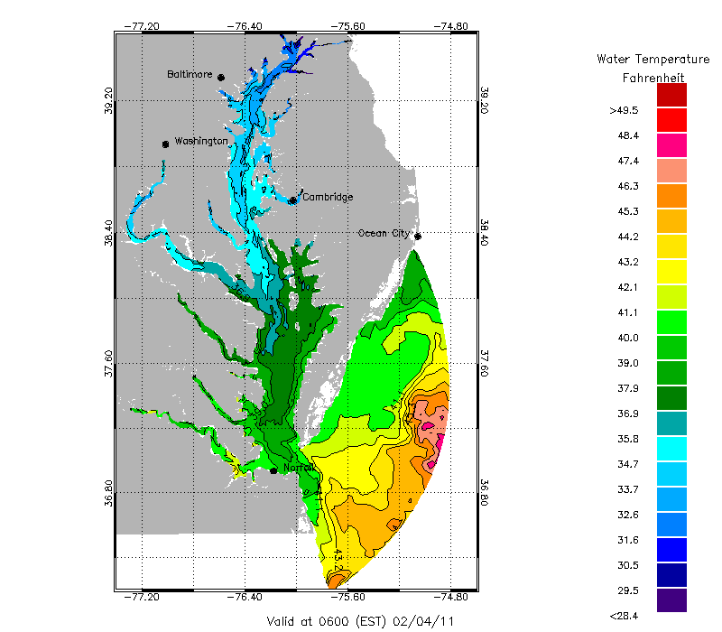
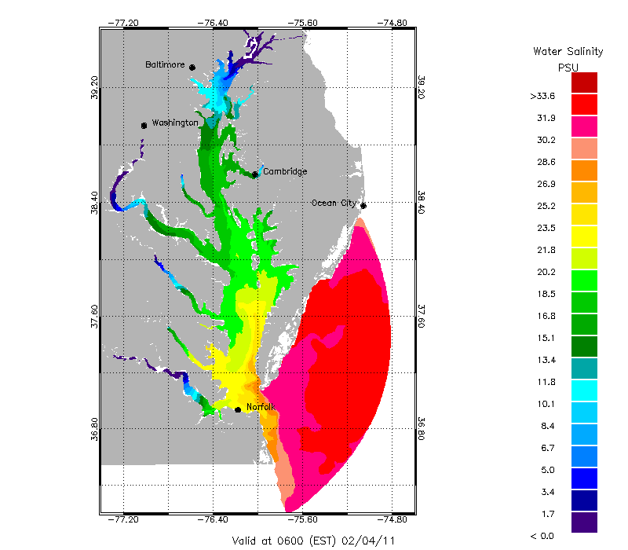
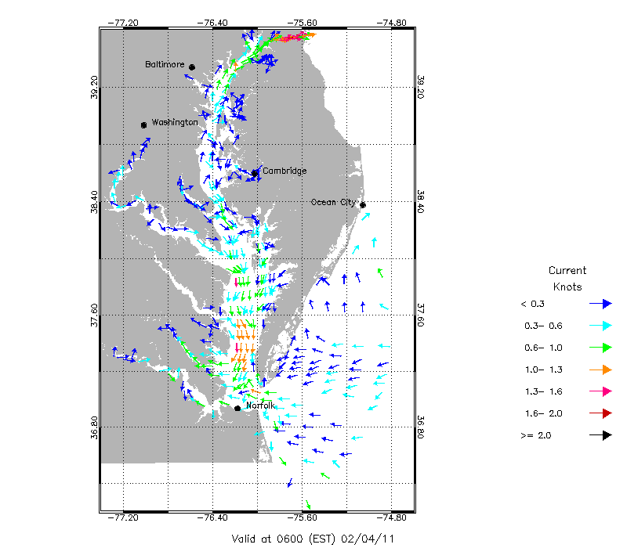
National Coastal Modeling
Network of Operational Nowcast and Forecast Hydrodynamic Model Systems
  Provides nowcasts predictions
  Provides short-term (0 hr -48 hr) forecast predictions
  Transitioning to high performance computers at NCEP
Winds
WL
Temp.
Salinity
Currents
Link to CBOFS
Notes:
13 models in operation
Image shows the Chesapeake Bay
HABs will be discussed later in the presentation

Slide 10
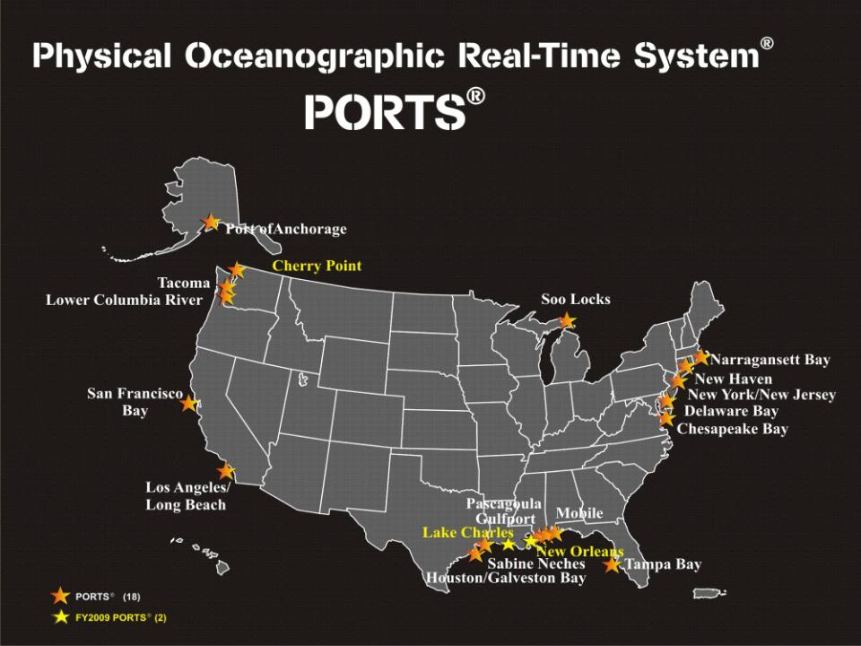

Operational PORTS (20)
FY2011 PORTS (1)
Operational Models (11)
FY2011 Models (2)
Great Lakes OFS
New London
St. John’s River OFS
Northern Gulf of Mexico OFS
Notes:
This map shows the locations (and future locations) of PORTS and Operational Models, or OFS. There 20 PORTS in operation and several of those include models. 1 new PORTS and 2 new models are slated in FY11 (New London PORTS and Columbia River and Northern Gulf of Mexico OFS).

Slide 11
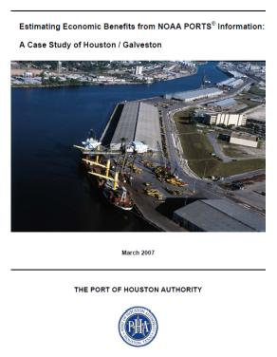
Maritime Safety and Efficiency
Houston / Galveston, TX
  60% reduction in tugs and tows groundings
  50% reduction in ship groundings
Tampa Bay, FL
  10% reduction in recreational distress calls
  50% reduction in ship groundings
New York / New Jersey
  Over 50% reduction in ship groundings
Lower Columbia River, OR, WA
  Estimated $6.4 million in annual economic benefits
Statistics based on economic studies by Hauke Kite-Powell, Woods Hole Oceanographic Institution

Slide 12
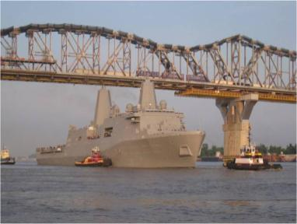
Program Overview
Maritime Services
Darren Wright, Program Manager

Slide 13
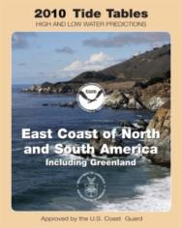
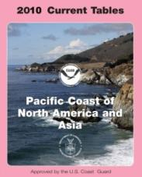
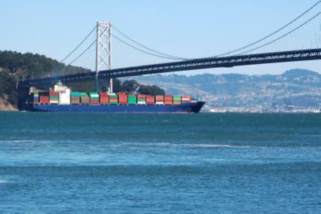
Maritime Services
Providing a reference system for the Nation
Supporting safe and efficient navigation
Notes:
Maritime Services encompasses PORTS, NWLON, NCOP, Great Lakes, Models, Met Program.
Explain datums (vertical reference)– picture of a vessel going under a bridge

Slide 14
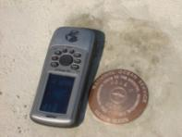
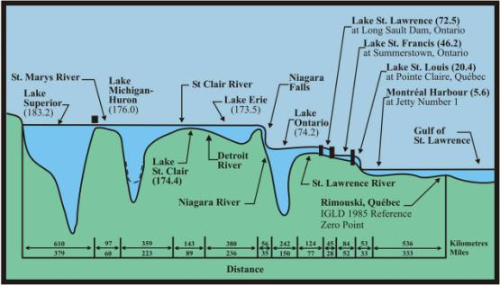
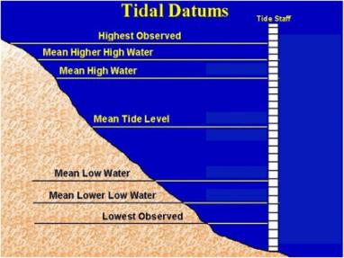
Maritime Services
Providing a reference system for the Nation
Vertical reference framework through tidal datums and International Great Lakes Datum (IGLD)
Part of National Spatial Reference System
Datums are referenced to fixed points known as bench marks.
Tools / Products
Tidal datums / IGLD

Slide 15
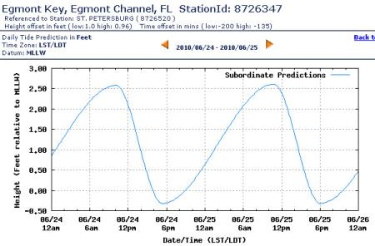
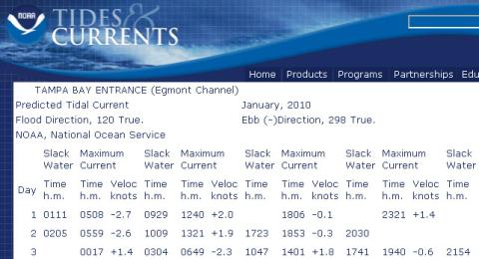


Maritime Services
Supporting safe and efficient navigation
Avoided groundings
More draft
Tools / Products
Tide and tidal current prediction tables
Real-time data dissemination
Web and digital products
Nowcast / Forecast

Slide 16
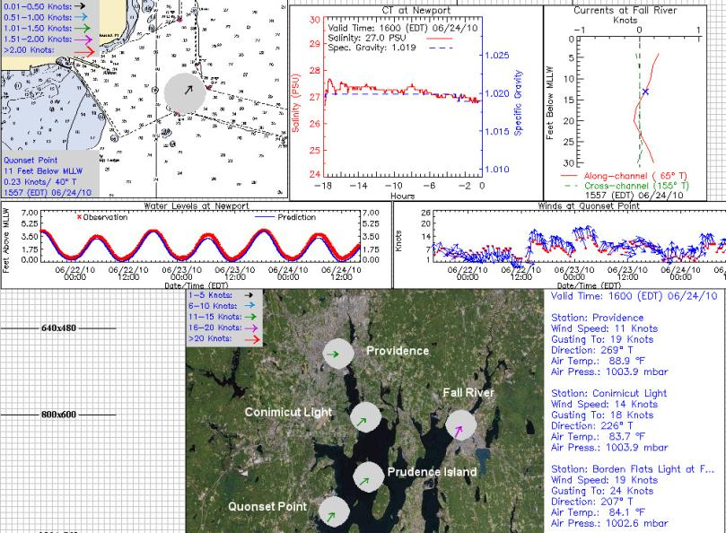
Maritime Services
Tools / Products
Tide and tidal current tables
Real-time data dissemination
Web and digital products
Nowcast / Forecast

Slide 17
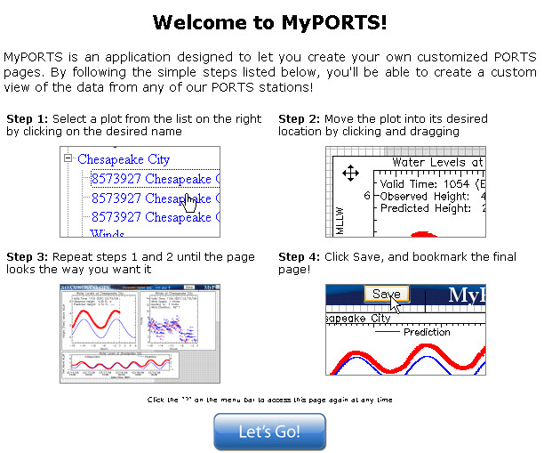
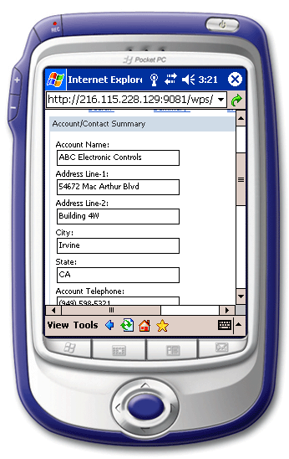

Maritime Services
Tools / Products
Tide and tidal current tables
Real-time data dissemination
Web and digital products
Nowcast / Forecast
PDA PORTS Application
Automated Real-Time Narrative Summaries (ARNS)
http://tidesandcurrents.noaa.gov/myports/

Slide 18
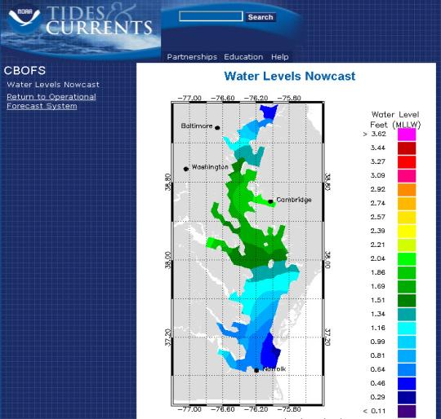
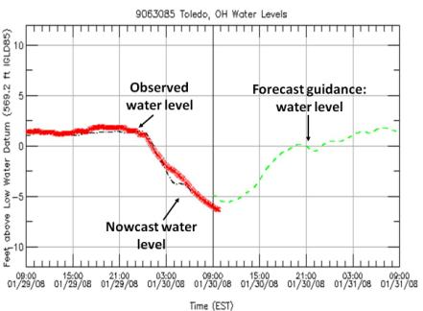
Maritime Services
Tools / Products
Tide and current predictions
Real-time data dissemination
Web and digital products
Nowcast / Forecast
Nowcasts and forecasts are scientific predictions about the present and future states of water levels and other oceanographic variables in a coastal area
Notes:
Nowcasts and forecasts are scientific predictions about the present and future states of water levels (and possibly currents and other relevant oceanographic variables, such as salinity and temperature) in a coastal area. These predictions rely on either observed data or forecasts from a numerical model. A nowcast incorporates recent (and often near real-time) observed meteorological, oceanographic, and/or river flow rate data. A nowcast covers the period of time from the recent past (e.g., the past few days) to the present, and it can make predictions for locations where observational data are not available. A forecast incorporates meteorological, oceanographic, and/or river flow rate forecasts and makes predictions for times where observational data will not be available. A forecast is usually initiated by the results of a nowcast.

Slide 19
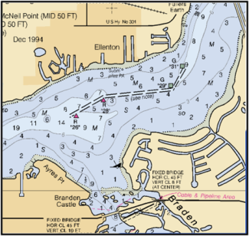
Program Overview
Mapping and Charting Services
Laura Rear McLaughlin, Program Manager

Slide 20
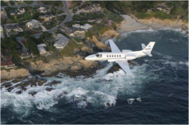
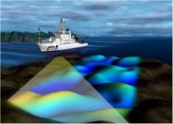
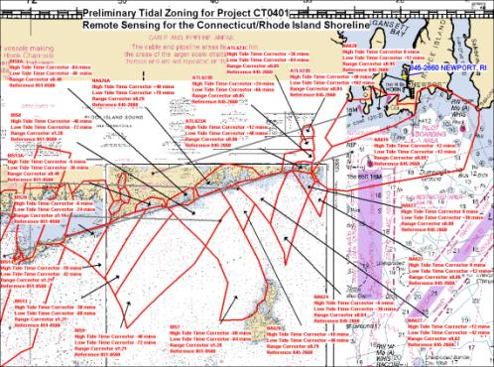
Mapping and Charting Services
Support for
Nautical charting
Shoreline mapping
Marine boundaries
NOS VDatum tool
USACE projects
Tools / Products
Tidal zoning
TCARI (Tidal Constituent
And Residual Interpolation)
Tidal correctors
International/Federal/State/Private boundaries
Guidance documents (USACE policy)

Slide 21
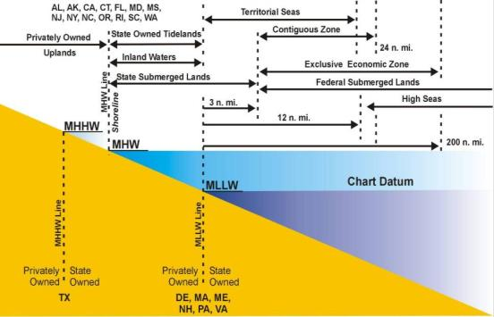
Mapping and Charting Services
Support for
Nautical charting
Shoreline mapping
Marine boundaries
NOS VDatum tool
USACE projects
Tools / Products
Federal/State/Private boundaries
State to State boundaries
U.S. and International boundaries

Slide 22
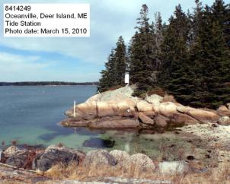
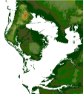
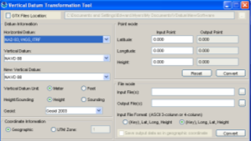
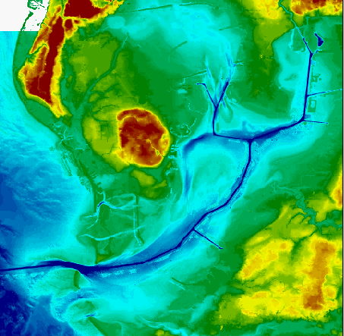
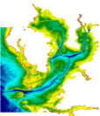
Mapping and Charting Services
Support for
Nautical charting
Shoreline mapping
Marine boundaries
NOS VDatum tool
USACE projects
  Dredging, coastal projects
CO-OPS collects water level data and determines tidal datums to support the VDatum program
Tools / Products
VDatum Worklists
VDatum Complete list
VDatum
Bathy/Topo
Digital Elevation Model
Topography
Bathymetry
Notes:
VDatum is a free software tool being developed jointly by NOAA's National Geodetic Survey (NGS), Office of Coast Survey (OCS), and Center for Operational Oceanographic Products and Services (CO-OPS). VDatum is designed to vertically transform geospatial data among a variety of tidal, orthometric and ellipsoidal vertical datums - allowing users to convert their data from different horizontal/vertical references into a common system and enabling the fusion of diverse geospatial data in desired reference levels.
Because of the hurricane Katrina damage, especially in New Orleans where the levees were breached. Congress has asked USACE to use NOAA certified water level datums for all their dredging, shoreline protection, navigation, coastal projects.
CO-OPS performs the assessment of tidal, geodetic, and ellipsoidal datums and develops VDatum Work List for each area. CO-OPS collects water level data and determines tidal datums. NGS, CO-OPS, and OCS personnel and resources (NOAA Ships, NRT) collect geodetic and ellipsoidal information. CO-OPS also analyzes the tidal, geodetic, and ellipsoidal information and develops VDatum Complete List. Based upon this information, OCS Coast Survey Development Lab (CSDL) develops VDatum models. NGS develops Sea Surface of Topography and currently maintains the VDatum website. NGS also collects data and maintains Continuously Operating Reference Stations (CORS) for GPS applications, Online Processing and User Services (OPUS DB) for GPS applications, gravity measurements, leveling and bench mark height information, and National Spatial Reference System (NSRS) – all of which are vital for the NOS VDatum Program.

Slide 23


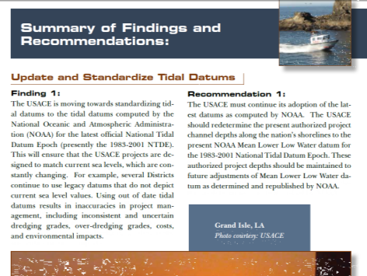
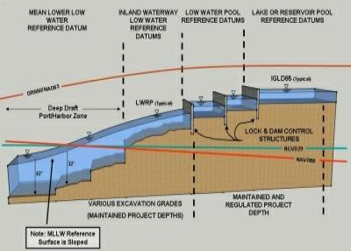
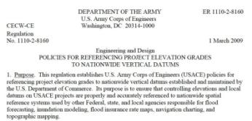
Mapping and Charting Services
Tidal Datums + Geodetic Datums = Spatial Reference Frame
Notes:
Added policy graphic: Talk about how the the recommendation was made, then USACE published policy
Removed USGS logo: Speak to partnership with USGS, or create another slide on the USGS-USACE-NOAA collaborative efforts

Slide 24
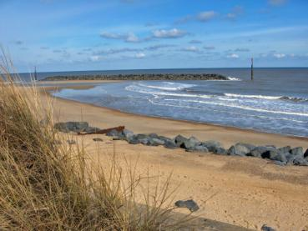
Program Overview
Coastal Oceanographic Applications and Services of Tides and Lakes (COASTAL)
Allison Allen, Program Manager

Slide 25
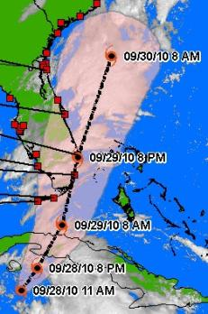
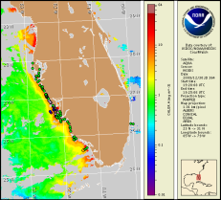
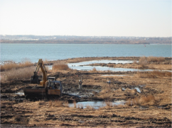
COASTAL
Coastal Oceanographic Applications and Services of Tides and Lakes
Ecosystem Management
Restoration
Shoreline stabilization
Monitoring and ecosystem science
Ecological forecasting (HAB forecasts)
Mitigation strategies
Tools / Products
Frequency and Duration of Inundation
Exceedance Probability
Marsh Analysis and Planning Tool Integrating Tides and Elevations (MAPTITE)
Operational HAB forecast bulletin
QuickLook
SLOSH input
Sea Levels Online
1-min. real-time data
Guidance documents
Coastal Hazards
Storm surge
Tsunami
Storm QuickLook
Climate Change
Sea level definition
Long-term trends
Global sea level contribution
HAB Bulletin
Marsh Restoration
Notes:
Added 1-minute real time data to Tools/Products

Slide 26
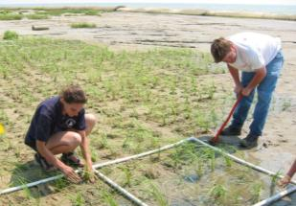


Helping Planners Restore Coastal Ecosystems
Marsh restoration managers need to predict
salinity and inundation
Tools / Products
    Frequency and Duration of Inundation
    Exceedance Probability
    MAPTITE
    Guidance Documents

Slide 27



COASTAL
Coastal Oceanographic Applications and Services of Tides And Lakes Program
HAB Forecasts
HAB Bulletin
  Condition report issued twice a week after confirmation of a HAB; and once weekly during the inactive HAB season
Harmful algal blooms (HABs) threaten the health and safety of humans and marine organisms.
Notes:
Moved HAB slide to follow ecosystems slide

Slide 28


Supporting Storm Surge Warning and Emergency Management
Storm QuickLook
Tools
  Storm Quicklook
  SLOSH Model Input
Notes:
Removed “water level networks” because it isn’t a specific tool/product like Quicklook and SLOSH model

Slide 29




Supporting National Tsunami Warning and Mitigation Efforts
Photo: Crescent City, March 17, 2011
Notes:
Products:
1-minute real-time data
15 second data for research

Slide 30



COASTAL
Coastal Oceanographic Applications and Services of Tides And Lakes Program
Climate Change
  Long-term Sea Level
  Sea Level Variability

Slide 31







Questions
Marine Navigation & Safety
Wetlands Restoration & Monitoring
Coastal & Environmental
Planning & Assessment
Storm Surge Monitoring
Emergency & Hazardous Response
Tsunami Warning
Marine Forecasting
Shoreline & Marine Boundaries
Sea Level Change & Variability
Notes:
We are dedicated to serving our customer communities by turning operational oceanographic data into meaningful and user-friendly information.

Slide 32
Background Slides

Slide 33

Authorization
Legislative Mandates
  US Coast and Geodetic Survey Act of 1947
  Hydrographic Services Improvement Act (1998)
  Boundary Waters Treaty of 1909
  US Tsunami Warning and Education Act (2006)
Legal Precedents
  1936 Borax, Ltd v. City of Los Angeles U.S. Supreme Court case
  United States v California, 332 U.S. 19, 26 (1947)
  National Tidal Datum Convention of 1980
  Dinkum Sands Court case
Notes:
CO-OPS serves both the public at large and other government agencies. CO-OPS is the authoritative source for accurate, reliable, and timely water level and current measurements that support safe and efficient maritime commerce, sound coastal management, and recreation.
Legislative Mandates
US Coast and Geodetic Survey Act of 1947
– Authorizes tide and current observations for safe and efficient navigation
Hydrographic Services Improvement Act (1998)
– Authorizes real time data
– Authorizes other uses; coastal resource management, emergency response, homeland security
Boundary Waters Treaty of 1909
- Creates guidelines governing the management any waters bordering the US and Canada
US Tsunami Warning and Education Act (2006)
– Authorizes tide gauge warning networks
-----------------------------------------------------------------------------------------------------
Legal Precedents
1936 Borax, Ltd v. City of Los Angeles U.S. Supreme Court case
Use of 19-year tidal datum epoch concept in legal context
United States v California, 332 U.S. 19, 26 (1947)
Established use of ordinary low water mark as baseline for offshore submerged lands as defined and determined by Coast and Geodetic Survey.
National Tidal Datum Convention of 1980
Authorized the NOAA definitions of MHW, MHHW, MLW and MLLW as the official policy of the U.S. Government.
Dinkum Sands Court case

Slide 34
CO-OPS Budget Overview
$ Thousands | 2005 | 2006 | 2007 | 2008 | 2009 | 2010
Base | $23,509 | $22,105 | $23,781 | $26,142 | $28,837 | $29,278
Earmarks | $3,439 | $5,423 | $3,004 | $1,315 | $0 | $599
PORTS O&M |  |  |  | [$1,410] | $2,498 | $3,796
Supp | $250 | $3,000 | $1,000 | $0 | $0 | $0
HAB |  |  |  |  |  | $571
TOTAL | $27,198 | $30,528 | $27,785 | $27,457 | $31,335 | $34,244
Notes:
Earmarks
2005 – Alaska, Great Lakes
2006 – Alaska, Great Lakes
2007 – Alaska
2008 – nothing
2009 – PORTS O&M

Slide 35
CO-OPS Hot Topics
PORTS, PORTS, PORTS
  Current cost shared model is inefficient and unstable.
  Identified as high priority by NOAA stakeholders.
  Congress has provided authorization and appropriations language as well as funding for local maintenance costs.
  Significant safety and economic benefits
Ecosystem-based Coastal and Marine Spatial Planning
Contribution to Climate

Slide 36

Continuous Operational Real-Time Monitoring System
24-7 Quality Control-System Monitoring Operation
CORMS / AI
  Rule-based system
  Performs QC and notifies Watchstanders of suspect data

Slide 37


Photo taken at the trade center in downtown Mobile, looking south down the ship channel:
3/24/10 ~8:30am CDT
Episode: 00:00 to 10:30 CDT
3/23 21:30 – 3/24 15:30 CDT
Notes:
First operational sensor at Mobile Bay

