Slide 1
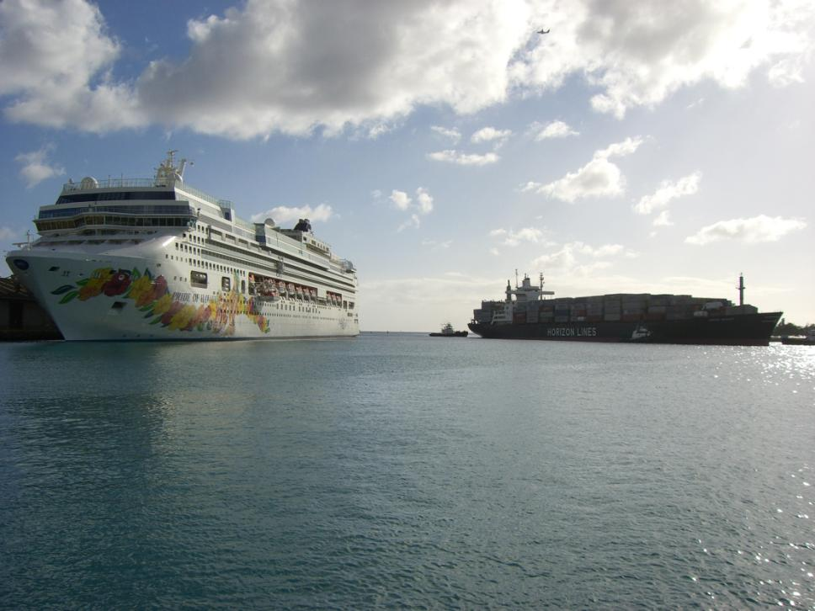
Navigation Services Division
Notes:
est. January 2000

Slide 2
Office of Coast Survey
Navigation Services Division
MCD
HSD
CSDL
Coast Pilot Branch
Customer Affairs Branch
Navigation Response Branch

Slide 3
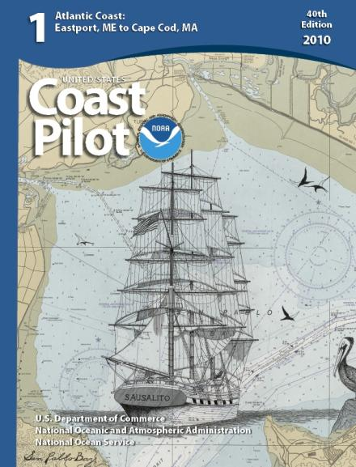
Coast Pilot Branch

Slide 4
What is the Coast Pilot?
The Coast Pilot is a companion to the chart
9 Volumes, each of them printed once per year
The Coast Pilot provides descriptive material which cannot be shown on the chart
Navigation Regulations
Sailing Directions
Weather and Climatological Information
Ice Information
Supplies
Port Facilities
Repairs
Notes:
Dangers, Cautions, Pilotage, Quarantine, Anchorage Info, Tug and Tow Information, Small craft Facilities, Channels, Prominent Features, Communications Protocol, Tides and Currents,

Slide 5
Coast Pilot Coverage

Slide 6
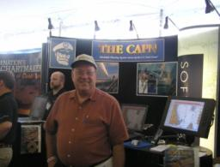
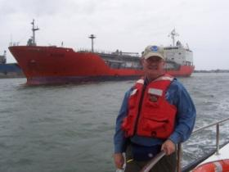
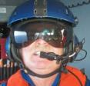
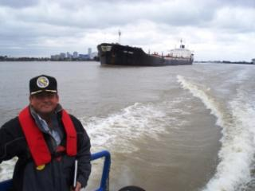
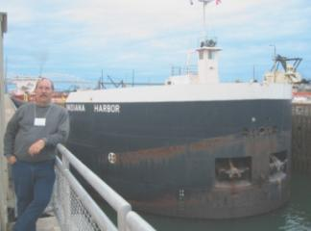
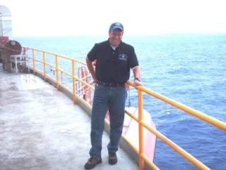
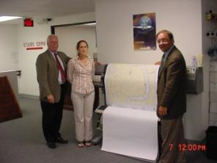
Customer Affairs Branch
Navigation Managers are OCS representatives in the field, interacting with the maritime community, and helping to identify the challenges facing marine transportation
Navigation Managers focus on educating and soliciting feedback on NOAA's navigation products and services from the maritime community.
Notes:
Technical expert for the Office of Coast Survey in matters concerning NOS’s various products and services.
Assist NOAAs customers throughout their region of responsibility by Provide a source of information concerning regional navigational and environmental issues.
Visit regional ports and/or port areas as assigned for the purpose of reviewing and revising the relevant sections of the Coast Pilot and nautical charts.
Inform present and potential users throughout their region of NOAA’s products and services through presentations, meetings, and workshops.
Conduct or attend region-wide harbor workshops among the professional maritime community for the purpose of updating, assessing, and verifying NOS charting and navigational products and services. Relate users’ ideas and concerns by Providing accurate information for Coast Pilot and nautical charts updates.
Facilitate the flow of source for the verification of recommended changes (e.g., photographs, records). Enlist the assistance of local knowledgeable groups (pilot associations, port authorities) in updating local nautical charts and the Coast Pilot.

Slide 7
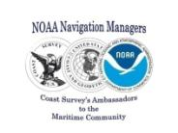
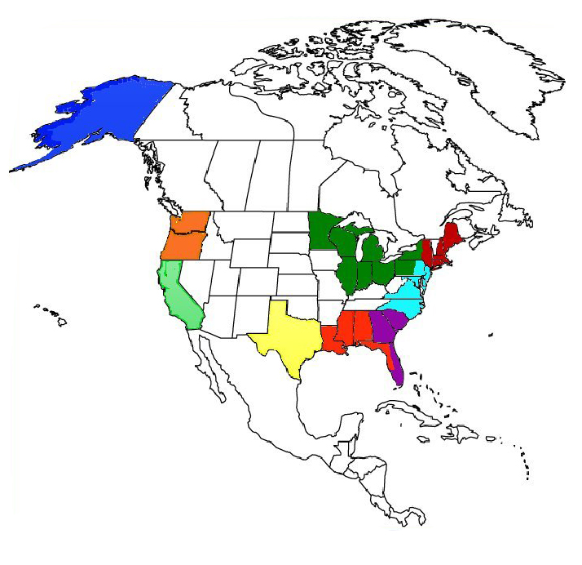
Maritime Community Interaction
Matthew Forney, Alaska
Phone: 907-242-4925
Cell: 513-235-5328
matthew.forney@noaa.gov
October 2010
Brian Link, Great Lakes Region
Phone: 231-759-1252
Cell: 231-740-4110
Email: brian.link@noaa.gov
Northwest Vacant
LT Matt Ringel (Temporary)
Phone: 206-526-6319
Email: matthew.ringel@noaa.gov
Northeast Vacant
Matthew Kroll (Temporary)
Phone: 301-713-2730 x 179
Email: matt.kroll@noaa.gov
NRT 5
NRT 3
Howard Danley, Chesapeake, Delaware Bay
Phone: 301-713-2729 x 160
Cell: 301-980-4807
Email: howard.danley@noaa.gov
Gerry Wheaton, California
Phone: 831-583-2365
Cell: 831-801-8457
Email: gerry.wheaton@noaa.gov
NRT 4
NRT 6
LT Sarah Mrozek, NOAA at Nauticus, Mid Atlantic
Phone: 757-627-7072 x11
Email: Sarah.Mrozek@noaa.gov
LT Kyle W. Ryan, Pacific Islands
Phone: 808-532-3202
Cell: 850-866-0204
Email:Kyle.Ryan@noaa.gov
NRT 2
Southeast Vacant
Michael Henderson (Temporary)
Phone: 727-824-5396
Cell: 727-772-3708
Email: michael.henderson@noaa.gov
Alan Bunn, West Gulf Coast
Phone:409-621-5151 x 118
Cell: 979-676-2866
Email: alan.bunn@noaa.gov
NRT 1
Tim Osborn, Central Gulf Coast
Phone: 337-291-2111
Cell: 337-254-5933
Email: tim.osborn@noaa.gov
Patrick Fink Central Gulf Coast
Office: 251-690-7712
Cell: 337-501-3097
Email: patrick.fink@noaa.gov
Matthew Kroll
Chief, Customer Affairs Branch (Acting)
Phone: 301-713-2730 x 179
Email: matt.kroll@noaa.gov
Fax: 301-713-9312
Stephen Soherr, Cartographic Advisor
Phone: 301-713-2730 x 174
Cell: 703-314-5587
Email: steve.soherr@noaa.gov
Michael Henderson
South Florida, PR and USVI
Phone: 727-824-5396
Cell: 727-772-3708
Email: michael.henderson@noaa.gov
Harbor Safety Committee Navigation Response Team
V 03.16.10

Slide 8
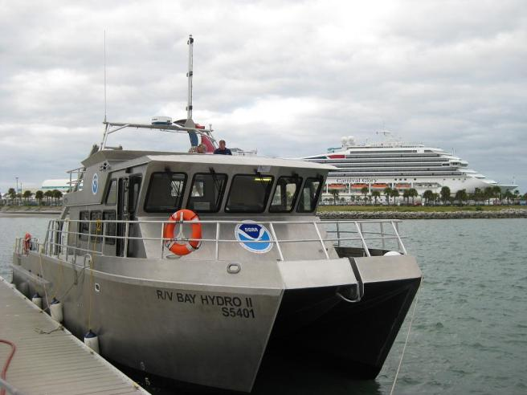
Navigation Response Branch

Slide 9
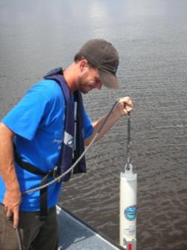
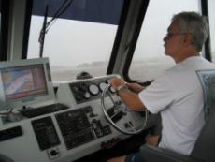
NRB Personnel and Vessels
Headquarters
CDR Todd Haupt, Branch Chief
Chris Hare, Project Manager
Vitad Pradith, Systems.
Field
Six Navigation Response Teams (NRT)
Bay Hydro II
Type of Work
Emergency Responses and
Hydrographic & ENC Verification
Surveys
Notes:
In NRB
We have 3 people in HQ
CDR Todd Haupt, who is the Chief of the Branch
Chris Hare, the project Manager and Vitad Pradith also provide Logistical and Operation Support
In the field
We have six NRTs and the new Bay Hydro II, which just replaced the Bay Hydrographer

Slide 10
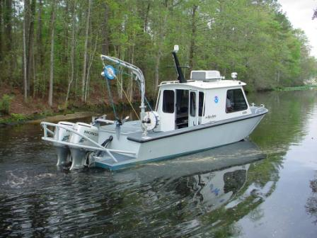
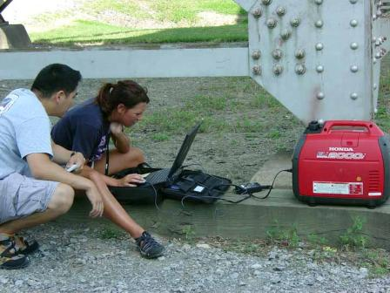
NRT equipment and staffing
-Highly mobile/trailer
-3 Person teams
-SSS/VBES/MBES capability
Notes:
NOAA’s Navigation Response Teams (NRT)
are mobile emergency response teams.
They survey ports and near-shore waterways
NRTs have the ability to be transported by trailer over land from one location to another for quick response
Largest boat that can be trailered with out it being oversized
The team is made up of a three member crew
SSS, MBES and VBES
Office trailer – process the data

Slide 11
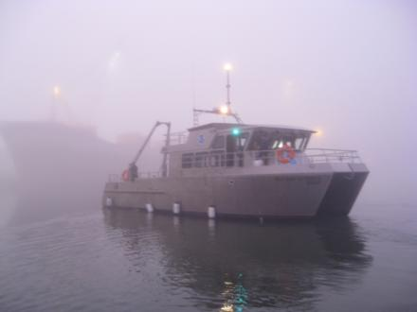
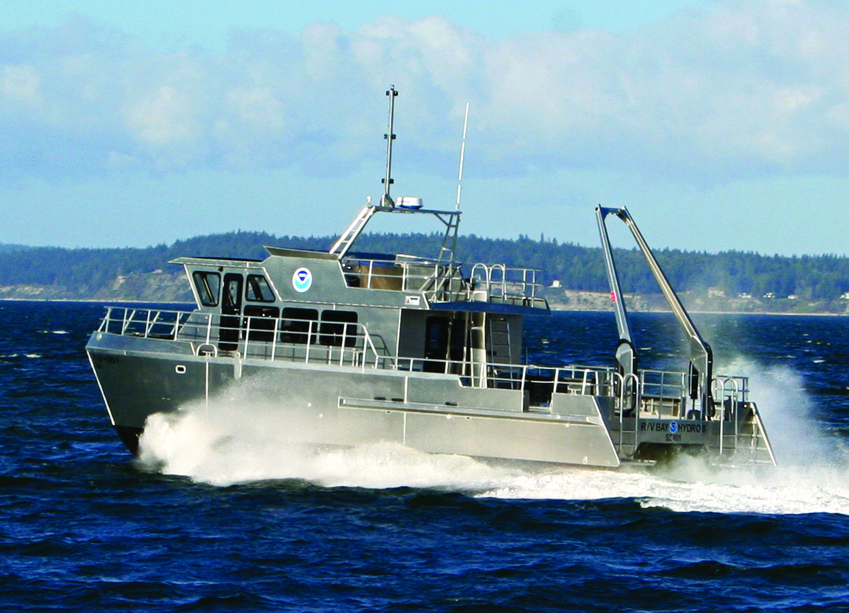
R/V Bay Hydro II
-Delivered in 2009
-3 Person team
-Response to Chesapeake Bay and Mid-Atlantic
-SSS/VBES/MBES capability
-OCS R&D platform
Notes:
The new Bay Hydro II
3 Member crew
Solomons, MD
Area of operations is the Chesapeake Bay
Hydrographic Surveys and Research and Development
Tide Buoy
Interf
AUV

Slide 12
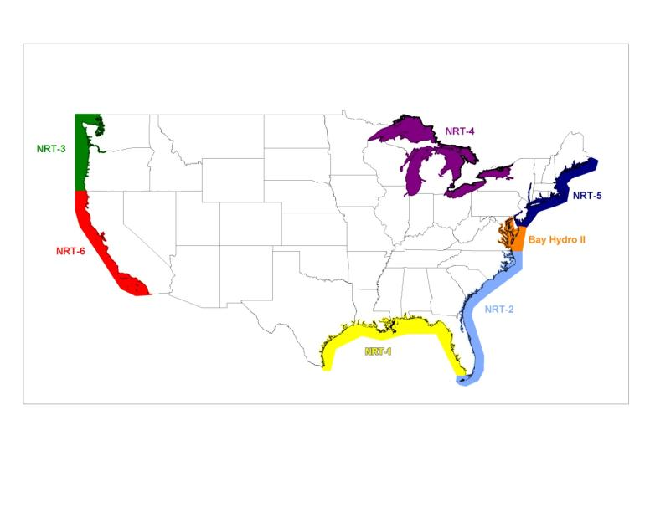
NRB Vessel Locations
Notes:
The teams are regional located.
Helps in quick responses.

Slide 13
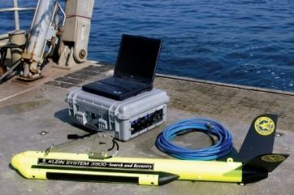
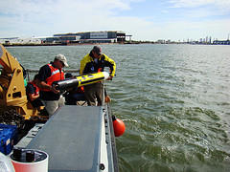
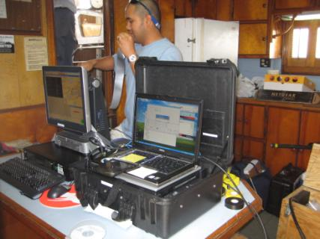
Emergency Responses
Mobile Integrated Survey Team (M.I.S.T.)
Autonomous Underwater Vehicle (AUV)
Notes:
(M.I.S.T.)
Two person crew
Highly portable
24 hour mobilization
SSS, VBES capable
Reliant upon vessel of opportunity
Endurance dependant on vessel
(AUV)
Portable
SSS/Non-IHO depths
Force Multiplier
8 hour mission length
High current problematic
Two person crew
Reliant on vessel of opportunity
Deliverables within 24 hours

