Slide 1
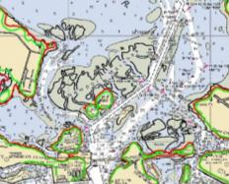
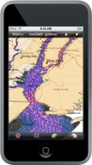
Overview of Navigation Services for HSRP members
March 2011
Capt. John Lowell
Director
Office of Coast Survey

Slide 2
We have two questions today…
1.
What are Navigation Services’ contributions to national economic growth and coastal sustainability?
2.
How can the HSRP help NOAA enhance those contributions?
Notes:
What are Navigation Services’ contributions to national economic growth and coastal sustainability?
How can HSRP help NOAA enhance those contributions?
In the next slides, we’re going to try to give you a very high-level overview of the important contributions we make.
At the end, we’ll present the context for HSRP’s deliberations over the coming years, as you help NOAA strengthen our response to the Presidential priorities as outlined in the National Ocean Policy.

Slide 3
National Ocean Policy priority objectives, for context…
  Ecosystem-based management
  Coastal and marine spatial planning
  Resiliency and adaptation to climate change
  Regional ecosystem protection and restoration
  Changing conditions in the Arctic
  Ocean, coastal and Great Lakes observations, mapping and infrastructure
Notes:
Definitions –
(3) Hydrographic data.--The term ``hydrographic data'' means information acquired through hydrographic or bathymetric surveying, photogrammetry, geodetic, geospatial, or geomagnetic measurements, tide and current observations, or other methods, that is used in providing hydrographic services.
(4) Hydrographic services.--The term ``hydrographic services'' means--
(A) the management, maintenance, interpretation, certification, and dissemination of bathymetric, hydrographic, geodetic, geospatial, geomagnetic, and tide and current information, including the production of nautical charts, nautical information databases, and other products derived from hydrographic data;
(B) the development of nautical information systems; and
(C) related activities.
Mandates – Hydrographic Services Improvement Act (HSIA)
Administrator shall--
(1) acquire and disseminate hydrographic data;
(2) promulgate standards for hydrographic data used by the Administration in providing hydrographic services;
(3) promulgate standards for hydrographic services provided by the Administration;
(4) ensure comprehensive geographic coverage of hydrographic services, in cooperation with other appropriate Federal agencies;
(5) maintain a national database of hydrographic data, in cooperation with other appropriate Federal agencies;
(6) provide hydrographic services in uniform, easily accessible formats;
(7) participate in the development of, and implement for the United States in cooperation with other appropriate Federal agencies, international standards for hydrographic data and hydrographic services; and
(8) to the greatest extent practicable and cost-effective, fulfill the requirements of paragraphs (1) and (6) through contracts or other agreements with private sector entities.
Defining high level direction
2010 - National Ocean Policy
2010 - NOAA’s Next Generation Strategic Plan
In development - NOS Vision
Office Strategic Plans

Slide 4
Next Generation Strategic Plan
Long-term goal: Resilient Coastal Communities and Economies
Global trade will further increase the need for safe and efficient maritime transportation...
At the same time, the interdependence of ecosystems and economies makes coastal and Great Lakes communities increasingly vulnerable to… impacts of natural and human-induced hazards, including climate change, oil spills, harmful algal blooms and pathogen outbreaks, and severe weather hazards.
Geospatial services will support communities, navigation, and economic efficiency with accurate, useful characterizations, charts and maps, assessments, tools, and methods.

Slide 5
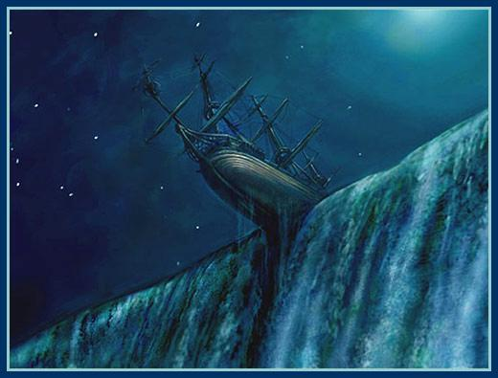
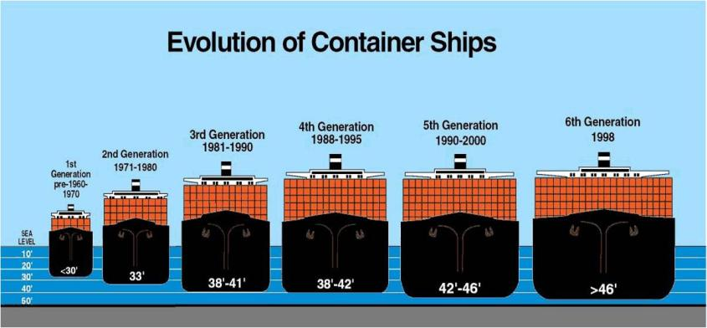
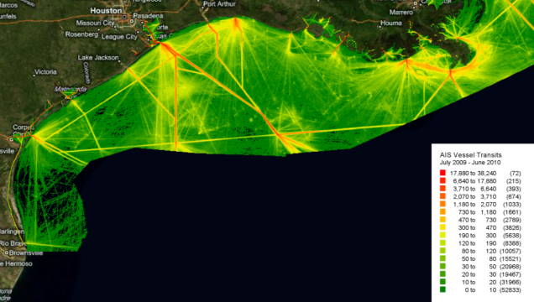
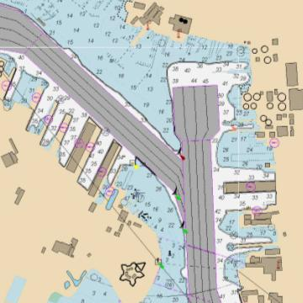
Helping the maritime system handle more traffic in crowded ports & sea-lanes
NOAA provides up-to-date, accurate, and accessible navigation information
Notes:
New Maersk vessel purchase –
10 Triple-E mega ships
Economy of Scale
Energy efficiency
Environmentally improved
400 m length
59 m width
73 m height (above water)
14.5 m draft
Carry 18,000 TEU capasity (16% larger than the next largest container ship)

Slide 6
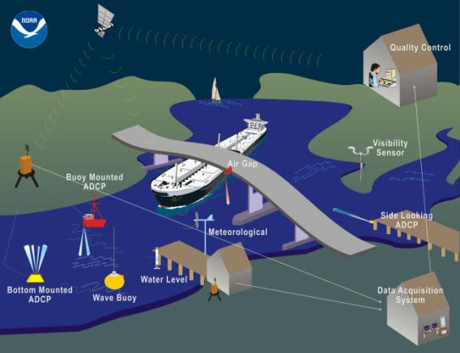
Preventing ship groundings and bridge strikes
PORTS® provides
environmental observations of:
water levels
currents
salinity
water temperature
meteorological parameters
airgap
(bridge clearance)
visibility
waves

Slide 7
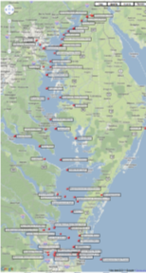
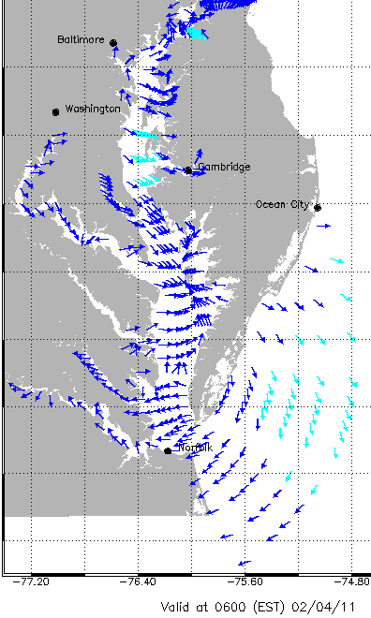
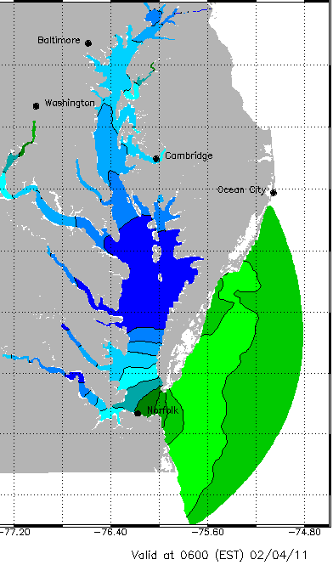
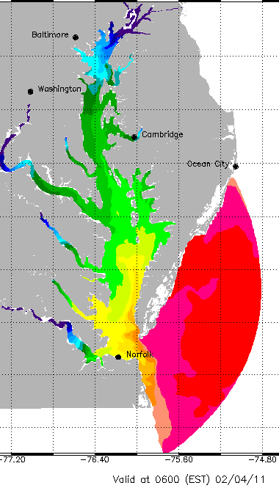
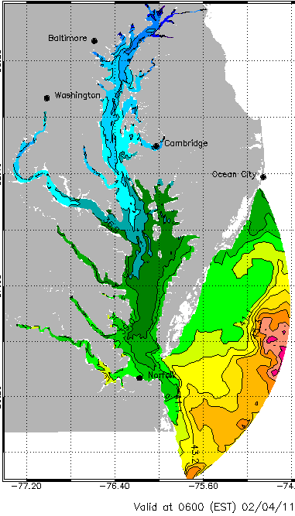
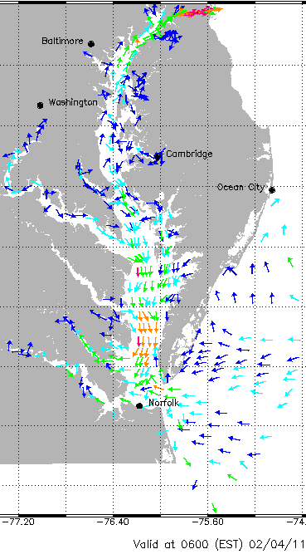
Giving commercial mariners observational forecasts for voyage planning
More water > add more cargo
Less water > load less cargo, or adjust schedule
Winds
WL
Salinity
Temp
Currents
Mariners can time transit to take advantage of,
or avoid, strong currents
Notes:
Allows consumers of the information to increase knowledge of the situation, and mitigate risk

Slide 8
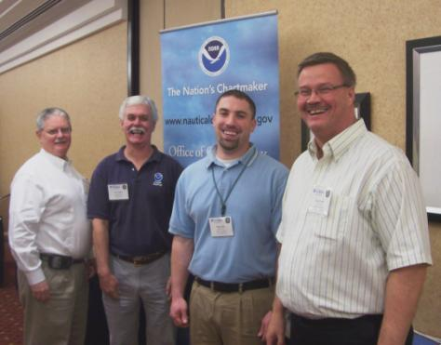

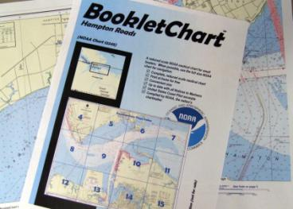
Encouraging safe recreational boating
NOAA develops
consumer friendly navigation products
Reaching out to boating public at boat shows and community events
Notes:
Outcome - Safe Recreational Boating

Slide 9
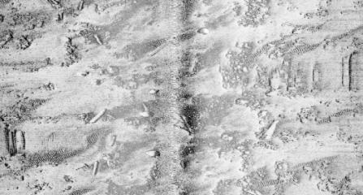
Contributing to homeland security
Pre-threat Maritime Homeland Defense hydrographic surveys
of major dual-use ports contribute to
military threat detection analysis
Notes:
Acquired baseline surveys in four dual-use ports
Groton, CT
Norfolk/Portsmouth/Newport News, VA
Jacksonville, FL
Earle, NJ
Provided 7 years of archived hydrographic data to Navy for commercial and dual-use ports
Developed NOAA-NAVO survey data conversion software
March/April 2011 – NRT 5 re-surveying Groton

Slide 10
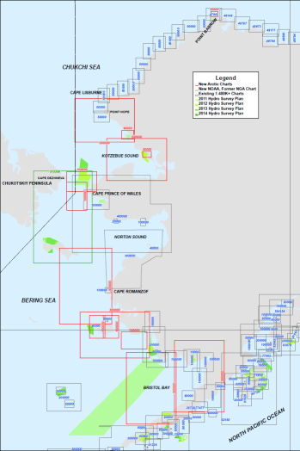
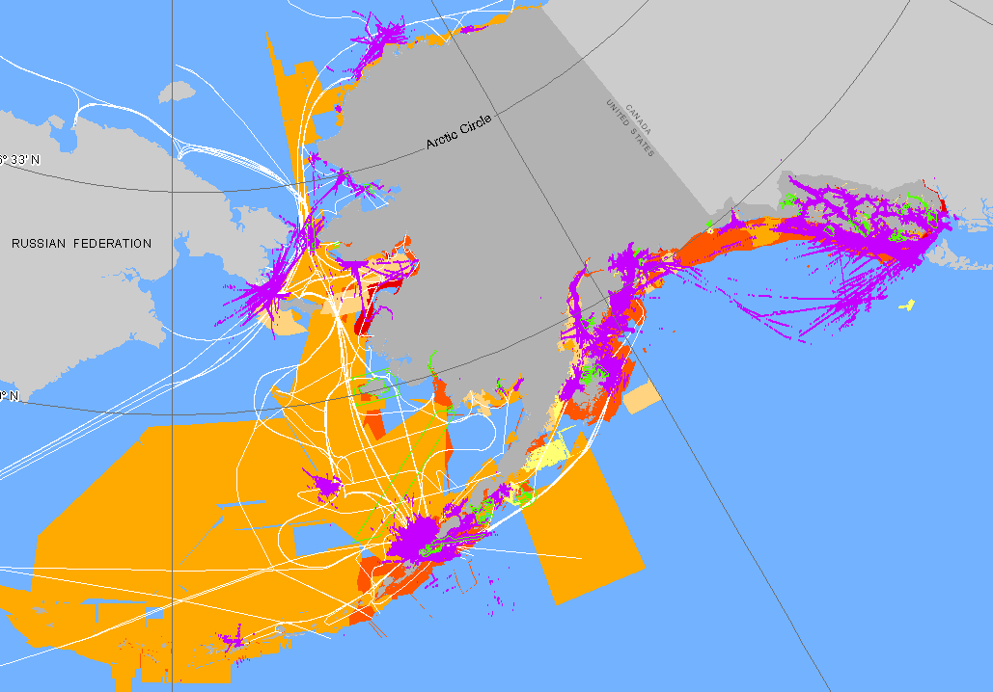
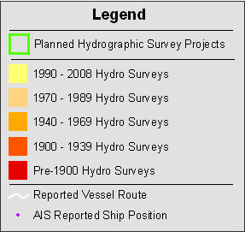
Preparing for new
Arctic transportation routes
Notes:
For the past 30 years, Coast Survey has concentrated surveying and charting efforts in AK to SE, SC, and SW AK peninsula.
As we plan for the Arctic , we are examining age of hydro data and traffic patterns, and consulting with D17, AMP, and USN – as well as private shipping companies.
The colors in the image on the left show the age of survey data – broken out by the technology used; the purple indicates AIS data purchased from the Alaska Marine Exchange for the period mid-July to mid-August 2009.
CLICK - On the right is the overall layout of planned new charts (in red) in the draft Arctic charting plan. As new data from shoreline surveys and hydro surveys becomes available, we will create these new charts. Again, this could take many years.
Mention GRAV-D, CORS and NWLON planing

Slide 11
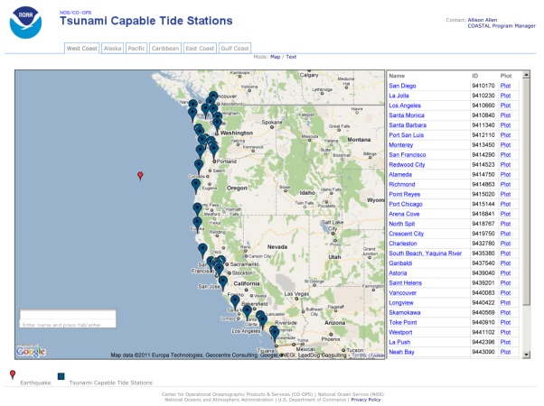
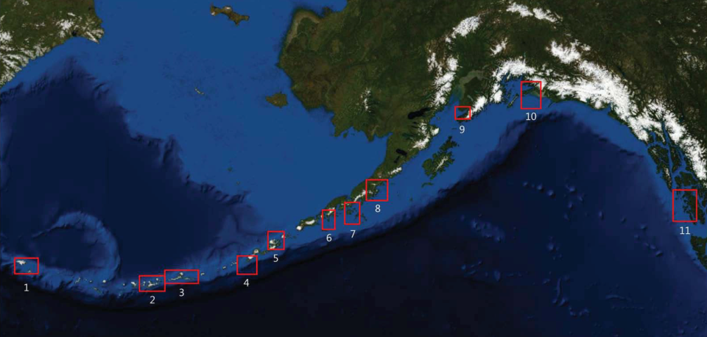
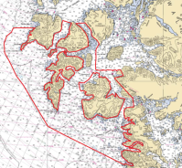
Warning coastal populations of a tsunami
Hydrographic survey data is used to build tsunami digital elevation models
Tide gauges confirm tsunami generation and provide input for National Weather Service models forecasting arrival times and intensity
Notes:
Outcome – Hazard planning and mitigation

Slide 12
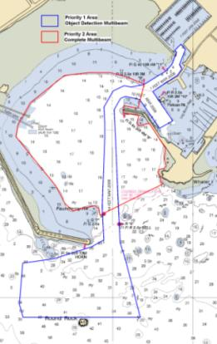
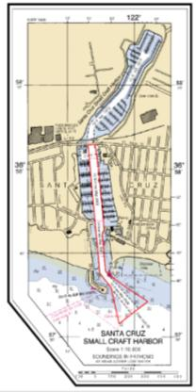
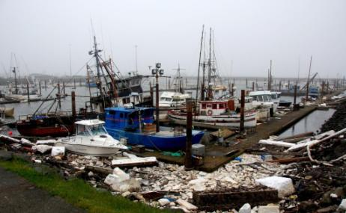
Responding to requests from Coast Guard and Army Corps of Engineers
Navigation Response Teams deploy to Crescent City and Santa Cruz, after
March 11 tsunami
Notes:
Japan Earthquake, and tsunami – impacts to US.
Example of hazard Response
Outcome – efficient clearing of waterway, reduced impact to economy

Slide 13
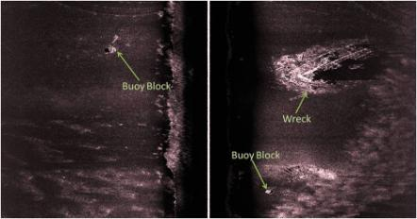
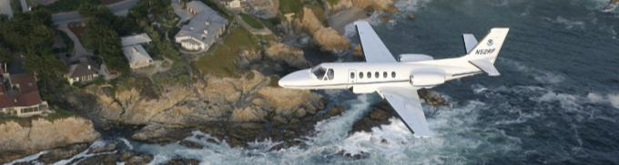
Speeding the re-opening of ports after hurricanes
Response teams survey ports and channels, searching for submerged debris
Aerial photography aids assessment of storm damage
Real-time data guides post-storm response
Notes:
Other examples of Hazard response - Hurricane

Slide 14
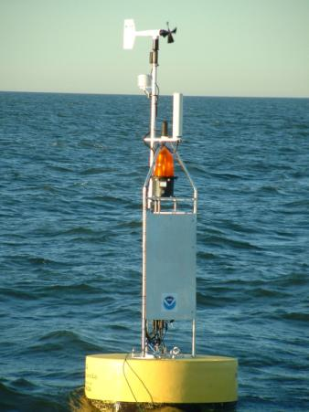
Responding to a release of hazardous materials / oil spill
Forecast and tidal current predictions describe conditions affecting rate, extent, and fate of oil dispersion
Notes:
Different type of Hazard response – Nav services responded in many ways
Buoy is CO-OPS Quick Response Environmental Buoy.

Slide 15
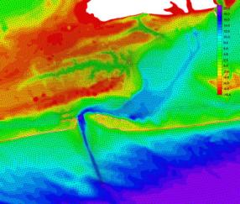
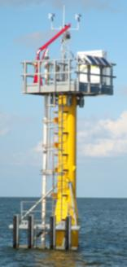
Helping coastal authorities plan for storm surge
NOAA combines seafloor data with land-based elevations to improve simulations of
storm surge
Hardened tide stations provide data when most needed for storm surge forecasts
Simulations + geodesy = awareness of flooding potential of evacuation routes
Notes:
Jesse’s Storm Surge Enterprise:
Coast Survey is working to produce more timely storm induced coastal inundation information.
We are working to make sure the information will be clearly communicated.
The result, we hope, will be significant reductions in loss of life.
We want to ensure that all coastal communities are optimally resistant and resilient to inundation impacts.

Slide 16
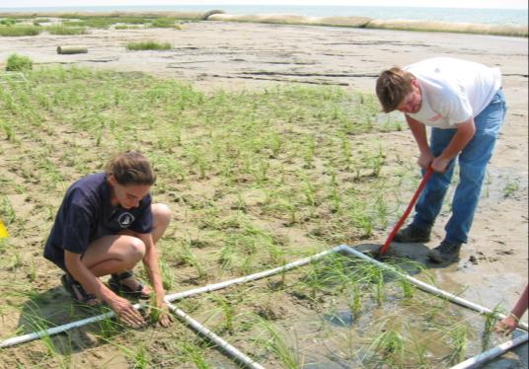
Helping planners restore coastal ecosystems
Marsh restoration managers need to predict
salinity and inundation
NOAA provides the spatial and water level information that informs the predictions

Slide 17
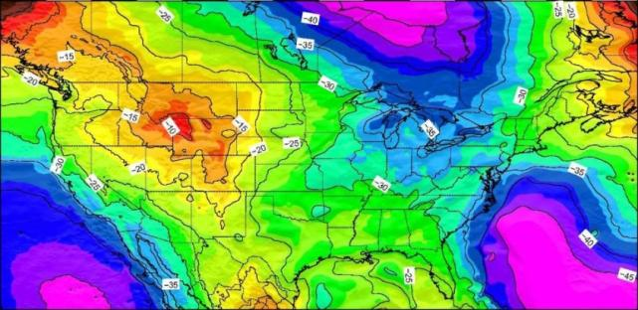
Improving elevations
through height modernization and
Gravity for the Redefinition of the American Vertical Datum
nautical charts * dam & levee safety * evacuation planning
hazard mitigation * flood-plain mapping
subsidence monitoring * determining high-water marks
Notes:
The graphic is current gravity or geoid model, Geoid 09
GRAV-D update
2010/2011 focus on Alaska:
In FY2010, collected gravity data over almost 300,000 square kilometers of Alaska.
Efforts in FY2011 through 2012 will cover most of Alaska (except Aleutians).
In April 2011, NGS plans, in coordination with OMAO, to use a NOAA P-3 to continue gravity collection efforts in the State.
Progress: So far in FY11, we increased the total area of the United States was flown to 11.03% coverage

Slide 18
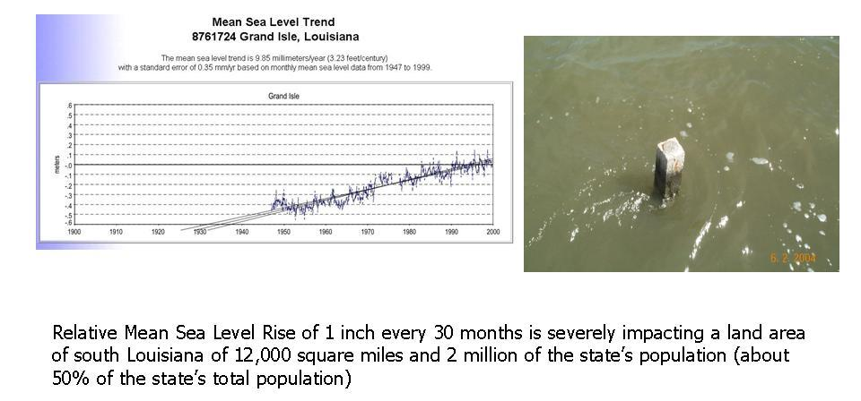
Showing trends in local sea level and land elevation changes
Notes:
Local Sea Level Change

Slide 19
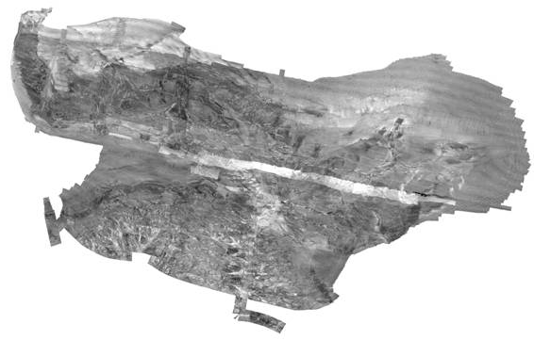
Helping to support healthy fish populations
Researchers use NOAA’s multibeam data to examine fish habitat
Surveys can determine composition of the seafloor and define bottom features as small as a meter cube
Notes:
Multipurpose hydrographic surveys can collect information for fish habitat research while acquiring data for chart making.
In addition to measuring the speed of sound waves – for bathymetry -- NOAA’s multibeam systems also measure the strength of the reflected sound. The strength, called backscatter, is related to the composition of the seafloor.
Mud or silt bottoms produce relatively weak acoustic returns, while rock or gravel produce stronger returns.
Depending on how the system is set to balance between measuring speed and measuring strength, they can define bottom features as small as a one-meter cube while also producing useful backscatter data.
In order to move fisheries management forward, researchers need characterizations of benthic (ocean bottom) habitats. While the relationship between acoustic returns and geological properties of the seafloor is reasonably well established, scientists are trying to determine whether these data describe the specific characteristics that are important to fisheries.
This is an image of backscatter acquired from a NOAA hydrographic survey of Pribilof Canyon in the eastern Bering Sea, in June 2009. It is part of research to develop habitat models to explain the distribution and abundance of fish.

Slide 20



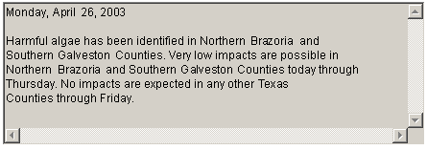
Predicting and modeling harmful algal bloom
Observations
(satellite imagery,
buoys, field samples)
Model output
(physical, ecological,
health impacts)
Analysis of data
and models
HAB bulletin (managers)
Conditions Report (public)

Slide 21
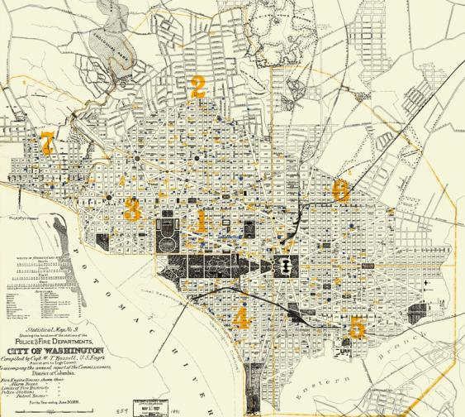
Helping to resolve boundary disputes
NOAA provides 35,000 historical maps & charts free, online
Notes:
We’ve heard stories that the historical images are used for
coastline or land change analysis,
for transportation route analysis,
for what I refer to as anthropological research – a lot of Civil War and pre-Civil War era work studying how people lived at that time.
People use the charts for ecological studies, geologic studies of ocean bottom features
A big use is in legal cases involving public and private land ownership rights. Charts are referenced in cases involving land ownership rights along the coast because the shoreline that we show on our charts has a reference to specific tidal levels that often align with legal public and private rights and jurisdictions on the land and on the adjacent seabed. Those shorelines are very important to a large number of our users.

Slide 22
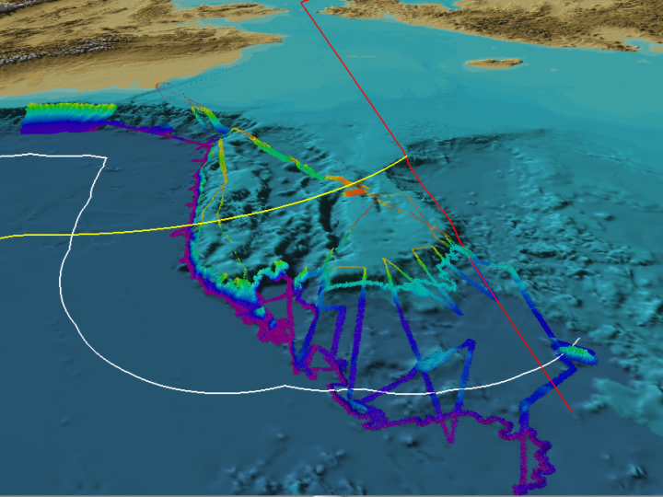
And extending U.S. boundaries…
Treaty line with Russia
350 nm
2500 m + 100 nm
(most conservative scenario)
Notes:
This slide shows the most conservative scenario of an extension to the 2500 m plus 100 nautical miles line. You can see on the image that we have mapped beyond that line, and located 2500 m contours farther seaward, so our limit will almost certainly be farther seaward.
The feature is Chukchi Cap, a natural prolongation of the US continental shelf beyond 200 nautical miles. Our sovereign rights extension in this area is likely to be to around 600 nautical miles.

Slide 23
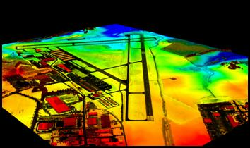
Improving aviation safety
NOAA’s airport runway and obstruction surveys facilitate safe landings and takeoffs.
Surveys help airports:
Establish approach and departure procedures
Determine takeoff weights
Guide planning and construction

Slide 24
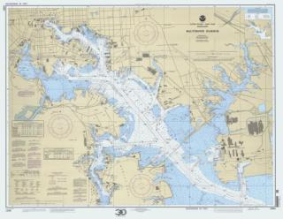
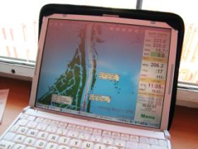
Working with commercial partners
Over 100 companies are agents for NOAA’s nautical charts, selling to millions of recreational boaters, commercial fishermen, and maritime pilots
Dozens of companies sell systems or software that give mariners access to NOAA’s electronic navigational charts
NOAA awards up to $25 million annually for hydro and LiDAR surveys. Another $4 million is awarded for support of tides & currents services.

Slide 25
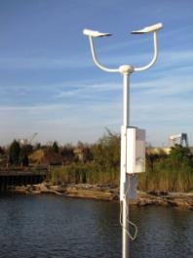
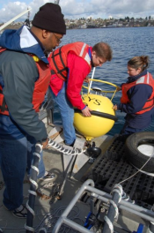
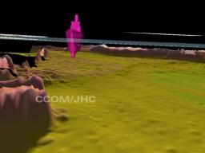
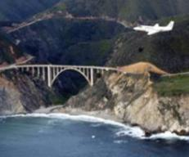
Developing and transitioning new technologies and techniques
Autonomous underwater vehicles
GPS water level buoys
Water level gauging improvements
Visibility sensors
Ellipsoidally referenced surveys
LIDAR techniques
Hydrographic surveying processing enhancements

Slide 26
Challenges facing NOAA’s Navigation Services Program
Improve the quality and delivery of navigation products and services to the maritime community.
Promote the value of navigation services in an era of declining Federal budgets.
Align navigation services to National Ocean Policy priorities:
  Ecosystem-based management
  Coastal and marine spatial planning
  Resiliency and adaptation to climate change
  Regional ecosystem protection and restoration
  Changing conditions in the Arctic
  Ocean, coastal and Great Lakes observations, mapping and infrastructure
Provide non-navigation constituencies with services, data, products, and expertise.
Notes:
“How do we xxxx”
Missing the export initiative and CMTS tie, but OK for now

Slide 27
