Slide 1
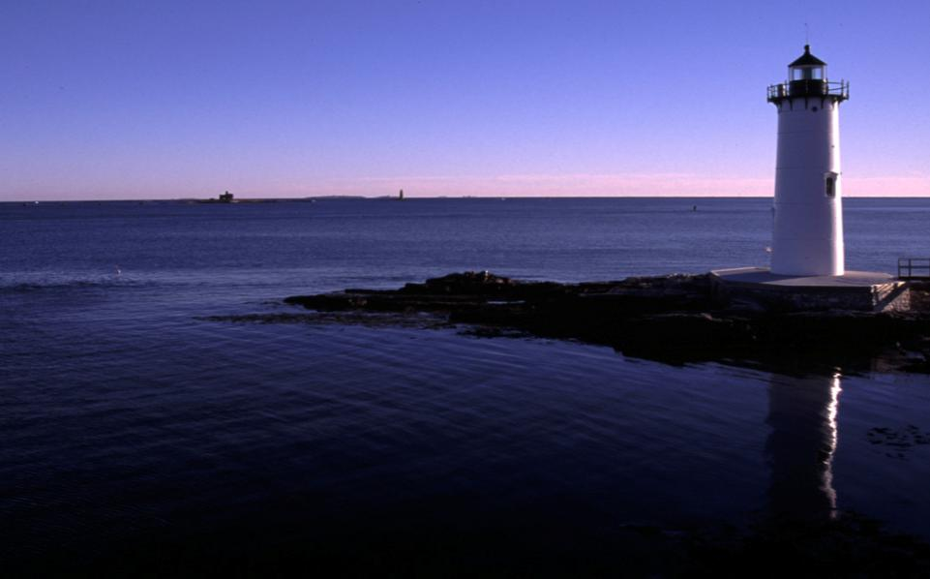
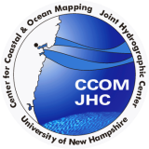
NOAA/University of New Hampshire Joint Hydrographic Center
Andy Armstrong
HSRP New Member Orientation
March 24, 2011

Slide 2
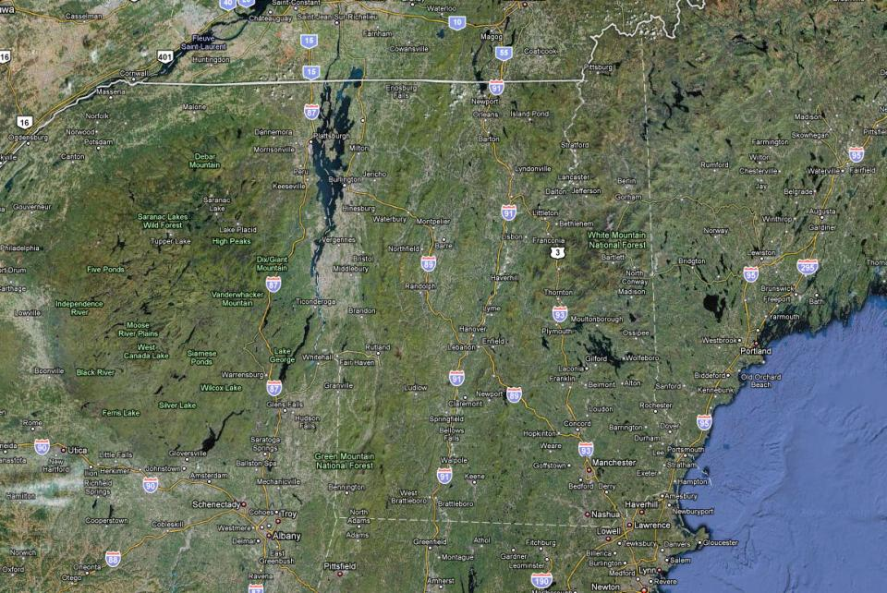
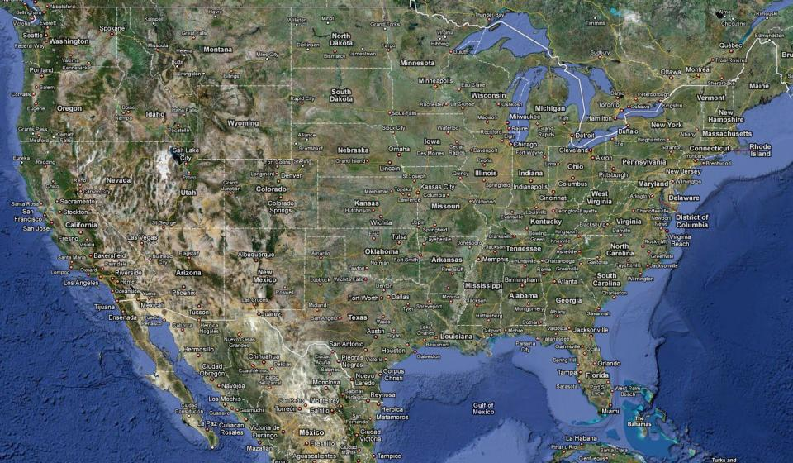

Slide 3
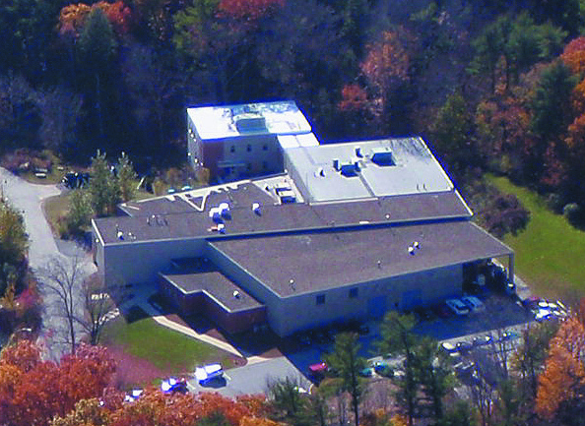

Slide 5
Center Goals
To be a world leader in the development of hydrographic & ocean mapping technologies and approaches
Notes:
Our goals:
Advance the technology: NOAA (and others I’m sure) have huge backlogs of hydrographic survey work. We need to to it faster and better.
Expand the applicability and uses of hydrographic and ocean mapping sensors and data--Resource management--Fisheries, Coral Reefs, Minerals
Educate new and old hydrographers.

Slide 6
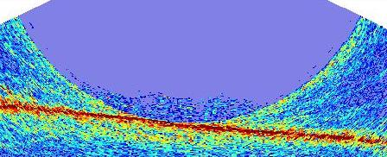
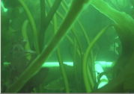
Center Goals
To expand the scope of ocean mapping clients and constituencies through the development of innovative applications and collaborative work with both the private sector and government labs
Notes:
Our goals:
Advance the technology: NOAA (and others I’m sure) have huge backlogs of hydrographic survey work. We need to to it faster and better.
Expand the applicability and uses of hydrographic and ocean mapping sensors and data--Resource management--Fisheries, Coral Reefs, Minerals
Educate new and old hydrographers.

Slide 7
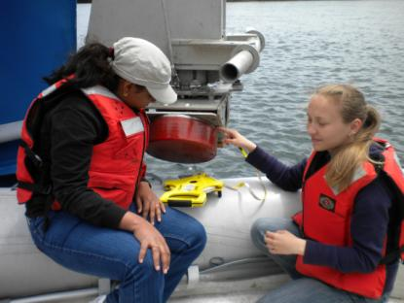
Center Goals
To educate a new generation of hydrographers and ocean mapping experts that can meet the growing needs of both government agencies and the private sector.

Slide 8
Complementary Centers
NOAA/UNH Joint Hydrographic Center (JHC)
A Government and University Partnership
Our primary sponsor is NOAA’s Office of Coast Survey
Funded by a competitively-awarded cooperative agreement (grant) from a dedicated budget line
We also receive support from NOAA Ocean Exploration and NOAA Fisheries
We work with several other NOAA offices
Notes:
The JHC is a NOAA and University partnership. It is based on an MOU between NOAA and UNH, and has a board of advisors from Government and the University
C-COM is a UNH entity. It is separately established to allow private sector and other university activities to flourish without financial conflict of interest issues with the Federal Government.
These are complementary and mutually beneficial Centers. Both the Govt - University and the University - Private Sector activities will benefit from the activities of the other. The University faculty and the facilities of the two centers are in common.

Slide 9
Complementary Centers
UNH Center for Coastal and Ocean Mapping (CCOM)
Provides for participation of private sector and other government agencies
A mechanism to keep government and university affairs separate when warranted
Notes:
The JHC is a NOAA and University partnership. It is based on an MOU between NOAA and UNH, and has a board of advisors from Government and the University
C-COM is a UNH entity. It is separately established to allow private sector and other university activities to flourish without financial conflict of interest issues with the Federal Government.
These are complementary and mutually beneficial Centers. Both the Govt - University and the University - Private Sector activities will benefit from the activities of the other. The University faculty and the facilities of the two centers are in common.

Slide 10
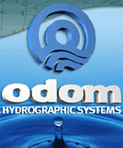
Industry Partners

Slide 11
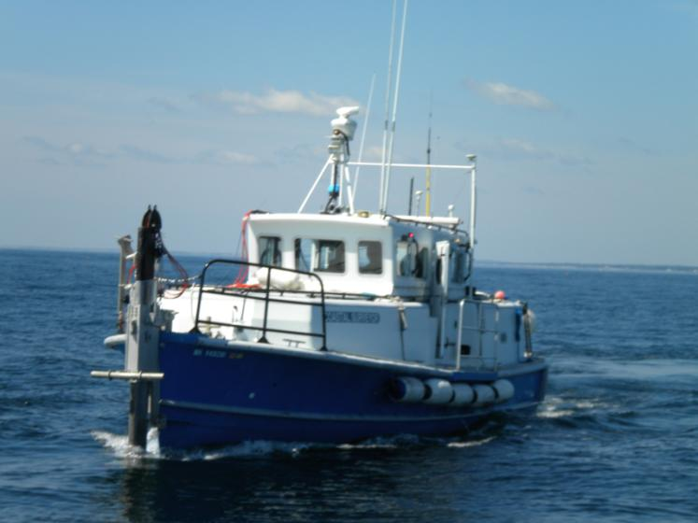
R/V Coastal Surveyor

Slide 12
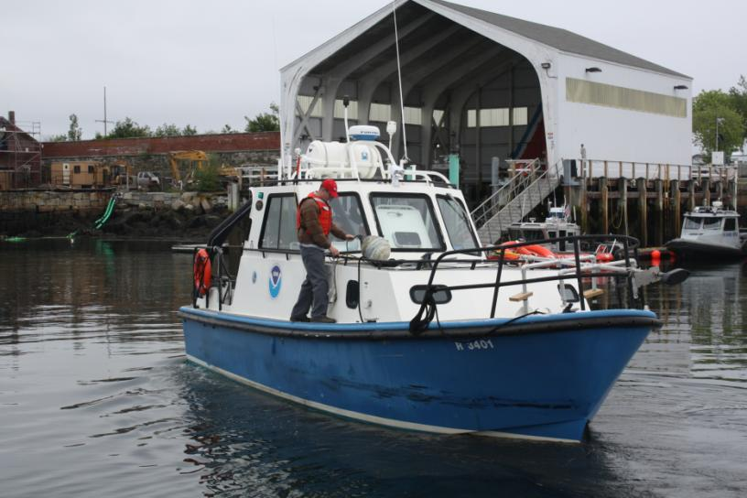
R/V Cocheco

Slide 13
Who are we?
19 Teaching and Research Faculty
7 Research Scientists and Engineers
13 Support and Administrative Staff
Several work-study undergraduates
8 NOAA scientists from OCS, CO-OPS, NGS, and Ocean Exploration
Visiting Scholars (14 so far—1 or 2 at a time!)
26 students, including 6 GEBCO Scholars
30 M.S./Ph.D. degree graduates
36 GEBCO alumni worldwide

Slide 14
Research Priorities
Hydrographic Sensor Technology
Hydrographic Data Processing
Seafloor mapping technologies for marine habitat, coastal resource management, and ocean exploration
Integrated ocean and coastal mapping technology
Visualization and display of hydrographic and ocean mapping data
New approaches for electronic navigation
Extended continental shelf mapping

Slide 15
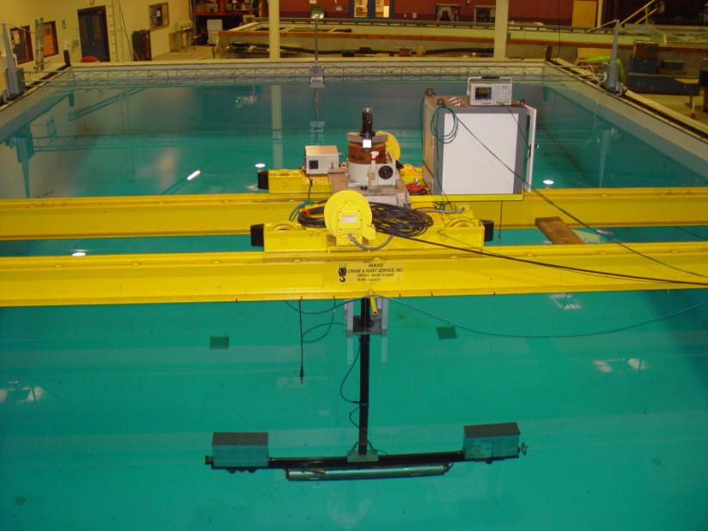

Slide 16
Bathymetric Lidar

Slide 17
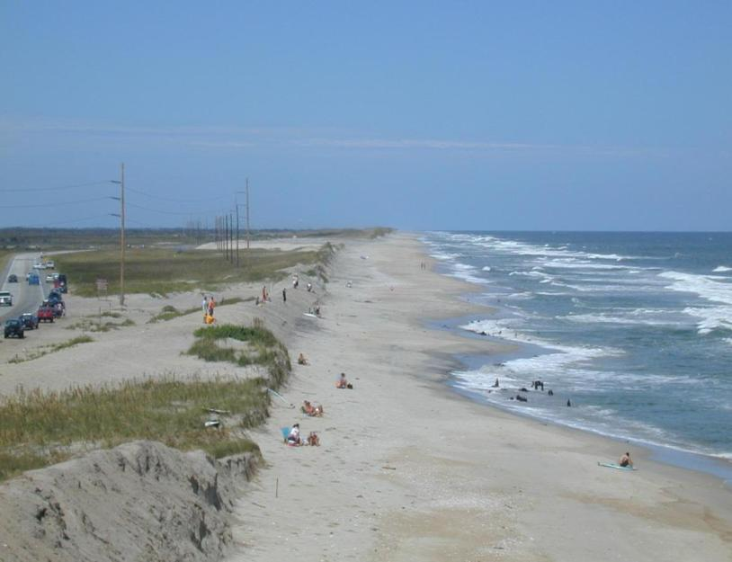
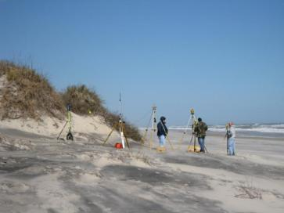
Lidar Shoreline Accuracy Assessment
Transects run from tidal BM using integrated laser level/RTK GPS system
lidar derived shoreline

Slide 18
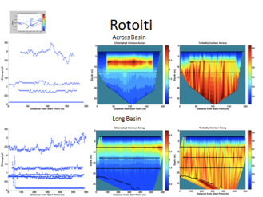
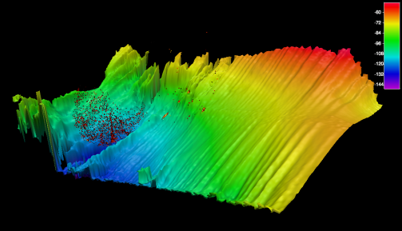
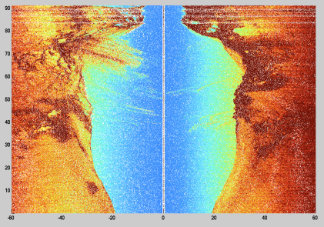
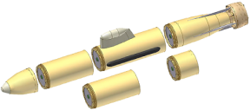
U Del GAVIA w/GeoSwath

Slide 19
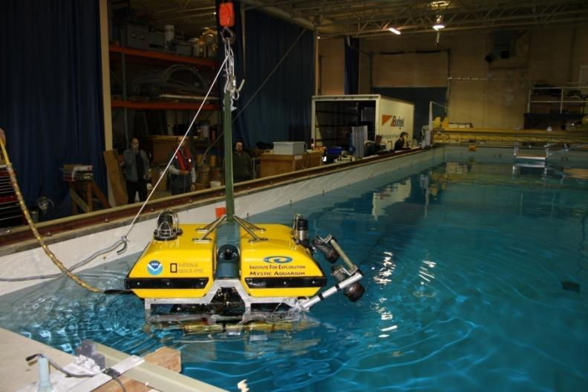
“Little HERC” being tested in acoustic test tank

Slide 20
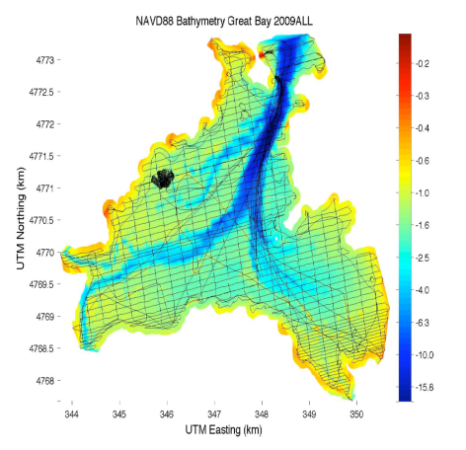
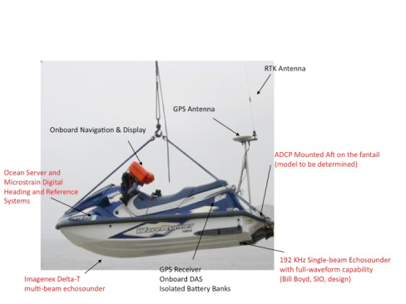
Wave Runner integrating multibeam echo sounder, ADCP, and inertial reference system

Slide 21
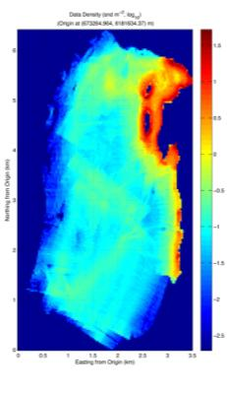
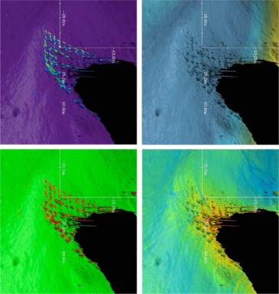
CUBE and Geocoder
Ongoing software development and commercialization

Slide 22
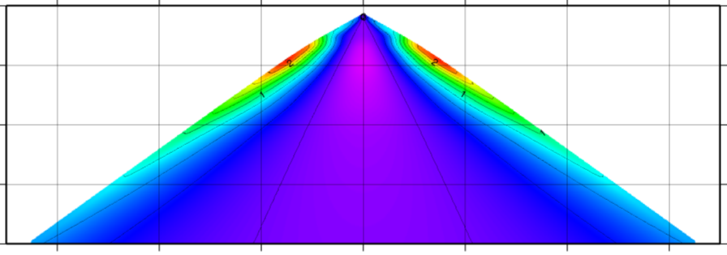
Speed of Sound Corrections
Uncertainty Wedge

Slide 23
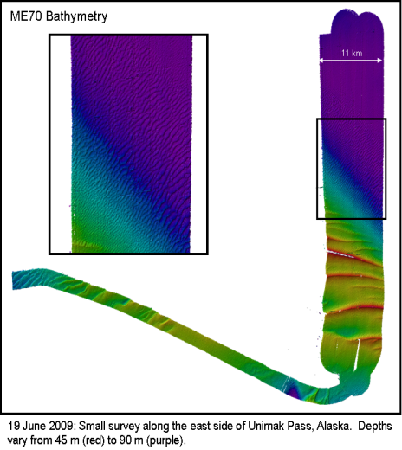
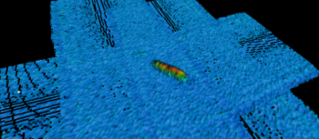
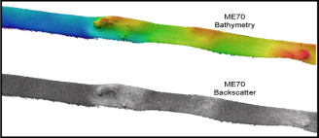
ME-70 Trials on NOAA Fisheries Vessels

Slide 24
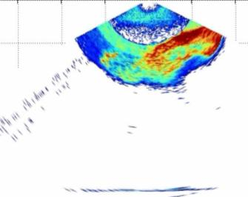
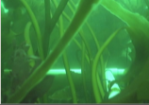
Water Column from a Hydrographic Multibeam
Fish
Kelp

Slide 25
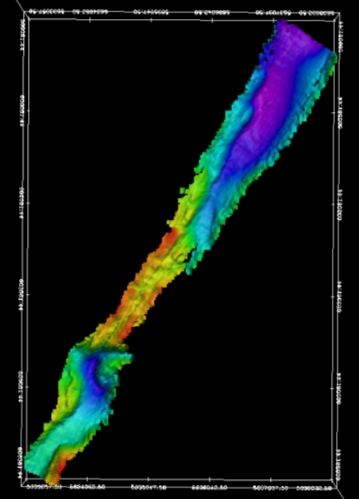
Bathymetry from a Fisheries Sonar
Bathymetry collected from the Inside Passage

Slide 26
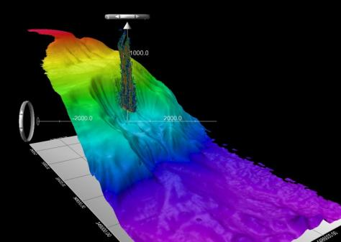
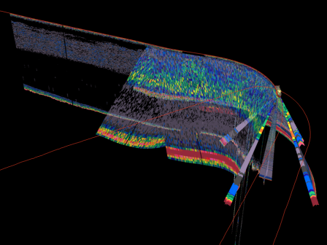
Mid-water mapping Collaboration with IVS

Slide 27
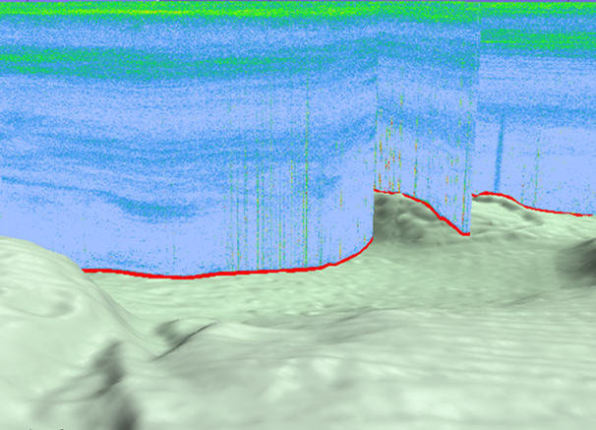
Sea surface
Acoustic scattering from biota
Acoustic Data
Interference from rigs
Suspected natural seep
(methane gas and hydrate)
seafloor
DWH MC252 NOAA Ship Gordon Gunter: Example Acoustic Data

Slide 28
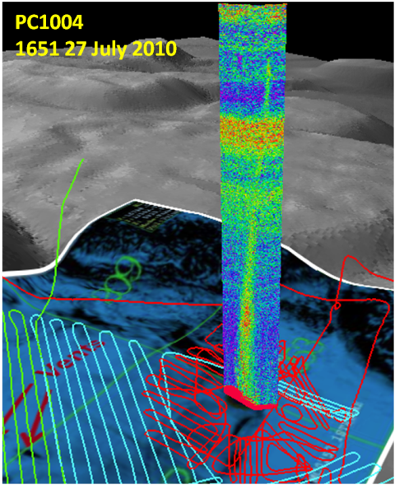

Slide 29
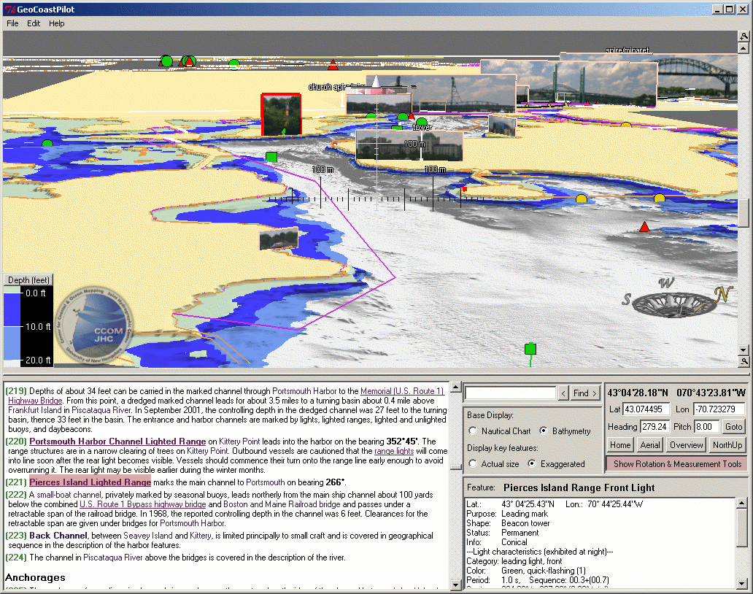
E-Navigation and the Chart of the Future

Slide 30
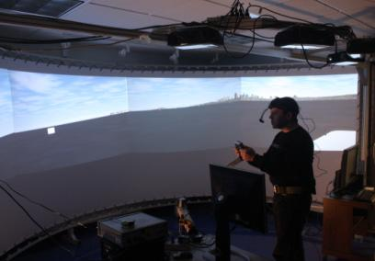
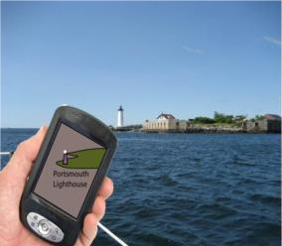
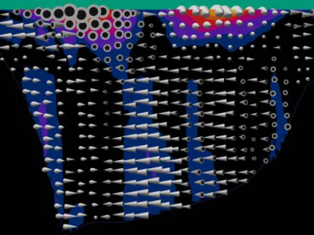
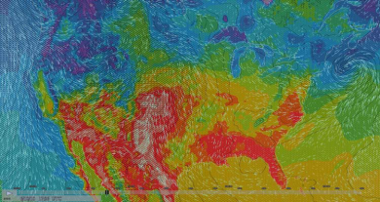
Improved situational awareness with hand held devices
Optimal visualization of environmental conditions

Slide 32
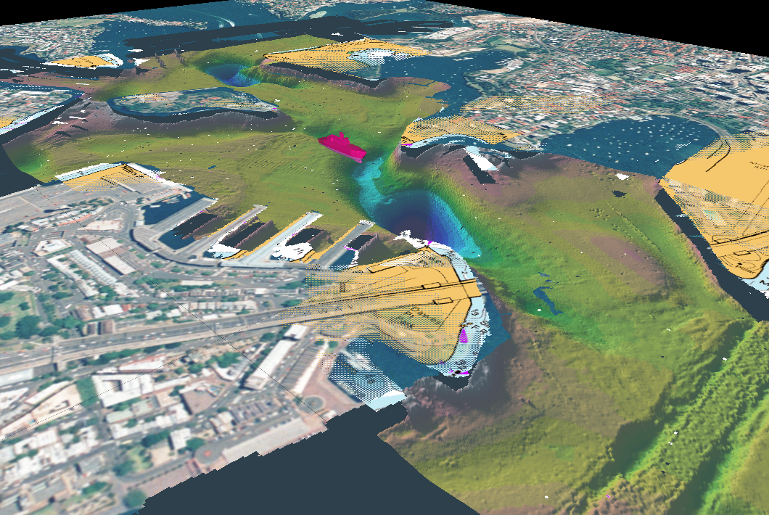
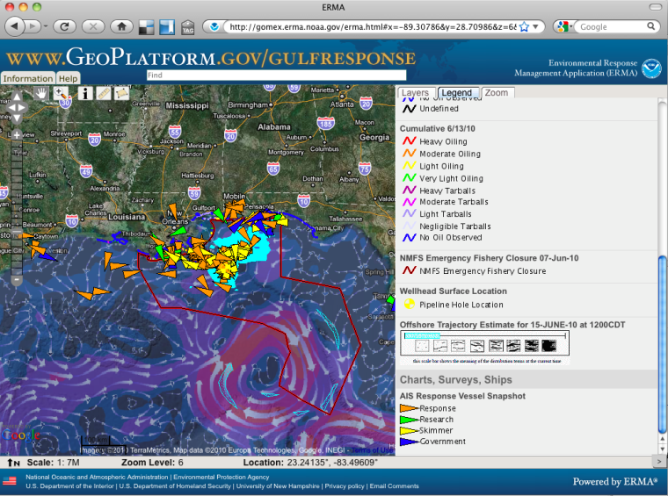
Partnership with OCS NowCoast and Office of Response and Restoration
Employed by Coast Guard in DWH response

Slide 33
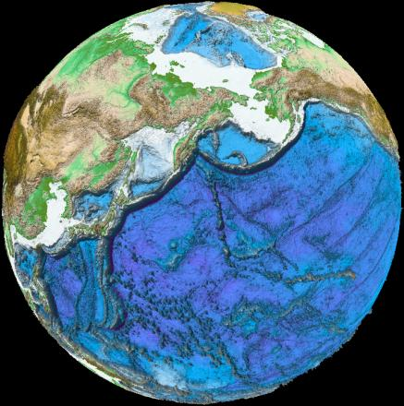
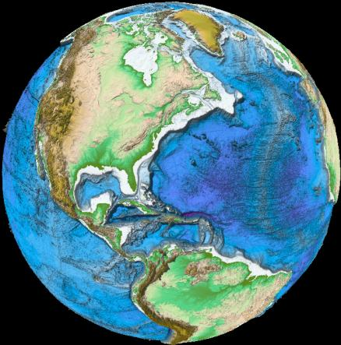
Extended Continental Shelf
>1,600,00 km²
Arctic
2003
2004
2007
2008 2009 2011
Mendocino FZ 2009
Gulf of Alaska
2005
Atlantic
2004
2005
Bering Sea
2003
2008
Gulf of Mexico
2007
Necker Ridge 2011
Kingman Reef-
Palmyra Atoll
2010
Marianas 2006 2007 2010

Slide 34
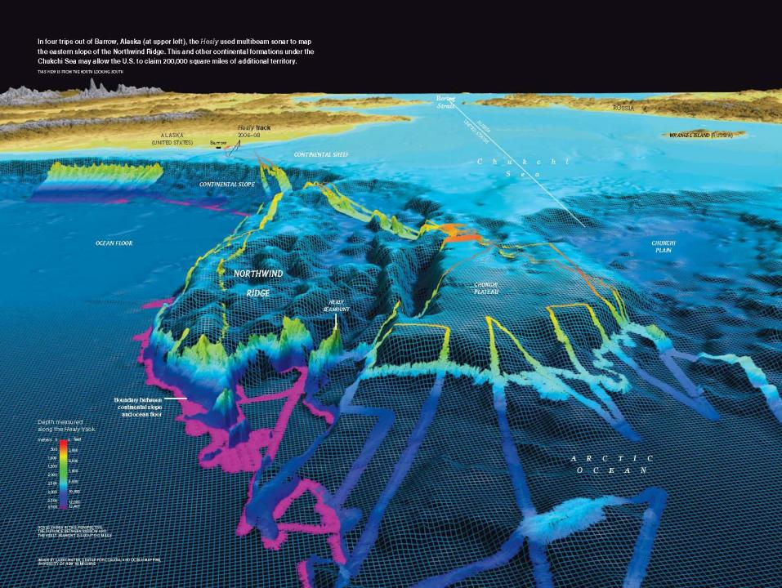
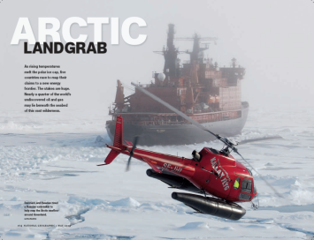

Slide 35
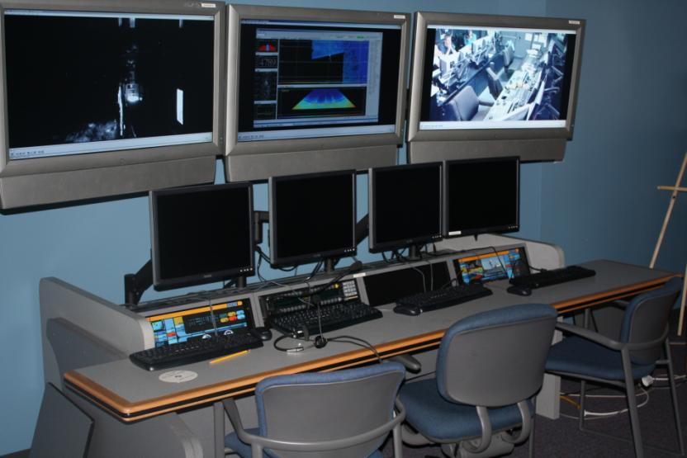

Slide 36
Educational Programs
M.S. and Ph.D.
Two Ocean Mapping tracks:
Ocean Engineering
Earth Sciences/Oceanography/Natural Resources
Also Computer Science and Electrical Engineering
Graduate Certificate Program
Nippon Foundation/GEBCO Training Program
Short Courses and Seminars
IHO CAT A Certification – Due for renewal 2010

Slide 37
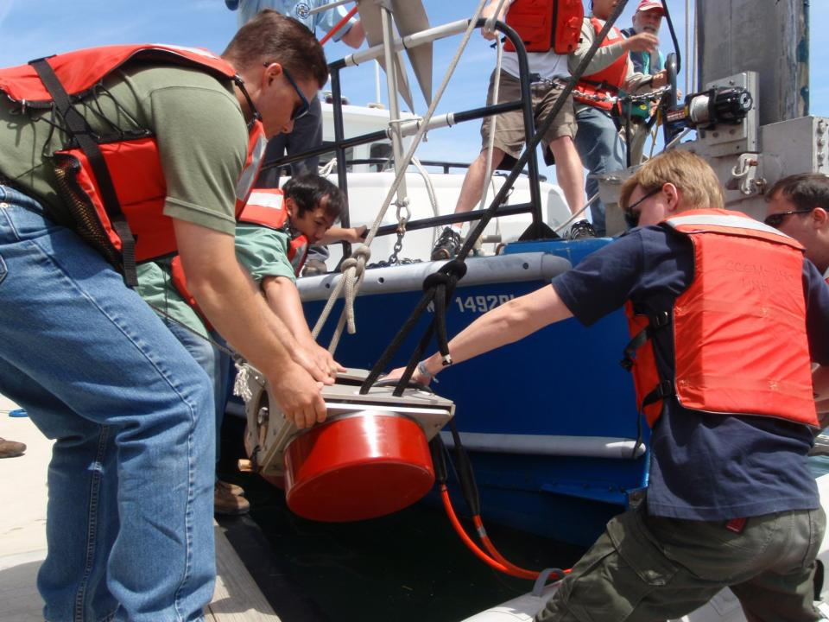

Slide 38
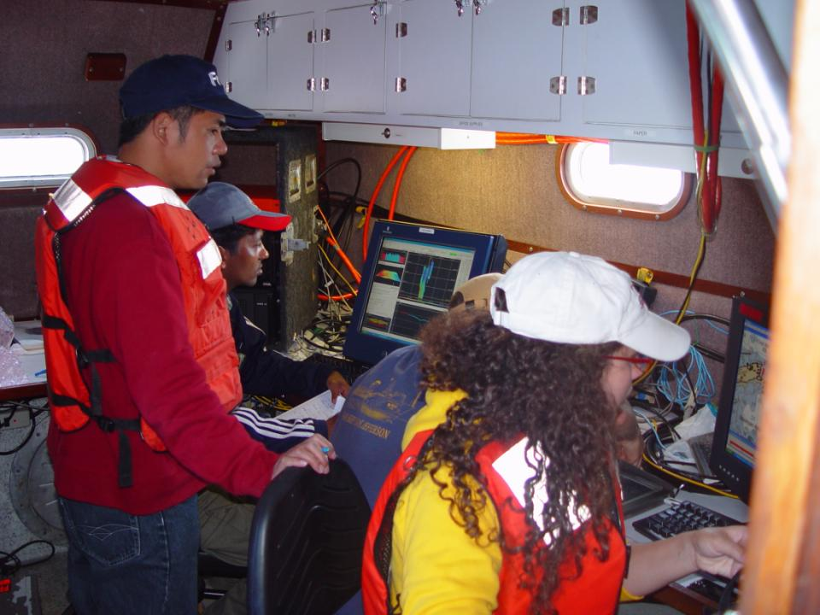

Slide 39
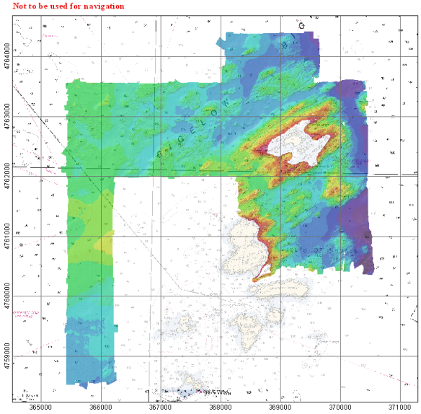
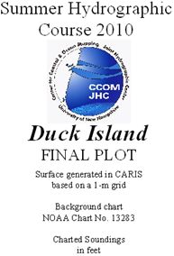
Summer Hydrographic Field Course

Slide 40
Public Outreach Science on a Sphere at Smithsonian Ocean Hall

Slide 41
Middle School Science Students

Slide 42
Center for Coastal and Ocean Mapping– Joint Hydrographic Center

