Slide 1
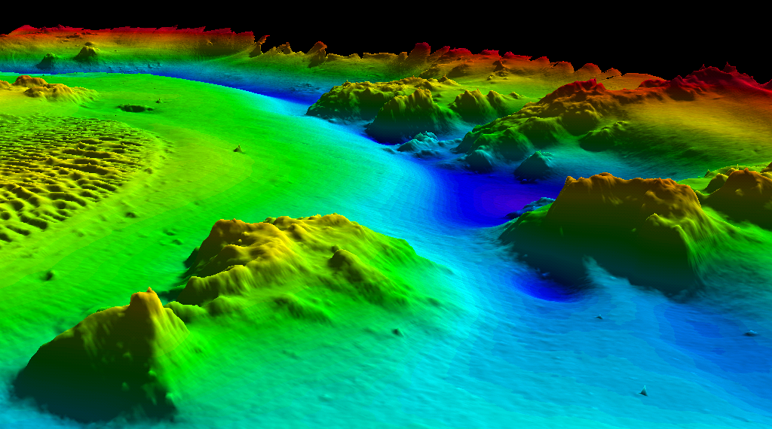
NOAA’s Office of Coast Survey: Hydrographic Surveys Division “World Class Hydro Data Delivered On Time”
Hydrographic Surveys Division
Slide Credit: CCOM/JHC

Slide 2
Office of Coast Survey
Program Planning & Management Staff
Hydrographic Surveys Division
HSD Staff
Marine Chart Division
Navigation Services Division
Coast Survey Development Laboratory
Operations Branch
Raster/Paper Charts
Coast Pilot
Hydrographic Systems & Technology Programs
Data Acquisition & Control Branch
Electronic Navigational Charts (ENC)
Customer Affairs
Atlantic Hydrographic Branch (AHB)
Norfolk, VA
Cartographic & Geospatial Technology Programs
Critical Corrections Update Service
Navigation Response
Nautical Data
Pacific Hydrographic Branch (PHB)
Seattle, WA
Marine Modeling & Analysis Programs
Quality Assurance, Plans & Standards
Notes:
Manages NOAA’s Nautical Charting and Nautical Data Collection & Information Programs
Nautical Charts
Marine/Navigation-related products
Coast Pilots
National Authority on Hydrographic Matters; Represents the U.S. in Hydrographic Organizations and Partnerships
Collaborates across NOS, NOAA and other Federal Agencies on Marine Transportation System (MTS) initiatives to:
Protect life & property
Support economic growth & development
Protect the environment
COAST SURVEY OPERATING PRINCIPLES – People have the Right Info to Navigate & Manage the Nation’s Waterways
Customer Focus: Deliver World-Class Products & Services that Support Safe Navigation for Marine Transportation
Develop & Maintain a Comprehensive Database of Marine Geographic Information that Supports Multiple Products on Demand
Foster a Workplace Climate that Encourages & Values Initiative, Risk-Taking & Innovation
Build Positive Partnerships with Industry (includes contractors) and Academia

Slide 3
Hydrographic Surveys Division
Data Acquisition Arm of OCS
Plan, manage, support hydrographic operations
Verify, certify and compile hydrographic data
Data Stewardship
(archive and public availability through NGDC)
Integrated Ocean and Coastal Mapping (IOCM)

Slide 4
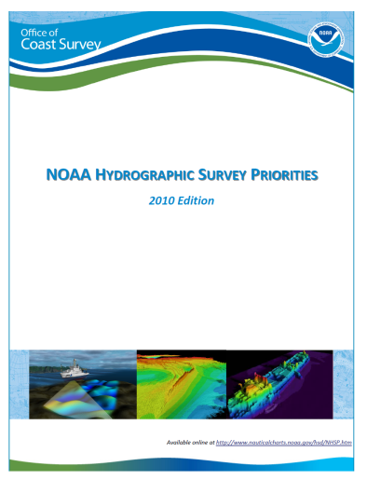
National Hydrographic Survey Priorities
US Exclusive Economic Zone:
3.4 million snm
Navigationally Significant Area: 537,000 snm
Critical Areas:
1994 43,000 snm
2010 ~ 16,000 snm
*snm = square nautical miles

Slide 5
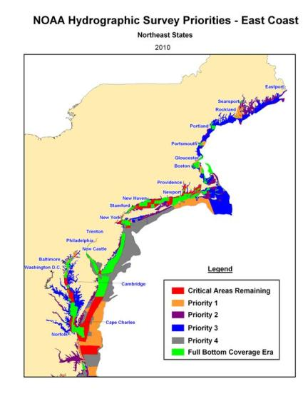
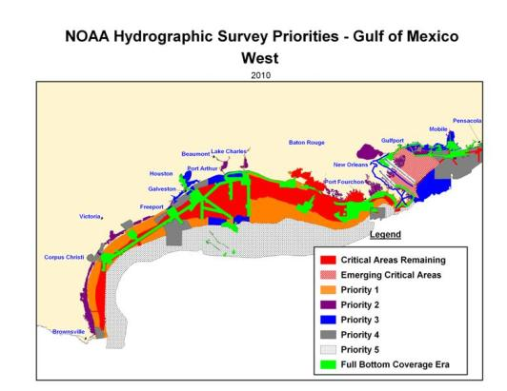
NOAA Hydrographic Survey Priorities Critical, Priority and
Re-survey Areas
Notes:
The National Oceanic and Atmospheric Administration (NOAA) has a statutory mandate to provide nautical charts and related hydrographic information for the safe navigation of marine commerce, and to provide basic data for engineering and scientific purposes, and other commercial and industrial activities. This mandate extends over the more than 3 million square nautical miles of ocean that comprise the U.S. Exclusive Economic Zone (EEZ) an area which extends offshore from the nation’s coastline to 200 nautical miles.
Since the 1950's, maritime commerce has doubled and is expected to double or triple in the next 20 years. This increase in commerce has been accompanied by a doubling of the length, width and draft of the largest ships carrying cargo such that 1000-foot long, 120-foot wide, 50-foot draft vessels are not uncommon. Today, more than 95% of U.S. foreign trade by weight (two billion tons) is shipped by sea, half which is petroleum or other hazardous materials. It is obvious, then, that the safe and efficient movement of goods through U.S. ports is vital to maintaining the competitiveness of the U.S. in the global economy. In addition, there has been increasing sensitivity to the environmental damage caused by vessel groundings and collisions at sea. Together, these trends emphasize the need for high accuracy nautical charts as a critical component to a safe and profitable waterways system. The production of high quality charts is dependent on the availability of up-to-date, reliable hydrographic survey data.

Slide 6
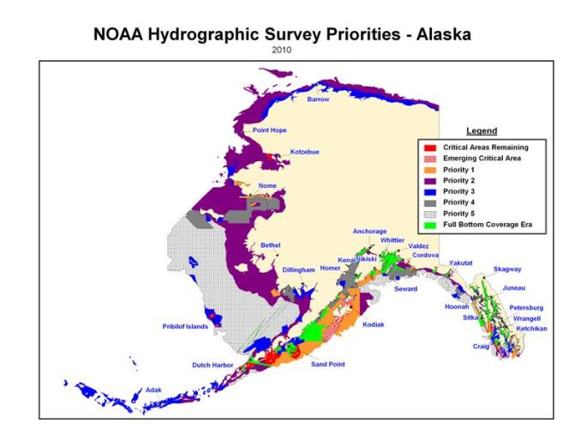
National Hydrographic Survey Priorities
Navigationally Significant, Critical,
and Re-Survey Areas
Notes:
The National Oceanic and Atmospheric Administration (NOAA) has a statutory mandate to provide nautical charts and related hydrographic information for the safe navigation of marine commerce, and to provide basic data for engineering and scientific purposes, and other commercial and industrial activities. This mandate extends over the more than 3 million square nautical miles of ocean that comprise the U.S. Exclusive Economic Zone (EEZ) an area which extends offshore from the nation’s coastline to 200 nautical miles.
Since the 1950's, maritime commerce has doubled and is expected to double or triple in the next 20 years. This increase in commerce has been accompanied by a doubling of the length, width and draft of the largest ships carrying cargo such that 1000-foot long, 120-foot wide, 50-foot draft vessels are not uncommon. Today, more than 95% of U.S. foreign trade by weight (two billion tons) is shipped by sea, half which is petroleum or other hazardous materials. It is obvious, then, that the safe and efficient movement of goods through U.S. ports is vital to maintaining the competitiveness of the U.S. in the global economy. In addition, there has been increasing sensitivity to the environmental damage caused by vessel groundings and collisions at sea. Together, these trends emphasize the need for high accuracy nautical charts as a critical component to a safe and profitable waterways system. The production of high quality charts is dependent on the availability of up-to-date, reliable hydrographic survey data.

Slide 7
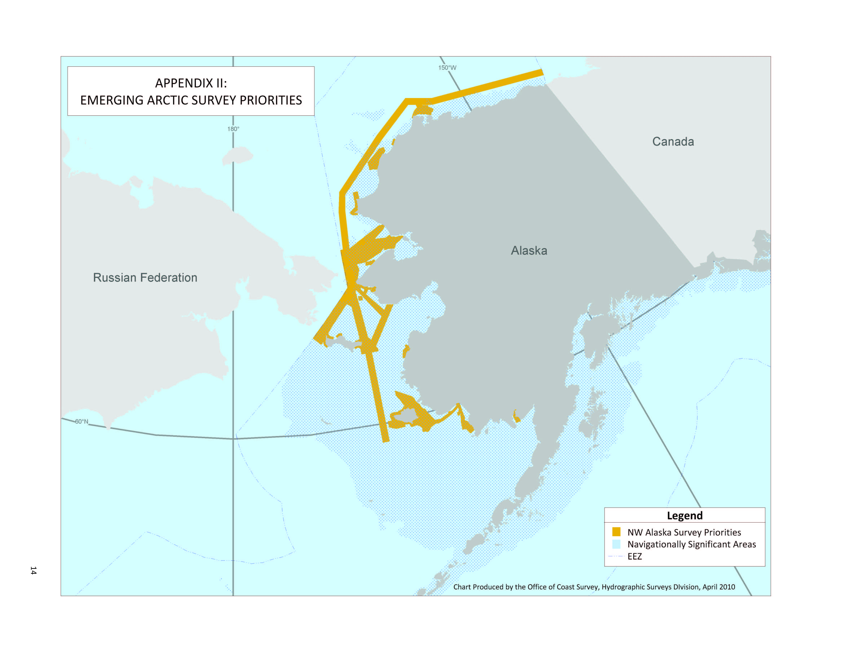
National Hydrographic Survey Priorities
Emerging Arctic Priorities
Notes:
The National Oceanic and Atmospheric Administration (NOAA) has a statutory mandate to provide nautical charts and related hydrographic information for the safe navigation of marine commerce, and to provide basic data for engineering and scientific purposes, and other commercial and industrial activities. This mandate extends over the more than 3 million square nautical miles of ocean that comprise the U.S. Exclusive Economic Zone (EEZ) an area which extends offshore from the nation’s coastline to 200 nautical miles.
Since the 1950's, maritime commerce has doubled and is expected to double or triple in the next 20 years. This increase in commerce has been accompanied by a doubling of the length, width and draft of the largest ships carrying cargo such that 1000-foot long, 120-foot wide, 50-foot draft vessels are not uncommon. Today, more than 95% of U.S. foreign trade by weight (two billion tons) is shipped by sea, half which is petroleum or other hazardous materials. It is obvious, then, that the safe and efficient movement of goods through U.S. ports is vital to maintaining the competitiveness of the U.S. in the global economy. In addition, there has been increasing sensitivity to the environmental damage caused by vessel groundings and collisions at sea. Together, these trends emphasize the need for high accuracy nautical charts as a critical component to a safe and profitable waterways system. The production of high quality charts is dependent on the availability of up-to-date, reliable hydrographic survey data.

Slide 8
Bering Straits

Slide 9
2011 Planned Survey Projects

Slide 10
2011 Planned Survey Projects

Slide 11
AIS Vessel Traffic
Additional input for determining Survey Priorities

Slide 12
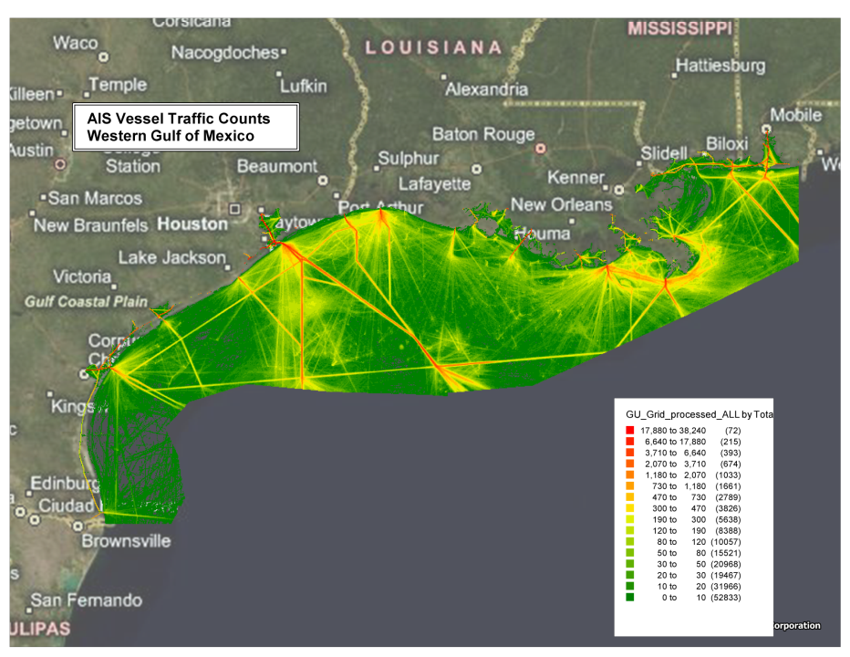

Slide 13
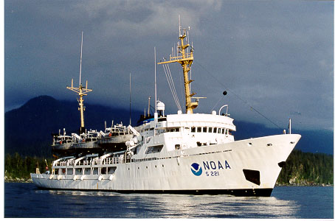
NOAA Ship RAINIER
RAINIER Seattle, WA -- 1968
231 - Foot Hydrographic Vessel
5 Survey Launches
Klein 5000 (4), Reson 7125 (1)Kongsberg EM 710 (Ship Hull Mount)
OP Area – Primarily Alaska and Pacific Coast
700 to 1,000 SNM Per Year
Personnel Complement - 55

Slide 14
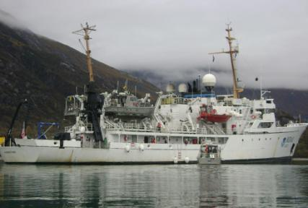
NOAA Ship FAIRWEATHER
FAIRWEATHER Ketchikan, AK --1968 (2004 refit)
231 - Foot Hydrographic Vessel
4 Survey Launch Capability
FA - Reson 7111 (100KHz, 3-1000m) & 8160 (50KHz, 10-3000m)
Launches - (4) Reson 7125
OP Area – Primarily Alaska
500 to 900 SNM Per Year
Personnel Complement - 36

Slide 15
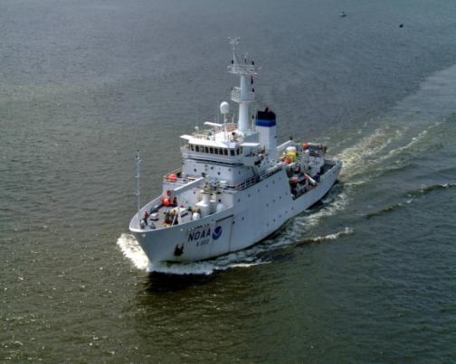
NOAA Ship THOMAS JEFFERSON
THOMAS JEFFERSON Norfolk, VA -- 1992 (2003 to NOAA)
208 - Foot Hydrographic Vessel
2 Survey Launches
Klein 5000 (3), Reson 7125
OP Area -- East Coast, Gulf of Mexico and Caribbean
400 – 600 SNM Per Year
Ship Outfitted to Tow SSS
Personnel Complement - 33

Slide 16
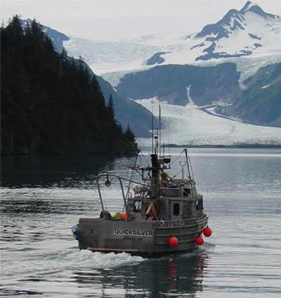
NOAA’s Hydrographic Data Acquisition Resources
Contract surveys contribute over 50% of
data acquisition (Approx. $25M per year)
Notes:
$40M for outsourcing:
-including: LIDAR services Hydrography survey services vessel time charter contracting support functions (COTR, ad min etc.)
-funding level including carry over from FY02
-Funding does not include support for in-house data acquisition

Slide 17
Hydrographic Survey Firms Currently On Contract for NOAA
Fugro Pelagos – Fugro LADS
C & C Technologies
SAIC
TerraSond
David Evans & Associates
OSI
Williamson and Assoc.

